Slide 1


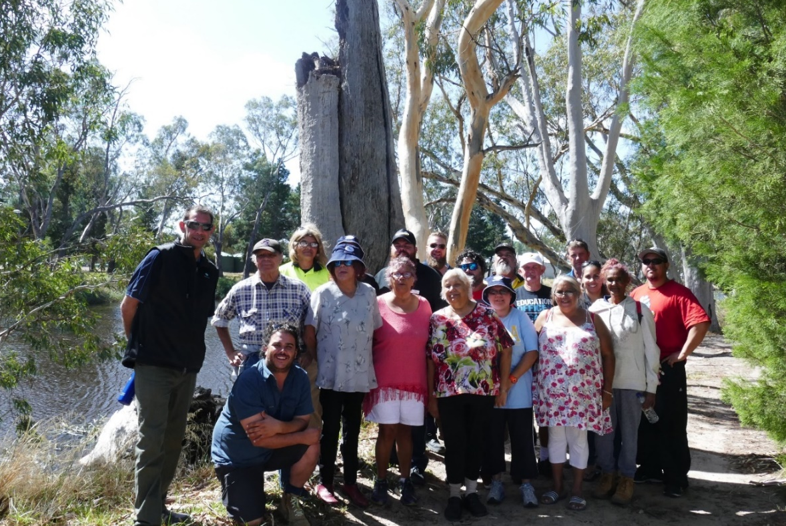

Place your
logo here
River yarns
A pilot project partnership for cultural flows in the Wimmera
Ben Muir and Joel Boyd
Wimmera CMA
BRISBANE, AUSTRALIA | 18 - 20 SEPTEMBER 2017
MANAGED BY

Slide 2
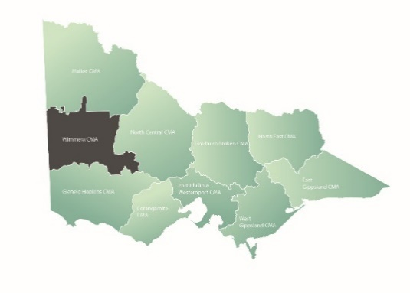
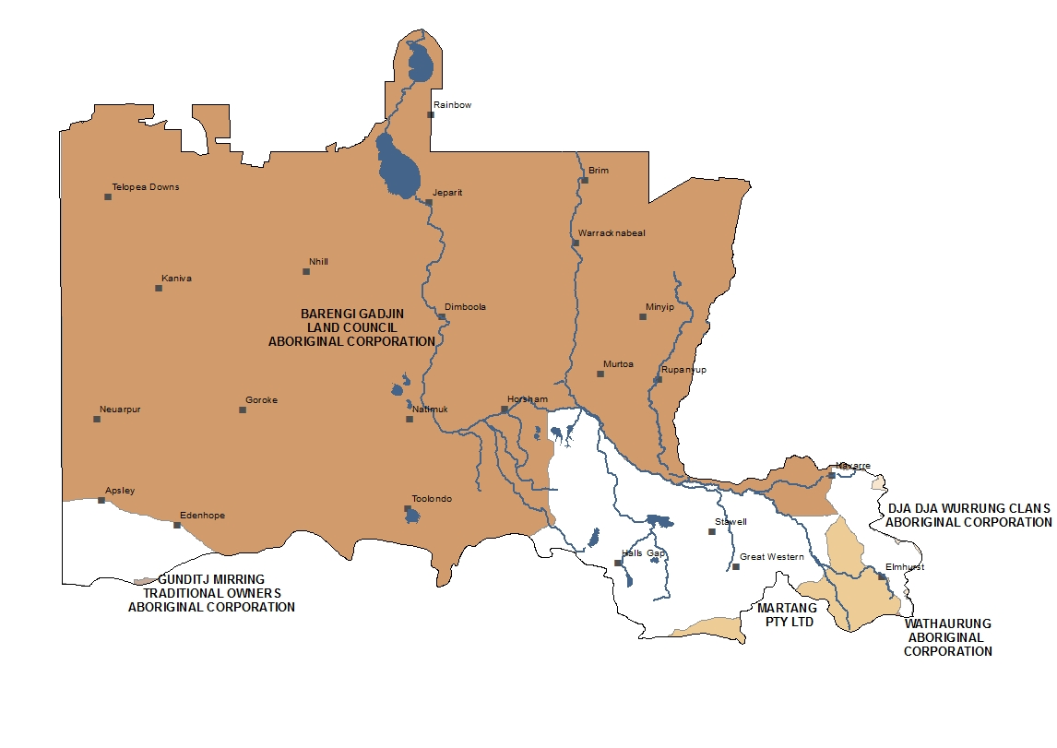
Place your
logo here
BRISBANE, AUSTRALIA | 18 - 20 SEPTEMBER 2017
MANAGED BY

Slide 3

Place your
logo here
developed by Wimmera CMA and Barengi Gadjin Land Council to support community aspirations for the lower Wimmera River system
opportunities for Benno and other Traditional Owners to work with community partners to develop information on local culture, traditional practices, uses of water and the Wimmera River environment
MLDRIN has been a great partner for the project
BRISBANE, AUSTRALIA | 18 - 20 SEPTEMBER 2017
MANAGED BY

Slide 4
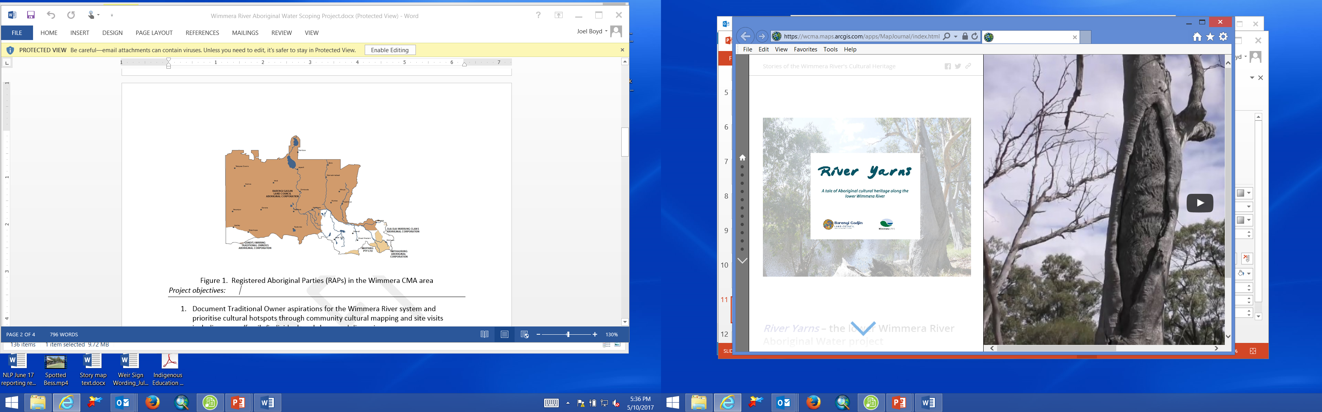
Place your
logo here
River Yarns Story Map
http://arcg.is/2iVMooc
BRISBANE, AUSTRALIA | 18 - 20 SEPTEMBER 2017
MANAGED BY

Slide 5
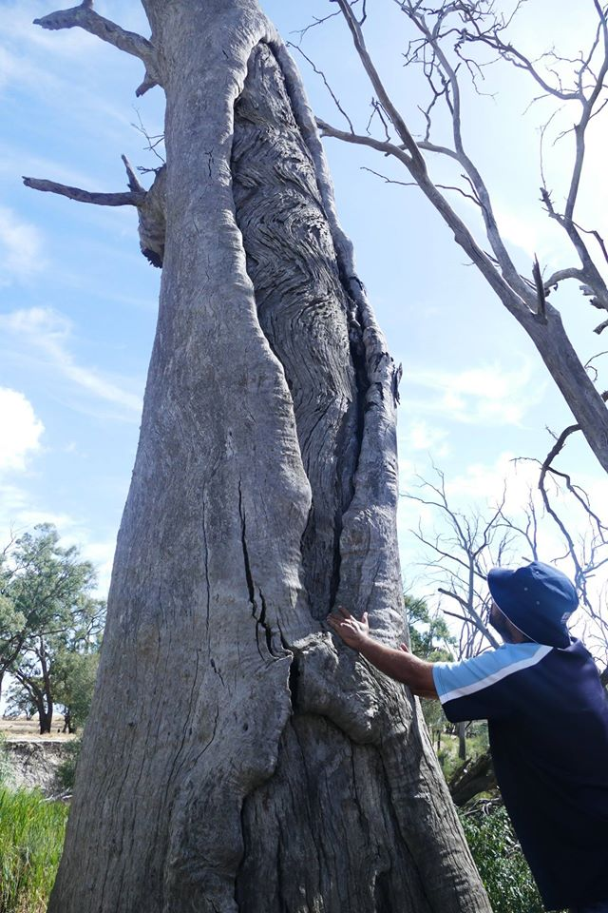
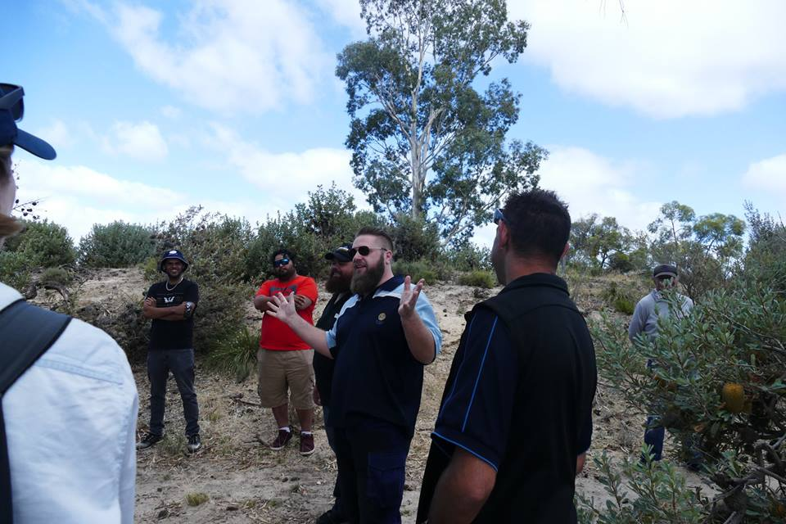
Place your
logo here
AWA in practice on Wotjobaluk Country
The first day was about learning the AWA process and building a sense of teamwork
BRISBANE, AUSTRALIA | 18 - 20 SEPTEMBER 2017
MANAGED BY

Slide 6
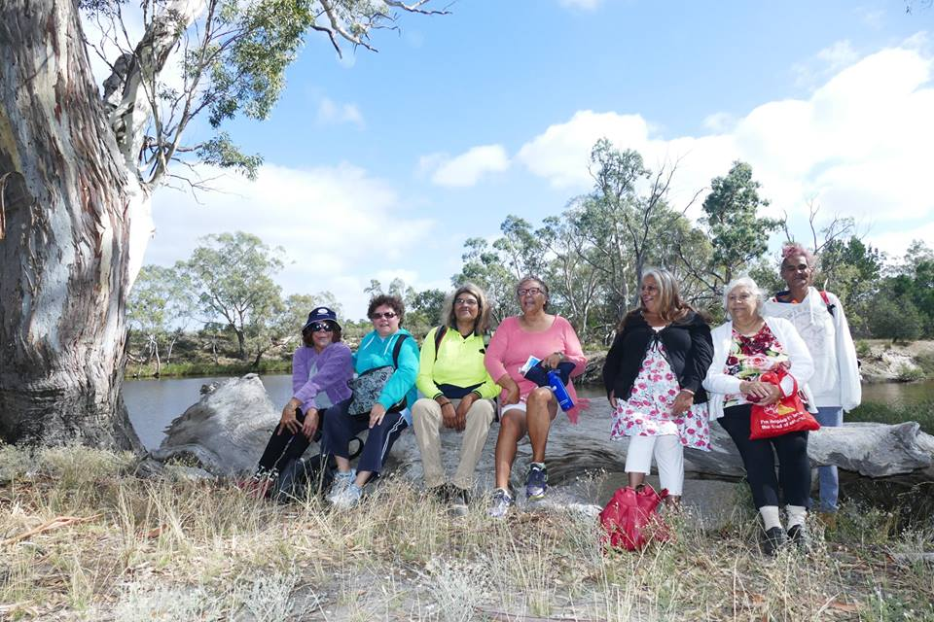

Place your
logo here
By Day 2 everyone was very relaxed
and the yarns were flowing
BRISBANE, AUSTRALIA | 18 - 20 SEPTEMBER 2017
MANAGED BY

Slide 7
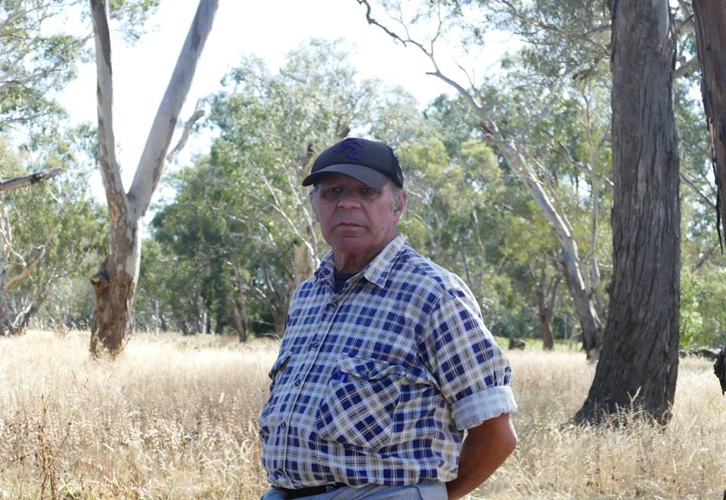
Place your
logo here
Uncle Nukka!
BRISBANE, AUSTRALIA | 18 - 20 SEPTEMBER 2017
MANAGED BY

Slide 8
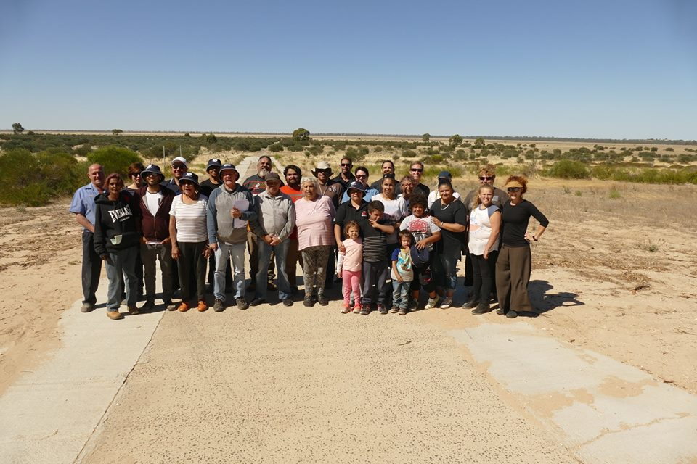
Place your
logo here
We finished up at Lake Albacutya – a very special place
BRISBANE, AUSTRALIA | 18 - 20 SEPTEMBER 2017
MANAGED BY

Slide 9
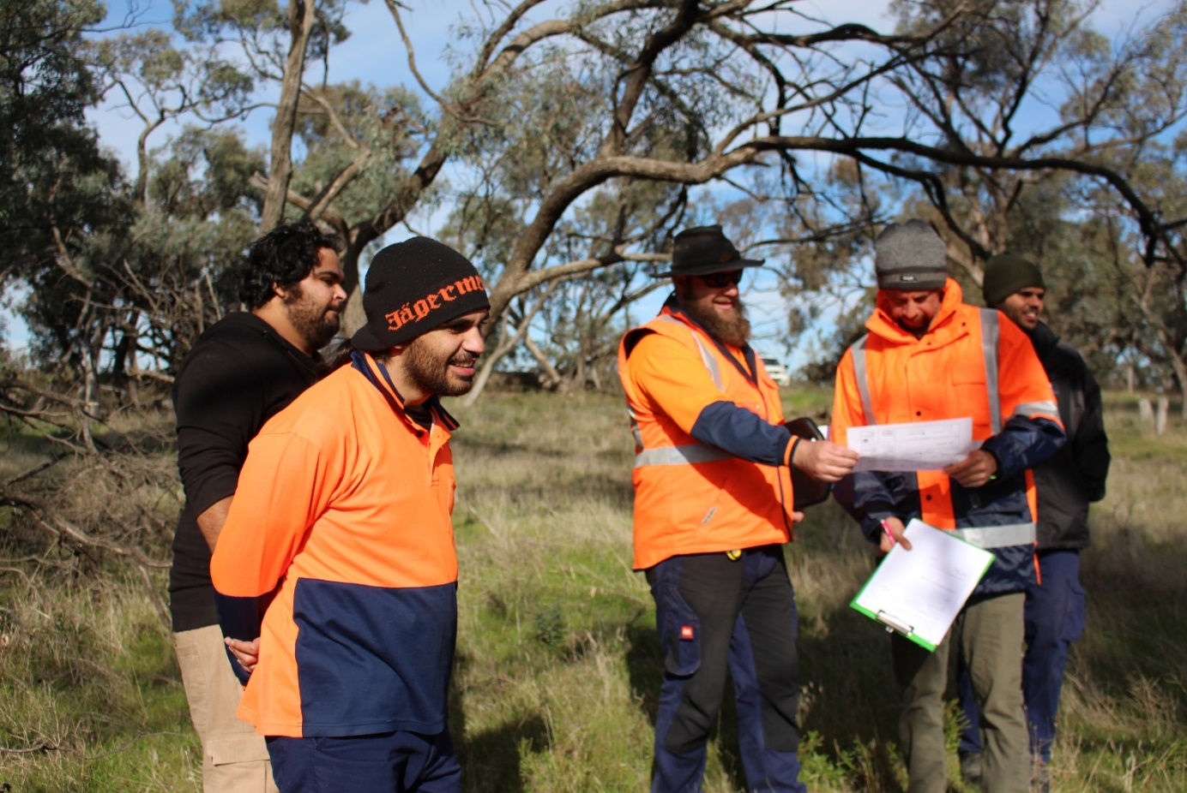
Place your
logo here
Next Steps
BRISBANE, AUSTRALIA | 18 - 20 SEPTEMBER 2017
MANAGED BY

Slide 10
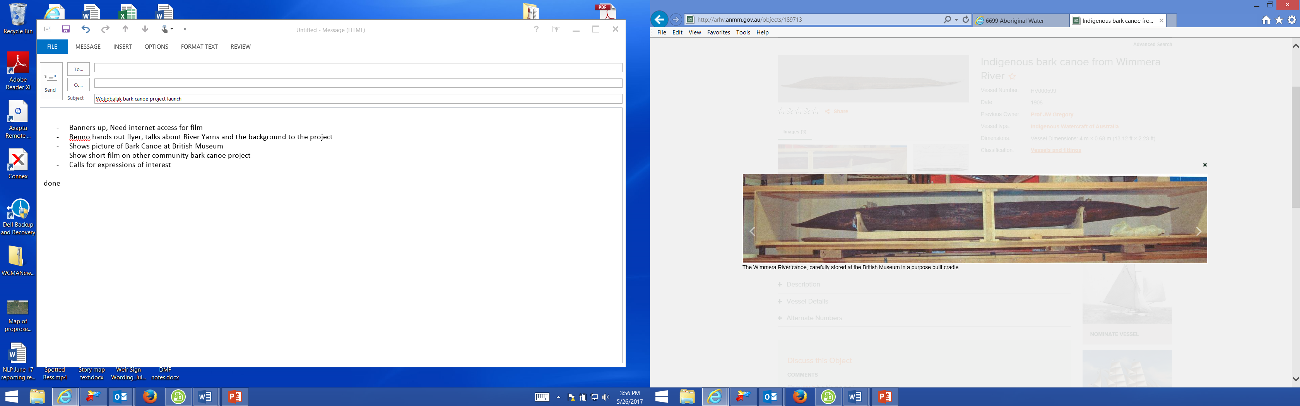
Place your
logo here
Next Steps
Yunguip Wotjobaluk Bark Canoe project
(source: British Museum)
“Our connection to the river is not only through the past,
it’s about desire for a great future for our community”
BRISBANE, AUSTRALIA | 18 - 20 SEPTEMBER 2017
MANAGED BY

Slide 11
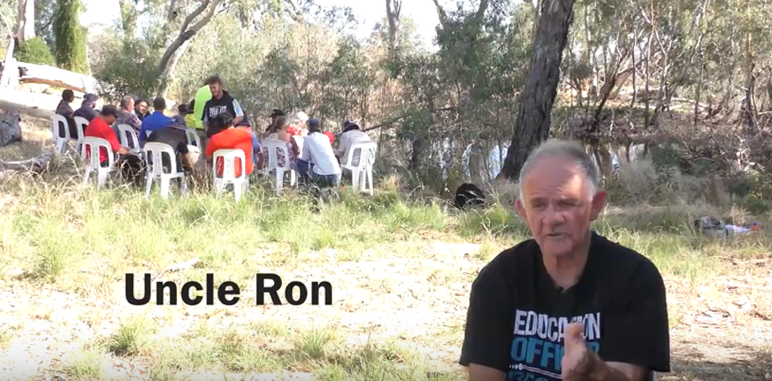
Place your
logo here
Next Steps
BRISBANE, AUSTRALIA | 18 - 20 SEPTEMBER 2017
MANAGED BY

Slide 12
Place your
logo here
The project has promoted connections to County through a range of pathways and has significantly increased Aboriginal participation in water resource planning and management in the Wimmera in a short period of time.
The need to create more cultural and natural resource career opportunities for young people is one of the strong messages from the community.
Ben Muir muirb@wcma.vic.gov.au
Joel Boyd boydj@wcma.vic.gov.au
BRISBANE, AUSTRALIA | 18 - 20 SEPTEMBER 2017
MANAGED BY

