Slide 1
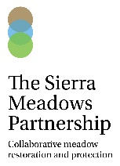
Place your
logo here
Sierra Meadow Strategy: A Process and Outcome Centered on Increasing Pace and Scale of Meadow Restoration
Mark Drew, Ph.D.
Nina Hemphill, Ph.D.
Levi Keszey
Amy Merrill, Ph.D.
Acknowledgements: CA Department of Fish & Wildlife, members of the Sierra Meadows Partnership
BRISBANE, AUSTRALIA | 18 - 20 SEPTEMBER 2017
MANAGED BY

Slide 2
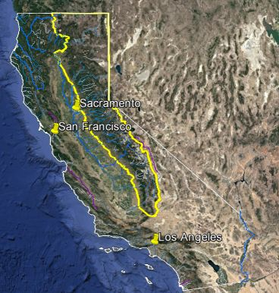
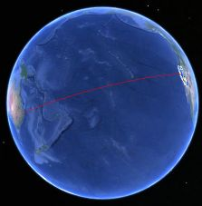
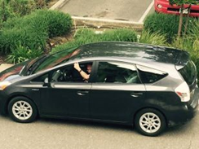
Place your
logo here
From Brisbane to California’s Sierra Nevada
BRISBANE, AUSTRALIA | 18 - 20 SEPTEMBER 2017
MANAGED BY

Slide 3
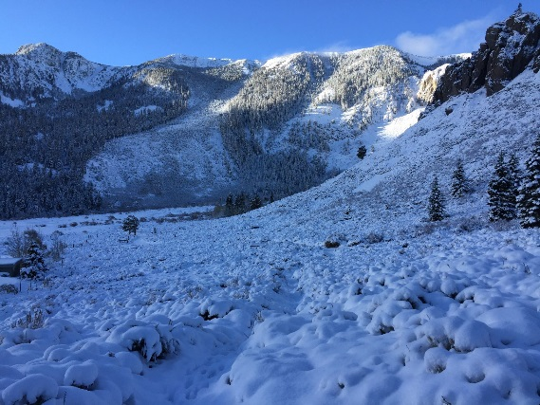
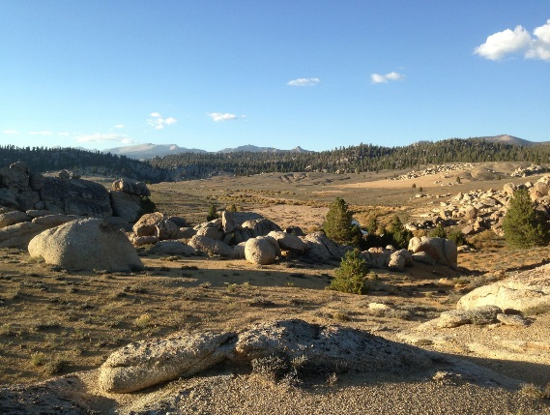
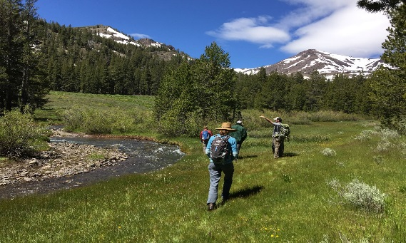
Place your
logo here
California’s Sierra Nevada
70,000 km² landscape
Snow pack driven system; provision of ~60% of California’s domestic water
~75% of California’s energy via hydropower capacity
Home to an abundance of flora and fauna, including 40 species of native fish and ~ 400 species of terrestrial vertebrates
Fundamental to local livelihoods and CA economy: ~ $4 billion annual tourism based; agriculture etc.
BRISBANE, AUSTRALIA | 18 - 20 SEPTEMBER 2017
MANAGED BY

Slide 4
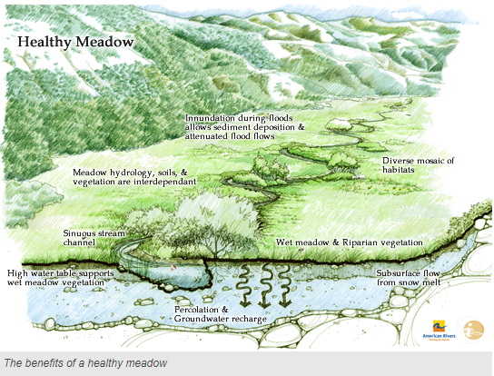
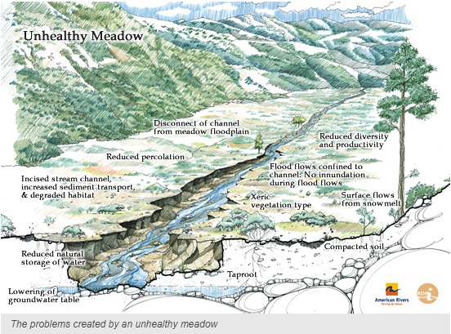
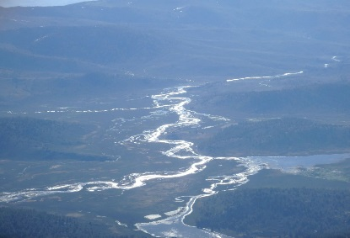
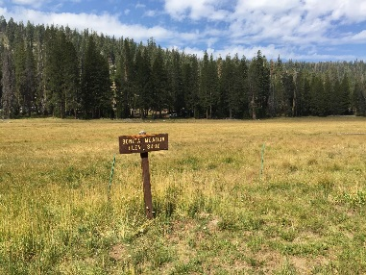
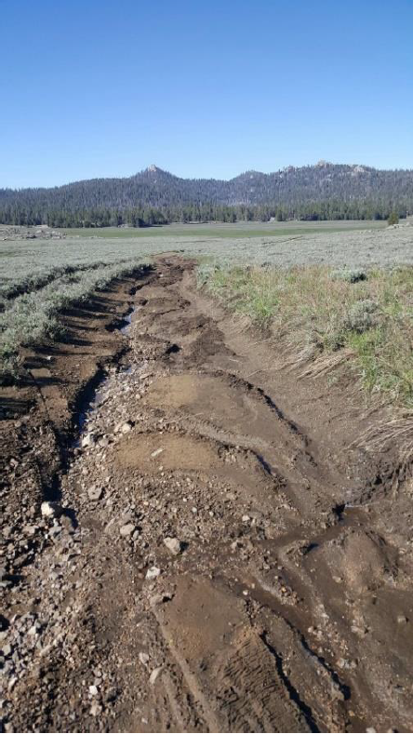
Place your
logo here
Meadows Matter!
Provide important, valuable ecological services for people, flora and fauna
Water retention
Water quality
Aquatic habitats
Flood attenuation
Feeders to streams and rivers
GHGs sinks
Recreational & spiritual connections
~ 79,000 hectares, ~ 40-60% degraded !!! Action required
BRISBANE, AUSTRALIA | 18 - 20 SEPTEMBER 2017
MANAGED BY

Slide 5
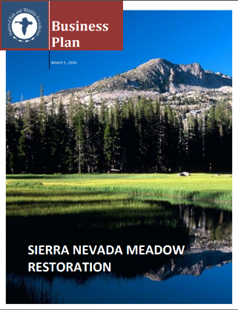
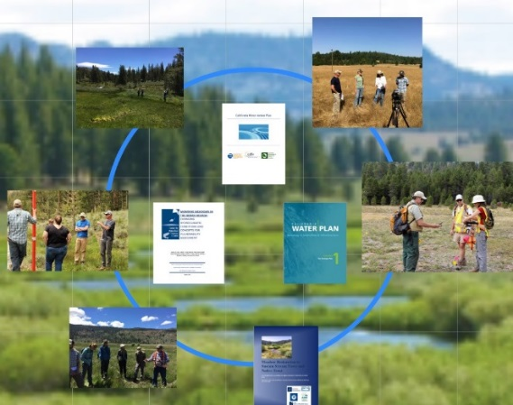
Place your
logo here
Evolution of a Meadows Movement
~ 2010 A plan, with funding support, is developed
~2012-2014 Political momentum begins supporting headwaters and meadows
BRISBANE, AUSTRALIA | 18 - 20 SEPTEMBER 2017
MANAGED BY

Slide 6
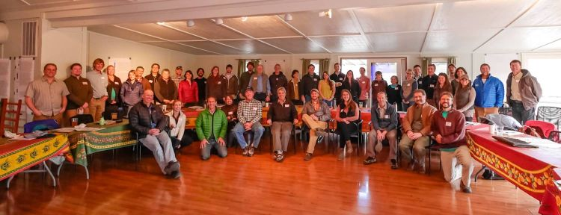
Place your
logo here
Feb, 2014 Calistoga I: The building of a collective stakeholder vision
BRISBANE, AUSTRALIA | 18 - 20 SEPTEMBER 2017
MANAGED BY

Slide 7
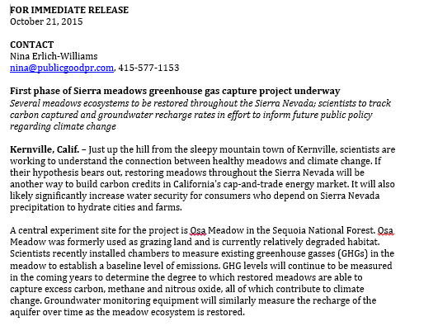
Place your
logo here
2014-2015
No Calistoga convening
Formation of Sierra Meadows Restoration, Research Partnership
Momentum renewed
BRISBANE, AUSTRALIA | 18 - 20 SEPTEMBER 2017
MANAGED BY

Slide 8
Place your
logo here
Feb, 2016
Calistoga II: Strategy and Partnership Development
The shared vision of the Sierra Meadows Partnership is a greater Sierra Nevada Region with healthy and resilient meadows that provide sustained goods and services to benefit flora, fauna and people .
BRISBANE, AUSTRALIA | 18 - 20 SEPTEMBER 2017
MANAGED BY

Slide 9
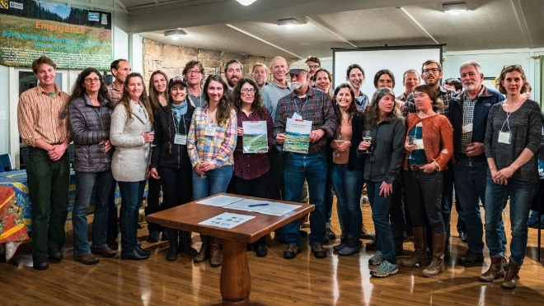
Place your
logo here
Feb. 2017, Calistoga III: Sierra Meadows Strategy is Completed, MOU Signed
Overarching goal: Restore and protect 12,000 hectares across the Sierra in the next 15 years!
BRISBANE, AUSTRALIA | 18 - 20 SEPTEMBER 2017
MANAGED BY

Slide 10
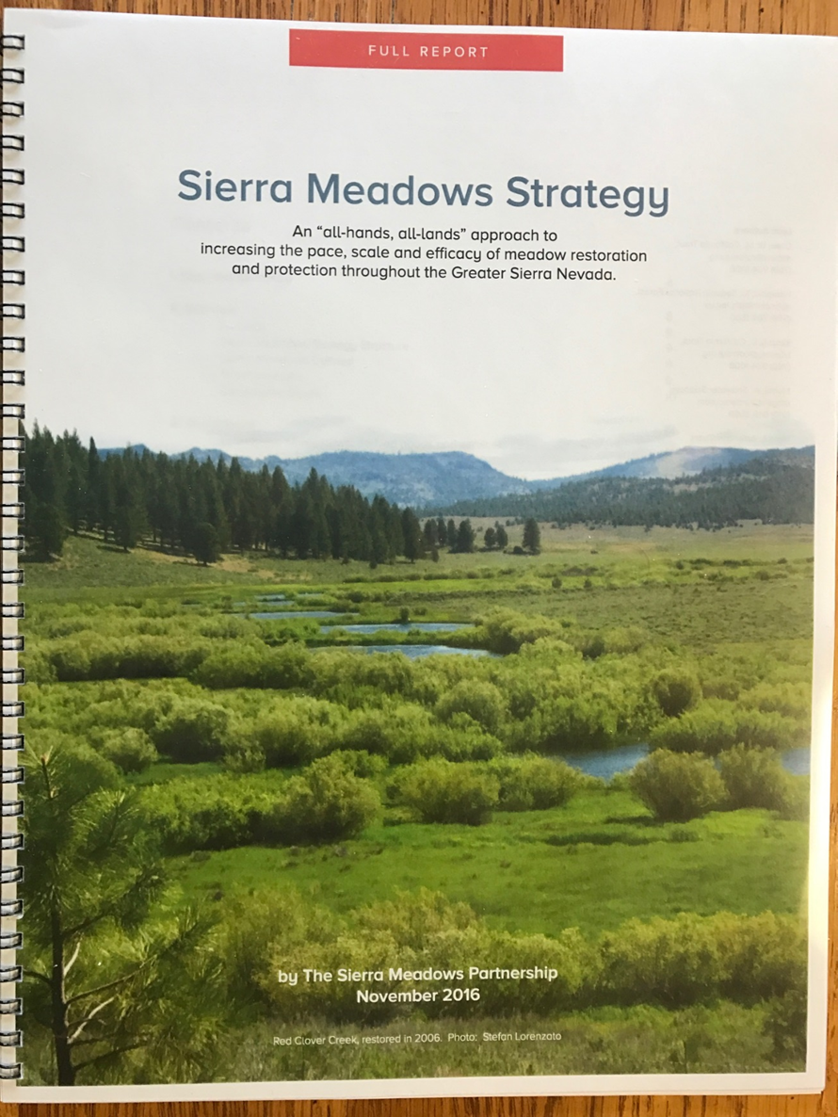
Place your
logo here
What We Accomplished
Collective action that created a living document providing a clear, concise set of goals, objectives, approaches, actions and metrics, as well as a prioritization framework, to guide Sierra meadow protection, management, restoration, research and potential investment through 2030.
BRISBANE, AUSTRALIA | 18 - 20 SEPTEMBER 2017
MANAGED BY

Slide 11
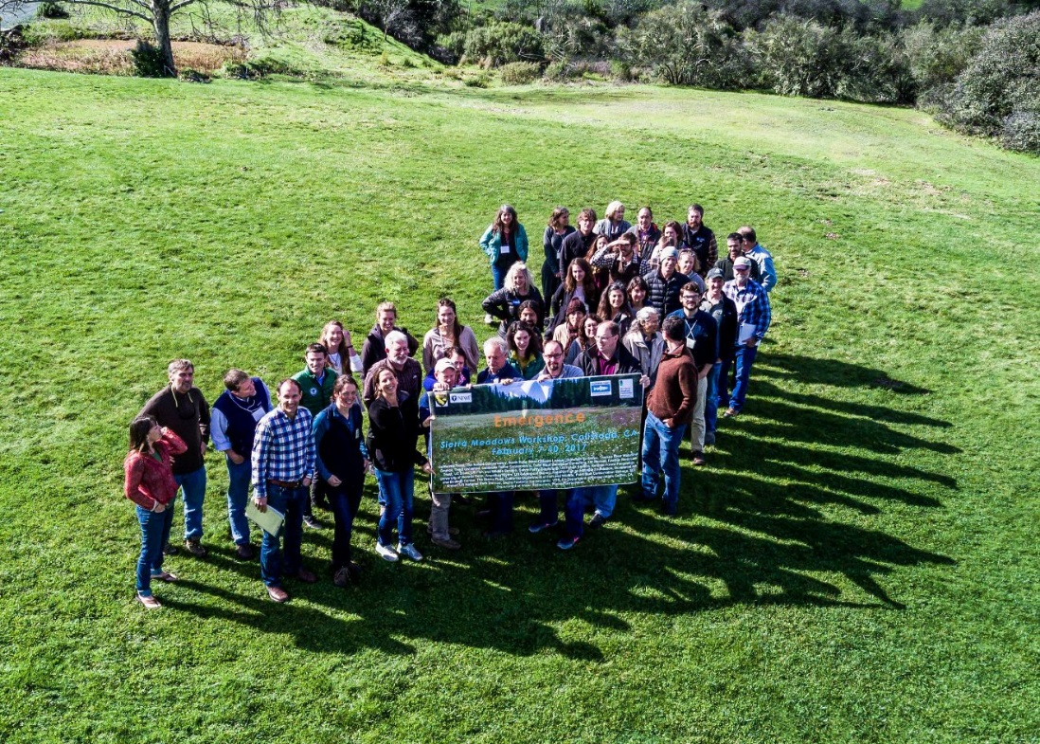
Place your
logo here
Next steps: Strategy Implementation
Calistoga IV: Annual Sierra Meadows Partnership meeting
Advancing scientific understanding and restoration efficacy
Improving planning and permitting efficiencies
Building on foundation, expand and advance partnerships
Communication strategy-meadows matter!
BRISBANE, AUSTRALIA | 18 - 20 SEPTEMBER 2017
MANAGED BY

Slide 12
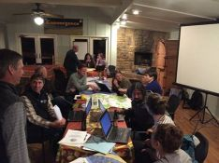
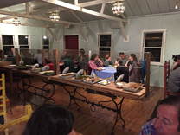
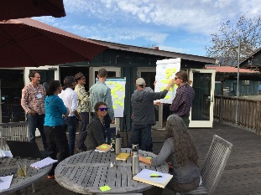
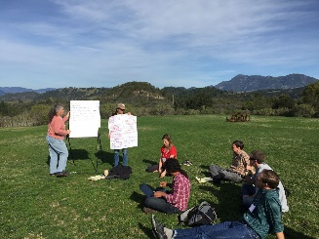
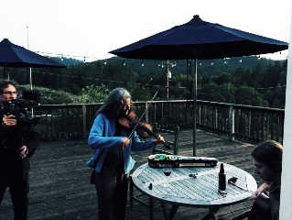
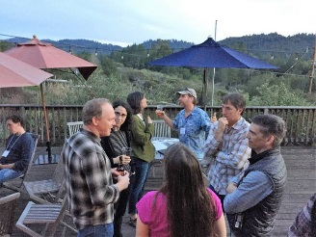
Place your
logo here
Outcomes and lessons learned
A lasting, cohesive Partnership already making a difference, pursuing a collective vision-people working together
A direction and pathway forward grounded in science & recognizing institutional changes are needed
Leveraged political, financial and capacity support
Creating space and time for thoughtful dialogue is beneficial
Material change requires understanding, patience and commitment
Leadership matters
Have fun-life is short
BRISBANE, AUSTRALIA | 18 - 20 SEPTEMBER 2017
MANAGED BY

Slide 13
Place your
logo here
Thank you!
Contact: mdrew@caltrout.org
URL: Caltrout.org
BRISBANE, AUSTRALIA | 18 - 20 SEPTEMBER 2017
MANAGED BY

