Slide 1
Towards Cultural Flows – Glenelg River Aboriginal Water Values Scoping Project Tyson Lovett-Murray (Gunditj Mirring Traditional Owners Aboriginal Corporation) Dr Jane Walker (Glenelg Hopkins Catchment Management Authority)
BRISBANE, AUSTRALIA | 18 - 20 SEPTEMBER 2017
MANAGED BY

Slide 2
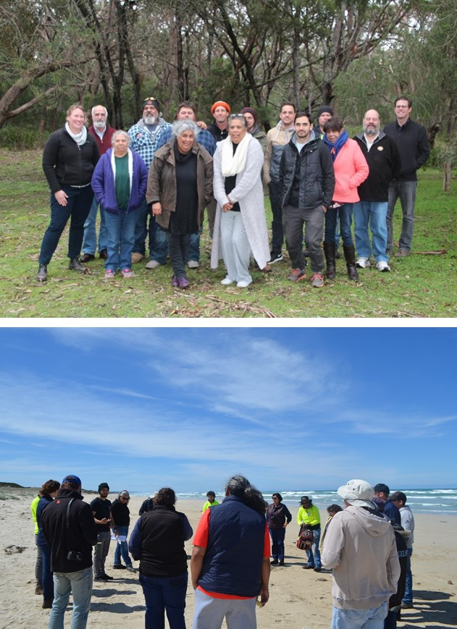
Project overview
Partnership project – Barengi Gadjin Land Council, Gunditj Mirring, Glenelg Hopkins CMA and DELWP
Explore and begin documenting Aboriginal water values and management aspirations
Develop a better understand of Aboriginal environmental outcomes and cultural flows
Build capacity, knowledge sharing & relationships amongst all partners

Slide 3
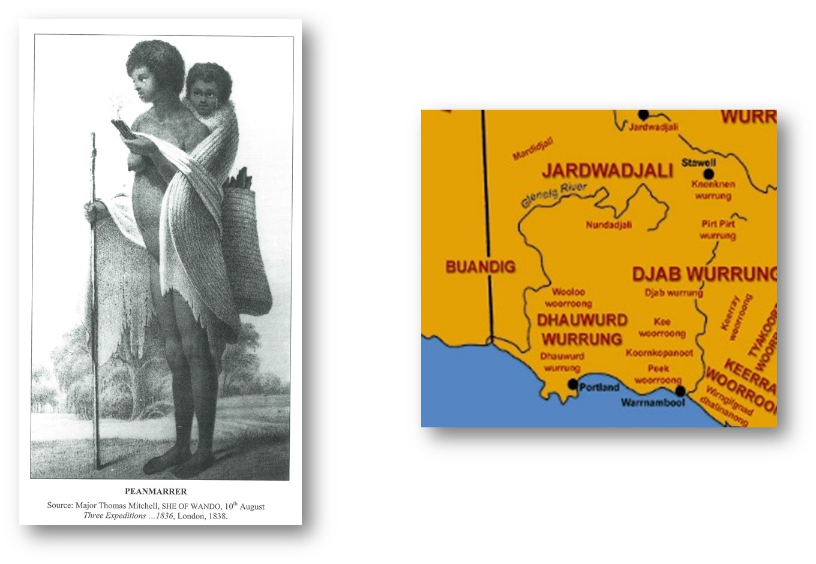
Bochara – the Glenelg River
“During winter and spring, the Glenelg Aborigines lived in permanent homes of mounds overlooking a swamp, lagoon or riverbank where Pigeon Ponds, Coleraine, Konong Wootong…. and Mt William are today.” (Massola)
“Men hunted kangaroos, emus, wombats… They built bird hides around lakes and lagoons and weirs along waterlines. Everyone fished. Women carrying digging sticks and woven baskets took children to collect dozens of varieties of eggs… and to gather roots, leaves, fruits and seeds”. (Dawson)

Slide 4
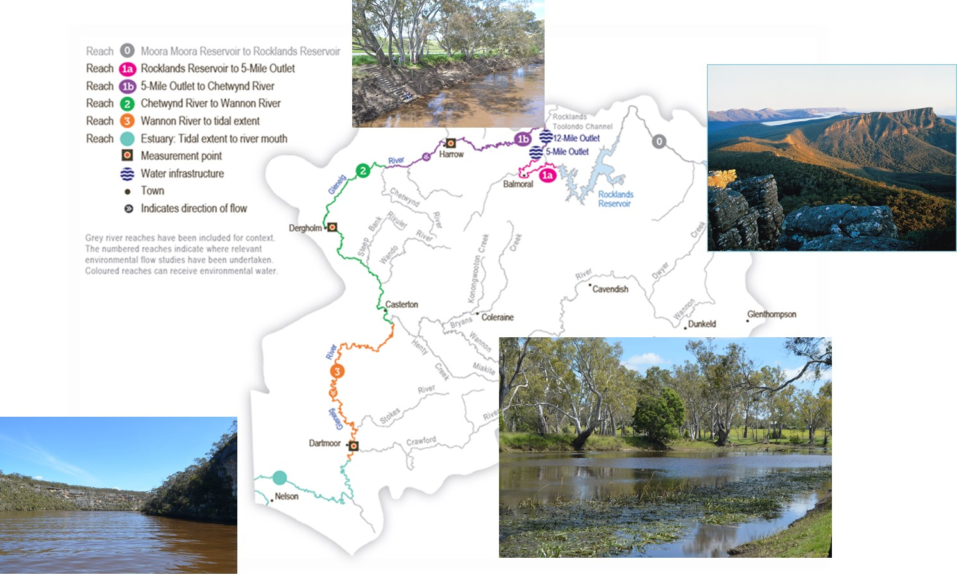
Environmental significance

Slide 5
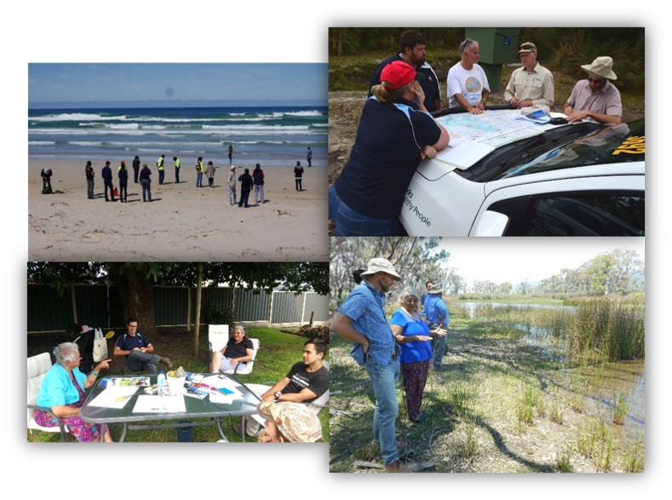
What did we do?
Project protocols and IP agreement
Literature review
Community interviews/ discussions/ country visits
Aboriginal Water Assessment (AWA) trial and review
2 community river trips, including AWA’s

Slide 7
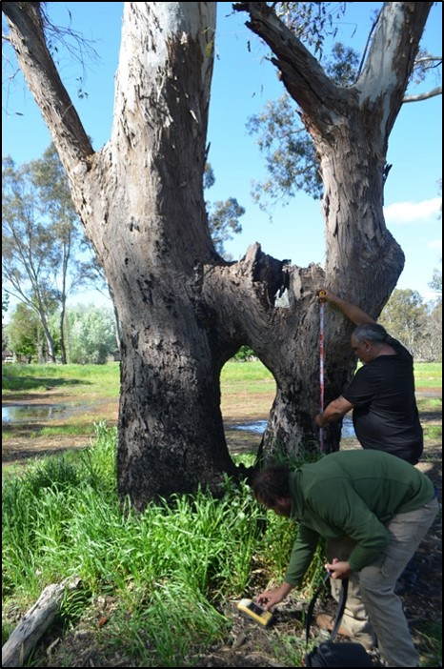
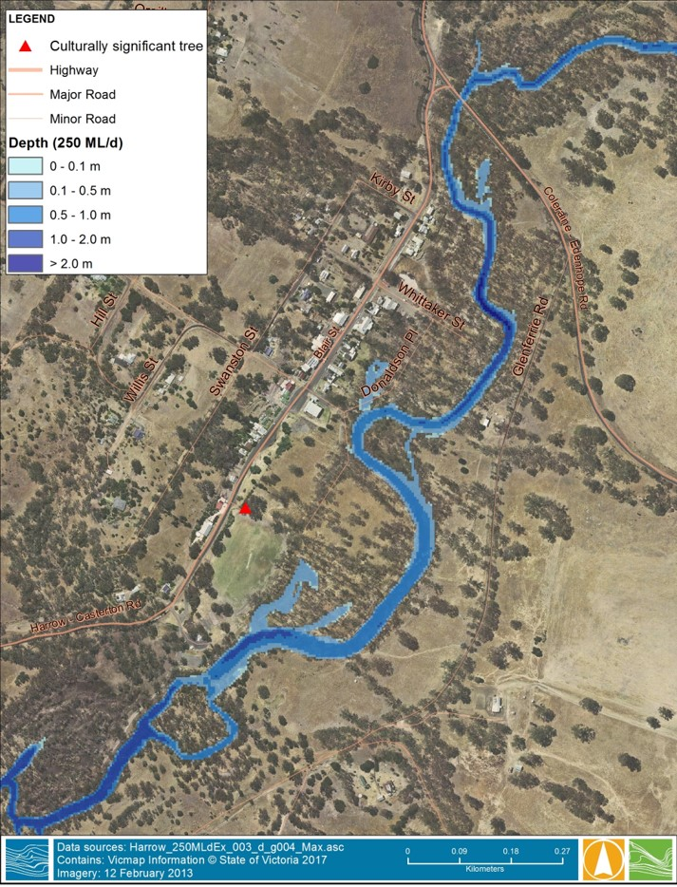
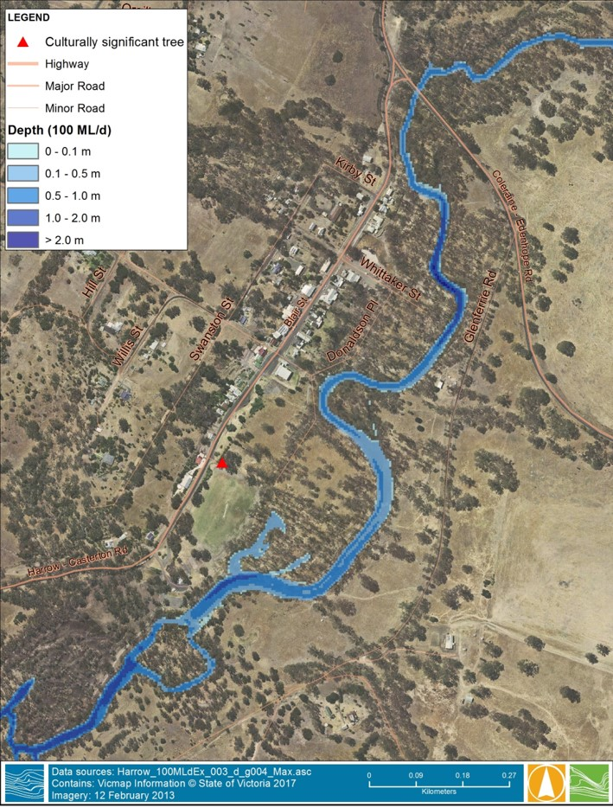
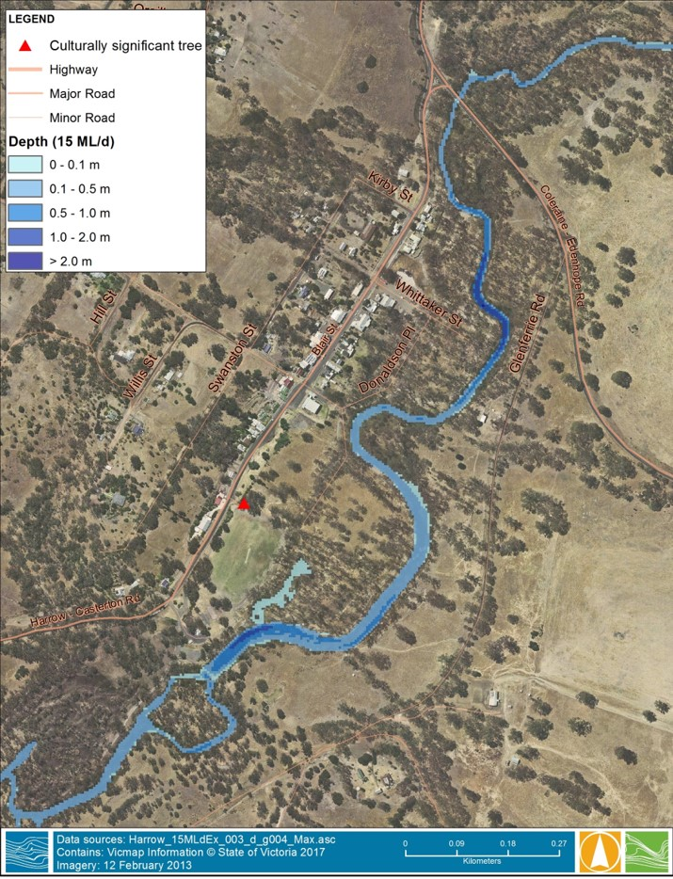
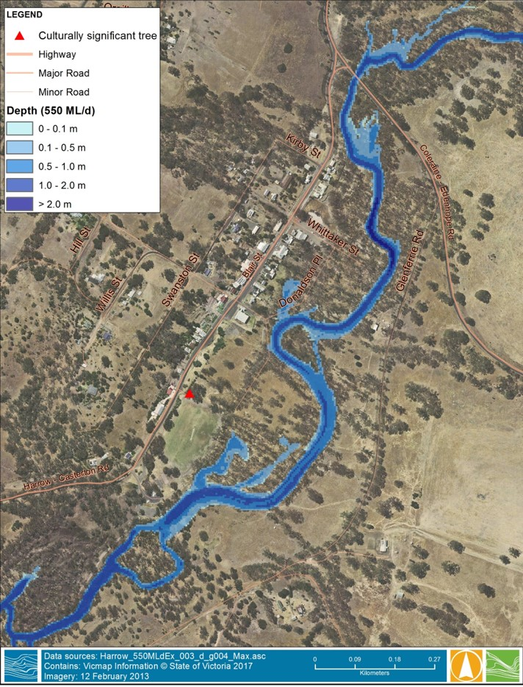
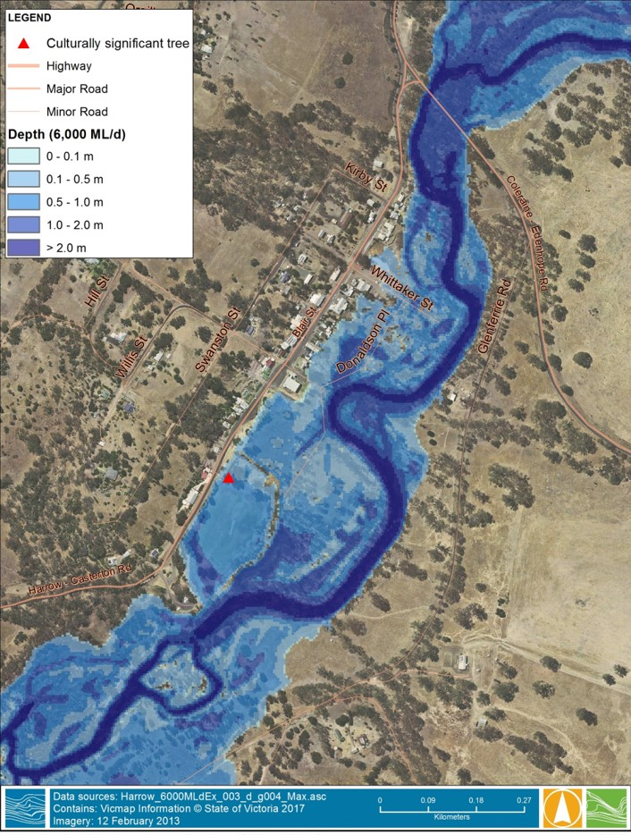
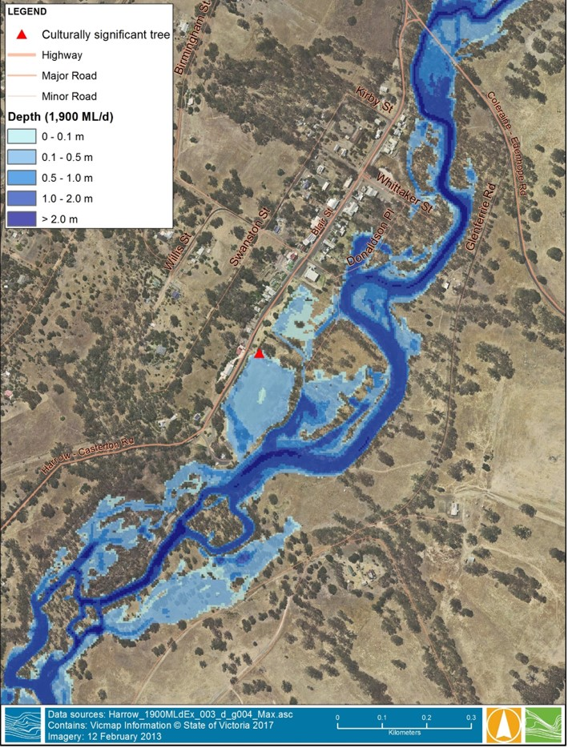
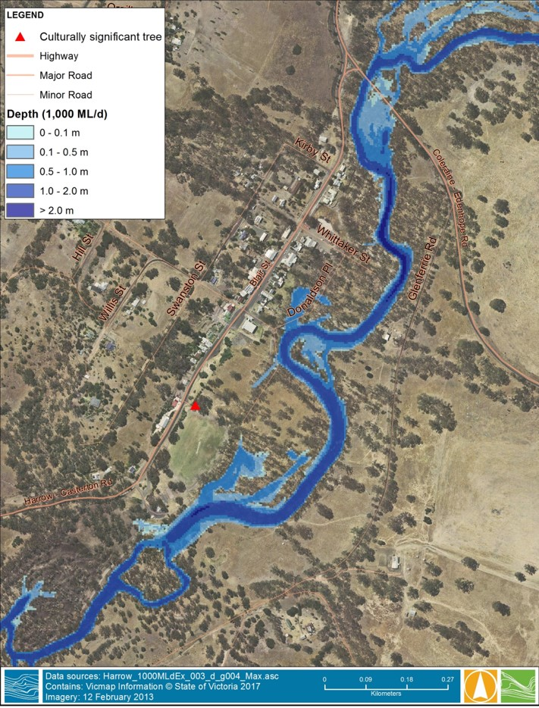
Harrow – a case study

Slide 9
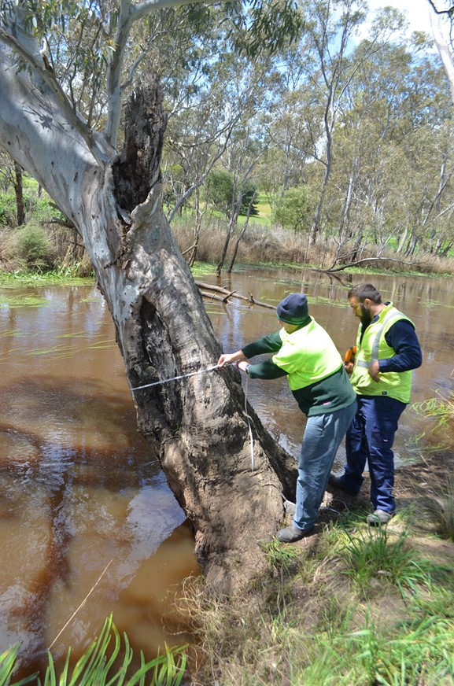
Outcomes of the project: Increasing Traditional Owner access
‘We could never do this as kids, because we didn’t have a car so it was difficult to get over to those areas and explore. There is always an interest there, culturally you want to connect, keep the story going to the kids.’
(Jason, Gunditj Mirring)

Slide 10
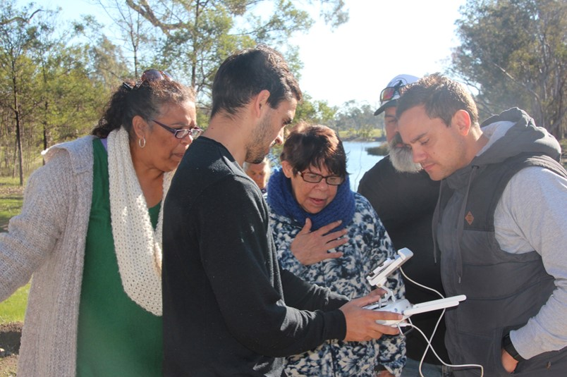
Outcomes of the project: Furthering relationships
‘Having Aunties come along, that is really important to me, getting elders back out on country… we have better knowledge of how some of these Agencies work, from working in conjunction with the MLDRIN guys and you [CMA] .’
(Brett, BGLC)

Slide 11
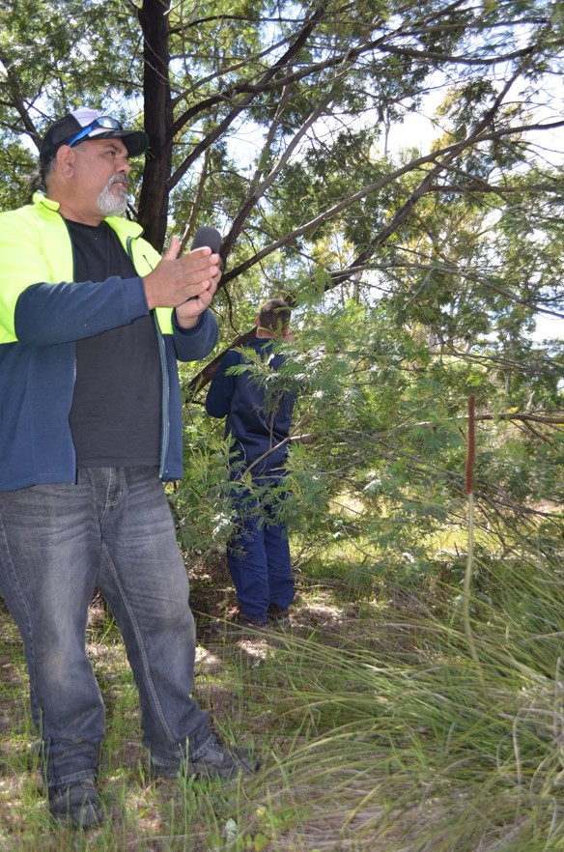
Outcomes of the project: Increasing knowledge
‘I mean I have never gone from the top of a river to the mouth just to have that experience itself, is something we will all remember for the rest of our lives… it is amazing to see, coming from the Murray, I can understand the greater scale of the Murray as well.’
(Steve, MLDRIN)

Slide 12
‘The Glenelg River Towards Cultural Flows project between Traditional Owners and the GHCMA has been great in fact, although there is more work to be done, it has been a starting point for giving Traditional Owners a voice in water management on Gunditjmara Country.’
(Denis, Gunditj Mirring)

