Slide 1
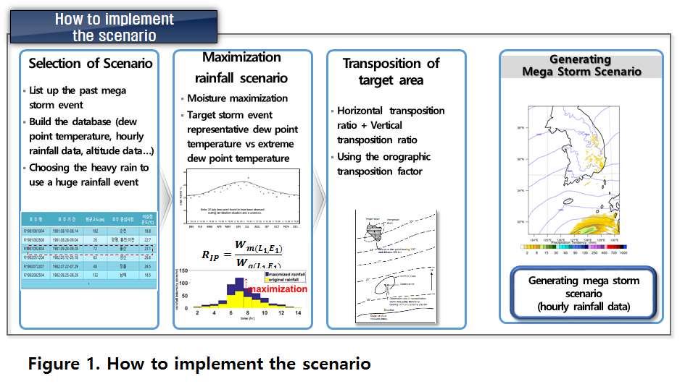
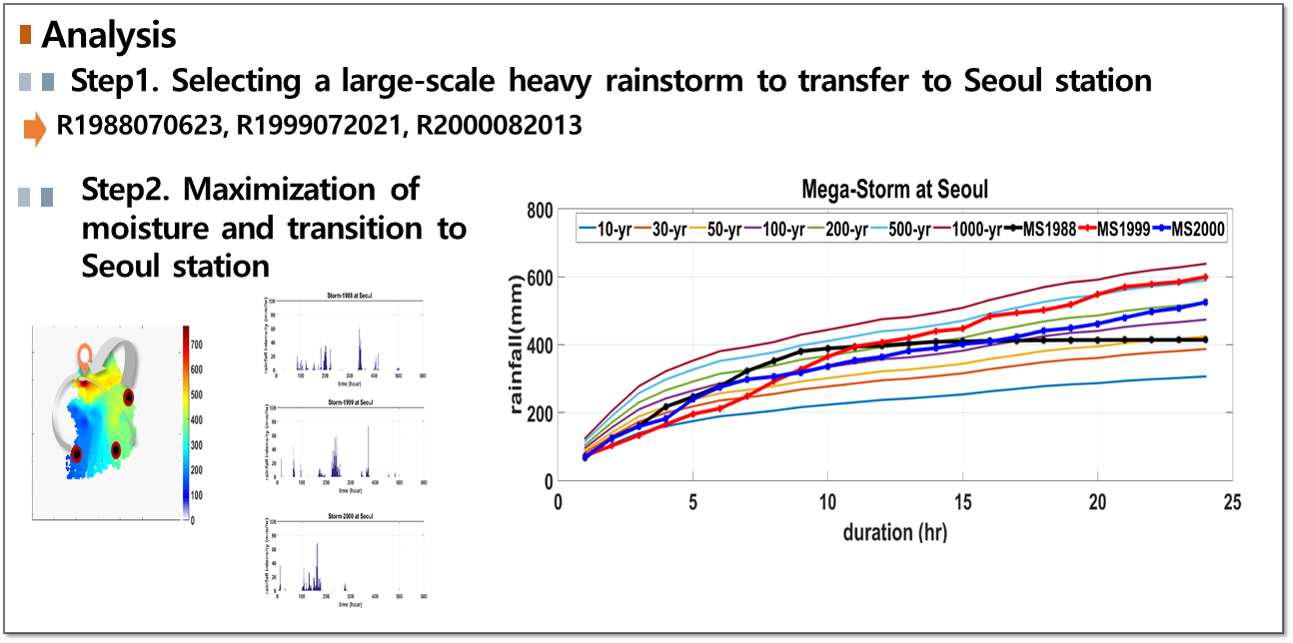
Development of mega-storm generating tool
Okjeong Lee, Sangdan Kim
Division of Earth Environmental System Science (Major of Environmental Engineering),
Pukyong National University, Busan 608-737 South Korea
Abstract
Method
In the 21st century, extreme weather phenomena are getting more and more frequent. In particular, the frequency of major disasters such as floods and typhoons is increasing and the intensity of disasters is also increasing. In order to prepare for catastrophic disasters, more active researches are needed. Losses due to storm and flood damage are increasing every year and the occurrence of huge disasters caused by abnormal climate conditions reminds us the need for a fundamental shift in the perception of each country's disaster prevention system. In this study, the mega storm generating tool (MSGT), which can transfer and maximize major rainfall events to desired area based on the past large storms, is developed. MSGT is based on a hydro-meteorological method which is one of methods estimating probable maximum precipitations: moisture maximization and storm transposition.
Since MSGT is based on notorious rainfall events that have occurred in the past, MSGT has the advantage that it can better explain the dangers of mega-floods caused by climate change to the public. Figure 1 shows the hyetograph of a storm sequences generated by MSGT.
Result
Acknowledgement
This research was supported by a grant ‘Development of the Evaluation Technology for Complex Causes of Inundation Vulnerability and the Response Plans in Coastal Urban Areas for Adaptation to Climate Change’ [MPSS-NH-2015-77] from the Natural Hazard Mitigation Research Group, Ministry of Public Safety and Security of Korea.
BRISBANE, AUSTRALIA | 18 - 20 SEPTEMBER 2017
MANAGED BY

