Slide 1
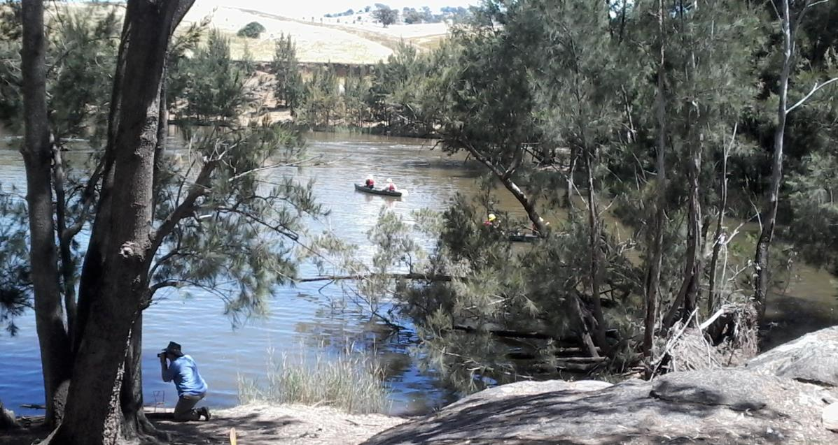
Title: 'Corridors of Effort’- Abercrombie River Connections
Author: Mary Bonet
BRISBANE, AUSTRALIA | 18 - 20 SEPTEMBER 2017
MANAGED BY

Slide 2
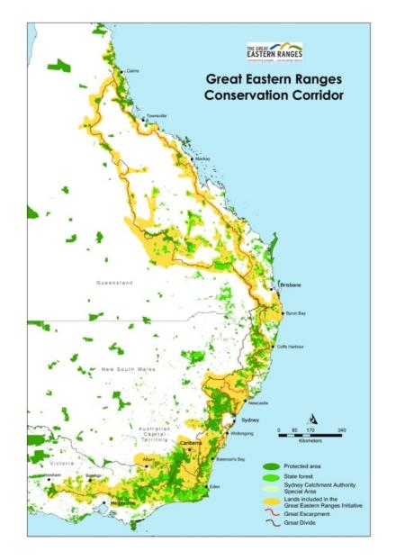
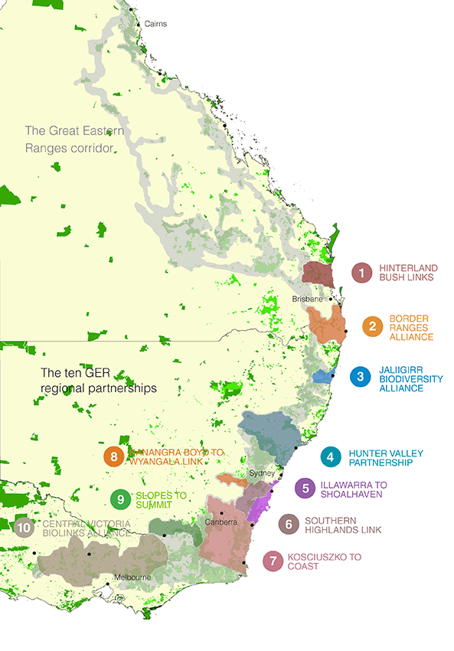
3,600km ‘continental lifeline’
Linking people, reserves and habitats within and across landscapes
From Western Victoria, through NSW and the ACT to the Queensland Wet Tropics
The K2W Link
BRISBANE, AUSTRALIA | 18 - 20 SEPTEMBER 2017
MANAGED BY

Slide 3
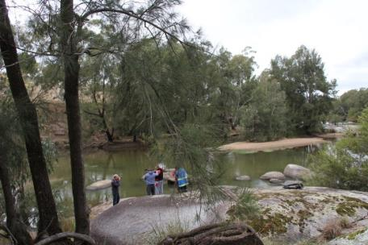
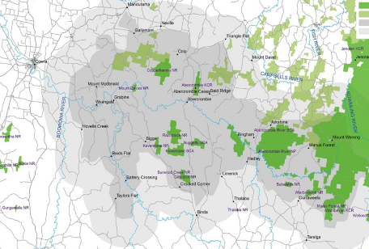
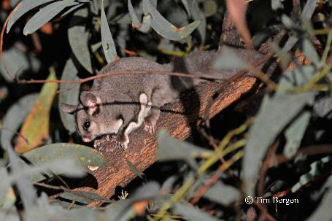
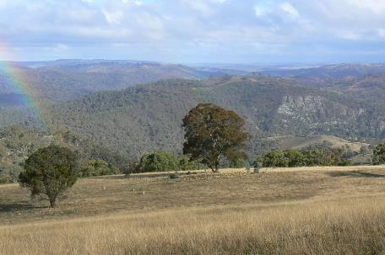
Kanangra –Boyd to Wyangala Link
From the Greater Blue Mountains following the Abercrombie River corridor to Wyangala Dam
Biologically rich landscape covering 319,200 ha
Supports a range of threatened species and ecological communities
BRISBANE, AUSTRALIA | 18 - 20 SEPTEMBER 2017
MANAGED BY

Slide 4
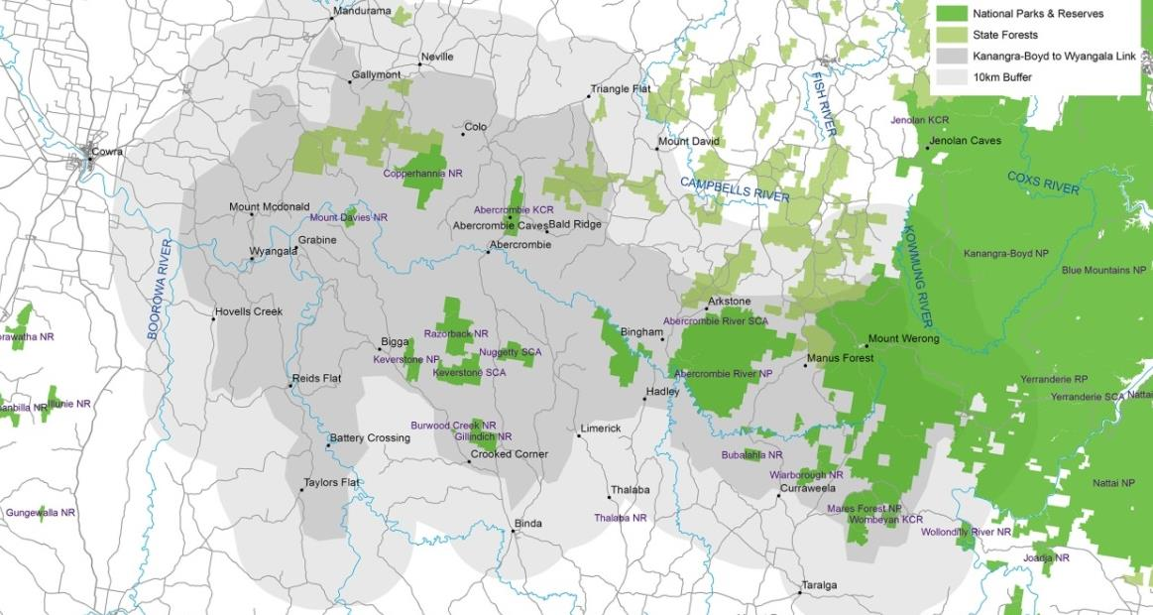
BRISBANE, AUSTRALIA | 18 - 20 SEPTEMBER 2017
MANAGED BY

Slide 5
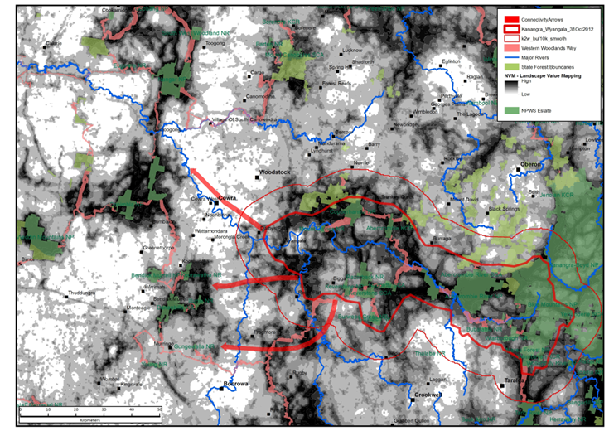
Map adapted from Drielsma et al 2012
BRISBANE, AUSTRALIA | 18 - 20 SEPTEMBER 2017
MANAGED BY

Slide 6
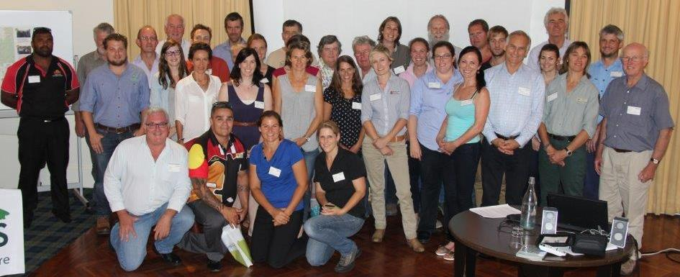
Started as a Government Initiative. Now a community-lead partnership.
Over 30 representatives from Landcare and community groups, government and nongovernment organisations, NRM bodies, universities and research organisations and landholders.
Working collaboratively to protect wildlife and natural resources in the Abercrombie River corridor.
BRISBANE, AUSTRALIA | 18 - 20 SEPTEMBER 2017
MANAGED BY

Slide 7
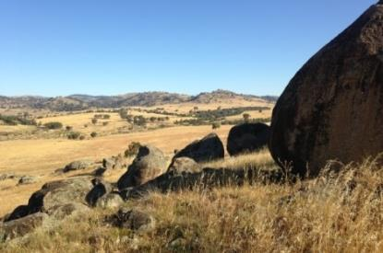
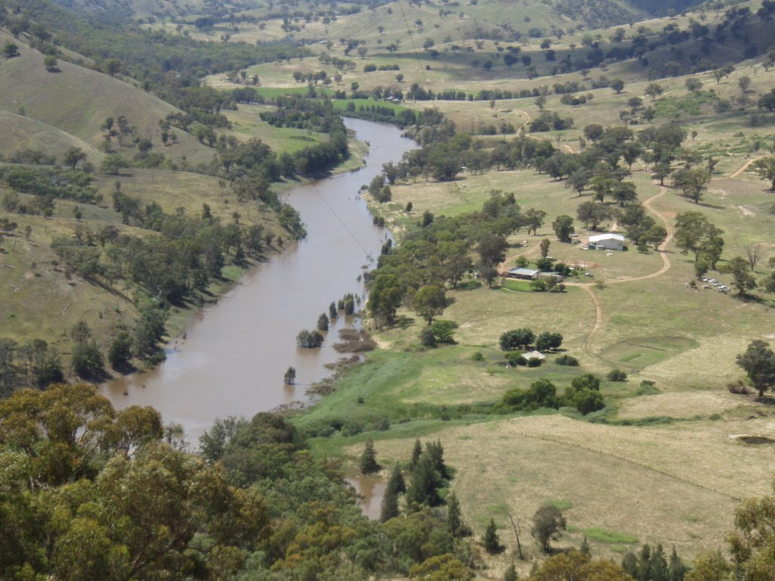
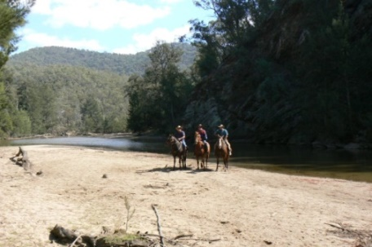
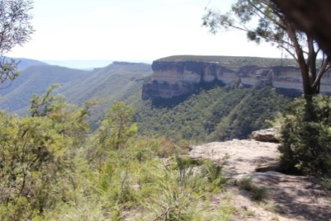
Values
Natural diversity – From mountains to western woodlands
Natural connections -Existing landscape corridor and functional connections
Nature’s highway - Used by resident, nomadic and migratory species
Network of protected habitats + Management by farmers and landholders
BRISBANE, AUSTRALIA | 18 - 20 SEPTEMBER 2017
MANAGED BY

Slide 8
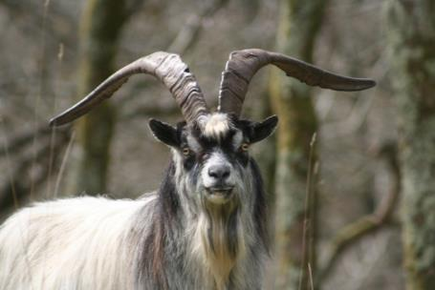
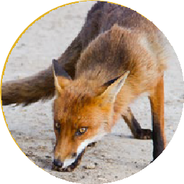
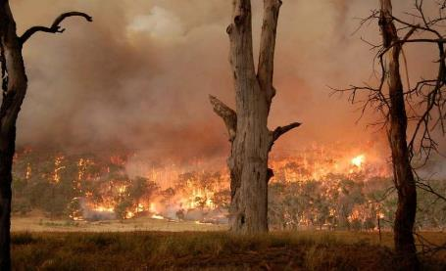
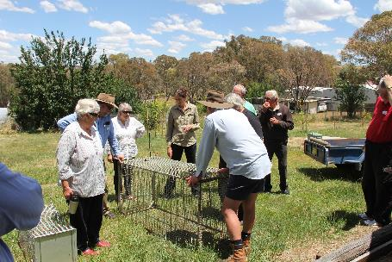
Threats
Weeds – Competition, changed disturbance (eg fire) and habitat structure
Introduced fauna – Grazing, predation and competition
Fragmentation – Reduced effectiveness of natural connections
Habitat loss – Past clearing and continued loss of condition
Species decline – Wider population decline
BRISBANE, AUSTRALIA | 18 - 20 SEPTEMBER 2017
MANAGED BY

Slide 9
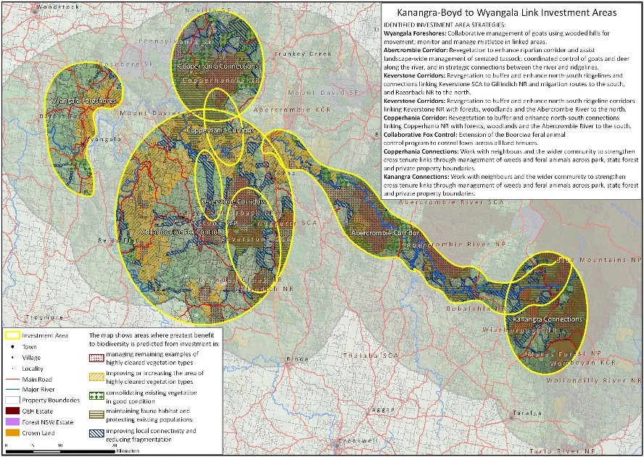
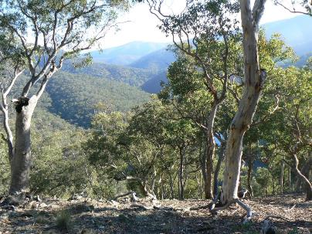
Funding
$2.7M - Australian Government Biodiversity Fund (2012-2017)
Developed an investment strategy
BRISBANE, AUSTRALIA | 18 - 20 SEPTEMBER 2017
MANAGED BY

Slide 10
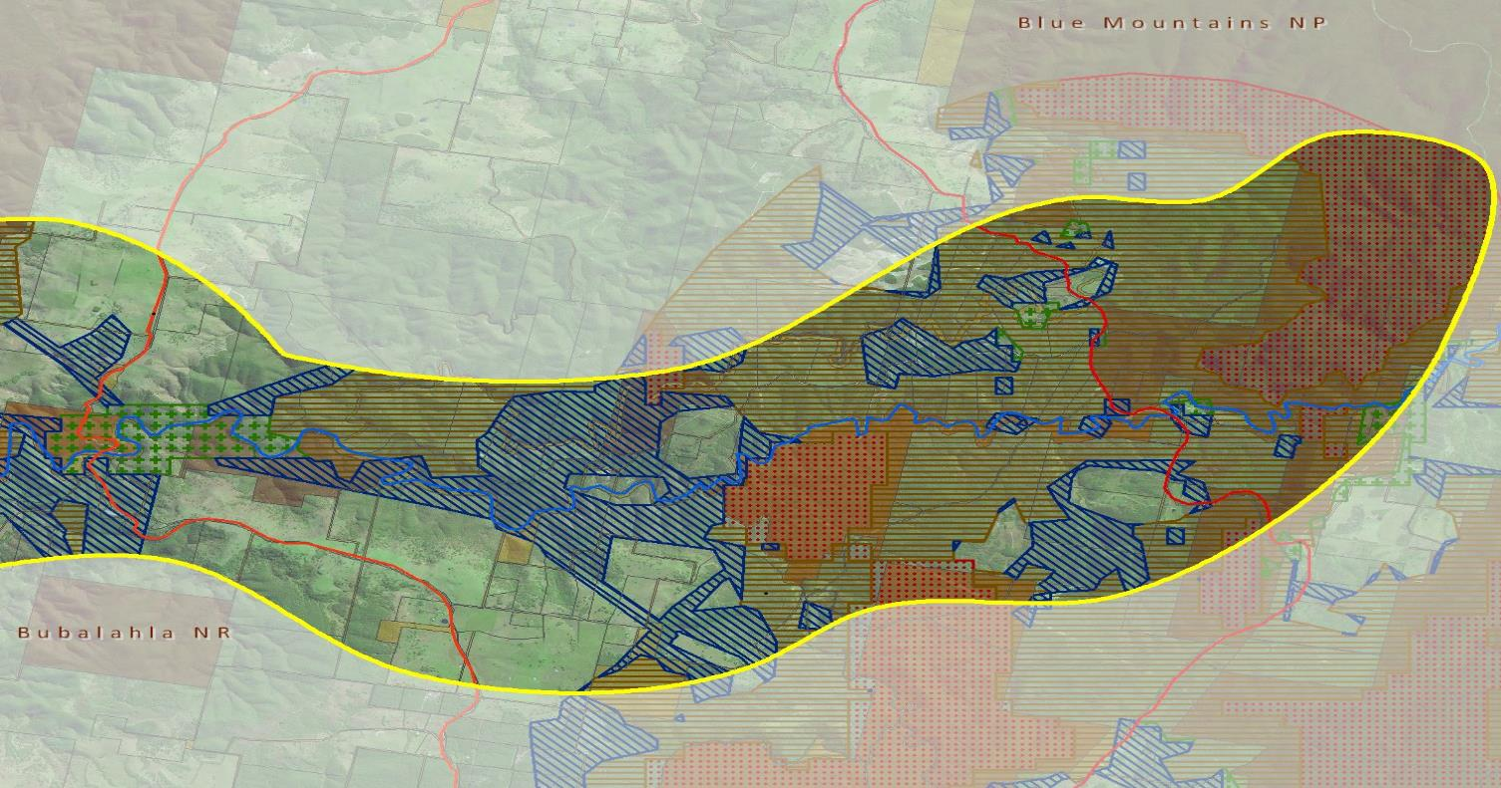
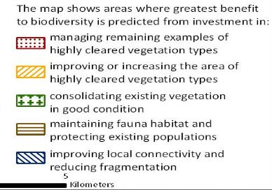
BRISBANE, AUSTRALIA | 18 - 20 SEPTEMBER 2017
MANAGED BY

Slide 11
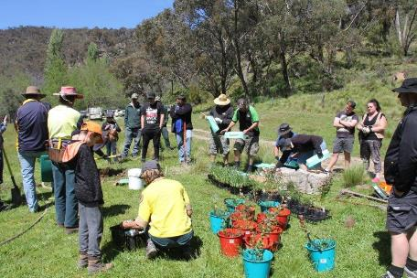
Aims for investment
Protection of areas of remnant native habitats through promotion of conservation mechanisms
Encourage collaborative control of pests and weeds across property boundaries to improve the condition & corridor value of habitat linkages
Restore lost habitat connections through assistance and support for voluntary revegetation
Support connection with country through sharing of Aboriginal traditional knowledge and development of new joint ventures
BRISBANE, AUSTRALIA | 18 - 20 SEPTEMBER 2017
MANAGED BY

Slide 12
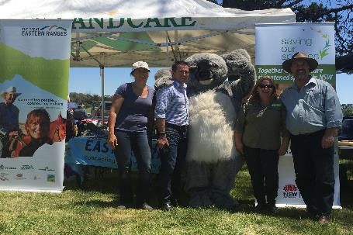
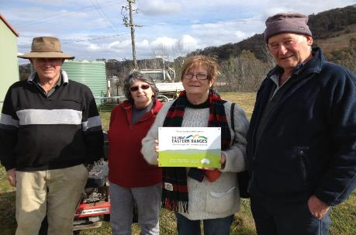
Lessons learnt…
Priority areas - Reaching landholders, especially absentee landholders
Lack of identity, confusion over where funding was coming from and what we are trying to achieve
Slow uptake of private land conservation
Who needing to consult with - Particularly on cultural aspects
Needing to bring whole community on board.
BRISBANE, AUSTRALIA | 18 - 20 SEPTEMBER 2017
MANAGED BY

Slide 13
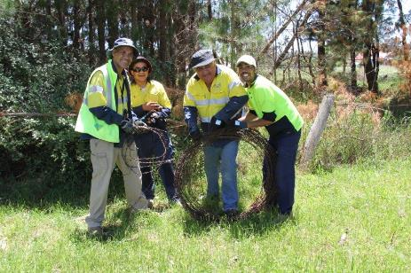
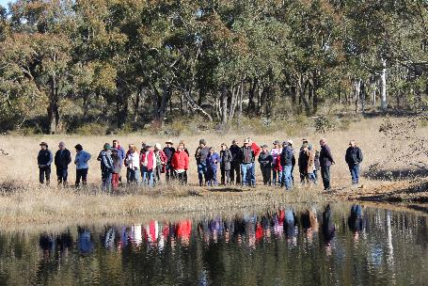
Corridors of Effort
Flagship species – Glideways Program
Build capacity of groups - Invest in skills, planning, volunteers
Build on existing successful programs - Tussock Tamers, Barb Busters, Feral Fighters
Find local champions
BRISBANE, AUSTRALIA | 18 - 20 SEPTEMBER 2017
MANAGED BY

Slide 14
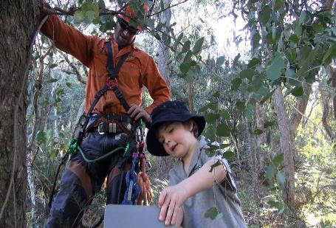
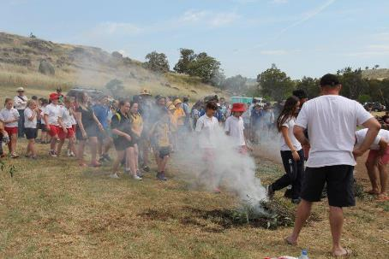
Corridors of Effort…
Work with local teachers to design education program to enable meaningful participation from schools
Investment strategy for Invasive species - include local coordination, assistance for absentee landholders. Innovative programs such as goat musters with economic incentives rather than cull
Cultural connections program- who to consult with, opportunities for working on country, Traditional Ecological Knowledge, cultural sites
BRISBANE, AUSTRALIA | 18 - 20 SEPTEMBER 2017
MANAGED BY

Slide 15
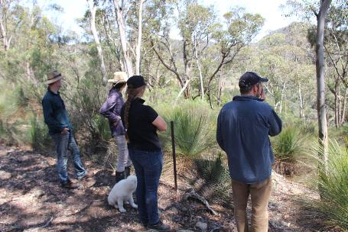
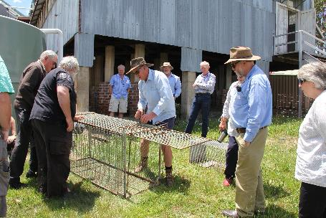
Achievements
800ha revegetated with 30,000 tubestock planted
80 landholders and 15 community groups engaged with 45 property plans
13,000ha protected through conservation mechanisms
65,000 ha pest management on private and public lands, including aerial musters, culls, and baiting.
BRISBANE, AUSTRALIA | 18 - 20 SEPTEMBER 2017
MANAGED BY

Slide 16
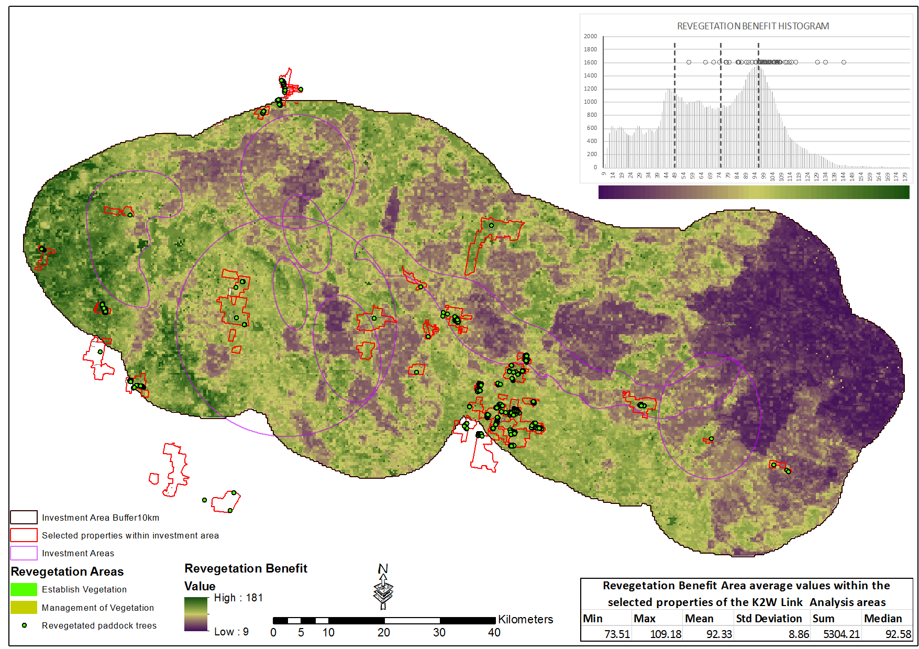
Michael Drielsma, Rajesh Thapa and Jamie Love
Ecosystem Management Science OEH
University of New England, Armidale
BRISBANE, AUSTRALIA | 18 - 20 SEPTEMBER 2017
MANAGED BY

Slide 17
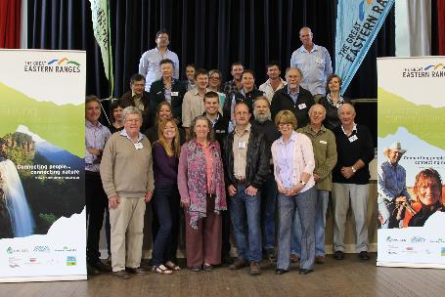
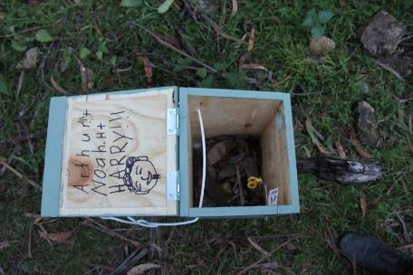
Achievements
5,000 ha cross property weed management
100 events with nearly 3000 participants
220 Indigenous participants and working on country opportunities, with 5 cultural sites protected
11 primary schools and 4 local high schools participating in Glideways and 100 nest boxes installed
BRISBANE, AUSTRALIA | 18 - 20 SEPTEMBER 2017
MANAGED BY

Slide 18
An additional $750,000 in funding and commitment for a further 8 years
BRISBANE, AUSTRALIA | 18 - 20 SEPTEMBER 2017
MANAGED BY

Slide 19
Thanks to our Supporters
BRISBANE, AUSTRALIA | 18 - 20 SEPTEMBER 2017
MANAGED BY

Slide 20
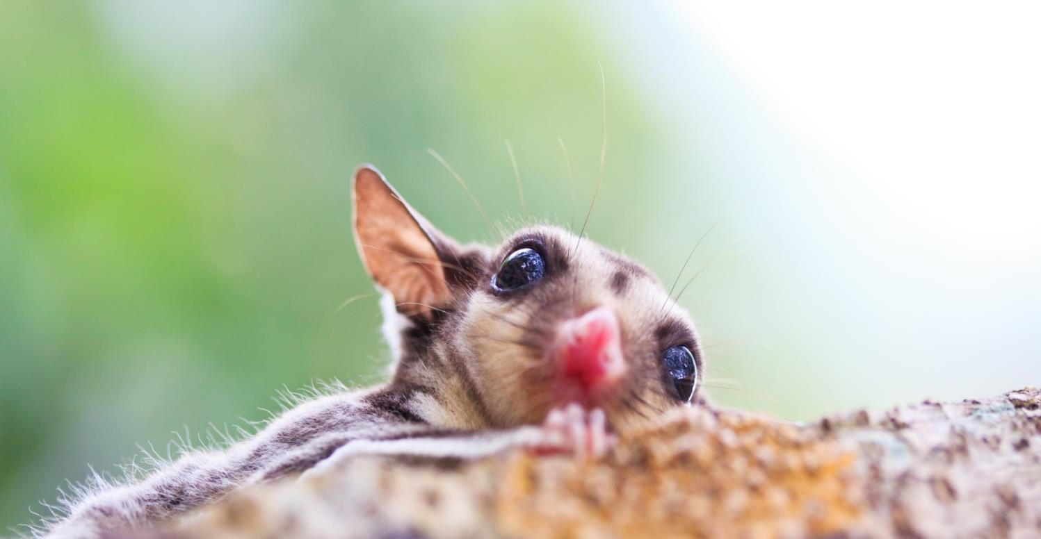
For more information www.glideways.org.au
mary@glideways.org.au
BRISBANE, AUSTRALIA | 18 - 20 SEPTEMBER 2017
MANAGED BY

