Slide 1
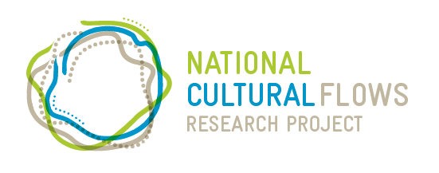
Understanding cultural flows:
a coordinated research effort in pursuit of Aboriginal water rights
Rene Woods
Murray Lower Darling Rivers Indigenous Nations
BRISBANE, AUSTRALIA | 18 - 20 SEPTEMBER 2017
MANAGED BY

Slide 2
Cultural flows
‘Cultural Flows are water entitlements that are legally and beneficially owned by the Indigenous Nations and are of a sufficient and adequate quantity and quality to improve the spiritual, cultural, environmental, social and economic conditions of those Indigenous Nations. This is our inherent right.’
The Echuca Declaration, September 2010

Slide 3
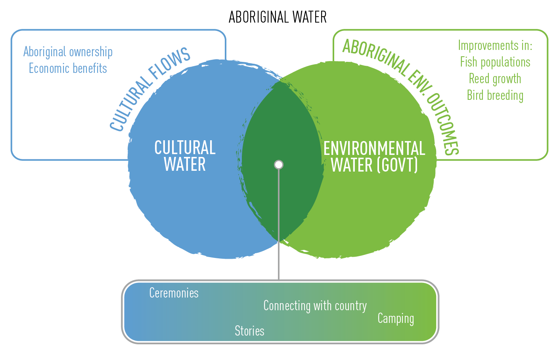

Slide 4
National Cultural Flows
Research Project
A future where Aboriginal water allocations are embedded within Australia’s water planning and management framework, delivering cultural, social, spiritual, environmental and economic benefit to communities across Australia

Slide 5
Research principles
Acknowledging rights of Traditional Owners
Holistic and integrated research
Benefit of Aboriginal people
Respecting intellectual property rights
Actively building capacity
Participatory research approach
Free, prior and informed consent
Aboriginal decision-making and ownership
Alignment with government strategies and policies
Focus on robust science with sound methodologies

Slide 6
Research components
1
Literature review
2
3
4
Values and aspirations
Modelling and watering trials
Analyse impacts
5
Investigate policy, legal and institutional reforms
6
7
8
Capacity building
Communications
Project management

Slide 7
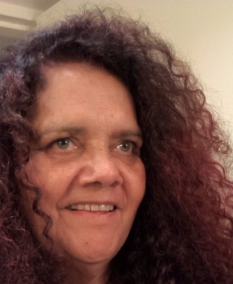
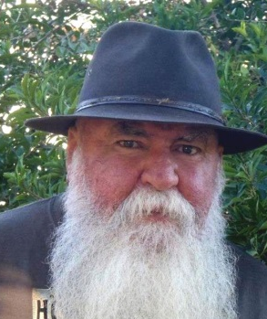
Planning and Research Committee
Murray Lower Darling Basin Indigenous Nations
Northern Basin Aboriginal Nations
Maureen McKellar
Michael Anderson
Grant Rigney
Rene Woods
North Aust. Indigenous Land and Sea Management Alliance (NAILSMA)
Independent chair
Plus
Murray Darling Basin Authority
C’wealth Environmental Water Office
National Native Title Council
Basin State Governments
Paul Lane
Damein Bell

Slide 8
Research outcomes
Rigorous basis for articulating value and importance of cultural flows
Methodologies for defining cultural values and quantifying water required to meet them
Monitoring and indicator frameworks that can be applied to other sites
Identified opportunities for policy, legislative and governance reform

Slide 9
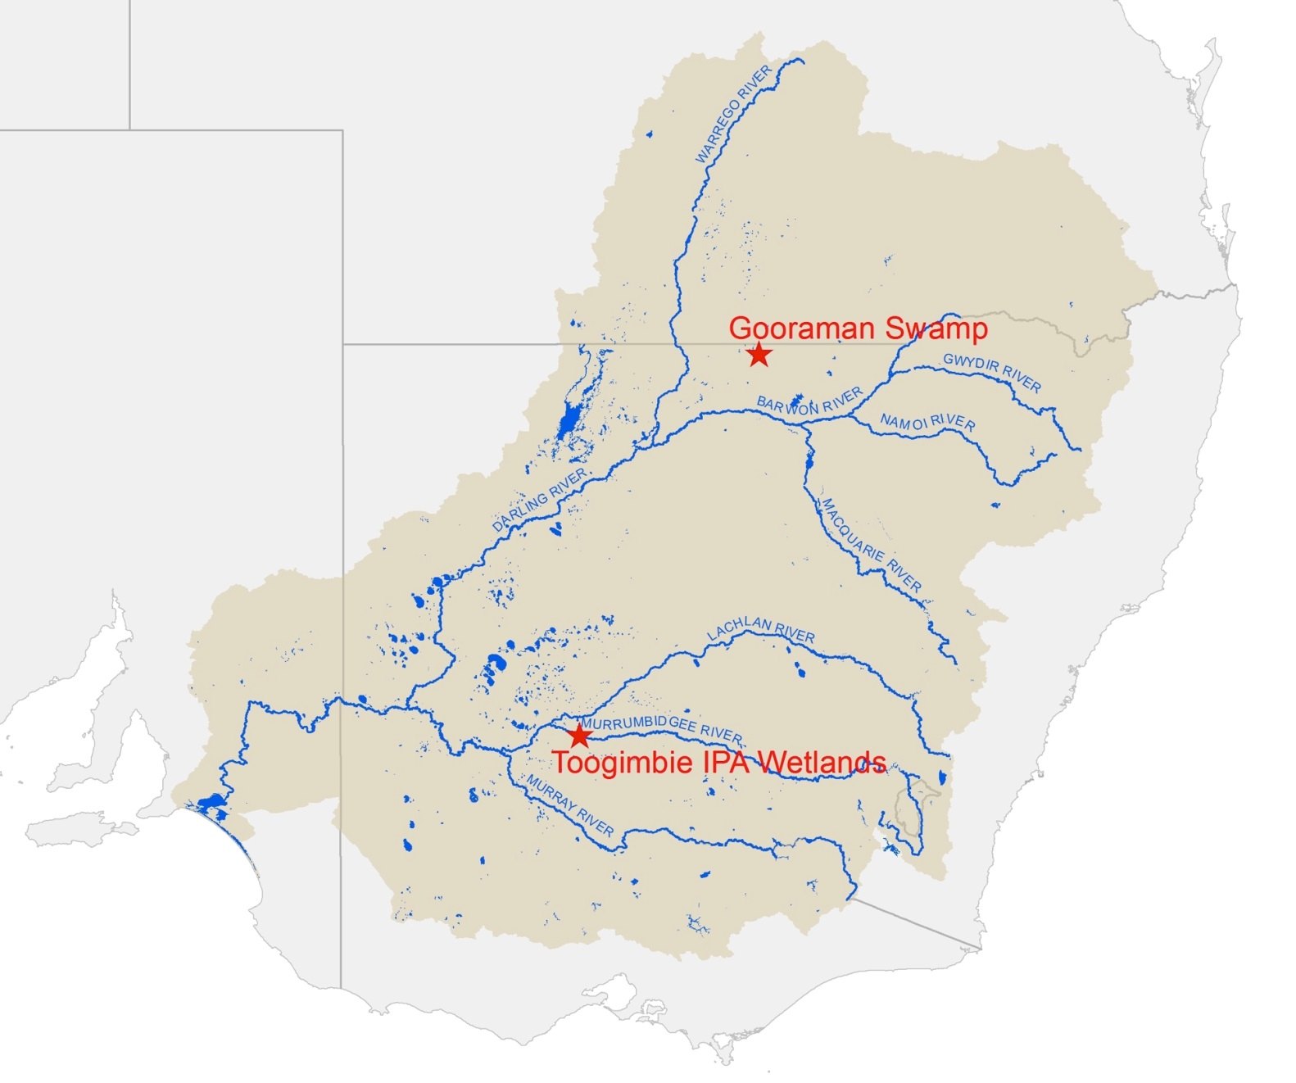
Case study sites

Slide 10
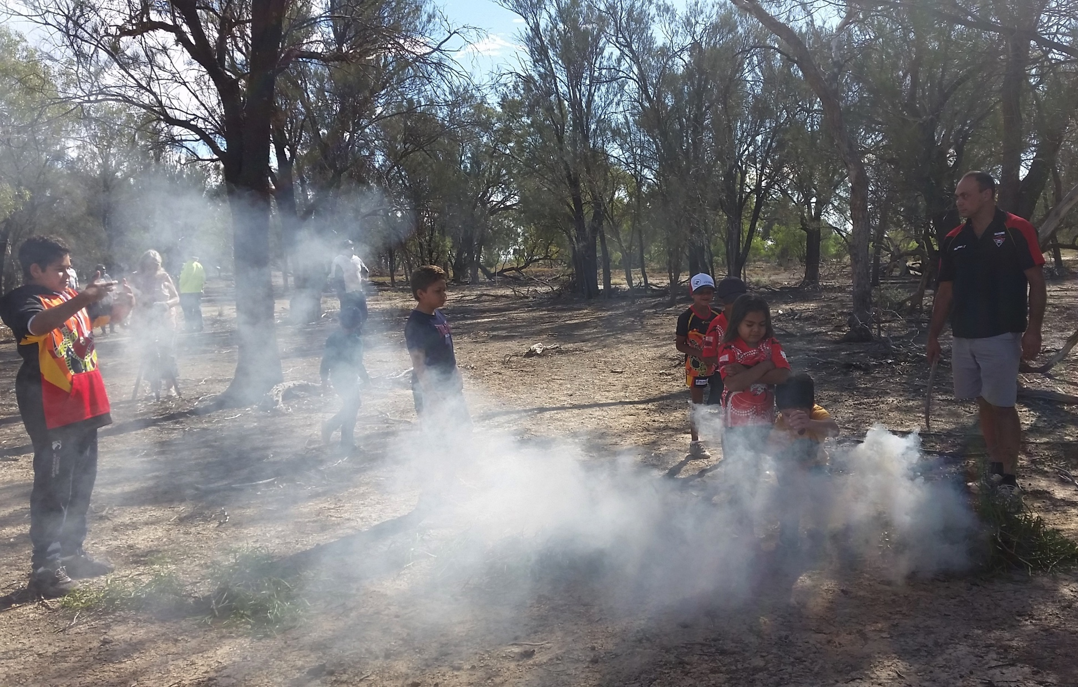
Gooraman Swamp
Field trip 1 Design fieldwork
Field trip 2 Identify aspirations for cultural flows
Field trip 3 Modelling, indicators and monitoring
Field trip 4 Analyse findings

Slide 11
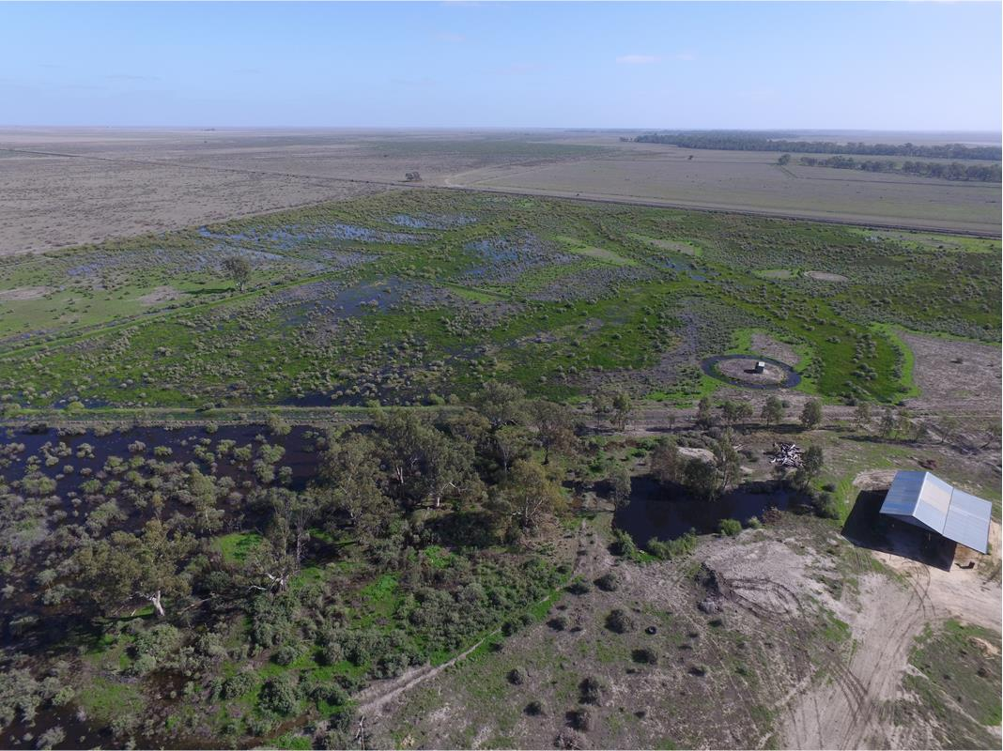
Toogimbie Wetlands
Field trip 1 Design fieldwork
Field trip 2 Identify aspirations for cultural flows
Field trip 3 Pre-flow monitoring
Field trip 4 Post-flow monitoring
Field trip 5 Analyse findings

Slide 12
Project progress
Field research complete at the two case study sites
Currently analysing legal, policy and governance opportunities to achieve cultural flows
MLDRIN, NBAN and NAILSMA looking at ways to effectively communicate results
Ongoing discussions with state and federal government agencies
Project due to be completed in December 2017

Slide 13
Key lessons from the project
Aboriginal ownership of the project
Keeping nations informed and engaged
Importance of co-designing the field research with nation partners
Community benefits from research partnership – confidence, capacity and cultural regeneration
Involving government in project governance

Slide 14
www.culturalflows.com.au
BRISBANE, AUSTRALIA | 18 - 20 SEPTEMBER 2017
MANAGED BY

