Slide 1
Drought Security Assessments
Modelled analysis of NSW regulated rivers
based on recent drought operations
Michael Wrathall and Rowan Murray
BRISBANE, AUSTRALIA | 18 - 20 SEPTEMBER 2017
MANAGED BY

Slide 2
Purpose
To assess the frequency and duration of droughts in NSW regulated river systems
Better understand the drought resilience of NSW regulated rivers
Investigate the security of urban water needs
Assist in prioritising funding
Propose broad options for improving drought security
BRISBANE, AUSTRALIA | 18 - 20 SEPTEMBER 2017
MANAGED BY

Slide 3
Assessment tool
The standard modelling tool for surface water systems in NSW is the Integrated Quantity-Quality Models (IQQM)
Simulates major hydrological processes and management rules in river valleys at a daily time-step
Reproduces average long-term behaviour for planning purposes
Calibrated to match reservoir levels, diversions and flows over the calibration period
BRISBANE, AUSTRALIA | 18 - 20 SEPTEMBER 2017
MANAGED BY

Slide 4
Mismatches
Lived experience vs retrospective approach
Adaptive management vs fixed modelling environment
Extreme conditions vs long-term averages
BRISBANE, AUSTRALIA | 18 - 20 SEPTEMBER 2017
MANAGED BY

Slide 5
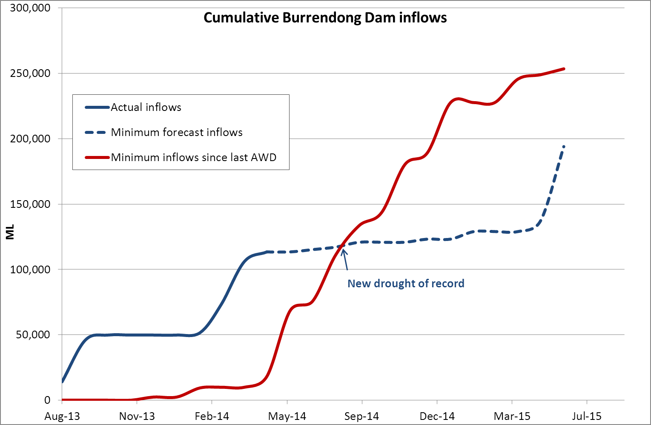
1. Lived experience vs retrospective approach
BRISBANE, AUSTRALIA | 18 - 20 SEPTEMBER 2017
MANAGED BY

Slide 6
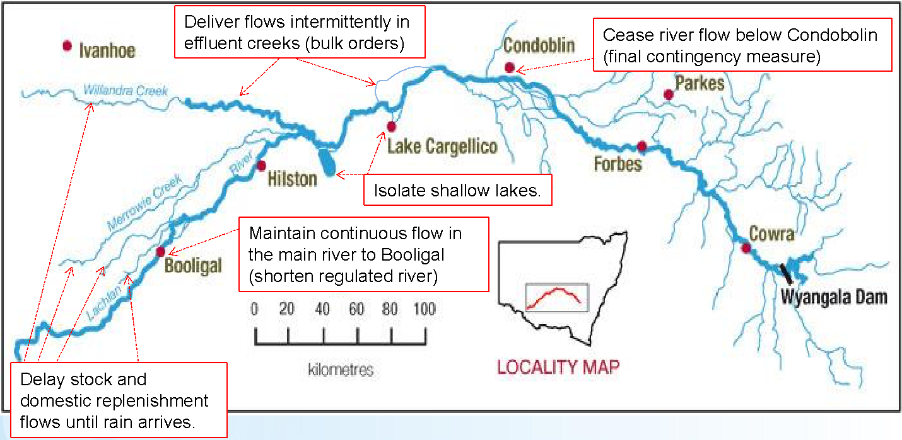
2. Adaptive management vs fixed modelling environment
BRISBANE, AUSTRALIA | 18 - 20 SEPTEMBER 2017
MANAGED BY

Slide 7
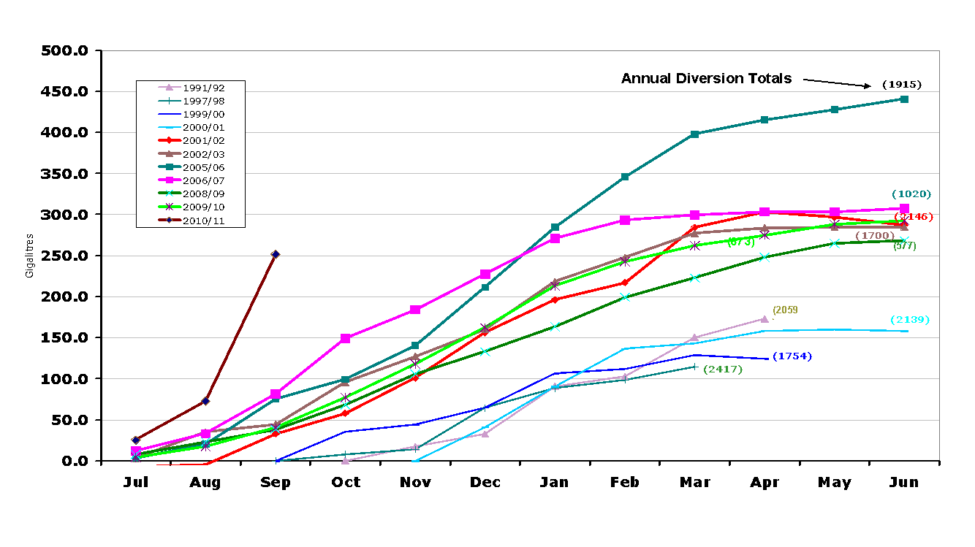
3. Extreme conditions vs long term averages
Delivery losses 50% higher than previous largest
Transmission Losses (GL)
BRISBANE, AUSTRALIA | 18 - 20 SEPTEMBER 2017
MANAGED BY

Slide 8
Definition of drought
Those periods of time where the regulated river requires contingency approaches to conserve water, rather than ‘normal’ water sharing and river operations.
This could include some or all of the below:
allocations of less than 100 per cent of entitlement to higher priority licence categories
periodic ‘block release’ strategies
temporary suspension of certain water sharing plan rules
BRISBANE, AUSTRALIA | 18 - 20 SEPTEMBER 2017
MANAGED BY

Slide 9
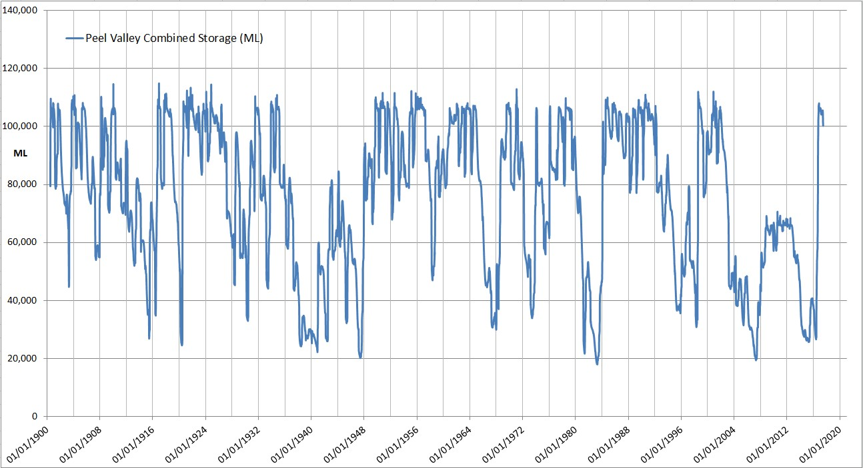
Methodology (1)
Total 116 years of record
BRISBANE, AUSTRALIA | 18 - 20 SEPTEMBER 2017
MANAGED BY

Slide 10
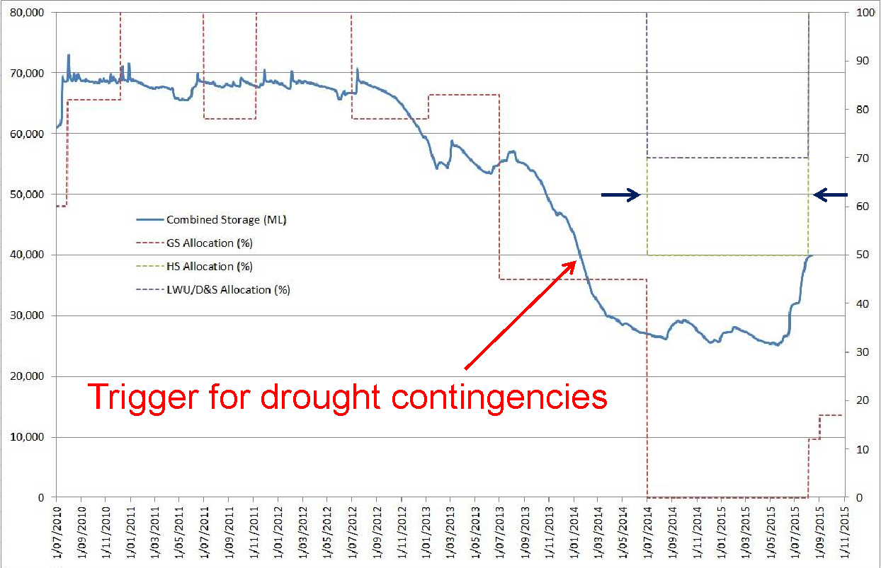
Methodology (2)
BRISBANE, AUSTRALIA | 18 - 20 SEPTEMBER 2017
MANAGED BY

Slide 11
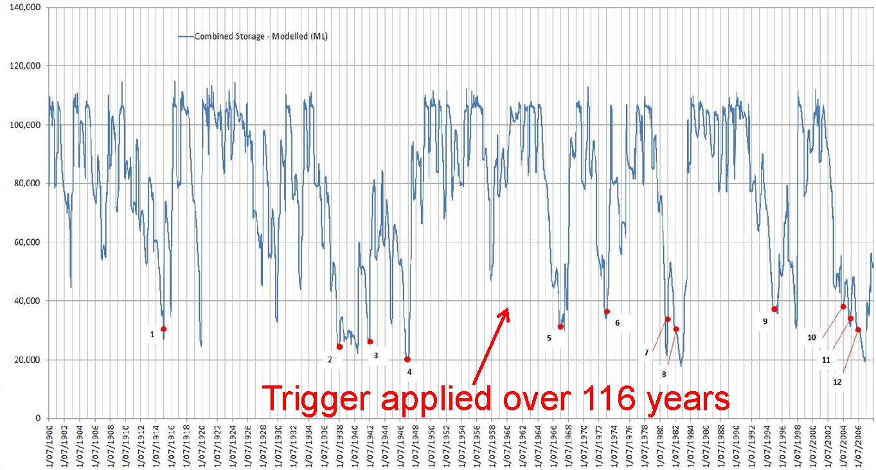
Methodology (3)
BRISBANE, AUSTRALIA | 18 - 20 SEPTEMBER 2017
MANAGED BY

Slide 12
Regulated rivers assessed to date
River system | Significant towns
Gwydir | Inverell
Namoi | Walgett
Peel | Tamworth
Macquarie-Cudgegong | Nyngan, Cobar, Dubbo
Lachlan | Parkes
Murrumbidgee | Balranald, Hay, Gundagai, Narrandera, Jerilderie
Hunter | Scone, Aberdeen, Muswellbrook, Singleton
BRISBANE, AUSTRALIA | 18 - 20 SEPTEMBER 2017
MANAGED BY

Slide 13
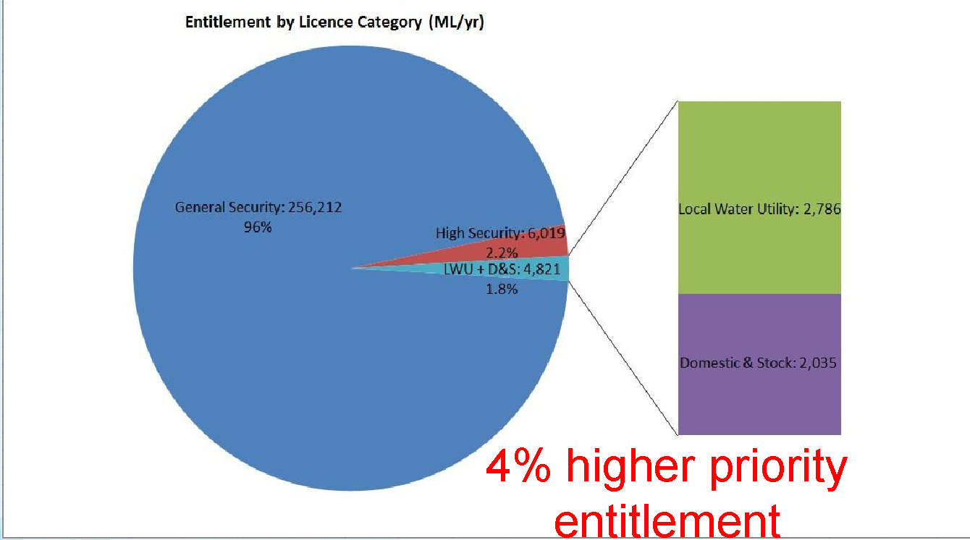
Namoi regulated river
BRISBANE, AUSTRALIA | 18 - 20 SEPTEMBER 2017
MANAGED BY

Slide 14
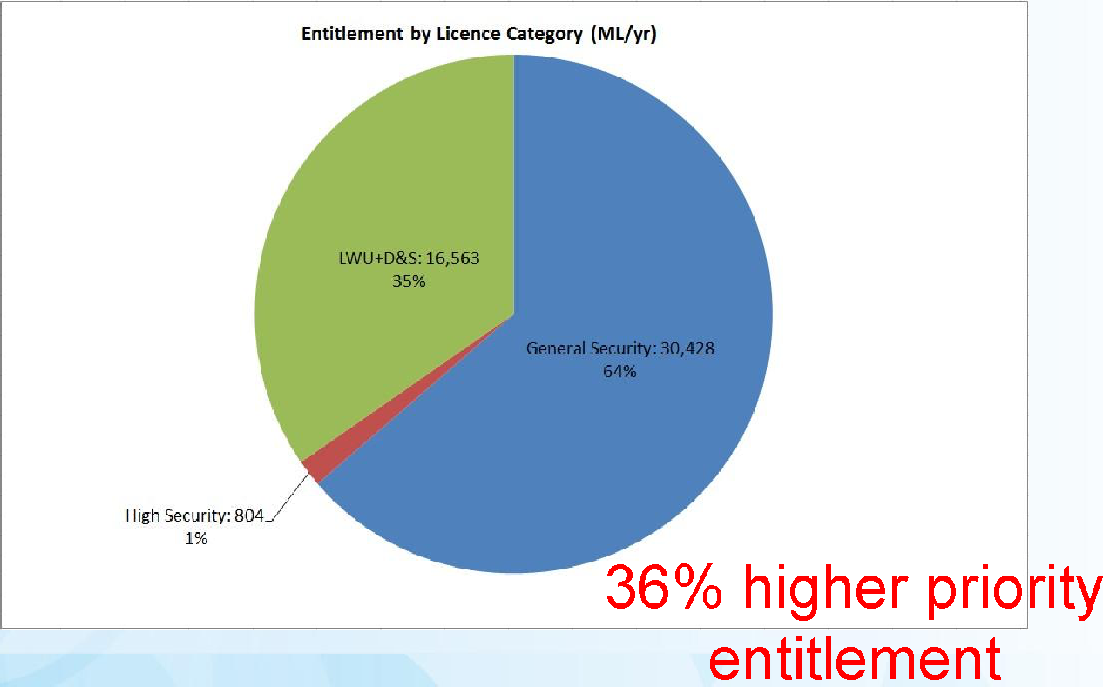
Peel regulated river
BRISBANE, AUSTRALIA | 18 - 20 SEPTEMBER 2017
MANAGED BY

Slide 15
Critical drought period
River system | Critical drought | Duration (months)
Gwydir | 1936 – 1941 | 57
Namoi | 2014 – 2016 | 25
Peel | 1938 – 1941 | 31
Macquarie-Cudgegong | 1980 – 1981 | 13
Lachlan | 2003 – 2005 | 27
Murrumbidgee | 2007 – 2010 | 38
Hunter | 1937 – 1949 | 140
BRISBANE, AUSTRALIA | 18 - 20 SEPTEMBER 2017
MANAGED BY

Slide 16
Summary of droughts over period of record
River system | Total months of drought | Long duration droughts (>6 mths)
Gwydir | 280 | 10
Namoi | 97 | 6
Peel | 112 | 4
Macquarie-Cudgegong | 57 | 3
Lachlan | 101 | 4
Murrumbidgee | 40 | 1
Hunter | 206 | 5
Common but resilient
Frequent, not multi-yr
Recent droughts
Infrequent drought history
Longer duration recently
Millennium drought
One very long event
BRISBANE, AUSTRALIA | 18 - 20 SEPTEMBER 2017
MANAGED BY

Slide 17
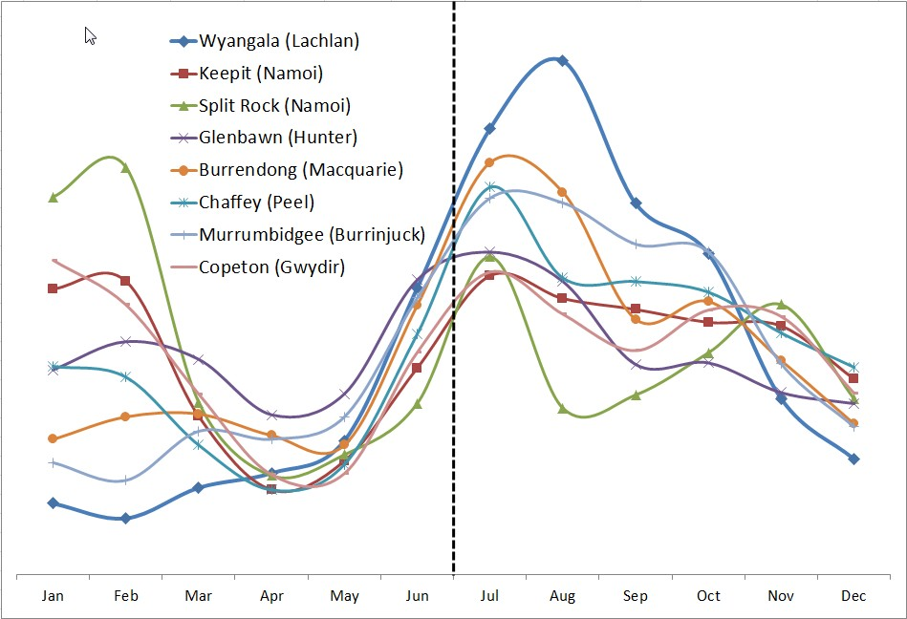
Modelled monthly average inflows (normalised)
Variability in summer
Large late-winter, spring inflows
Low autumn inflows
BRISBANE, AUSTRALIA | 18 - 20 SEPTEMBER 2017
MANAGED BY

Slide 18
Future work
Extend the analysis to the remaining NSW regulated rivers (12 in total) by the end of 2017
Work alongside the DPI Water modelling group to more explicitly represent drought operations in IQQM/Source
Climatic drought extension beyond the measured period
Inform more detailed analysis for individual valleys:
State Infrastructure Strategy
Surface water / groundwater interactions
BRISBANE, AUSTRALIA | 18 - 20 SEPTEMBER 2017
MANAGED BY

Slide 19
Questions?
Main contributors to this work:
Michael Wrathall
Manager Knowledge Coordination
Rowan Murray
Water Resource Analyst
BRISBANE, AUSTRALIA | 18 - 20 SEPTEMBER 2017
MANAGED BY

