Slide 1
Yinsheng Zhang，Jie Ding，F Suhaib
Institute of Tibetan Plateau Research
Chinese Academy of Sciences
Impacts of snow/glacier variability over the hydrologic regimes in upper Indus River Basin（UIB)
BRISBANE, AUSTRALIA | 18 - 20 SEPTEMBER 2017
MANAGED BY

Slide 2
Introduction
Observation network
Monitoring of Snow Cover in UIB
Monitoring of Glaciers in UIB
Snow and Glacier melt to UIB Stream-flow
Conclusions

Slide 3
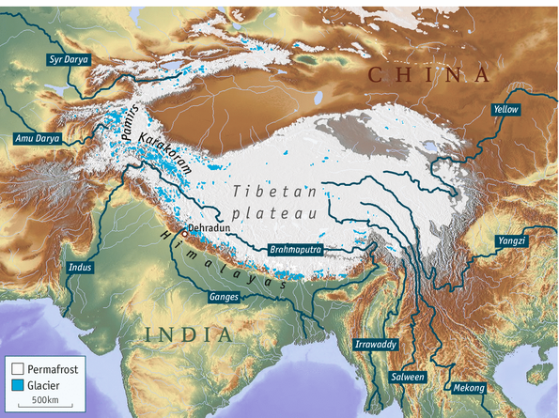
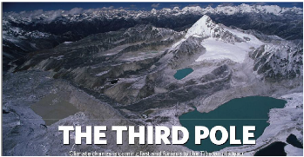
i. Introduction
Third Pole (TP) – Water Tower of the Region
Significant concentration of Cryosphere – Third Pole
Origination of Larger Rivers – Water Tower
Pakistan – Origin of River Indus

Slide 4
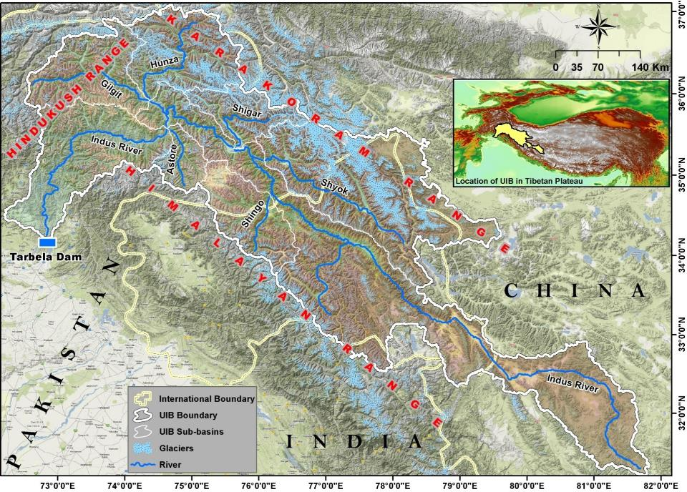
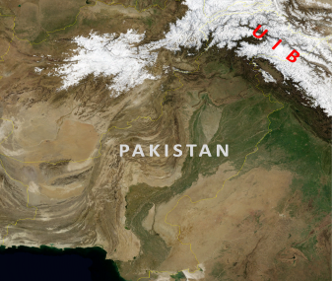
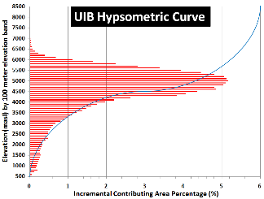
Huge amount of Glaciers in Upper Indus Basin (UIB)
Confluence of HKH
Area (~166,000 km²)
12% glaciers area
Notes:
Located in the Western Part of TPE
Lie in Pakistan, China and India
Situated at the confluence of Himalaya, Karakoram and Hindukush Ranges
Catchment Area (~166,000 km²)
More than 12% area is covered by glaciers
During Winter more than half of the basin area is covered by seasonal Snow
Most of the Annual precipitation falls in winter and Spring mainly due to Westerly circulations
Low contribution of Monsoon circulations in the Annual precipitation
UIB is characterized by a range of stratified climatic zones, from high-altitude catchments covered by glaciers controlling runoff via seasonal temperature input, to mid-altitude catchments with summer flow dominated by preceding winter precipitation, to foothill areas predominantly controlled by rainfall both in winter and in the monsoon season.
Most of the flows are dependent on snow and glacier melt water
Most of the annual volume of the UIB catchments flows during Summer.
Most of the annual volume of glacierized sub-basins are generated during late summer, conversely most of Snow fed basins flows are generated during early summer.

Slide 5
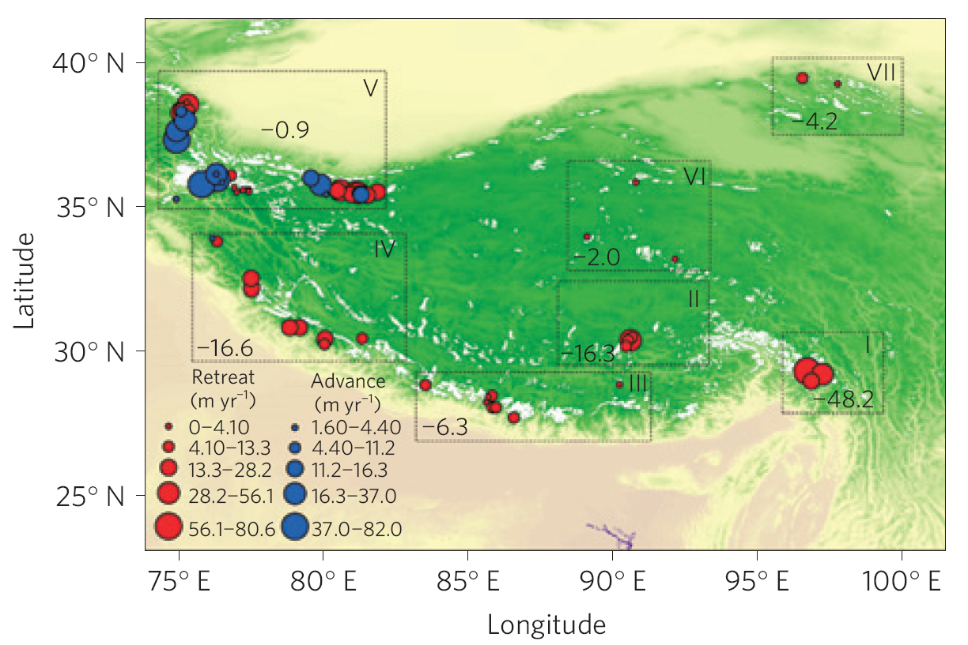
The glaciers in UIB are stable, differ to the others
（Yao et al，Nature clim，2012）

Slide 6
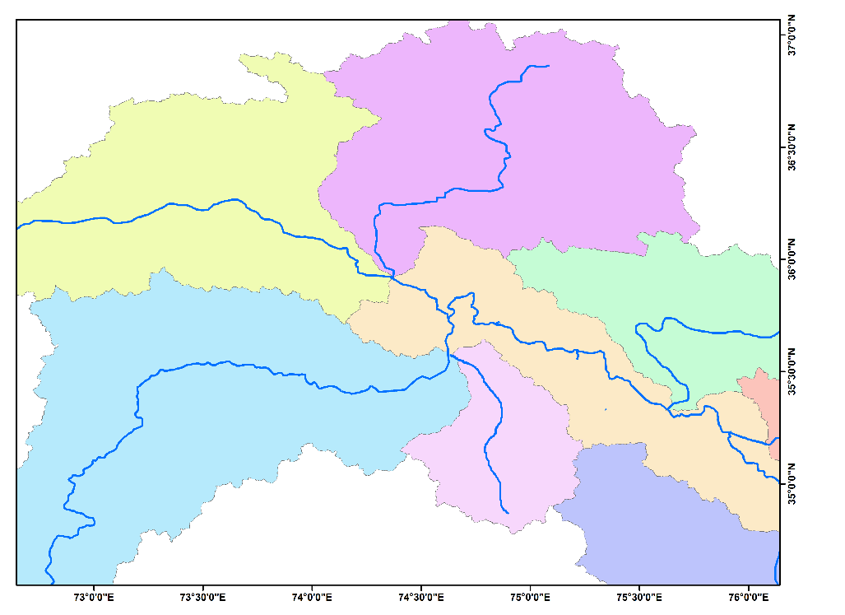
UIB Precipitation (mm)
Khunjerab (4730)
Ziarat (3669)
Yasin (3353)
Zani Pass (3000)
Naltar (2810)
Gupis (2156)
Hunza (2156)
Ushkor (3353)
Gilgit (1459)
Shendur
(3719)
Bunji (1470)
Shigar (2300)
Chillas (1251)
Rama (3140)
Astore (2168)
Skardu
(2181)
Hushey
(2995)
Rattu (2920)
Deosai (4356)
Shangla
(2134)
Burzil (4030)
Most of the UIB Precipitation falls in winter and spring seasons mainly due to westerly circulations, whereas summer precipitation constitutes limited proportion

Slide 7
Mean Monthly UIB sub-basins Discharge (maf)
Seasonal discharge of the UIB catchments suggested that more than 90% of the annual volume of the UIB catchments flows during April-October
Notes:
More than 70% of the annual volume of the glacierized sub-basins (e.g. Hunza) are generated from Jul-Oct, conversely more than 60% of Snow-fed sub-basins (e.g. Astore) flows are generated from Apr-Jul.

Slide 8
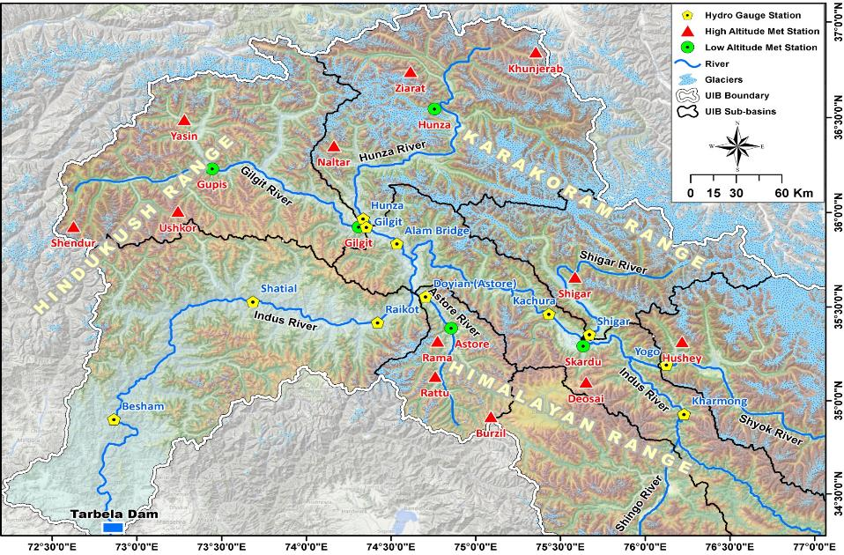
ii. Observation network
Meteorological & Hydrological Stations in UIB

Slide 9
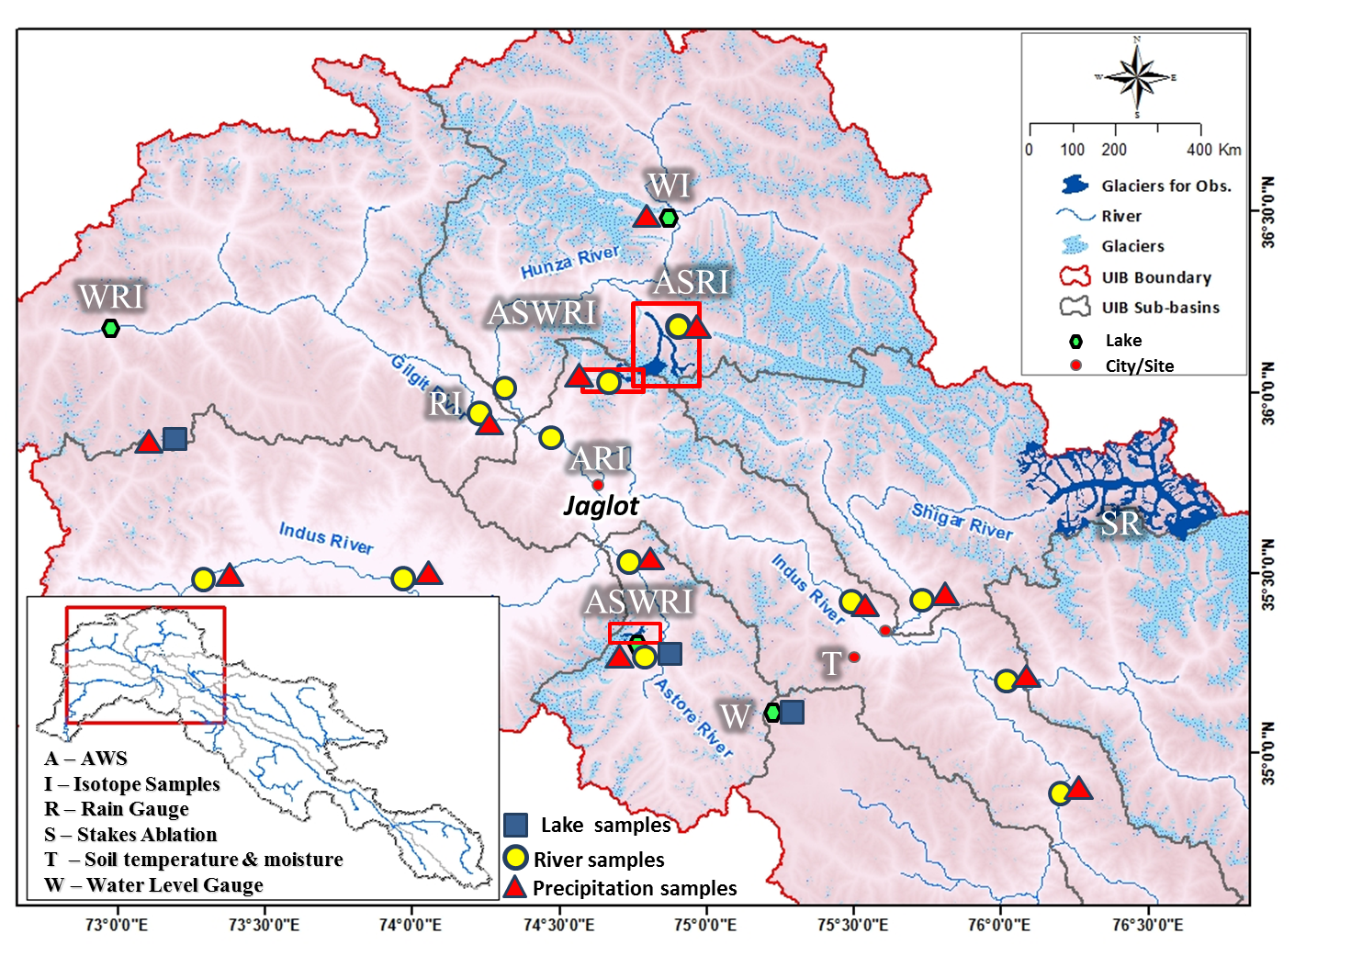
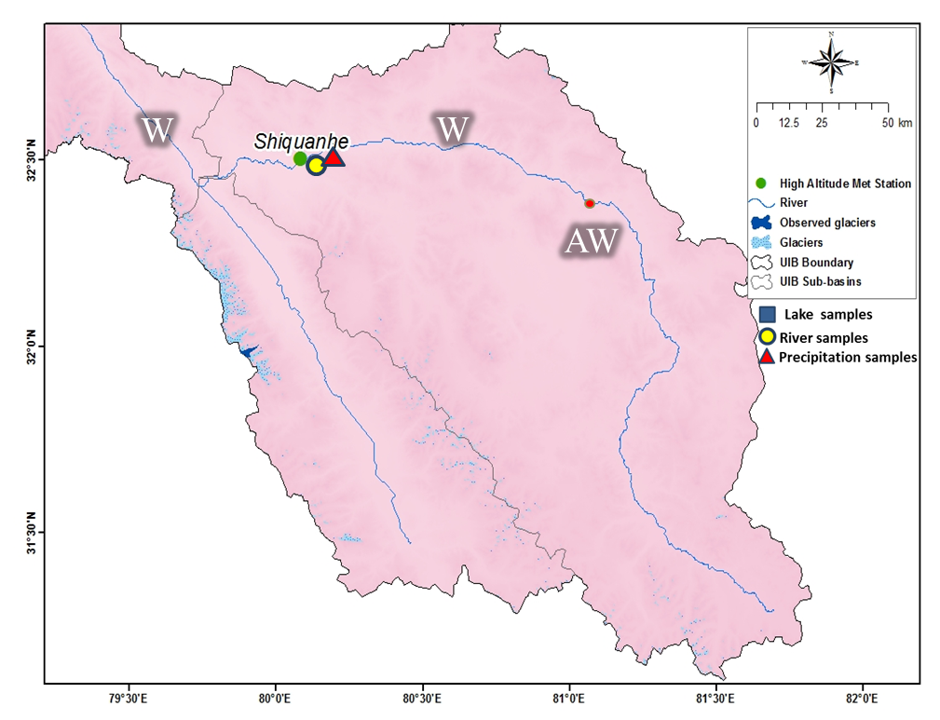
1. Establish of observation network
Pakistan Part
Glacier Mass Balance | Barpu, Gharko, Sachen
Water Stable Isotope | Precipitation-5, River -4, Lake-5, Glacier melt stream-3
Hydrological observation | Discharge sites-4, AWS-4 Rain Gauge-9
Water Stable Isotope | Precipitation-1 River -1
Hydrological observation | Discharge sites-1 AWS-1 Rain Gauge-1
China Part-Shiquan River

Slide 10
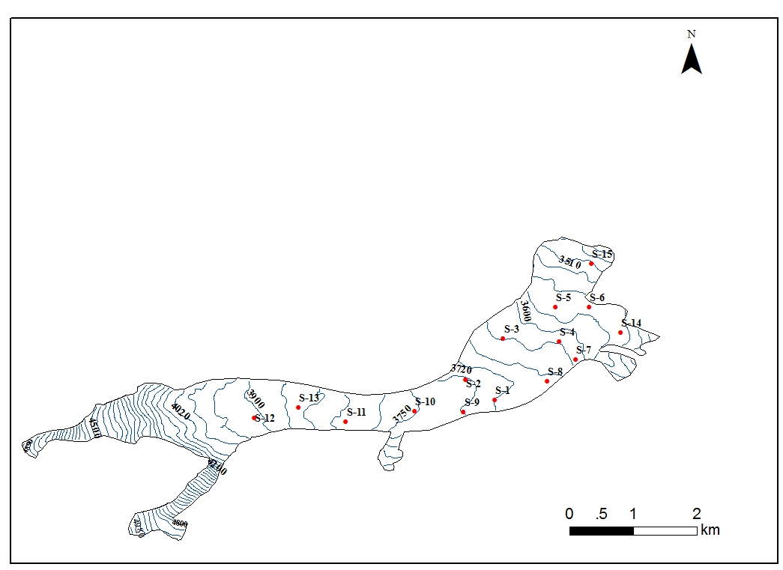
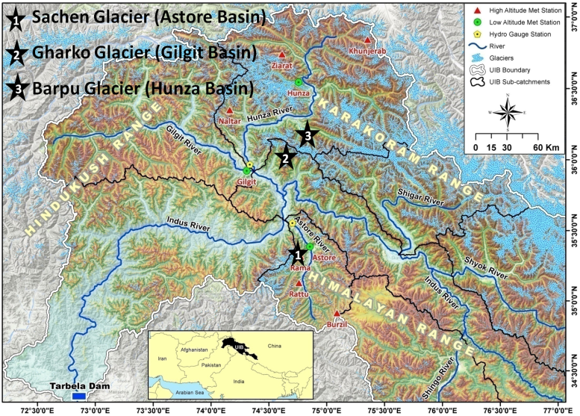
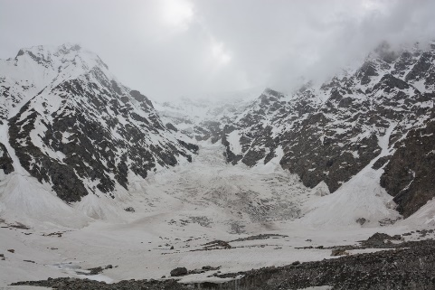
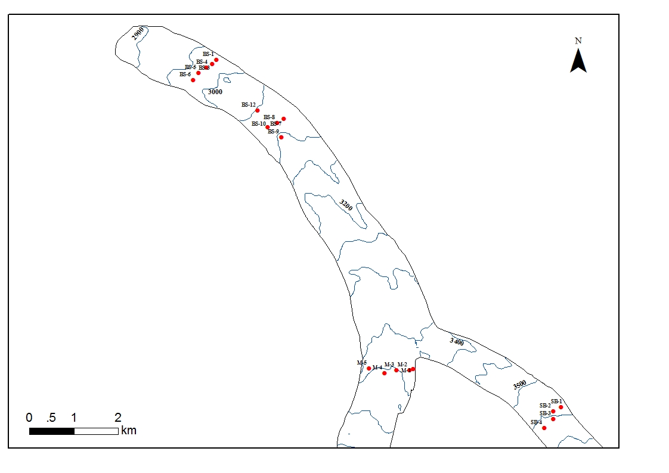
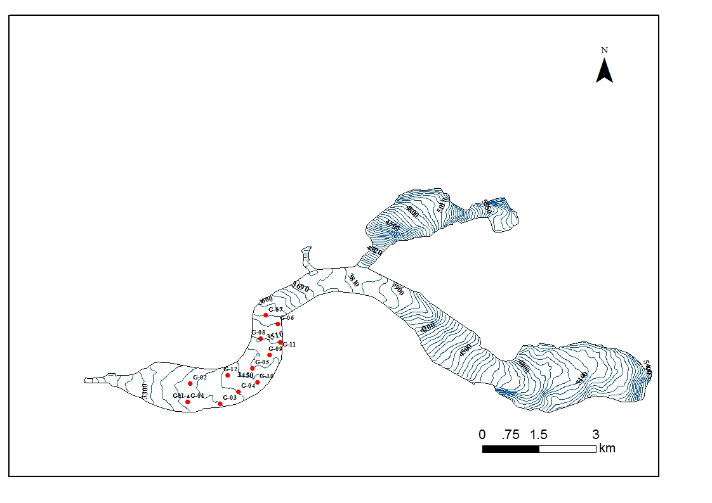
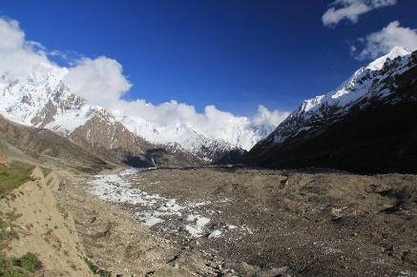
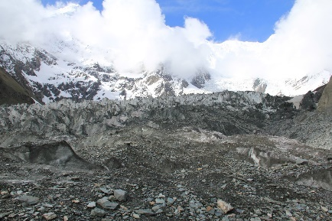
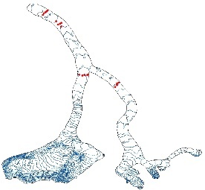
2. Glacier Mass Balance Observation
Location of observed glaciers
Sachen Glacier (Astore)
(4709m)
(3538m)
(3448m)
(4170m)
Discharge measurement
AWS
Rain gauge
Ablation Stakes
Snow pit
Lake level gauge
(2784m)
Barpu Glacier (Hunza)
(3827m)
(2928m)
(4610m)
(3455m)
(3568m)
Gharko Glacier (Gilgit)

Slide 11
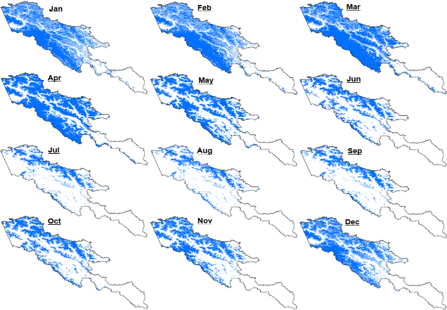
iii. Monitoring of Snow Cover in UIB
UIB Mean Monthly Snow Cover (2003-2010)
Snowfall started at the month of September
Maximum snow-cover reaches in Mar-Apr month
Seasonal snow cover reaches 50-60% of the basin area
Snow-melt period starts in late March or early April
Most of the snow melted away be the end of August

Slide 12
Monthly Snow Cover in UIB during 2003-2010
No significant snow cover trends were observed in UIB sub catchments during 2003-2010
2003
2004
2005
2006
2007
2008
2009
2010

Slide 13
iv. Monitoring of Glaciers in UIB

Slide 14
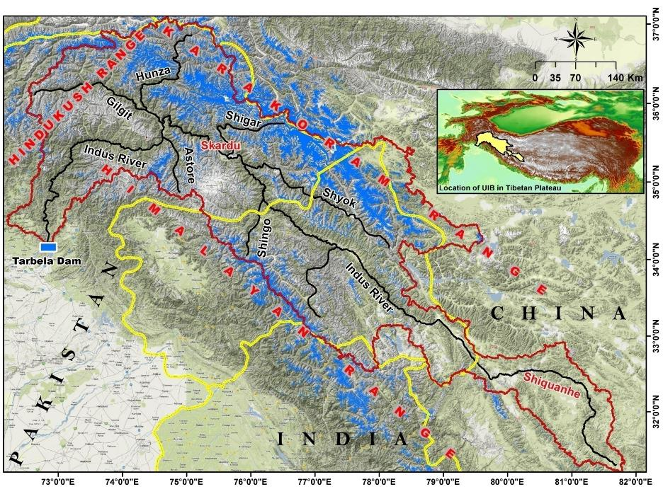
Glacier cover in UIB
Jammu
&
Kashmir
Glacier Area 12%
No. of Glaciers 18,495
Covered Area 21,192 Km²
Ice Reserves 2,696 Km³

Slide 15
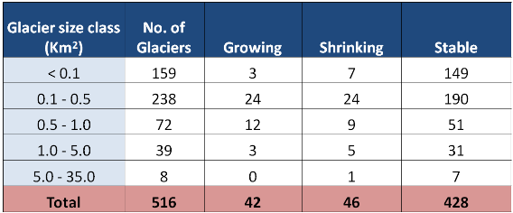
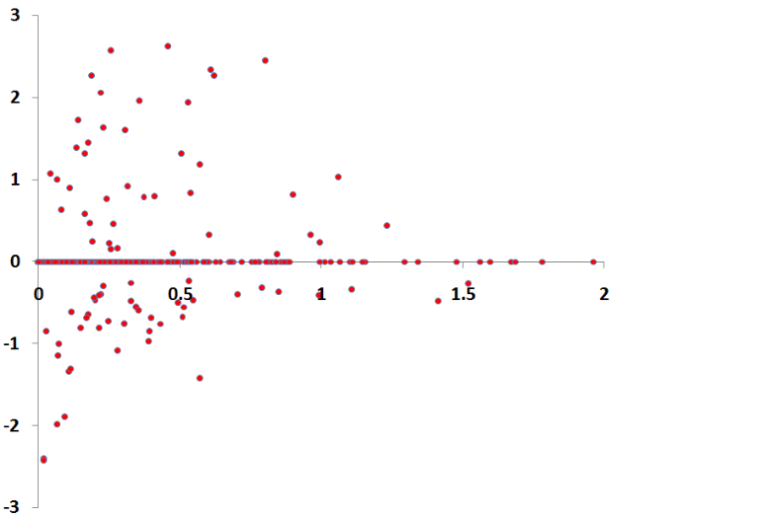
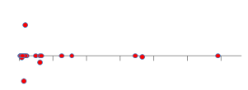
Astore Basin Glacier changes during 1973-2013
Glacier Area Change (% / year)
2
15
25
35
Rescaled Graph
Glacier Size (Km²)
Only Small Glacier in Astore basin represented both growing and shrinking during 1973-2013

Slide 16
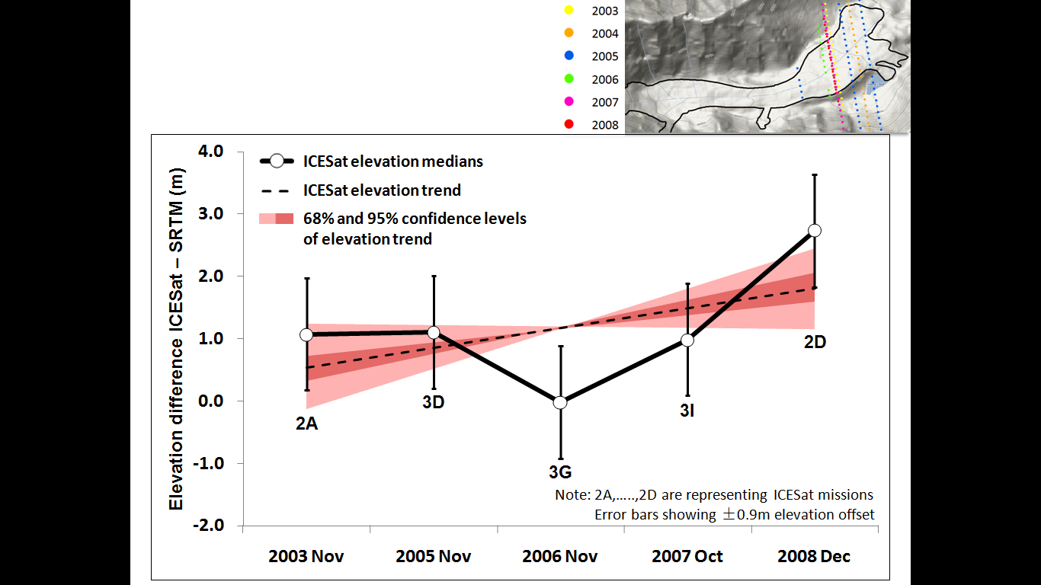
Sachen Glacier (Astore) Thickness Changes by GLAS-ICESat (2003-2008)
During 2003-2007, Sachen glacier does not shown much variation in thickness. However in 2008 it shows slight increase in thickness.

Slide 17
v. Snow and Glacier Melt contribution to Stream-flow

Slide 18
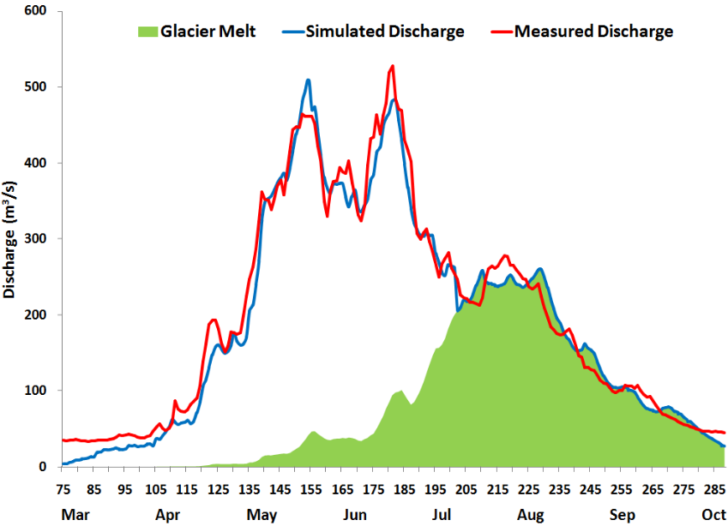
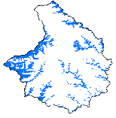
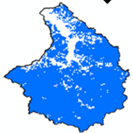
Snow and Glacier melt contribution to Astore Annual Stream-flow
Snow and Glacier melt Contributes ~76%
Whole Basin Glacier melt Simulated
Discharge
Whole Basin
Simulated Discharge
Whole Basin
Measured Discharge
Astore
Glaciers
Astore
Snowcover
Snow Melt
(41%)
Glacier Melt
(35%)
Base Flow + Rain (24%)

Slide 19
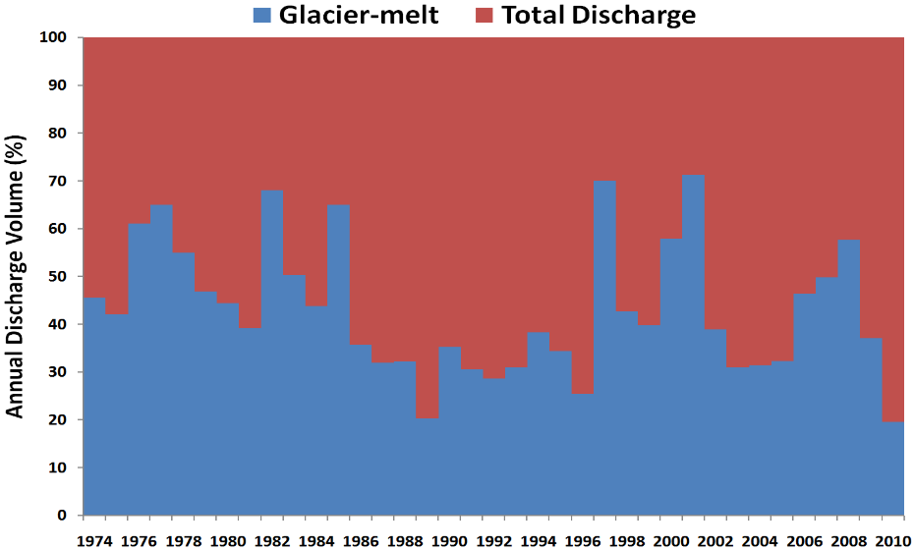
Contribution of Glacier melt to Annual stream-flow during 1974-2010
Mean Annual
Summer Temperature

Slide 20
Relationship between Temperature, Precipitation and Runoff fluctuations
Correlation results clearly evidences that the runoff fluctuations of Astore River was mainly influenced by the variations in precipitation but not by the changes in temperature during 1980-2010

Slide 21
Conclusions
Predominant Westerly circulations brings significant snowfall in winter and spring seasons, therefore snow cover reaches 85% of the basin area, which plays an important role in the basin hydrology. No significant trends in the snow cover area was observed.
More than 10% of basin’s glacier area is covered by heavy Debris, which considerably influence the dynamics of glacier’s interaction with atmosphere, and consequently significant lower melting rates of debris covered ice as compare to clean ice, were observed.
Satellite data reveals stability of Astore basin glaciers, which is in contrast of the surrounding regions, mainly due to decrease in summer temperatures. Overall 83% of the Glaciers found stable, 8% depicts slight expansion, whereas only 9% shows slight retreat.
Snow- and glacier-melt produced water plays a most significant role in the basin Runoff, which collectively constitutes ~76% of the Basin’s Annual Runoff volume.
Runoff fluctuation of Astore River was found mainly influenced by the variations in precipitation but not by the changes in basin temperatures.

Slide 22
Thanks for your attention!

