Slide 1



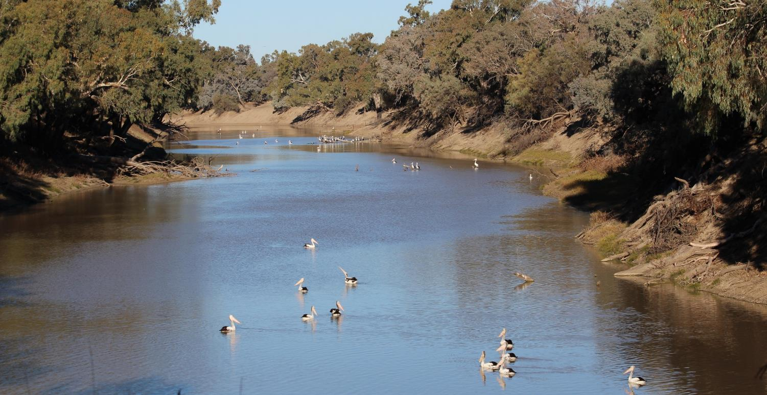

Foodweb responses to hydrologic regimes in floodplain rivers
Darren Ryder, Ben Gawne, Rob Rolls, Darren Baldwin, Nick Bond, Rebecca Lester, Barbara Robson, Ross Thompson
BRISBANE, AUSTRALIA | 18 - 20 SEPTEMBER 2017
MANAGED BY

Slide 2
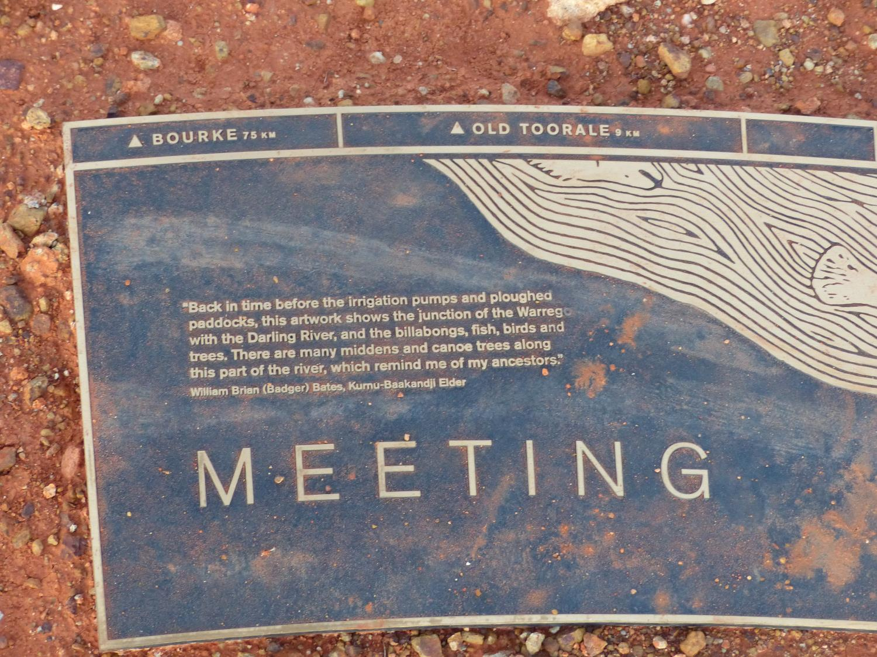

Slide 3
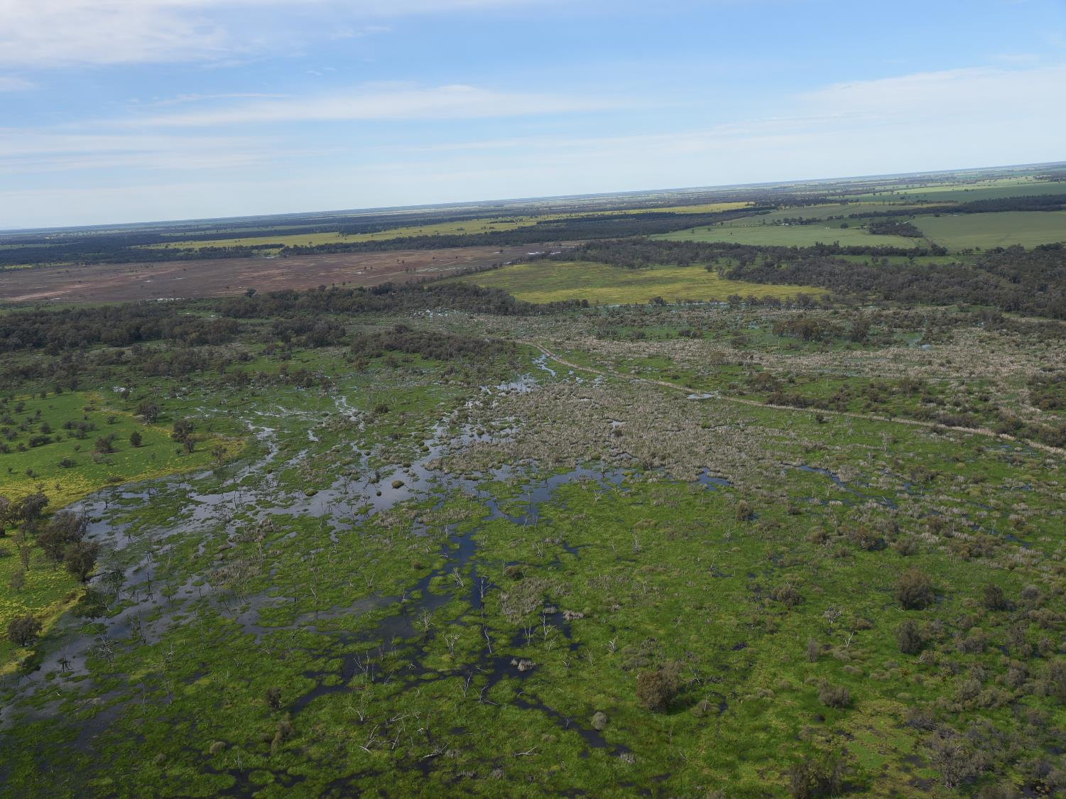
Disturbance for community composition and dynamics
Provide cues for major life-history events
Influence foodwebs and energetics

Slide 4
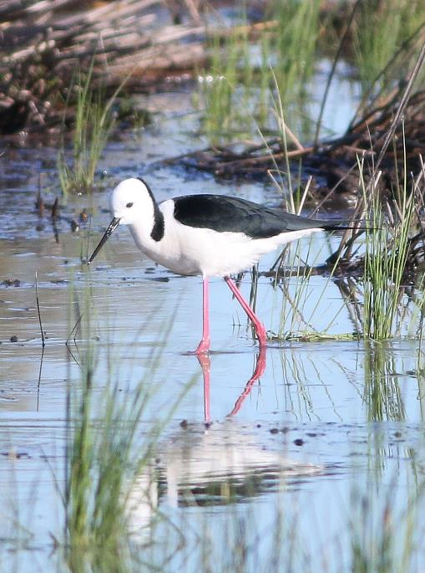
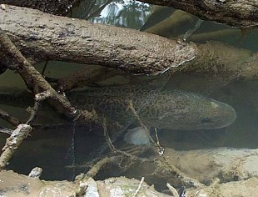
Murray-Darling Basin Environmental Water Knowledge and Research (EWKR) Project
Research to support environmental watering: a collaborative approach in the MDB
Funded through the Australian Governments Commonwealth Environmental Water Office
Four themes:
  Vegetation
  Fish
  Water birds
  Food webs
BRISBANE, AUSTRALIA | 18 - 20 SEPTEMBER 2017
MANAGED BY

Slide 5
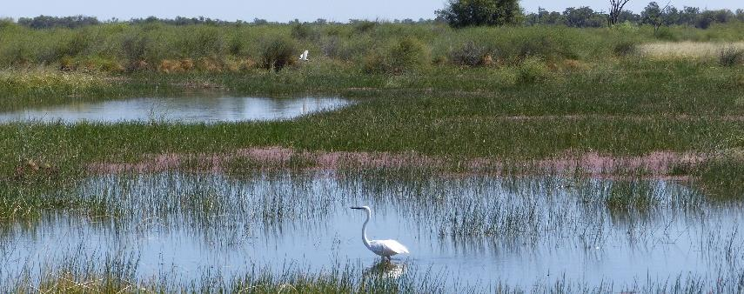
  How does hydrology drive trophic dynamics?
  How can we analyse trophic dynamics?
  Can we incorporate foodweb attributes into routine monitoring?
BRISBANE, AUSTRALIA | 18 - 20 SEPTEMBER 2017
MANAGED BY

Slide 6
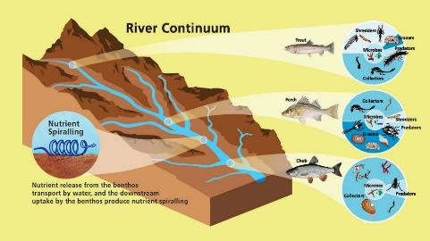
How does hydrology drive trophic dynamics?
Models:
  River continuum concept, Flow pulse concept, Serial discontinuity concept, Riverine productivity model, River wave concept, Riverine ecosystem synthesis, Reciprocal provisioning model, Hydraulic food chain models
BRISBANE, AUSTRALIA | 18 - 20 SEPTEMBER 2017
MANAGED BY

Slide 7
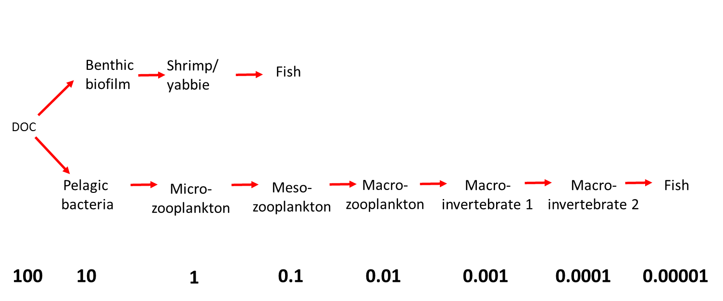
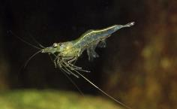
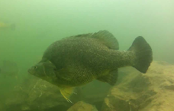
  How does hydrology drive trophic dynamics?
A conceptual shift to consider Ecosystem Energetics within a spatially and/or temporally dynamic Nutritional Landscape
BRISBANE, AUSTRALIA | 18 - 20 SEPTEMBER 2017
MANAGED BY

Slide 8
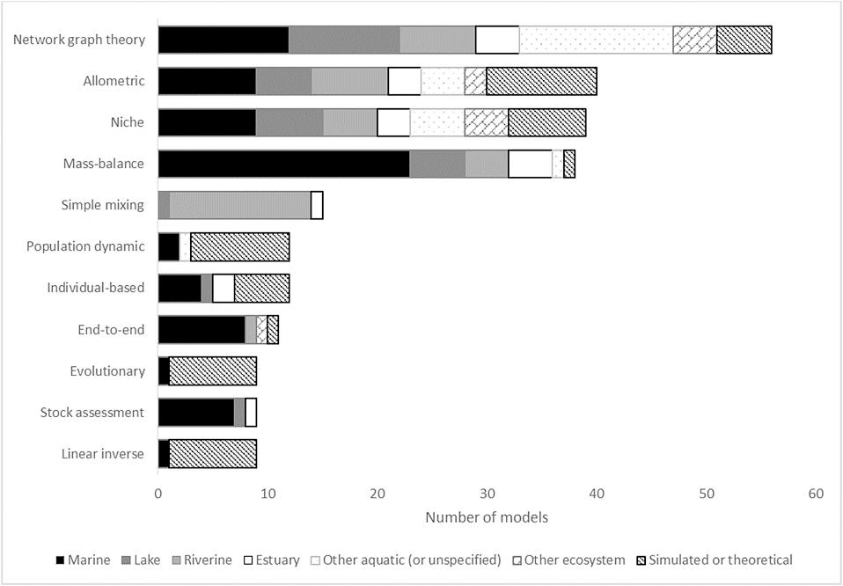
  2. How have we analysed trophic dynamics?
Robson et al. 2017. Modelling food-web mediated effects of hydrological variability and environmental flows. Water Research, 124.
BRISBANE, AUSTRALIA | 18 - 20 SEPTEMBER 2017
MANAGED BY

Slide 9
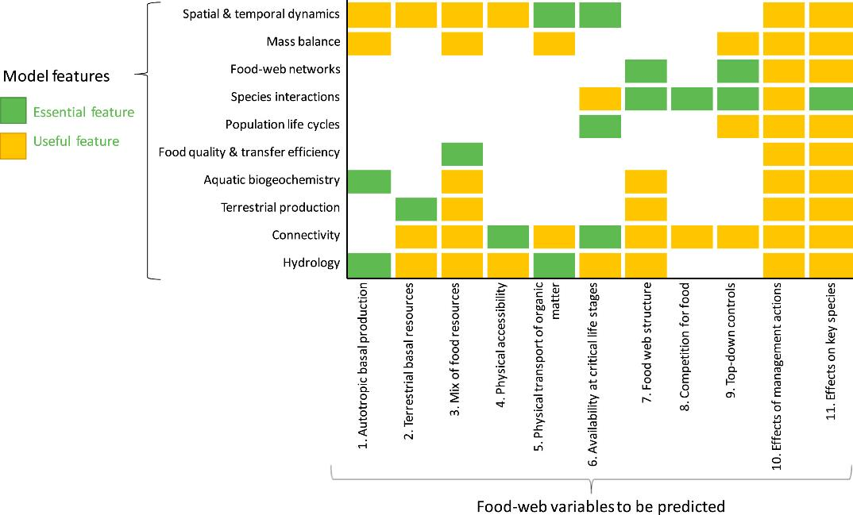
  2. How should we analyse and model trophic dynamics?
Robson et al. 2017. Modelling food-web mediated effects of hydrological variability and environmental flows. Water Research, 124.

Slide 10
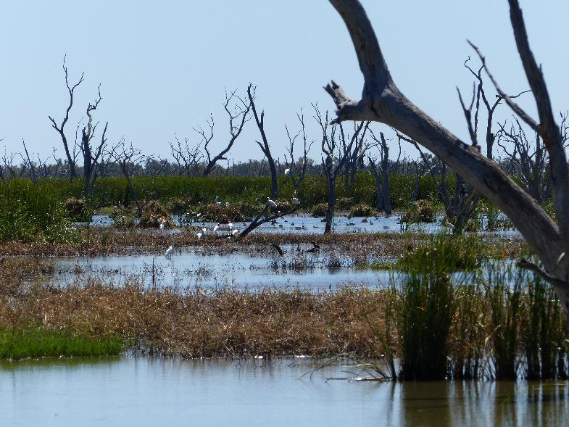
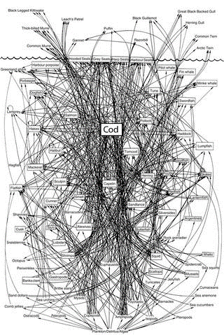
  3. Can we incorporate foodweb attributes into routine monitoring?
=
BRISBANE, AUSTRALIA | 18 - 20 SEPTEMBER 2017
MANAGED BY

Slide 11
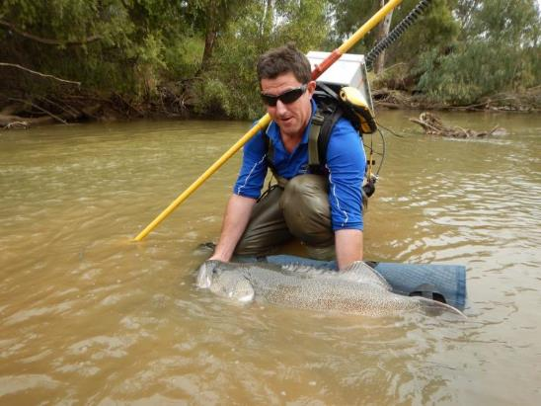
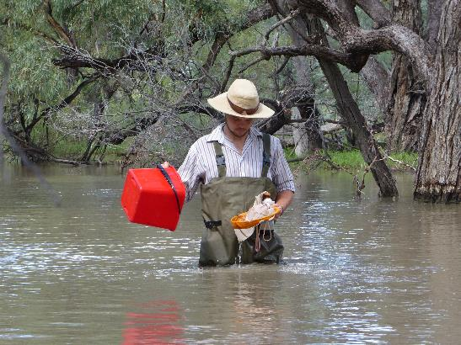
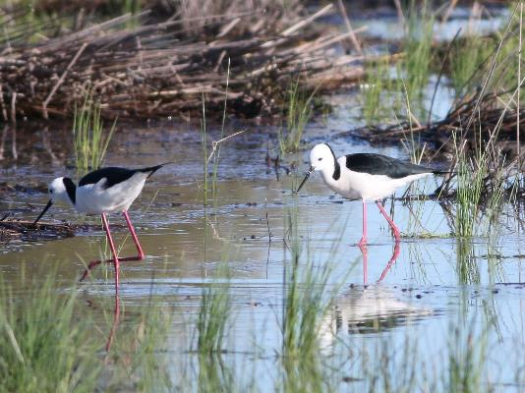
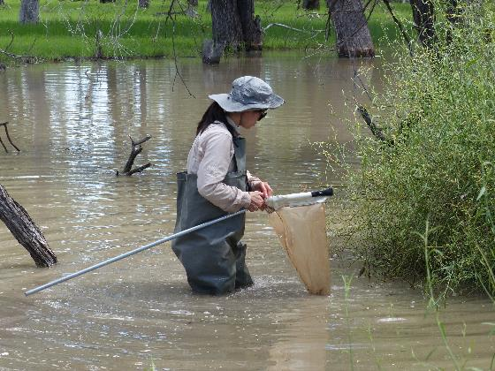
  Requires a framework for linking foodweb and population-level responses to flow
MANAGED BY
BRISBANE, AUSTRALIA | 18 - 20 SEPTEMBER 2017

Slide 12
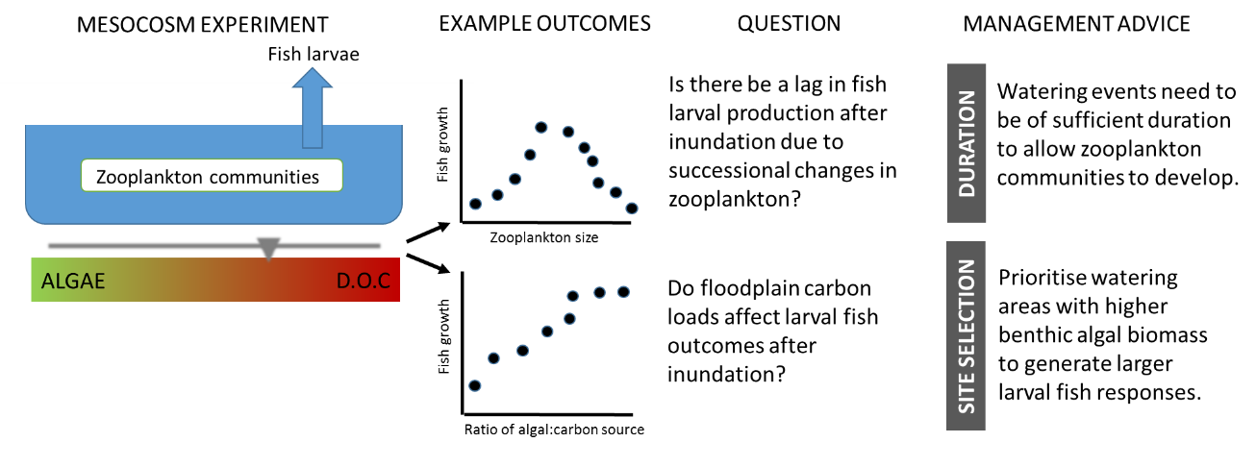
  How can flow be used to create times or places that can underpin successful fish and bird recruitment?
Rolls et al. 2017. A framework for evaluating food-web responses to hydrological manipulations in riverine systems. J. Env Management, 203.
BRISBANE, AUSTRALIA | 18 - 20 SEPTEMBER 2017
MANAGED BY

Slide 14
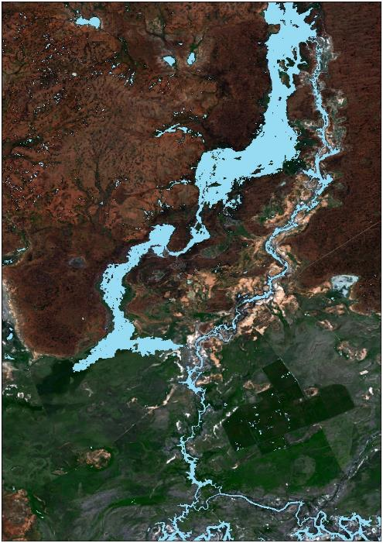
  Environmental Water and Knowledge Research – Foodweb Theme
  Improve understanding of hydrological drivers of trophic dynamics
  Capacity to analyse and model trophic dynamics
  Incorporate foodweb attributes into monitoring
Nutritional landscapes
BRISBANE, AUSTRALIA | 18 - 20 SEPTEMBER 2017
MANAGED BY

Slide 15
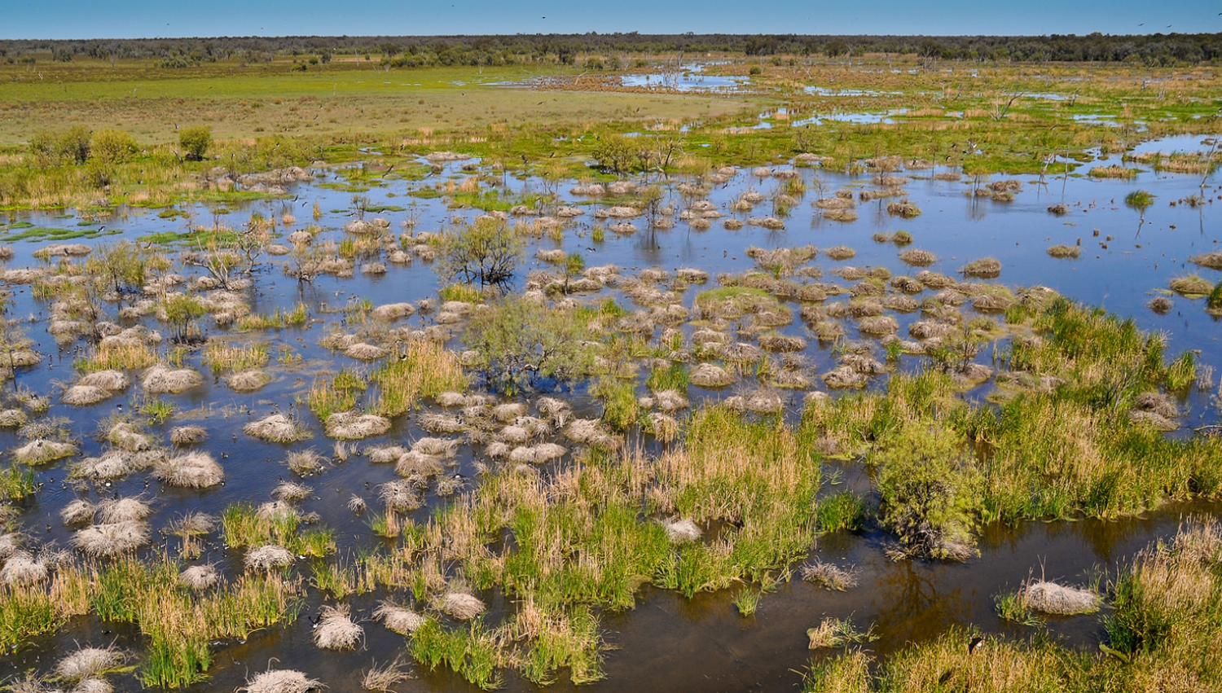





EWKR Foodweb Video: https://youtu.be/_OR5OTV0g9Y
MANAGED BY

