Slide 1
Place your
logo here
WERRIBEE RIVER
An integrated approach to rural, urban and environmental water priorities
BRISBANE, AUSTRALIA | 18 - 20 SEPTEMBER 2017
MANAGED BY
Notes:
Objectives
This is high level
Acknowledge draws on work by many others
My role is umbrella

Slide 2
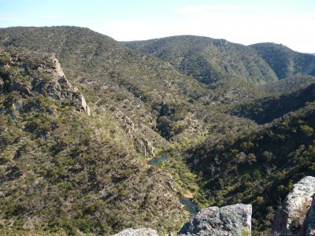
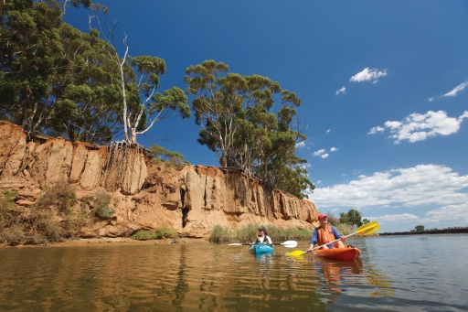
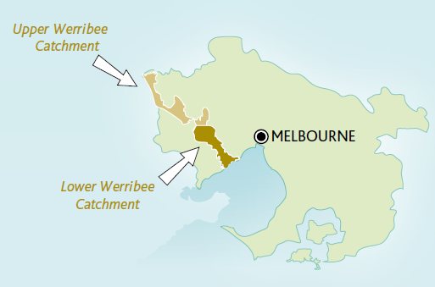
Place your
logo here
RIVER CONTEXT
Images: Melbourne Water, Parks Victoria
BRISBANE, AUSTRALIA | 18 - 20 SEPTEMBER 2017
MANAGED BY
Notes:
The Werribee River originates in the Wombat State Forest on the Great Dividing Range, and flows for about 110 kilometres (~68 miles) south-east via Ballan, Bacchus March and Werribee to the north-western shores of Port Phillip Bay.
Basalt plains dominate geology in the catchment, and the climate is regarded as temperate. Annual rainfall ranges from about 1000 millimetres at the headwaters to about 450 millimetres on the plains near Melton and Werribee. These plains form part of Victoria’s western volcanic plains grassland ecosystem (now highly fragmented), which lie in the rain shadow of the Otway Ranges and are the driest area south of the Great Divide in Victoria.
Two-thirds of the catchment has been cleared for agriculture, particularly dry land grazing. Significant areas (about 5%) have been urbanised (such as Werribee, Melton and Bacchus Marsh), with additional areas set aside for low-cost housing. Only
one-quarter of the catchment retains natural forest elements.
The lower Werribee River flows through market gardens in Werribee South, with considerable areas of the catchment also used for open space and recreation (such as golf courses) and housing. Land clearing and urbanisation have contributed to
widespread erosion, increased nutrient levels and salinity, and loss of habitat for aquatic life.
VEWH View
http://www.vewh.vic.gov.au/rivers-and-wetlands/central-region/werribee-river
http://www.vewh.vic.gov.au/rivers-and-wetlands/central-region

Slide 3
Place your
logo here
RIVER SYSTEM
Balancing priorities
Ecological health
Rural irrigation
Urban
Demand
Runoff
Wastewater
Amenity
Image: Victorian Environmental Water Holder
BRISBANE, AUSTRALIA | 18 - 20 SEPTEMBER 2017
MANAGED BY
Notes:
1. Regulated System
2. Components include
Werribee Gorge
Major Storages
Pykes Creek Reservoir
Merrimu Reservoir
Melton Reservoir
Bacchus Marsh Irrigation District
Werribee Irrigation District
Weirs and Diversion Weirs as shown
Port Phillip Bay
Priority environmental flow reaches = Reach 6 (downstream of Lake Merrimu), Reach 9 (within Werribee), Estuary

Slide 4
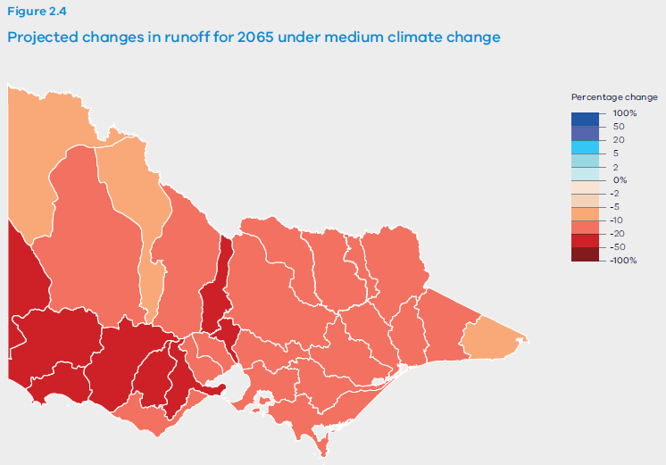
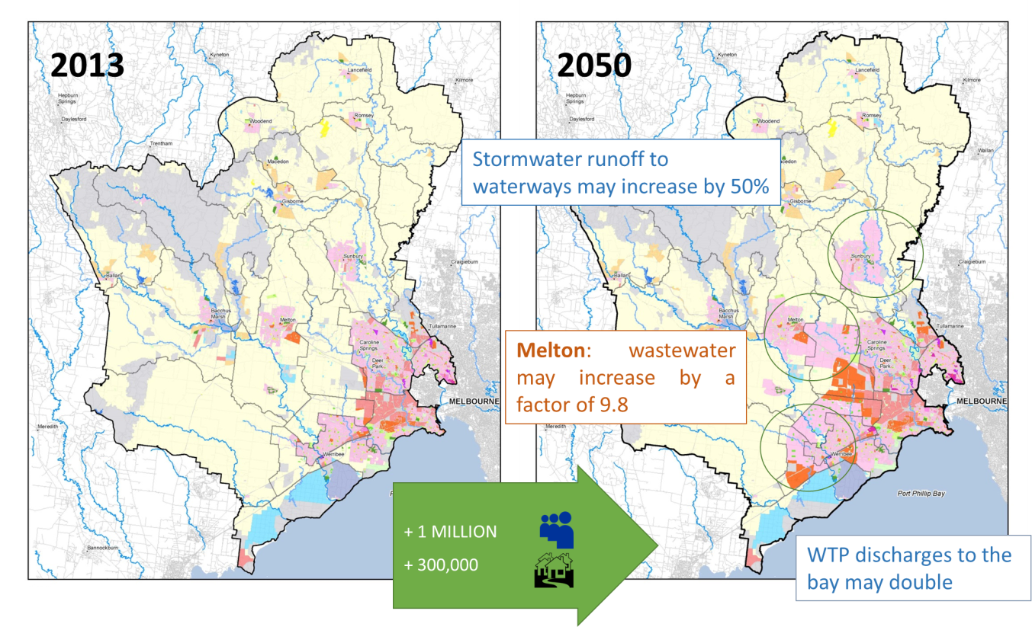
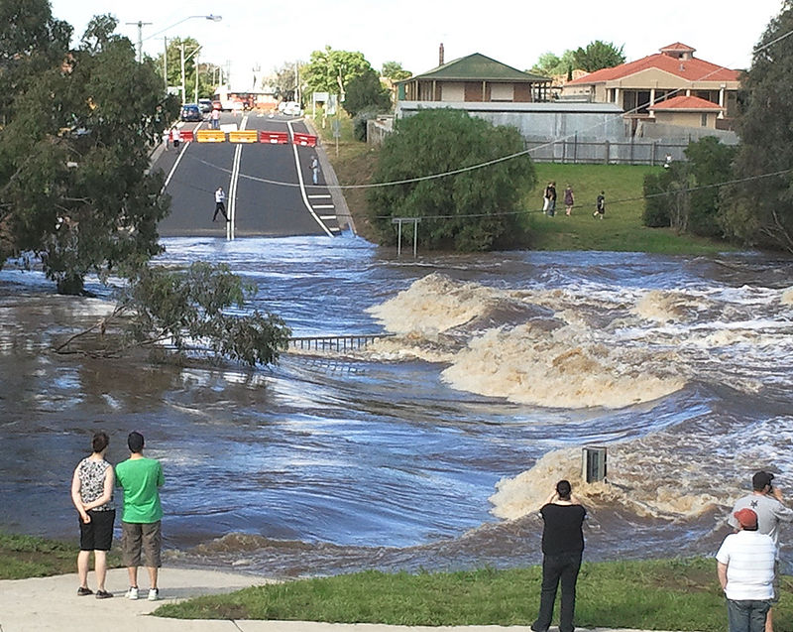
Place your
logo here
SYSTEM PRESSURES
Images: Water for VIctoria., Wikicommons
BRISBANE, AUSTRALIA | 18 - 20 SEPTEMBER 2017
MANAGED BY
Notes:
Climate Change
Drying Climate
Increase in extreme events
Growing Urban Development
Irrigation demand expressed increases in dry climate

Slide 5
Place your
logo here
RESPONSE
Recognizing the need to view issues with a system understanding
Applying an integrated lens
Collaborating across organisations
Examining opportunities before barriers
BRISBANE, AUSTRALIA | 18 - 20 SEPTEMBER 2017
MANAGED BY

Slide 6
Place your
logo here
APPROACH
Integrated Water Management
Werribee River Impacts Study
Werribee River Waterways Investigation
Stage 1
Stage 2
Ecological Risk Assessment
Flows assessment
Opportunities
Development
BRISBANE, AUSTRALIA | 18 - 20 SEPTEMBER 2017
MANAGED BY

Slide 7
Place your
logo here
OUTCOMES
There may be opportunities to improve river health through changing alternative water management approach
Preferred scenarios are clear, need to understand hydrological regime with other demands incorporated understanding variables
The risks need to be better understood
Achievement of fit-for-purpose water is critical to feasibility
BRISBANE, AUSTRALIA | 18 - 20 SEPTEMBER 2017
MANAGED BY

Slide 8
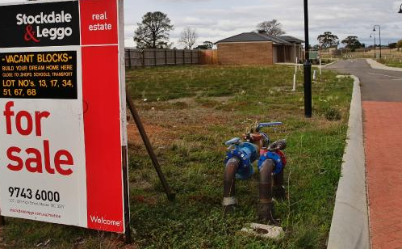
Place your
logo here
NEXT STEPS
Full discussion regarding progression with all parties – subject for IWM Forum
If risks are found to be acceptable, or mitigated - development of a stronger policy framework is required
There are still gaps in understanding of future health scenarios
There is pressure on servicing decisions being made by stakeholders. Financial analysis of technical solutions to produce fit-for-purpose conditions is required. Who pays?
BRISBANE, AUSTRALIA | 18 - 20 SEPTEMBER 2017
MANAGED BY

Slide 9
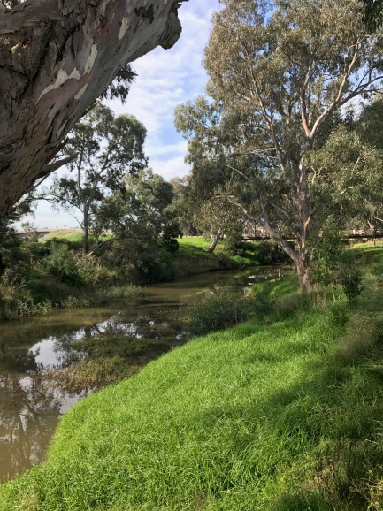
Place your
logo here
LESSONS & REFLECTIONS
Collaboration requires more work but is essential
Critical to consider science centrally not leap to engineering solutions
Examining opportunities before barriers is valuable
Change is the constant, uncertainty is part of decision making
Are we working to best outcome, or least worst outcome? For who?
BRISBANE, AUSTRALIA | 18 - 20 SEPTEMBER 2017
MANAGED BY

