Slide 1
Incorporating social indicators in the monitoring and evaluation of environmental flows
Lauren Zielinski Zielinski Environmental Monitoring and Evaluation, LLC – USA
Rebecca Tharme Riverfutures Limited – UK
BRISBANE, AUSTRALIA | 18 - 20 SEPTEMBER 2017
MANAGED BY

Slide 2
Contents
Definitions
Why are social indicators important for M&E of eflows?
Examples - Monitoring for social indicators
Turning monitoring into management
BRISBANE, AUSTRALIA | 18 - 20 SEPTEMBER 2017
MANAGED BY

Slide 3
Objective: A specific statement detailing the desired accomplishments, milestones, or outcomes of a project
“To maintain a flow regime which allows for flood recession agriculture”
Indicator: A units of information measured over time that document changes in a specific condition. An objective can have multiple indicators.
“Amount of rice, maize, and native vegetables sold”
Method: A specific technique used to collect data to measure indicators
“Interviews with local farmers at the end of the growing season”
“ Agricultural output in kilograms from local farmer cooperatives”
DEFINITIONS – WHY SOCIAL INDICATORS – EXAMPLES – MONITORING INTO MANAGEMENT
BRISBANE, AUSTRALIA | 18 - 20 SEPTEMBER 2017
MANAGED BY

Slide 4
“Environmental flows describe the quantity, timing, and quality of water flows required to sustain freshwater and estuarine ecosystems and the human livelihoods and well-being that depend on these ecosystems.”
DEFINITIONS – WHY SOCIAL INDICATORS – EXAMPLES – MONITORING INTO MANAGEMENT
BRISBANE, AUSTRALIA | 18 - 20 SEPTEMBER 2017
MANAGED BY

Slide 5
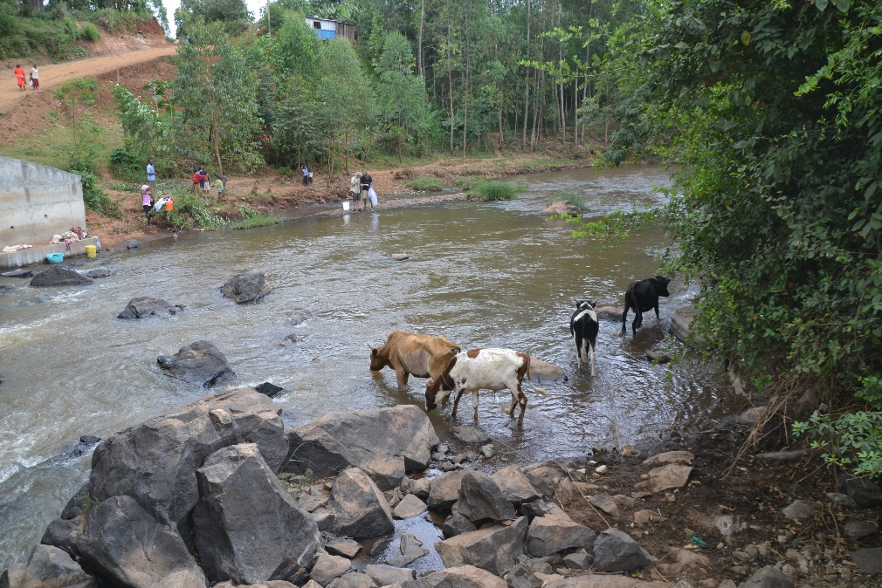
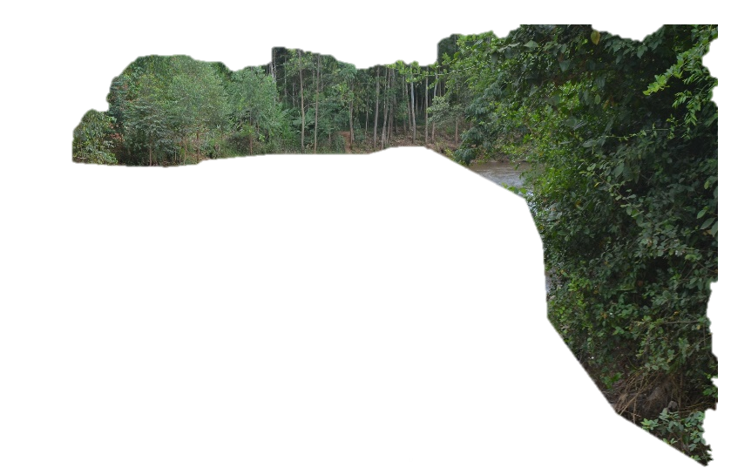
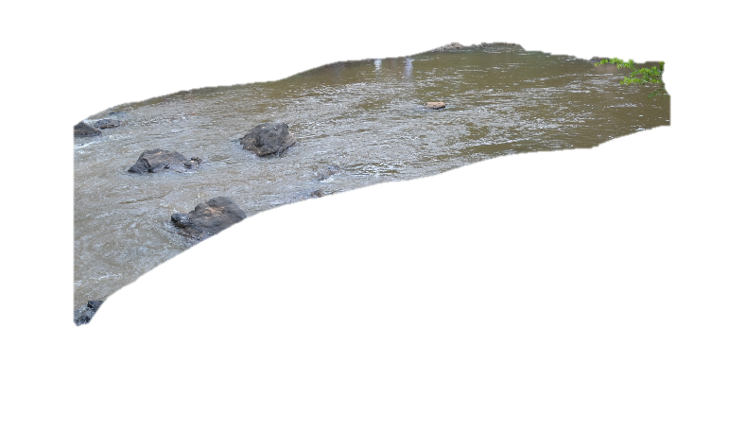
Environmental Flow Assessment
Environmental Flow Recommendations
Environmental Flow Implementation
Establish mgmt. objectives
Create monitoring plan
Collect and evaluate data
Adaptively manage
Hydrological indicators
Ecological indicators
Social indicators
DEFINITIONS – WHY SOCIAL INDICATORS – EXAMPLES – MONITORING INTO MANAGEMENT
BRISBANE, AUSTRALIA | 18 - 20 SEPTEMBER 2017
MANAGED BY

Slide 6
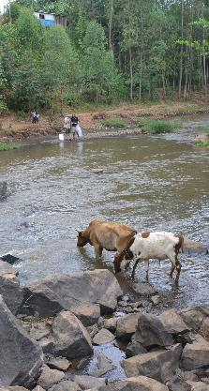
Humans have an impact on a system
Changes in vegetation and land cover
Nutrient and sediment pollution
Abstraction of water resources
Removal of animal, fish, and plant resources
Humans receive services from a system
Basic human needs
Collection of animal, fish, and plants for subsistence
Cultural and religious requirements
Recreation
Flood recession agriculture
DEFINITIONS – WHY SOCIAL INDICATORS – EXAMPLES – MONITORING INTO MANAGEMENT
BRISBANE, AUSTRALIA | 18 - 20 SEPTEMBER 2017
MANAGED BY

Slide 7
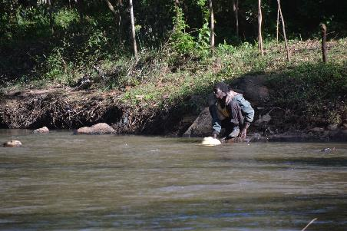
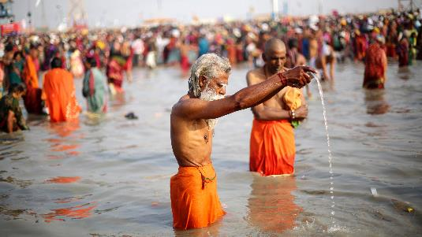
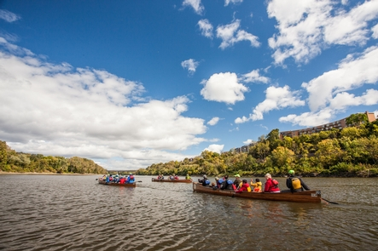
River systems are unique
Social indicators should be unique
Monitoring methods may also need to be unique
DEFINITIONS – WHY SOCIAL INDICATORS – EXAMPLES – MONITORING INTO MANAGEMENT
BRISBANE, AUSTRALIA | 18 - 20 SEPTEMBER 2017
MANAGED BY

Slide 8
“Traditional” Social Surveys
Interviews with local leaders or users of the river
Quantitative and qualitative data
Narratives are important
Comparison with hydrological and/or ecological indicators
Capable of capturing different types of data
Double check if other indicators and/or methods are appropriate
“Modern” Social Surveys:
Use of cell phone applications
Collection of different media:
Recorded interviews
Photographs and videos from local communities
Notification of abnormal conditions in real time
DEFINITIONS – WHY SOCIAL INDICATORS – EXAMPLES – MONITORING INTO MANAGEMENT
BRISBANE, AUSTRALIA | 18 - 20 SEPTEMBER 2017
MANAGED BY

Slide 9
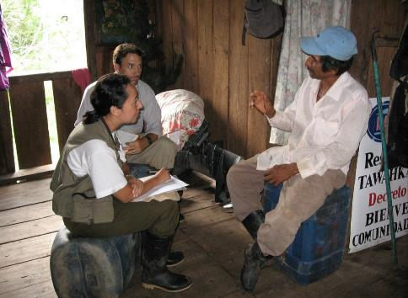
Rio Patuca – Traditional Ecological Knowledge
Interviewed local communities to understand how the river is important to fisheries, agriculture, and transportation
Identified social objectives and integrated with hydrological and ecological objectives to create environmental flow recommendations
Esselman, P. C., and J. J. Opperman. 2009. Overcoming information limitations for the prescription of an environmental flow regime for a Central American river. Ecology and Society 15(1): 6. [online] URL: http://www.ecologyandsociety.org/vol15/iss1/art6/
Photo credit: J. Opperman
DEFINITIONS – WHY SOCIAL INDICATORS – EXAMPLES – MONITORING INTO MANAGEMENT
BRISBANE, AUSTRALIA | 18 - 20 SEPTEMBER 2017
MANAGED BY

Slide 10
Combination with Other Indicators
SOCIAL
Ensure water is low enough to allow humans to cross safely
HYDROLOGY
Water levels at river gauging stations
SOCIAL
Presence of fish species important for subsistence
ECOLOGY - FISH
Monthly fish catch monitoring
SOCIAL
River system can support important recreation activities
PARTNER AGENCIES
Recreation data from a local park
DEFINITIONS – WHY SOCIAL INDICATORS – EXAMPLES – MONITORING INTO MANAGEMENT
BRISBANE, AUSTRALIA | 18 - 20 SEPTEMBER 2017
MANAGED BY

Slide 11
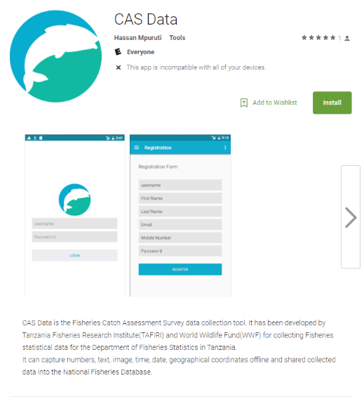
Combination with Other Indicators
RUFIJI RIVER BASIN, TANZANIA
Catch assessment survey (CAS) data
DEFINITIONS – WHY SOCIAL INDICATORS – EXAMPLES – MONITORING INTO MANAGEMENT
BRISBANE, AUSTRALIA | 18 - 20 SEPTEMBER 2017
MANAGED BY

Slide 12
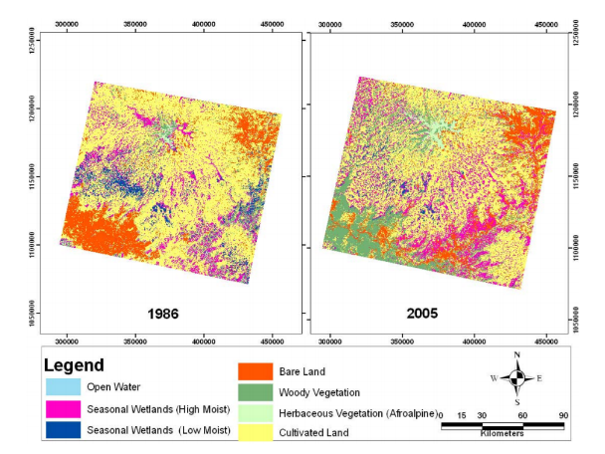
Change Detection Using Remote Sensing
Changes in river basin characteristics
Land use change
Changes in vegetation types
Well suited for large areas or remote locations
Useful for long-term trends
Dependent on quality of images
Teferi et al. 2010. The use of remote sensing to quantify wetland loss in Ethiopia. Hydrol. Earth Syst. Sci., 14, 2415–2428.
DEFINITIONS – WHY SOCIAL INDICATORS – EXAMPLES – MONITORING INTO MANAGEMENT
BRISBANE, AUSTRALIA | 18 - 20 SEPTEMBER 2017
MANAGED BY

Slide 13
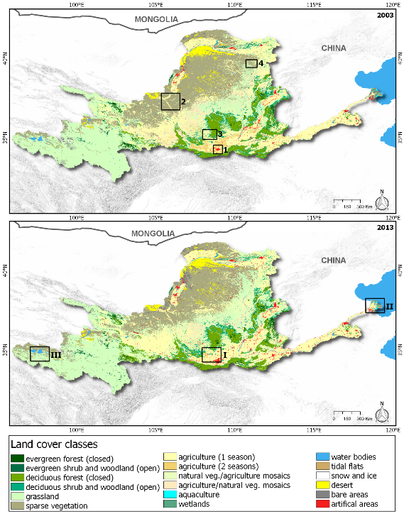
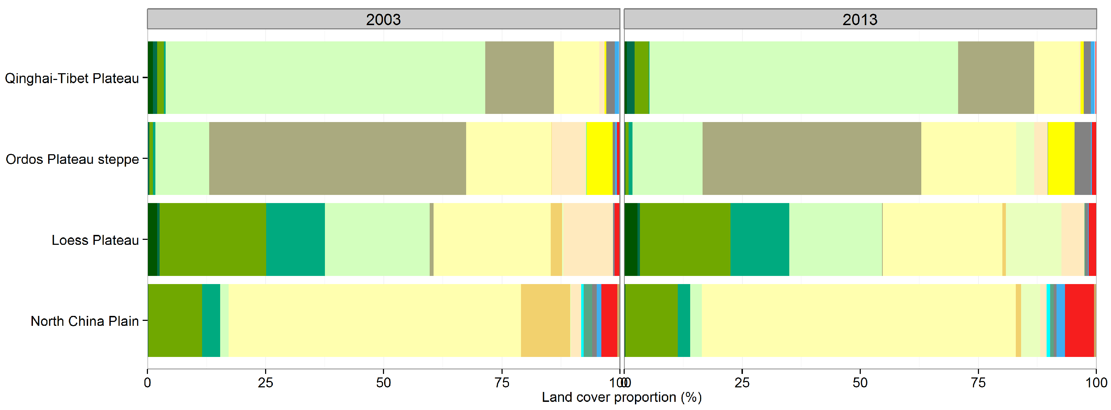
Change Detection Using Remote Sensing
Past:
Focused study area
Long time frame
Single comparison
Future:
GIS driven study areas
Continuous analysis
Short-term and long-term trends
Increase in resolution = increase in capabilities
Wohlfart et al. 2016. A River Basin over the Course of Time: Multi-Temporal Analyses of Land Surface Dynamics in the Yellow River Basin (China) Based on Medium Resolution Remote Sensing Data. Remonte Sens. 2016, 8, 186; doi:10.3390/rs8030186
DEFINITIONS – WHY SOCIAL INDICATORS – EXAMPLES – MONITORING INTO MANAGEMENT
BRISBANE, AUSTRALIA | 18 - 20 SEPTEMBER 2017
MANAGED BY

Slide 14
Turning Monitoring into Management
Social data is an important part of a holistic monitoring program
Helps to provide better understand of the “whole picture”
Data only useful if it’s actually used
Periodic evaluation of conditions
Act as a “trigger” for further investigation or management action
Direct inclusion of the concerns of the local users
Strengthens community engagement and involvement
DEFINITIONS – WHY SOCIAL INDICATORS – EXAMPLES – MONITORING INTO MANAGEMENT
BRISBANE, AUSTRALIA | 18 - 20 SEPTEMBER 2017
MANAGED BY

Slide 15
Thank you for your attention
Lauren Zielinski
lzielinski@ZEMEenviro.com
BRISBANE, AUSTRALIA | 18 - 20 SEPTEMBER 2017
MANAGED BY

