Slide 1



Place your
logo here
Ground-water Mitigation Banking:
a Tool for Environmental Flow Restoration
in the Deschutes Basin
Genevieve Hubert
Deschutes River Conservancy
Bend, Oregon, United States
gen@deschutesriver.org
www.deschutesriver.org
BRISBANE, AUSTRALIA | 18 - 20 SEPTEMBER 2017
MANAGED BY

Slide 2
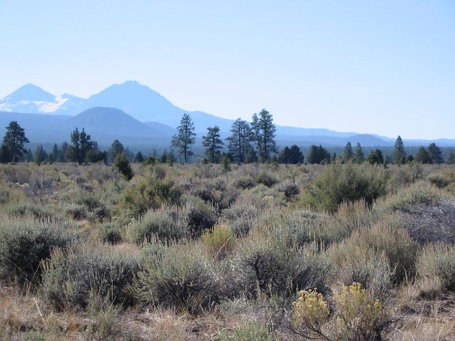
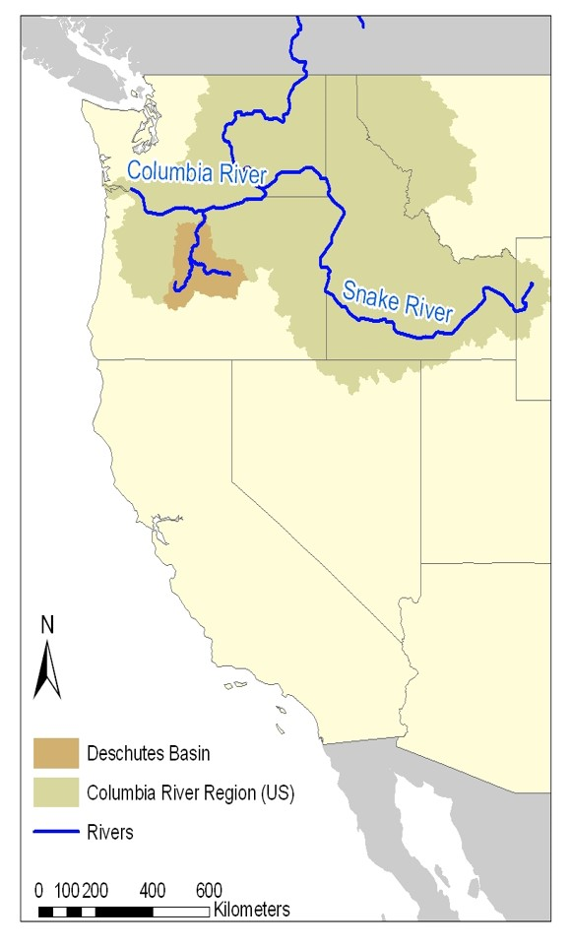
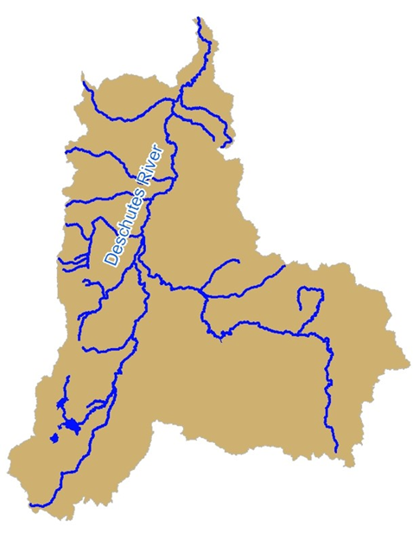



Place your
logo here
17,222 km²
BRISBANE, AUSTRALIA | 18 - 20 SEPTEMBER 2017
MANAGED BY

Slide 3
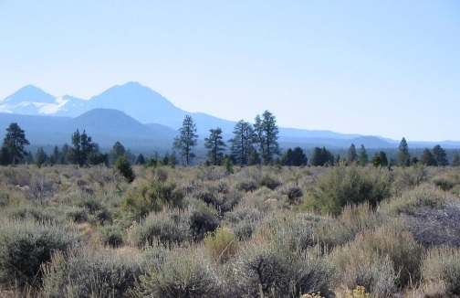
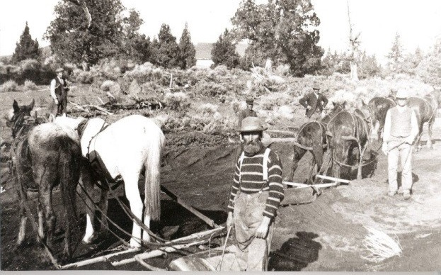
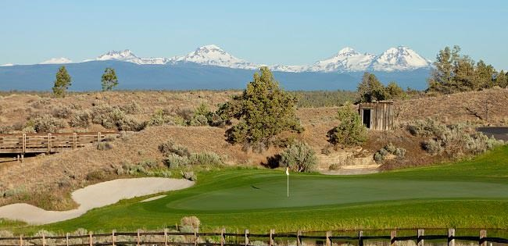
Place your
logo here
What happened?
Rapid development - concerns
Importance of Stakeholders
Growth > Market > Restoration
Does it work?

Slide 4
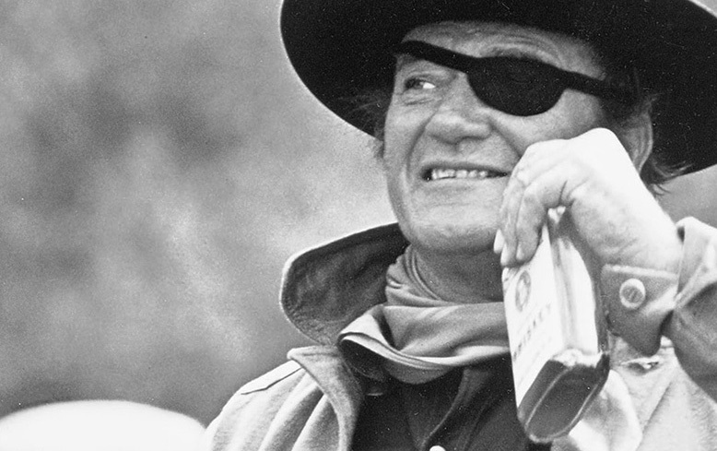

Place your
logo here
What happened???
Early 1900s, almost free resources
Over appropriated streams
1990s, continuous and rapid growth
Concern for remaining resources
Protected environmental flows 1987
Impacts and interactions understood
Hold on new GW development
Stakeholder involvement
Framework to allow development AND improve flows
Surface water?
Studies
Models
BRISBANE, AUSTRALIA | 18 - 20 SEPTEMBER 2017
MANAGED BY
Notes:
High desert, volcanic mountains
Snowpack, groundwater, springs
Streams variable to constant

Slide 5
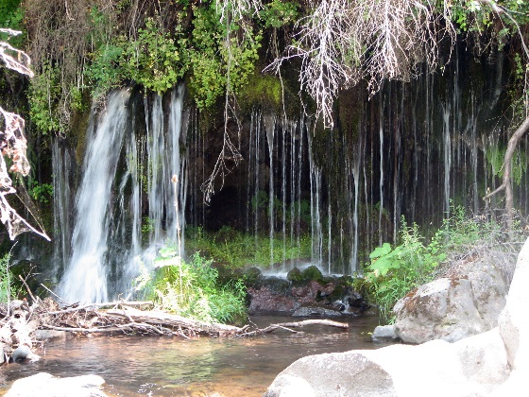
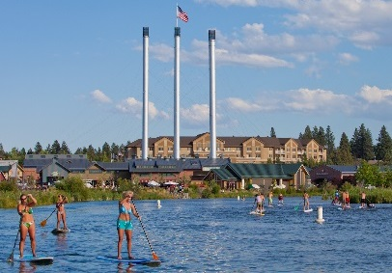
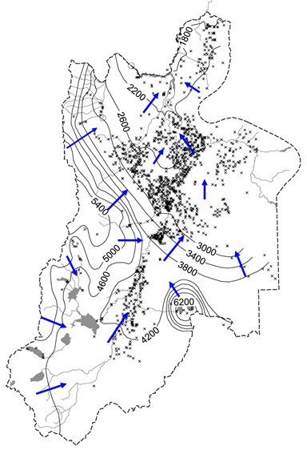
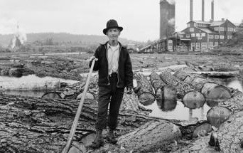

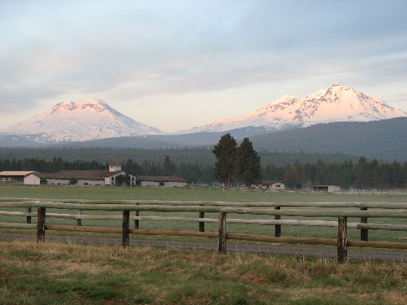
Place your
logo here
Foundation
Adjudicated/closed basin 1910 and 1996
Extensively measured and actively regulated
Surface water – ground water interactions
Prior appropriations protected senior & instream water rights
Process for transferring water
Notes:
High desert, volcanic mountains
Snowpack, groundwater, springs
Streams variable to constant

Slide 6
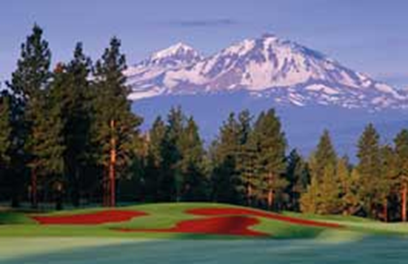
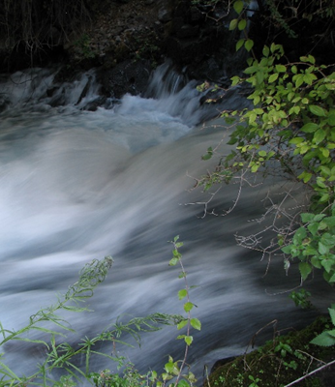
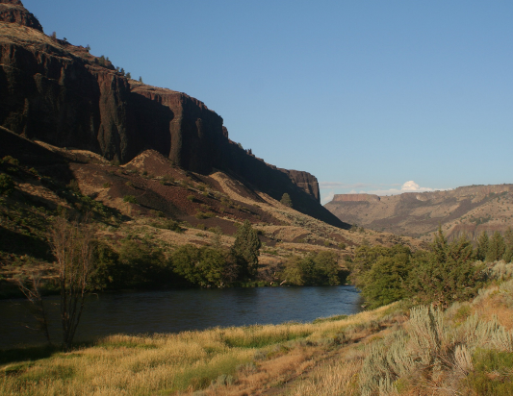
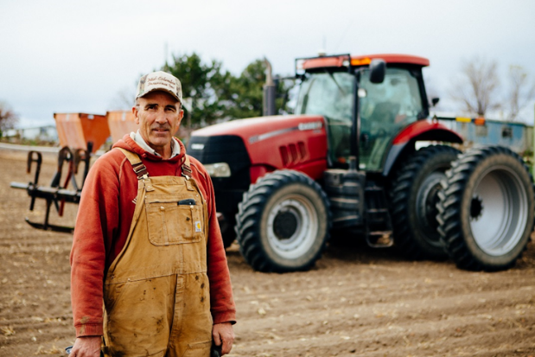
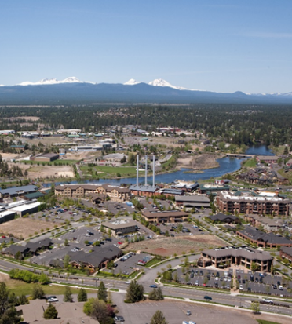
Place your
logo here
Studies - Stakeholder Involvement
3 goals
Protect wild & scenic waterways & instream water rights
Accommodate growth and development
Facilitate flow restoration in over-allocated streams
Rules
BRISBANE, AUSTRALIA | 18 - 20 SEPTEMBER 2017
MANAGED BY
Notes:
Rapid growth, no surface water availability
Groundwater development at pace to keep up with growth
Groundwater development = injury to protected streams

Slide 7
Place your
logo here
Framework
Zones of Impact
- new groundwater use - demand
- instream flow projects - supply
Consumptive use determination
  - credit need (demand)
  - flow benefit (supply)
BRISBANE, AUSTRALIA | 18 - 20 SEPTEMBER 2017
MANAGED BY

Slide 8
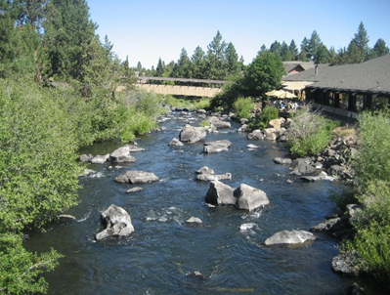
Place your
logo here
Framework
Projects to create credits
  - must protect flow instream
- volumetric, 1 credit = 1 acre-foot or 1,233 cubic meters
- timing?
year-round pumping
seasonal flow restoration
BRISBANE, AUSTRALIA | 18 - 20 SEPTEMBER 2017
MANAGED BY

Slide 9
Place your
logo here
Framework
Groundwater Banks
  - self funded
- annual supply
- permanent supply
Cap & sunset
  - 200 cfs or 5.66 m³/s
Reporting and Review
  - annual
  - 5 year
  - opportunities for stakeholder input
BRISBANE, AUSTRALIA | 18 - 20 SEPTEMBER 2017
MANAGED BY

Slide 10

Place your
logo here
Cost
Program capped/limited by rate
Traded by volume
Credit Need
and Purchase
$$$
Bank or other Credit Broker
$$$
credits
$$$
Purchase water, pay fees,
operate bank, complete projects
Water protected instream
BRISBANE, AUSTRALIA | 18 - 20 SEPTEMBER 2017
Notes:
100 acre-feet 12,000-27,500 $US
0.123 gigaliter 15,080-34,560 $AUS
100 acre-feet 200,000-600,000 $US
0.123 gigaliter 251,319-753,958 $AUS

Slide 11
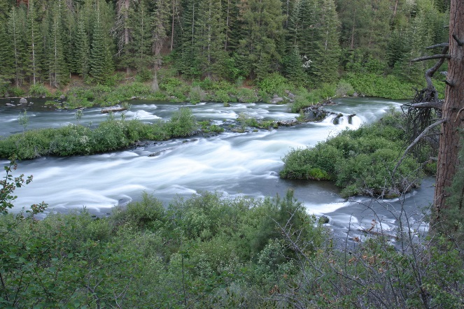
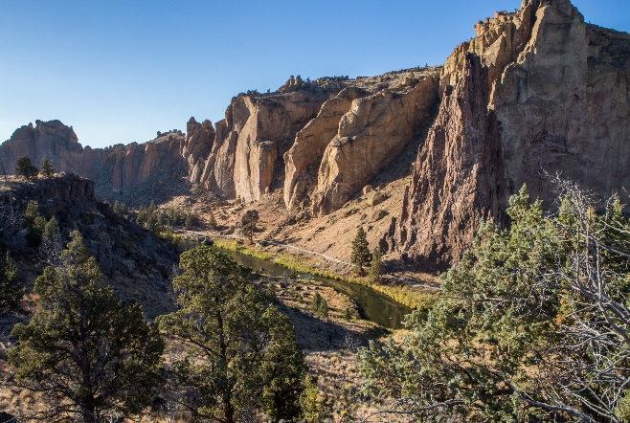

Place your
logo here
Success?
Environmental flow protected:
Accommodating growth
Technical/flow analysis by state agency shows offset is working
Protecting scenic flows and instream water rights
BRISBANE, AUSTRALIA | 18 - 20 SEPTEMBER 2017
MANAGED BY
Notes:
3600 AF annually
17075 AF permanently
20675 AF total

Slide 12
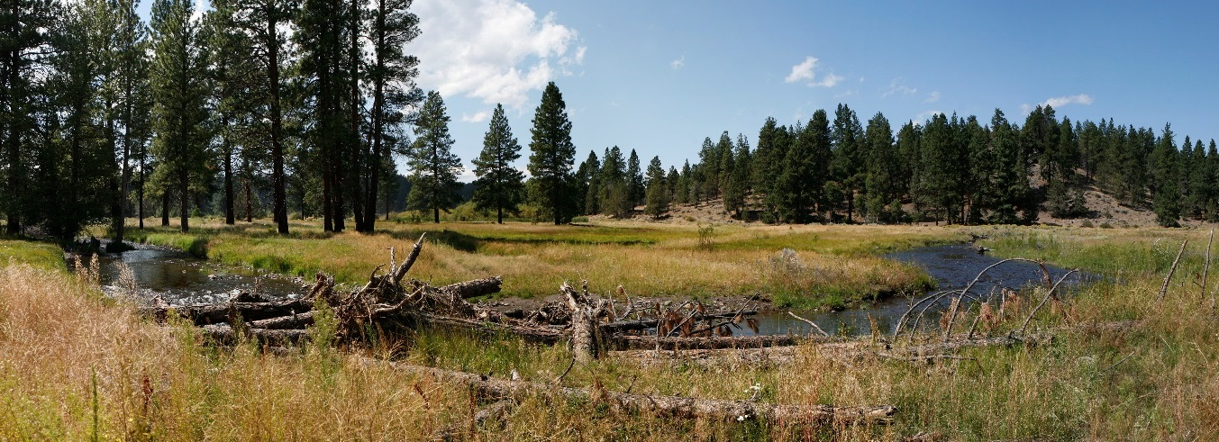
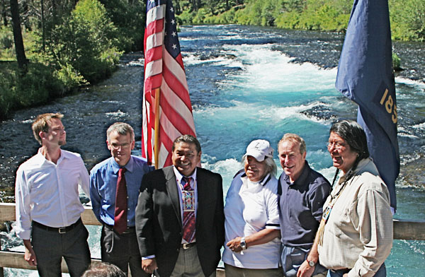
Place your
logo here
Lessons Learned
timing – consider functionality, might not be exact
restoration – ability to monitor and protect is important
options – types of projects for generating credits
restrictions – supply limitations
periodic review and ability to address limitations
stakeholder input – add/modify/new opportunities
too restrictive for success? Everyone happy (no)?
one of many flow restoration tools – Whychus Creek
Genevieve Hubert
gen@deschutesriver.org
www.deschutesriver.org
BRISBANE, AUSTRALIA | 18 - 20 SEPTEMBER 2017
MANAGED BY

Slide 13
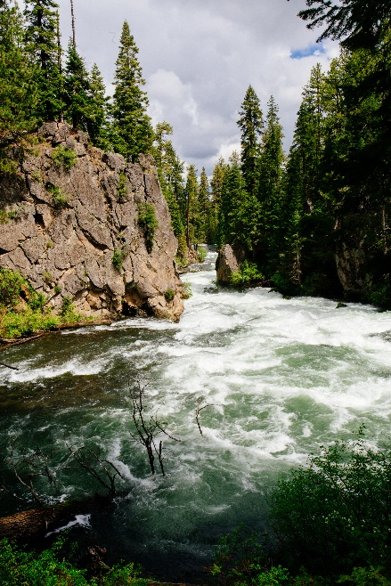
Place your
logo here
Genevieve Hubert
gen@deschutesriver.org
www.deschutesriver.org
BRISBANE, AUSTRALIA | 18 - 20 SEPTEMBER 2017
MANAGED BY

