Slide 1


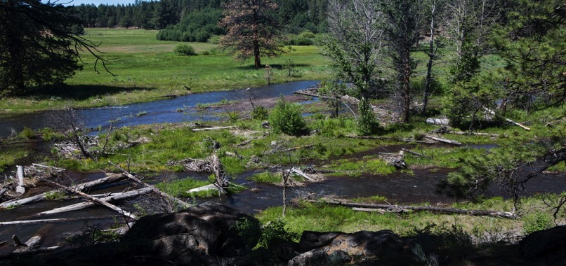

Place your
logo here
Evolution of Environmental Flows on Whychus Creek in the Deschutes Basin, USA
Natasha Bellis, Program Manager
BRISBANE, AUSTRALIA | 18 - 20 SEPTEMBER 2017
MANAGED BY
Notes:
Introduction
Mention that colleagues presented on Whychus at this conference 10 years ago
Update international eflow community on progress in Whychus since then

Slide 2
Whychus Creek Overview: Geography
Notes:
Orient audience.
The Deschtues River Conservancy restores streamflow and improves water quality in the Deschutes Basin, an approximately 17,000 sqkm catchment located in the north central part of the state of Oregon in the U.S.
Defining feature of the basin is the Deschues River, which runs north from its headwaters to it’s confluence with the Columbia River.
although works restores streamflow throughout the basin, projects primarily based in the upper watersheds.
today, I will focus on our streamflow restoration work on Whychus Creek, a tributary to the Deschutes River

Slide 3
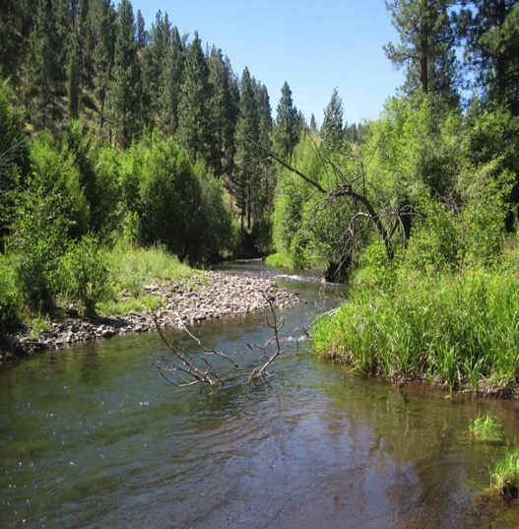
Place your
logo here
Whychus Creek Overview
  Geography
  Hydrology
  Flow targets
E Flows To Date
  Traditional tools
  Results
Future E Flows
  Need
  Contractual tools
Lessons Learned
Notes:
First a roadmap…

Slide 4
Place your
logo here
Notes:
Brief overview of Whychus Creek hydrology:
The Whychus watershed is a snowpack driven system, typical of many watersheds in the western US.
Streamflow peaks in the late spring/early summer with the increase in snowmelt from the creek’s headwaters in the Cascade mountains and then drops to base flows by end of September.
This graph represents a normal year, the 50% exceedance and dry year, 80% exceedance.

Slide 5
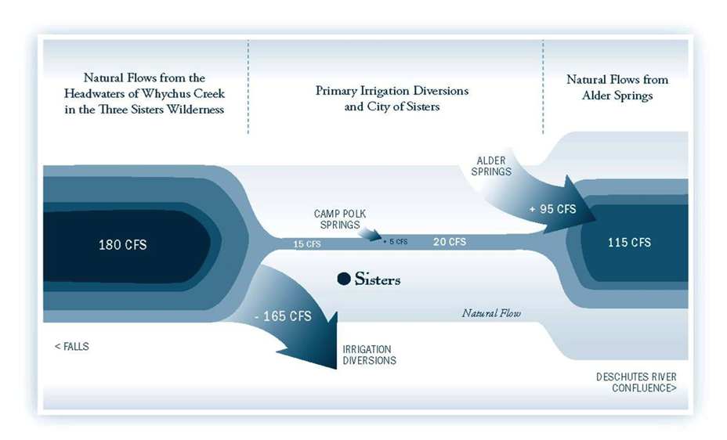
Place your
logo here
Whychus Creek Overview: Hydrology
2.7 cms
5 cms
.42 cms
.56 cms
3.25 cms
4.7 cms
Notes:
This is a simplified illustration of water use on the creek
Water allocation is based on a system of prior appropriation (for those unfamiliar: this is a system where older rights are served first in times of water shortage to the detriment of newer rights)
Run through graphic: about 5 cms coming into system from snowmelt high in the system; most of this water is diverted for irrigation by Three Sisters Irrigation District, the major water user on the creek, leaving very little streamflow through the town of Sisters (the gaging point for our flow targets) before some springs supplement the flow to the mouth.

Slide 6
Place your
logo here
Whychus Creek Overview: Flow Targets
Notes:
In the state of Oregon, under the Instream Water Rights Act passed in 1987, select state agencies can apply for instream water rights. They are however junior in priority. ODFW applied for instream water rights on Whychus Creek in 1991.
DRC uses these instream water rights as a starting point for its flow targets as they are based on biological indicators and specifically for redband trout for Whychus.
ODFW estimated the amount of water needed in a stream to support the spawning, rearing and migration of native redband trout based on the physical characteristics of the stream.
Whychus Creek has two instream water rights, one for the upper creek and one for the lower creek. While DRC aims to provide enough flow to meet both rights, we have essentially adopted the lower creek right as the flow target as it is higher in all but one month and meeting it will require protecting more water upstream.

Slide 7
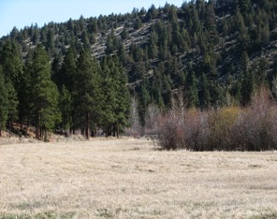
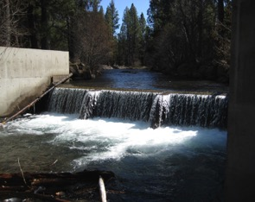
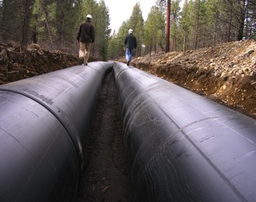
Place your
logo here
E Flows To Date: Tools
Transfers
Instream transfers
8.5 cfs/.24 cms permanently restored
Leasing
350-400 acres/142-462 ha leased annually
4.5 cfs/.13 cms/2.35 gl restored annually
Conserved Water
166,506 linear feet of pipe (over 49 km)
30 cfs/.8 cms restored instream
Notes:
DRC has used administrative or traditional flow restoration tools so far that allow us to put irrigation water rights instream under the priority date of the originating water right.
We began in 1997 with our instream transfers program.
Transferring water requires the permanent drying up of acreage. Transfers to date primarily involve water right holders outside of the irrigation district. Currently we hold about 8.5 cfs or .24 cms or 4.45 gl.
We began leasing in earnest in Whychus in 2002. Leasing requires the drying up of acreage either for a full or partial irrigation season. DRC can statutorily lease up to 5 years, although we can renew indefinitely. We primarily lease annually within the Three Sisters Irrigation District at an average rate of 4.5 cfs or .13 cms or 2.35 gigaliters
Most of our environmental flow comes from conservation measures, namely piping leaky ditches. In Deschutes Basin, we have very volcanic, porous soil and unlined ditches can lose up to 50% of water to seepage. Piping these ditches allows that seepage water to remain in the Creek. To date, we’ve restored 30 cfs or .8 cms or 15.7 gl.

Slide 8
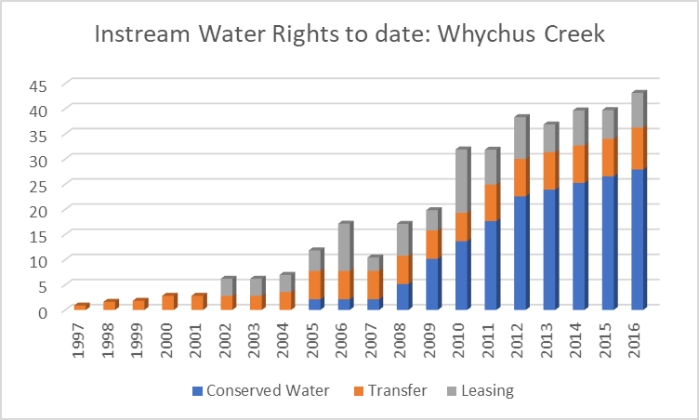
Place your
logo here
E Flows To Date: Results
Notes:
These administrative tools over time have led to a gradual, yet significant increase in the amount of instream water rights on Whychus Creek

Slide 9
Place your
logo here
E Flows To Date: Results
3: 5 years
2: 2 to 3 years
Notes:
This graph demonstrates the length of the terms of our instream transactions. You can see that the majority of our transactions are permanent, owing in large part to the irrigation efficiency projects we have helped implement since 2005. 1-5 year terms represent instream leasing.

Slide 10
Place your
logo here
Future E Flows: Need
Notes:
So, we’ve had a great deal of success on Whychus and on paper, we’ve exceeded our goal of 33 cfs or .9 cms in certificated instream water rights. So, why are we still working here? What’s left to do.

Slide 11
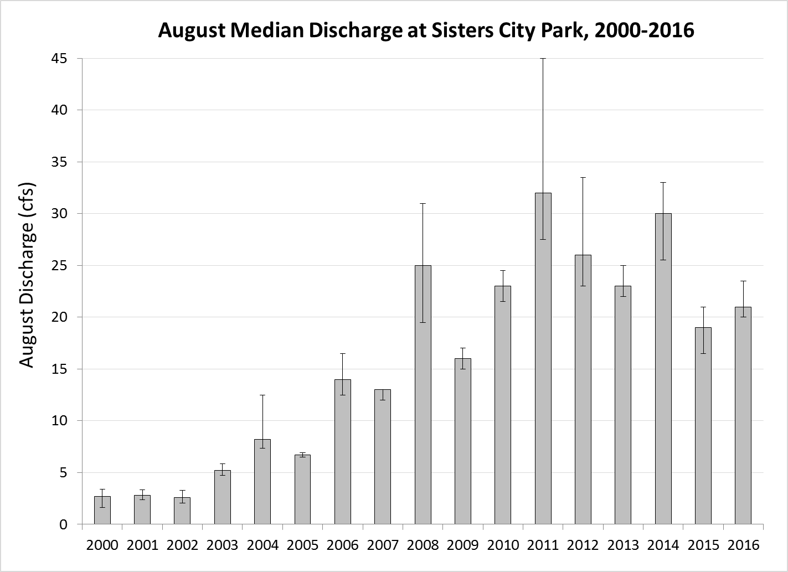
Place your
logo here
Future E Flows: Need
Notes:
As some of you may have guessed, while gaging shows that streamflow is indeed increasing-this is median discharge at the City of Sisters gage for August, one of the hottest months showing a dramatic increase over 16 year.

Slide 12
Place your
logo here
Future E Flows: Need
Notes:
We are still not reaching our target.
You can see here that while our instream water right certificates are well above the ODFW target for much of the irrigation season, actual streamflow fails to meet this target, particularly in the later part of the season as snowmelt begins to taper off.

Slide 13
Place your
logo here
E Flows To Date: Results
Notes:
This graph shows the level of security of water rights. While some have high priority or security, meaning they are served nearly 100% of the time, you can see that the bulk of our instream rights are moderate security, meaning that they are served with less reliability.

Slide 14
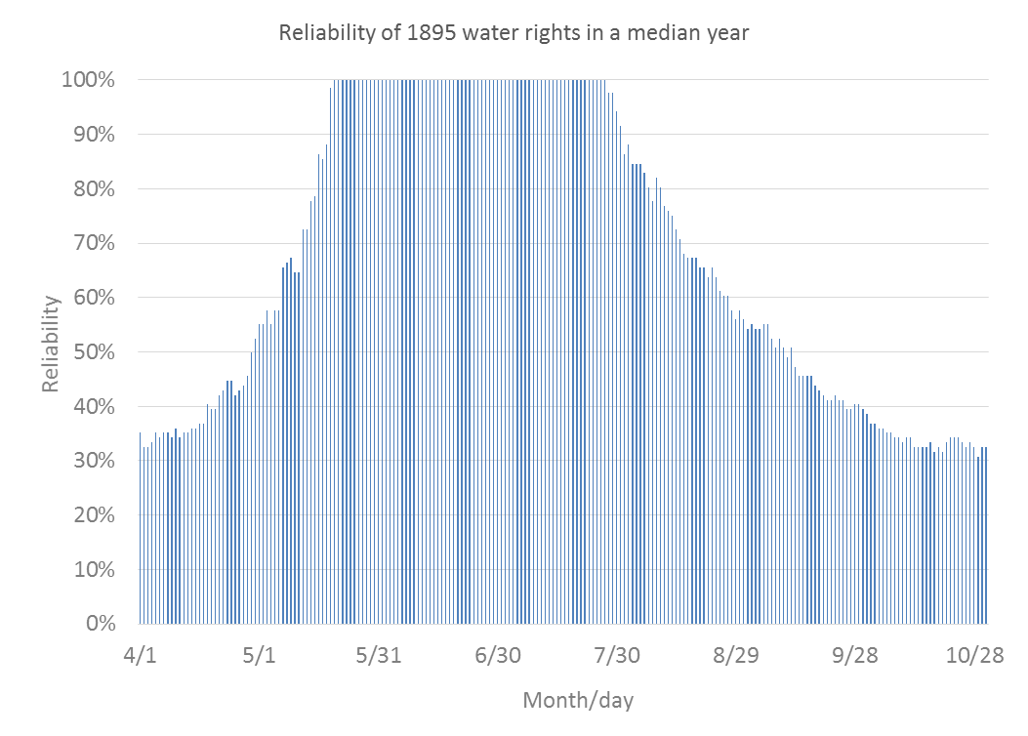
Place your
logo here
Future E Flows: Need
Notes:
This is a graph of the reliability of 1895 water right in a median year. You can see that from about mid May through mid July, they are served with 100% reliability but that quickly decrease on either side of these months.
On average, our 1895 instream water rights (cfs, cms) are served about 50% of the time.
Based on this information, we may need to secure substantially more water rights to consistently meet our flow target of 33cfs in the city of Sisters.

Slide 15
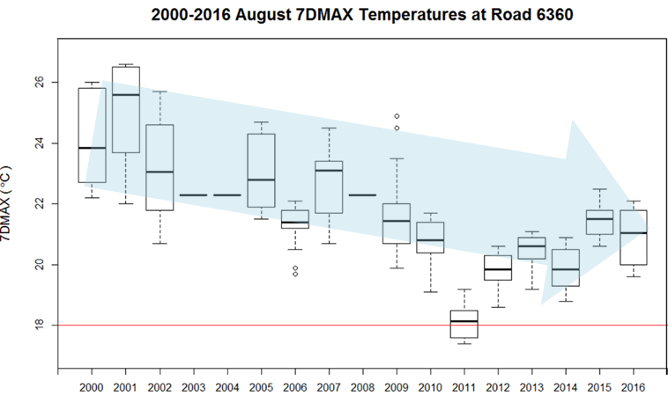
Place your
logo here
Future E Flows: Need
Notes:
Another factor affecting our need for environmental water is water quality parameters, specifically water temperature.
Our partners, the Upper Deschutes Watershed Council has been conducted extensive and long term water quality monitoring on Whychus Creek that definitively shows that 33 cfs of instream flow during the irrigation season does not result in stream temperature that meets DEQ’s water quality standard of 18 degrees Celsius. UDWC’s analyses of this temperature data indicates that mid-summer flows exceeding 40-50 cfs (1.13 – 1.4 cms) would be required to meet temperature standards.

Slide 16
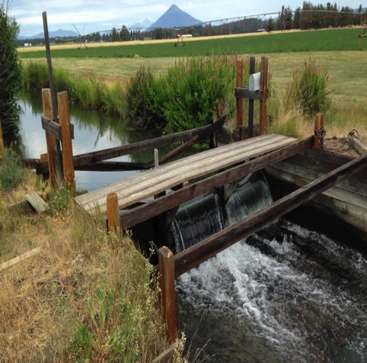
Place your
logo here
Future E Flows: Tools
Management Agreement
  Minimum Flow
  Mimics State Instream Flows initially
Irrigation Efficiencies
  Pipe laterals
  Install automated headgate and software
Habitat Conservation Plan
  Limits liability under ESA
  Powerful persuasion tool
Notes:
At this point, we are turning to less traditional tools and looking at contractual fixes.

Slide 17
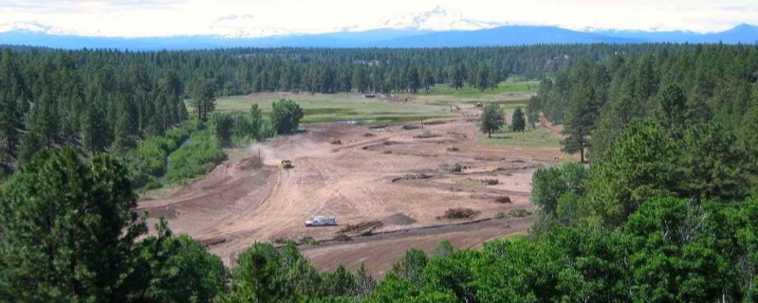
Place your
logo here
Lessons Learned
  Slow + steady = solid base

Slide 18
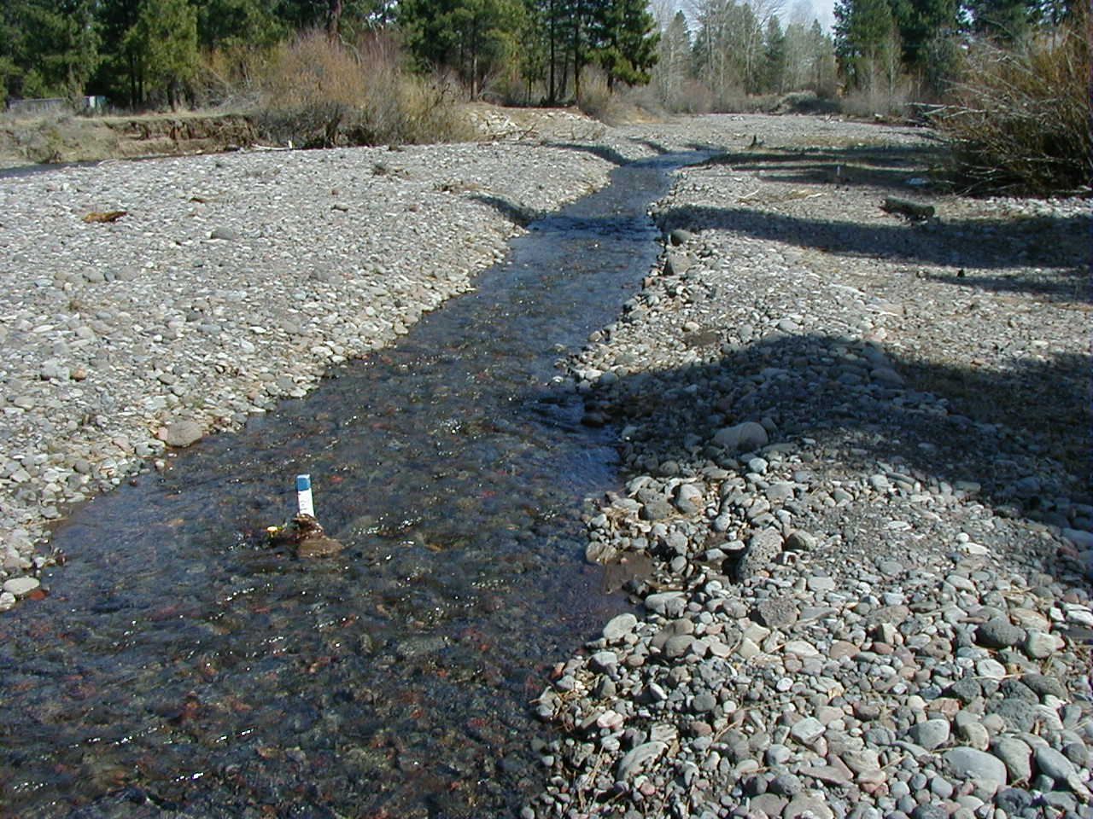
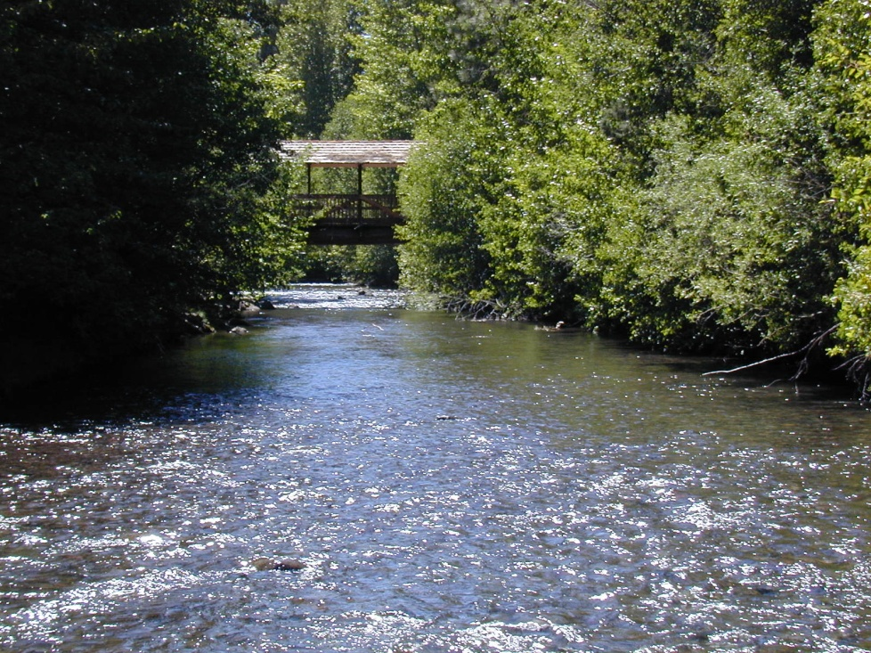
Place your
logo here
1997
2012

Slide 19
Place your
logo here
Lessons Learned
  Slow + steady = solid base
  Manage adaptively
  Partnerships are key

Slide 20






Place your
logo here
Thank you!
Natasha Bellis
natasha@deschutesriver.org
1-541-382-4077 x 14

