Slide 1
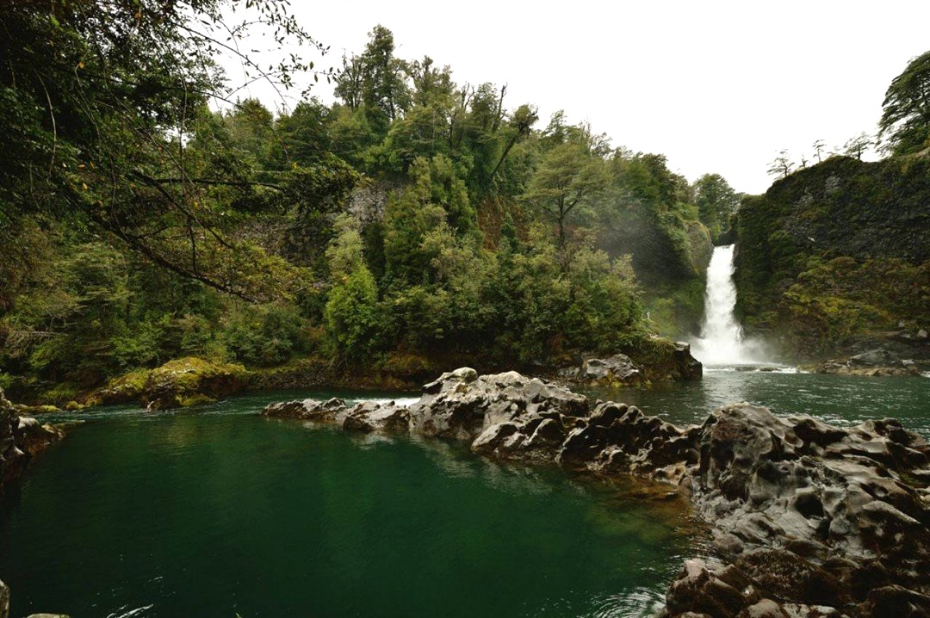
Legal framework and policy tools to protect free-flowing rivers in Chile
Pía Weber Salazar
Chilean Lawyer
LLM Candidate
University of Melbourne
Huilo Huilo, XIV Region, Chile.
BRISBANE, AUSTRALIA | 18 - 20 SEPTEMBER 2017
MANAGED BY
Notes:
Good afternoon, my name is Pía Weber, I am a Chilean lawyer, finishing my Master of Laws at the University of Melbourne. I am here to present my paper about legal frameworks and policy tools to protect free-flowing rivers in Chile, South America.

Slide 2
Key Elements
1) Definition and key elements of free-flowing rivers
2) Legal frameworks to protect free-flowing rivers
- National Wild and Scenic River System, USA
- Wild Rivers Act, Queensland, Australia
- Canadian Heritage River System, Canada
3) Chile and free-flowing river protection
- Protected Areas System
- Specific legislative approach
BRISBANE, AUSTRALIA | 18 - 20 SEPTEMBER 2017
MANAGED BY
Notes:
This presentation will address the definition of free-flowing rivers and their key elements.
It will refer briefly to 3 legal frameworks created to protect rivers in their natural state. Each model was assessed based on the respective benefits and disadvantages, in order to determine their adaptability and suitability for developing an appropriate model in Chile.
Chile is a country known for its wild rivers. Many of them are under threat due to hydroelectric power development, human interventions and climate change. Unfortunately, at present Chile does not have any specific laws to protect its rivers. Given this, I am interested in understanding the best options to approach river protection in my country.

Slide 3
Free-Flowing Rivers
WWF: “any river that flows undisturbed from its source to its mouth, either at the coast, an inland sea or at the confluence with a large river, without encountering any dams, weirs or barrages and without being hemmed in by dykes or levees.”
Wild River and Scenic Act, USA: free-flowing applies to any river or section of river “existing or flowing in natural condition without impoundment, diversion, straightening, rip-rapping, or other modification of the waterway” (minor structures on the river shall not automatically bar its consideration)
Notes:
There is no agreement of what we should understand to be a free-flowing river, but from these definitions and the Canandian and Australian legislation we can at least assume that we are talking about a river flowing in its natural condition, without any major infraestructure or human intervention.

Slide 4
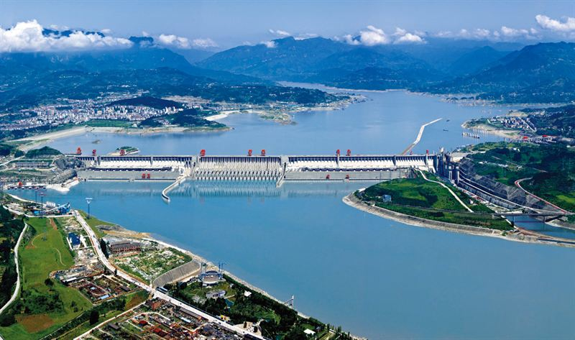
Key elements of a free-flowing river
1) Level of intervention: Unmodified or slightly modified
Three gorges dam, Yangtze River, China
2) Outstanding value: natural, cultural or recreational
3) River or section of river
BRISBANE, AUSTRALIA | 18 - 20 SEPTEMBER 2017
MANAGED BY
Notes:
1) Studies have identified 4 levels or stages of river modification: Unmodified; slightly modified; extensively modified; and completely modified
Unmodified refers to a river channel and floodplain that retain most natural characteristics, where the flood regime is unmodified by direct human intervention.
A slightly modified river contemplates some drainage channels and the existences of some small dams on smaller streams.
2) OUV: The intention is to highlight the outstanding and remarkable characteristics of a river and its relevance for present and future generations. These could be from a regional, national or international point of view.
3) River or a section of river. (This would benefit inclusion of some rivers that may need protection to restore their natural values that have been slightly altered.)

Slide 5
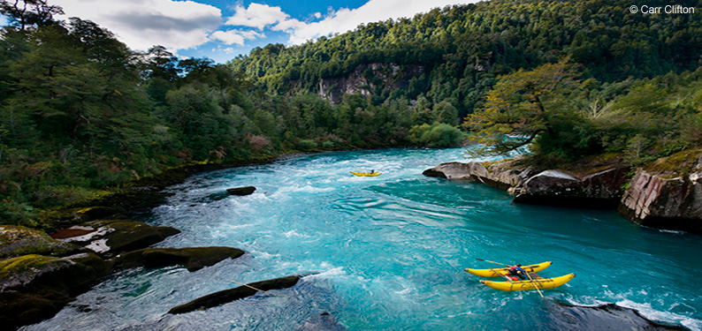
Why should free-flowing rivers be protected? Specific value of free-flowing rivers
May become extinct? WWF 2006: out of 177 rivers longer than 1,000 km, only 64 (less than 40%) free-flowing, and only 21 drain into the sea
Futaleufú River, X Region, Chile
BRISBANE, AUSTRALIA | 18 - 20 SEPTEMBER 2017
MANAGED BY
Notes:
Why should free-flowing rivers be protected? I believe that after this conference we will have a pretty good understanding of the tremendous value that rivers offer for humans and their well-being but also for nature itself. When a river is altered or intervened, the services they provide to humans can be diminished, and their ecological characteritisc can be significallty altered.
May become extinct? WWF 2006: out of 177 rivers longer than 1,000 km, only 64 rivers (less than 40%) are still free-flowing. Only 21 drain into the sea.
Several of them may be in danger of being dammed in the future.
World Wildlife Fund, Free-flowing rivers Economic luxury or ecological necessity? (World Wildlife Fund 2006)

Slide 6
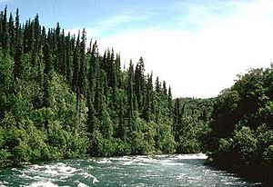
National Wild and Scenic Rivers System, USA (1968)
Free-flowing + outstandingly remarkable values
A) Wild River (Highest level of protection)
B) Scenic River (Intermediate level)
C) Recreational River (Least restrictive)
How are they being managed to
protect and enhance
outstandingly remarkable values?
Alagnak River, Wild River, USA
BRISBANE, AUSTRALIA | 18 - 20 SEPTEMBER 2017
MANAGED BY
Notes:
This was the first legal framework to protect rivers in their free-flowing conditions that have outstandingly remarkable values, and also protect the immediate environment for the benefit and enjoyment of present and future generations.
The legislation classifies free-flowing rivers into three categories:
A) Wild rivers are free from impoundments (dams, diversions, etc.) and generally only accessible by trail. The watersheds (area surrounding the rivers and tributaries) are primitive and the shorelines are essentially undeveloped.
B) Scenic rivers are free from impoundments and in generally undeveloped areas, but are accessible in places by roads.
C) Recreational rivers are readily accessible by road, with some shoreline development, and may have been subject to some impoundment or diversion in the past.
Criticism has been raised as to how those designated river corridors are being managed and their consistency with the Act’s mandate to protect and enhance the “outstanding remarkable values” of designated free-flowing rivers.
Particularly, because some activities like road construction, logging and mining, may be permitted AS LONG AS THEY ARE CONSISTENT WITH THE VALUES OF THE RIVERS
So my question is: How can these activities be consistent with a river that should remain in its natural condition? The MANAGEMENT OF THE FREE-FLOWING RIVER IS A KEY ELEMENT OF THE SYSTEM TO BE SUCESSFUL. It is not only relevant to create a system but also to determine the level of protection we are going to provide them with.
-----
The Smith River in California is classified as a recreational river. Under Forest Service guidelines, logging can occur in recreational river corridors as long as timber harvesting does not cause adverse impacts on ORVs.

Slide 7
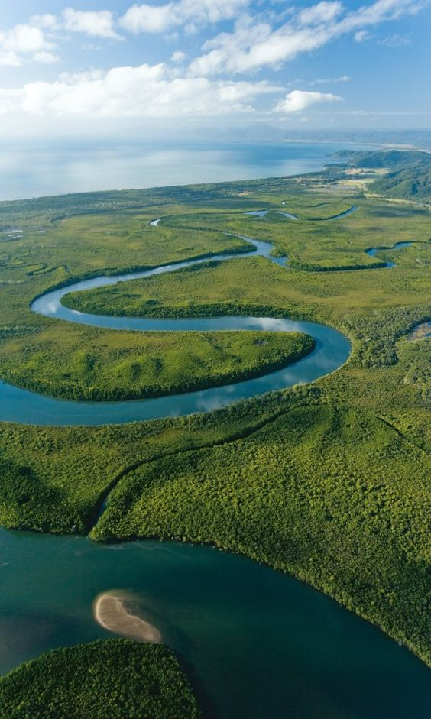
Wild Rivers Act, Queensland, Australia 2005
PURPOSE: ‘preserve the natural values of rivers that have all, or almost all, of their natural values intact’ (Art. 5 of the Act)
- Public participation process
- High Preservation Area + Preservation
- Focus: manage future development
The Wild River Act controversy
Daintree River, Queensland, Australia
Notes:
The purpose of the Act was ‘to preserve the natural values of rivers that have all, or almost all, of their natural values intact.’
Some relevant aspects of the regulation are that:
The Act establishes the process for declaring a river a “wild river” that includes a public participation process.
B) The legislation establishes that the area will be divided:
- A high preservation area will include the wild river, its major tributaries, special features and a surrounding buffer (the extent of which may also be negotiable).
- The rest of the declared wild river area is then known as the preservation area.
C) The policy is explicit in focusing on managing future development to maintain a wild river’s existing natural values, rather than winding back any existing authorised developments. This could be an approach to balance those who may opposed to legislation of this type due to existing activities in the area.
For example: Existing mining activities carried out over an area which becomes subject to a declaration are not affected by the terms of the declaration until that authorisation is renewed.
CONFLICT. This refers to the controversy surrounding the Wild Rivers Act that finally led to its repeal in 2009. The public debate included different points of view by traditional owners, community members, indigenous groups, environmental groups and stakeholders. This process highlights the relevance of the political context and the support needed to implement legislation of this type.
------
REPEALED 2009. The explanatory notes concluded that the policy objectives of the Act can be more effectively implemented through Queensland’s existing land use planning and development assessment framework and the new Regional Planning Interests Act 2014 (RPI Act).
But serious doubts have been raised whether the general framework will be able to provide a strong level of protection to the remaining rivers in natural conditions.
The Act has been criticized because the regulation did not provide any mechanism to encourage proactive land management. It was mainly focused on regulating uses and developments on the land, but gave no incentive to improve the quality of the river and its surroundings.

Slide 8
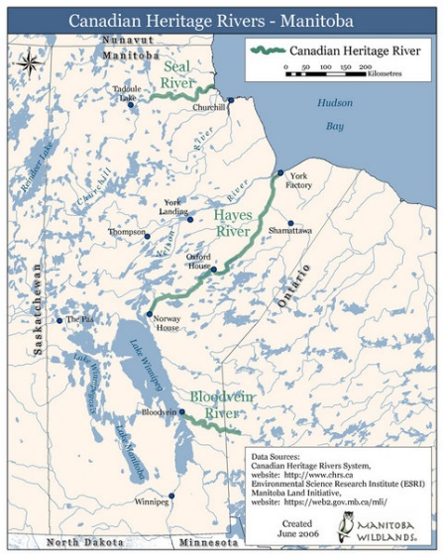
Canadian Heritage River System
National recognition to Canada’s outstanding rivers; encourages long-term management to conserve natural, cultural and recreational values for the benefit and enjoyment of Canadians, now and in the future.
- Cooperative and voluntary system
- Community engagement
- Effective?
MANAGED BY
Notes:
It is a cooperative and voluntary system, that rather than imposing a river management policy on the regional governments. It approaches river management through the spirit of cooperation between different levels of government.
The nomination process will normally start with an inquiry or an expression of interest at the local level. Frequently, local community members propose a river for protection. So there is a mechanism to encourage community members to participate and get involved in the process.
There have been discussions over the effectiveness of the system, particularly because it is a voluntary system, community-driven, and neither universally prohibits nor mandates activities. Once the river is in the system, the National Board will emit an annual report to determine the state of the river.
Today are 42 Canadian Heritage Rivers (39 designated and 3 nominated) across the country, that involve close to 12,000 km
EXAMPLE The Grand River in Ontario was designated a heritage river in 1994. The "Grand Strategy," the watershed management plan developed for the Grand River, included community as well as technical working groups and required approval from residents of over 60 communities. In 2000, the Grand River Conservation Authority was awarded the Thiess Services Riverprize, an international award for excellence in river management (Canadian Heritage Rivers Board 200I: 18-20).

Slide 9
Chile and free-flowing river protection
A. Protected Areas a viable option for Chile?
Protected Areas covered 19.5% of land area
Environmental Performance Review Chile 2016 (OECD)
Freshwater protected areas?
Chilean Free-Flowing Rivers Network
1.221 rivers
101 watersheds
Notes:
These international frameworks provided some insight in the relevant aspects that need to be considered to develop a national framework to protect rivers in their natural state. However, we also we need to consider the National context, and existing legal tools that the country already has.
Chile is a narrow country located in South America, to the west is the Pacific Ocean and to the east the Andes Mountains, bordered by Argentina. This particular geography causes water resources and the demand for it to be unequally distributed throughout the territory, producing conflicts. In addition, many rivers, particularly in the South because of the gradient and fast flows, have considerable hydropower potential.
In relation to the political and social context. In the last few years major hydroelectric projects have been stopped or slowed down because of the ongoing campaigns by NGOs, communities and some politicians. Also, different movements have been organizing themselves to protect rivers. Most recently, we established a Chilean Free-Flowing Rivers Network to organize research needs, communications, and political advocacy. So, there is momentum in Chile to talk about free-flowing river protection.
As I already said Chile does not have a river protection framework, but we do have a Protected Area System that covers around 19% of the land area. So the first question to address river protection for me, was if this system could provide a useful framework to protect rivers in their natural conditions.
There are two elements that needs to be considered to answer this question.
In July 2016, the Organisation for Economic Co-operation and Development (OECD) released the Environmental Performance Review Chile. The report recognized that many regions of the country are significant for global biodiversity, including freshwater ecosystems.
However, because natural resources are a pillar of Chile’s economy, the pressures on ecosystems remain intense. It also establishes that, there is deficient management and lack of sufficient financial and human resources support. And, despite current efforts it is likely that Chile will not have operational management and administration for all protected areas until 2050. So this does not seem to be a good scenario to approach river protection unless some changes occur soon.
2) Is the debate about how PA could be successful to achieve protection of free-flowing rivers? PA has been mainly focused on terrestrial and more recently marine protection, but freshwater ecosystems need a different approach to achieve a good outcome. In addition, free-flowing rivers are only a particular type of rivers, where most productive activities are forbidden. So that discussion is also something to take into account.

Slide 10
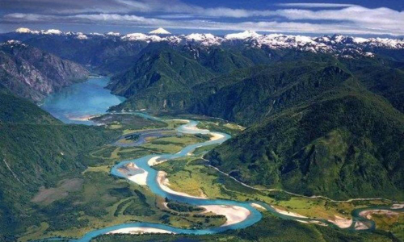
Protected Area Systems for free-flowing rivers
Would require:
New Biodiversity and Protected Areas System
Modern approach, based on rivers' hydrological basins
Watershed of the Puelo River, Chile
Notes:
Since 2014, Chile’s Parliament has been discussing legislation that would create a new Biodiversity and Protected Areas System, but until now the discussion has not included a particular reference to freshwater protected areas.
If the new system acknoledged the different characteristics of river protection and substantially improve managament and administration of the areas, this could be an approach to achieve river conservation in their natural state.
However, TIME is also relevant, and there is a need forurgent protection. Under this System, as the report said, it make take awhile to have a sucessuflly implemented protected area system. It is even more difficult to successfully protect freshwater ecosystems in the next couple of years.

Slide 11
B. Is a specific regulation for protecting free-flowing rivers a better option for Chile?
Improve knowledge about the state of rivers and their particular characteristics.
Unique category of rivers protected.
Nomination (community involvement), public participation, guidelines.
Process for adding more rivers into the system
Management of the rivers.
Compliance and enforcement mechanisms.
Notes:
So based on this analysis. I believe that a specific regulation to protect free-flowing rivers is the best approach for Chile.
Improve knowledge about the state of rivers and their particular characteristics, to be able to determine potential rivers to be protected.
-Unique category of protected rivers, like Australia, would be a better approach. Includes the free-flowing river, its major tributaries, special features and a buffer zone. When there are more than one category, it can produce a level of flexibility for some rivers that defeats the purpose.
Process. Nomination (include proposals from the community, consider some public funding for research). Public participation (Like in the Australian case, the opposition of certain groups could be intensified if they feel their opinions are not being properly taking into account). Guidelines (to determined if the rivers possess an outstanding value). Final Decision.
Process to include more rivers into the systems. It is easier to pass the legislation listing some key rivers in the country, and then keep adding more for protection. It makes the negotiation process easier, and helps deal with opposition.
Management. Should provide a high level of protection, encouraging activities that do not pose a significant threat to the river for example ecotourism.
Compliance and enforcement.
Activities that help to enhance the natural values of the rivers.
To finish this presentation I would like to mention I are still researching this topic, with a colleague of mine in Chile, Patrick Lynch, who is a member of the World Commission on Environmental Law. We are working to publish the final version of the paper. So please let me know your comments or observations, and if anyone would like to see this draft we would love to hear your thoughts.

Slide 12
THANK YOU!
e-mail: weberp@student.unimelb.edu.au

