Slide 1



Creating an integrated monitoring and evaluation system which informs adaptive management of environmental flows
Lauren Zielinski
Zielinski Environmental Monitoring and Evaluation, LLC – USA
John Conallin Andrew Warner
IHE-Delft – NL CDM Smith – USA
BRISBANE, AUSTRALIA | 18 - 20 SEPTEMBER 2017
MANAGED BY

Slide 2
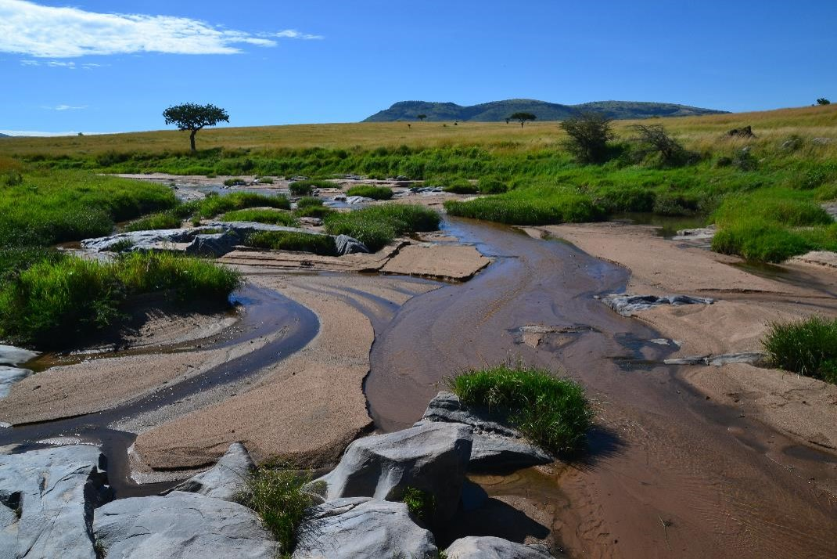
CONTEXT – CREATION PROCESS – OUTCOMES – IMPLEMENTATION – LESSONS LEARNED – NEXT STEPS
  Kenya & Tanzania
  7 EFAs
  0 implemented
  Why?
  Barriers?
  Pathway forward?
  Rural basins, limited resources
BRISBANE, AUSTRALIA | 18 - 20 SEPTEMBER 2017
MANAGED BY
Notes:
As the concept of environmental flows is gaining traction as a water resources management tool, many EFAs are being conducted in quickly developing and often rural areas around the world. This is often done in hopes of conserving important and unique ecosystem (instead of restoring them afterwards) and promoting responsible future development of that river basin. Yet, due to their lack of development and the lack of potential financial resources that come with it, these areas may also be in an unlikely position to actually implement these recommendations. This is the situation we found while working in eastern Africa. In Kenya and Tanzania, there have been at least 7 EFAs completed in the past 10 years, yet none of them have been meaningfully implemented. To us, this indicated that there must be an barrier to implementing these recommendations, which is likely only exasperated by the lack of financial and/or staff resources common among rural water management agencies. So wanted to figure out a way to overcome this barrier and help provide a pathway forward for river managers charged with implementing environmental flows.

Slide 3
CONTEXT – CREATION PROCESS – OUTCOMES – IMPLEMENTATION – LESSONS LEARNED – NEXT STEPS
  River Basin Information:
  Hydrological
  Ecological
  Social
  Are we meeting the environmental flow recommendations?
  How effective are these recommendations at protecting aquatic ecosystems and providing for local communities?
Monitoring plan
  How do we make a monitoring plan?
  How do we monitor with limited resources?
  What do we do with the data we’ve collected?
BRISBANE, AUSTRALIA | 18 - 20 SEPTEMBER 2017
MANAGED BY
Notes:
For us, a logical place to start was the need for river managers to have a good understanding of the conditions of their river basin, more specifically the hydrological, ecological, and social conditions. In this way, managers could then assess if the flow recommendations were being met and if these flow recommendations were effective in protecting aquatic ecosystems and providing for local communities. In essence, what was needed was a strong monitoring and evaluation program.
So we know we need a monitoring and evaluation plan, but then three important questions arise: 1) how to we make such a plan, 2) how to we undertake a monitoring program with limited resources, and 3) what do we do with the data we’ve collect. We decided to tackle each one of these steps individually, but also wanted to make sure that they connected and fed into each other.

Slide 4
CONTEXT – CREATION PROCESS – OUTCOMES – IMPLEMENTATION – LESSONS LEARNED – NEXT STEPS
  How do we make a monitoring plan?
Legislative Framework
Water Quantity
Management Framework
Water Quality
Geomorphology
  Objectives Hierarchy
Fish
Eflows Framework
Vegetation
Invertebrates
Key Ecosystem Components
Social
BRISBANE, AUSTRALIA | 18 - 20 SEPTEMBER 2017
MANAGED BY
Notes:
For the question of how to make an monitoring plan, we wanted to make sure that the objectives of implementing the environmental flows recommendations were a prominent feature of the monitoring plan. We also wanted to incorporate any other legal requirements and overall management visions into the structure. To accomplish this, we created a type of objectives hierarchy to guide this process. An objectives hierarchy is a way of breaking down high level management goals into more and more specific sub-objectives until measurable components can be determined. This management tool is also useful because it can be customized to meet different management situations. For our situation, we incorporated 3 different “frameworks” instead of sub-objectives to help drive the develop of a customized objectives hierarchy: 1) the legislative framework, which includes national level laws and regulations related to implementing environmental flows; 2) the management framework, which is any approved management plans or direction to be followed in that river basin; and 3) the environmental flows framework, which includes the detailed information included in the EFA at specific points along the river. These three frameworks help to determine the selection of key ecosystem components that need to be monitored in order to comply with any legal and management requirements. Examples of key ecosystem components include water quantity, water quality, geomorphology, fish, vegetation, invertebrates, and social uses.

Slide 5
CONTEXT – CREATION PROCESS – OUTCOMES – IMPLEMENTATION – LESSONS LEARNED – NEXT STEPS
  How do we make a monitoring plan?
Key Ecosystem Component
Management Objective
Monitoring Indicator(s)
Monitoring Methods?
BRISBANE, AUSTRALIA | 18 - 20 SEPTEMBER 2017
MANAGED BY
Notes:
These key ecosystem components then create the foundation for the creation of the monitoring plan. Each key ecosystem component will then have it’s own management objective and monitoring indicator(s). In general, a management objective is a desired condition (e.g., sustain populations of fish species important for subsistence fishing) while an indicator is what to watch in order to know if you’re achieving this objective (e.g., adult populations of species X and Y). The next step is to determine which monitoring methods (or field techniques) you will use to collect data on those indicators. There are usually many ways to monitoring a single indicator, and they can vary widely in collection time, cost, and complexity.

Slide 6
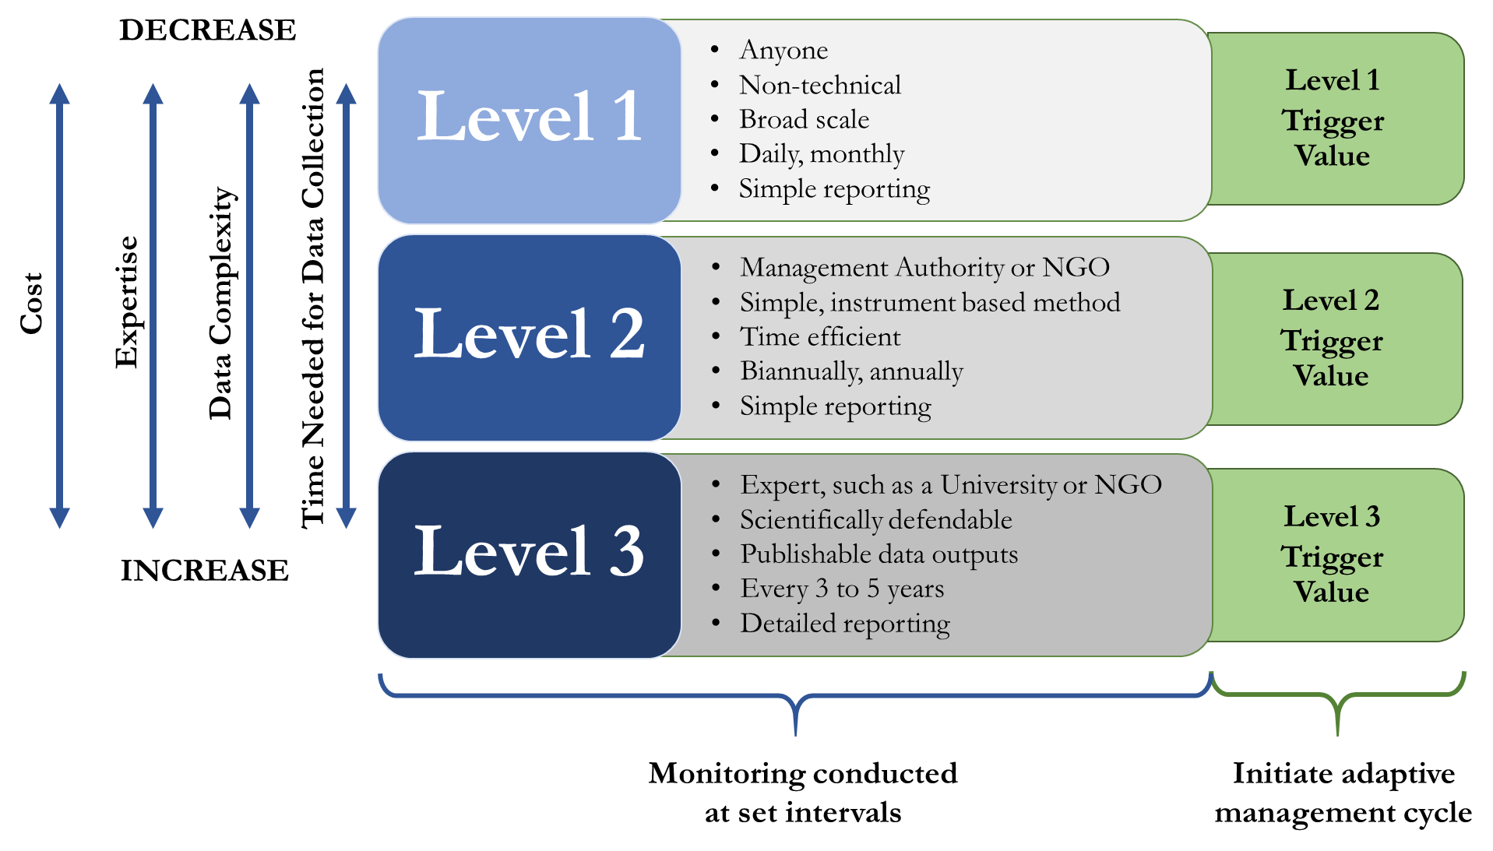
CONTEXT – CREATION PROCESS – OUTCOMES – IMPLEMENTATION – LESSONS LEARNED – NEXT STEPS
  How do we monitor with limited resources?
Location
Timing
Frequency
BRISBANE, AUSTRALIA | 18 - 20 SEPTEMBER 2017
MANAGED BY
Notes:
To help sort out the types of monitoring methods, we used a three-level system. Level 1 contains methods that are easy, cost effective, and can be collected frequently by anyone. However, it collects very basic data and provides information on conditions in a very broad sense. Level 2 contains methods that are usually undertaken by a management authority, requires some simple training, and provides more detailed information, but at a greater cost in time and money. Level 3 is very detailed information collected and analyzed by experts, but can be very costly in terms of time and money. The methods at all three levels feeds into each other to create a more complete understanding of the conditions of that key ecosystem. In general, Level 1 can be described as citizen science, Level 2 as the responsibility of the management authority, and Level 3 as expert level. They are normally conducted at set intervals, except when a trigger value is passed. Each level has their own trigger value which is where the data collected at that level indicates that there is a potential issue. If a trigger value is surpassed, then it indicates that a management action may need to take place. This system also allows for informative data to be collected, even in times of very limited resources.

Slide 7
CONTEXT – CREATION PROCESS – OUTCOMES – IMPLEMENTATION – LESSONS LEARNED – NEXT STEPS
  What do we do with the data we’ve collected?
Trigger values
Monitoring data
Adaptive management
Evaluation
“learning by doing”
Management action
BRISBANE, AUSTRALIA | 18 - 20 SEPTEMBER 2017
MANAGED BY
Notes:
The final step is deciding what to do with the data that’s collected. Here is where we implement adaptive management principles, or more simply, “learning by doing”. Adaptive management usually consists of a cyclical process where information is collected on a system, that information is then evaluated against management objectives, and then an action can be taken to change the condition of that system towards meeting that objective. In our case, the information is the data collected in the monitoring plan and the evaluation occurs at set intervals (e.g., annually) or when a trigger value is surpassed.

Slide 8
CONTEXT – CREATION PROCESS – OUTCOMES – IMPLEMENTATION – LESSONS LEARNED – NEXT STEPS
  What do we do with the data we’ve collected?
BRISBANE, AUSTRALIA | 18 - 20 SEPTEMBER 2017
MANAGED BY
Notes:
For our system, we’ve created adaptive management cycles to help managers analyze the situation and figure out which management actions to take. As a general overview, monitoring occurs and if a trigger value is surpassed (the yellow boxes), then it leads questions for the managers (green diamonds), and then potential management actions (blue boxes).

Slide 9
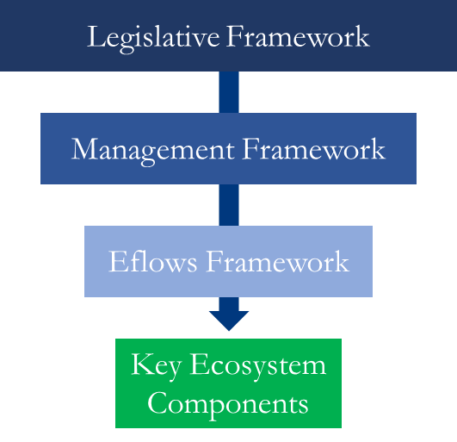
CONTEXT – CREATION PROCESS – OUTCOMES – IMPLEMENTATION – LESSONS LEARNED – NEXT STEPS
  How do we make a monitoring plan?
  How do we monitor with limited resources?
  What do we do with the data we’ve collected?
  Customized objectives hierarchy
  Multi-level monitoring plan
  Adaptive management cycles
BRISBANE, AUSTRALIA | 18 - 20 SEPTEMBER 2017
MANAGED BY
Notes:
Combining these three steps, we have created a way to develop a monitoring and adaptive management plan to assist in the implementation of environmental flows. And because this system is customizable with a big focus on implementability, it can be applied in a variety of situations, particularly in resource limited areas. So far we’ve implemented this in two river basins.

Slide 10
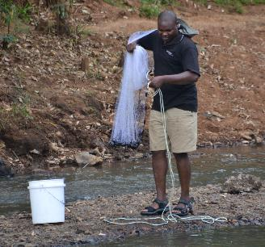
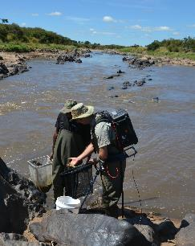
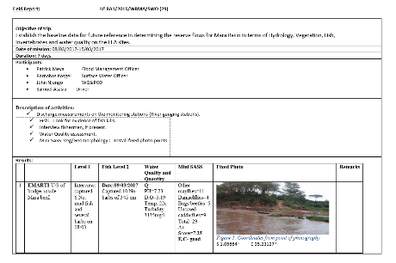
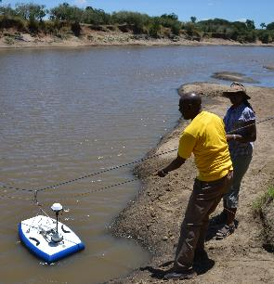
CONTEXT – CREATION PROCESS – OUTCOMES – IMPLEMENTATION – LESSONS LEARNED – NEXT STEPS
Mara River Basin, Kenya
  Relatively small basin: ~ 8,700 sq. km
  ~ 10 river gauging stations, all used for multiple monitoring methods
  Very limited funds, but two dedicated monitoring technicians
    Potentially only occasional Level 2 monitoring
MANAGED BY
Notes:
The first is the Mara River Basin in Kenya, which is where this methodology was first created and applied. The Mara River Basin in Kenya is a relatively small river basin with about 10 permanent river gauging stations. We focused all monitoring at these stations to provide the opportunity to link river conditions back to flow conditions. But we had a situation where funds were VERY limited financial resources, but had two dedicated monitoring technicians. Since there was no money to pay the locals to help with monitoring, many of the key ecosystem components only had recommendations for Level 2 and 3 monitoring, with the likely scenario that only occasional Level 2 monitoring would occur until financial resources improved.

Slide 11
CONTEXT – CREATION PROCESS – OUTCOMES – IMPLEMENTATION – LESSONS LEARNED – NEXT STEPS
Mara River Basin, Kenya
  Pilot basin - plan created in September 2016
  Monthly data collection by technicians beginning February 2017
  Need a central location for all monitoring data to make data useful for managers
MANAGED BY
Notes:
This plan was created in September 2016 and data collection began in 2017. Immediately, we discovered that it was there was no centralized data collection and management system in place, making it difficult for managers to easily access and visualize the data. Hence, making it difficult for the data to be used in decision making.

Slide 12
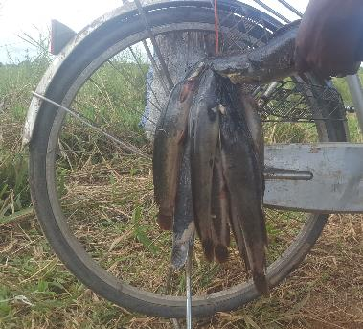
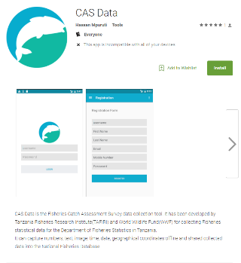
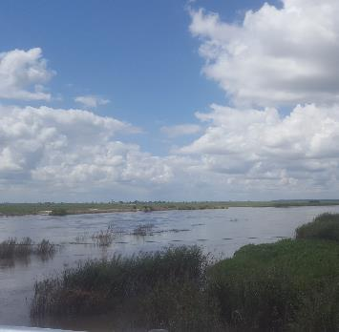
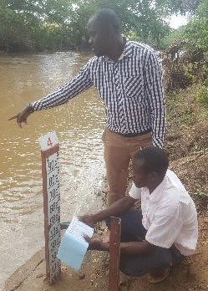
CONTEXT – CREATION PROCESS – OUTCOMES – IMPLEMENTATION – LESSONS LEARNED – NEXT STEPS
Rufiji River Basin, Tanzania
  Large basin: ~ 177,000 sq. km
  ~ 60 river gauging stations
  ~ 20 priority long-term monitoring sites determined at stakeholder workshop
MANAGED BY
Notes:
The second place this system was implemented was in the Rufiji River Basin in Tanzania. The river basin is vastly different than the Mara. While the Mara was relatively small and frequent monitoring trips to all monitoring sites could be easily accomplished, the Rufiji is a very large basin (about 1/5 of the entire country) and contains almost 60 river gauging stations. So having monitoring technicians conduct multiple monitoring methods at each site was not realistic. So at a stakeholder workshop, we selected about 20 priority long-term monitoring sites to help save time and resource.

Slide 13
CONTEXT – CREATION PROCESS – OUTCOMES – IMPLEMENTATION – LESSONS LEARNED – NEXT STEPS
Rufiji River Basin, Tanzania
  Increased incorporation of citizen science efforts, development of cell phone applications, and increased interagency coordination through establishment of steering committee
  Currently in development phase
MANAGED BY
Notes:
What makes this basin interesting is that there were a handful of interesting opportunities we are taking advantage of. First, there is an existing network of other ecological monitoring occurring by other federal agencies and conservation partners (including citizen science efforts), which is being integrated into the environmental flows monitoring plan, as well as a strong focus on the use of cell phones and mobile applications to collect and send data to the local water board. There is also a strong desire to establish a multi-agency monitoring steering committee to analyze and evaluate the data, and make collective management actions when required. This plan is currently in the development stages, to be completed by mid 2018. We’ve learned a lot between implementing it in this basin vs. the Mara ns updates to the process have already been made.

Slide 14
CONTEXT – CREATION PROCESS – OUTCOMES – IMPLEMENTATION – LESSONS LEARNED – NEXT STEPS
Lessons Learned
Begin planning of monitoring and adaptive management efforts during EFA planning process
Centralized data collection and management system is key
Important to have stakeholder input during development of overall EFA and monitoring objectives
  May also include interagency and public outreach to promote partnerships
BRISBANE, AUSTRALIA | 18 - 20 SEPTEMBER 2017
MANAGED BY

Slide 15
CONTEXT – CREATION PROCESS – OUTCOMES – IMPLEMENTATION – LESSONS LEARNED – NEXT STEPS
Next Steps
Continued implementation and development of the 3-step process
  Try applying to different EFA methodologies, different aquatic ecosystems, and different regions of the world
Integration of data collection and management into customized user interface
  Including centralized data system and cell phone applications
Synthesis of M&E/AM plans for environmental flow projects around the world
BRISBANE, AUSTRALIA | 18 - 20 SEPTEMBER 2017
MANAGED BY

Slide 16
Thank you for your attention
Lauren Zielinski
lzielinski@ZEMEenviro.com
BRISBANE, AUSTRALIA | 18 - 20 SEPTEMBER 2017
MANAGED BY

