Slide 1
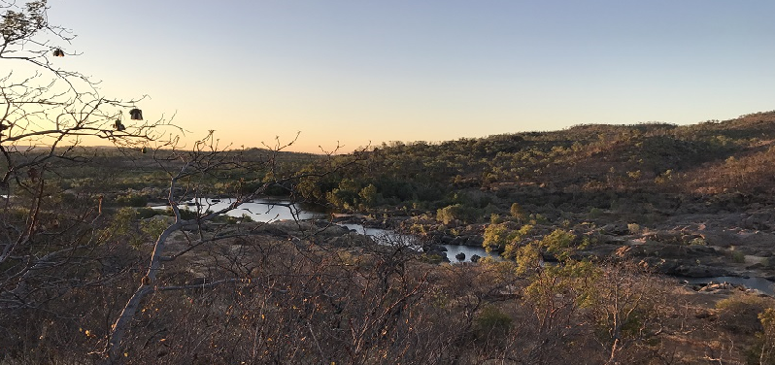
Water Resource Development as Opportunities to Strengthen Co-existence: Learnings from Indigenous Traditional Owners of the Mitchell Catchment
Dr Peci Lyons (Pethie) and Dr Marcus Barber
International River Symposium, 15 October 2018
Land and water
Notes:
Tips for communicating with impact
Keep to timing! You have been assigned 12 minutes, unless informed otherwise.
Keep your messages simple and avoid technical jargon. Share your achievements, practical experience, lessons learned and transferable outcomes.

Slide 2
Indigenous water values, rights, interests and development objectives
Northern Australia Water Resource Assessment
Commonwealth government interest in northern Australia economic development particularly agriculture
Agriculture Competitiveness White Paper
Northern Australia White Paper
Increasing focus from Indigenous groups of natural resource development potential of Indigenous lands
NAILSMA Indigenous Forums - Mary River 2012, Kakadu 2013
Current Indigenous Reference Group for Northern Australia
Over a decade of CSIRO research in this field
Notes:
Mary River 2012 – the Framework was a major outcome from the first meeting
Kakadu 2013 – development of a commercial framework that could assist Traditional owners to attract and engage with investors

Slide 3
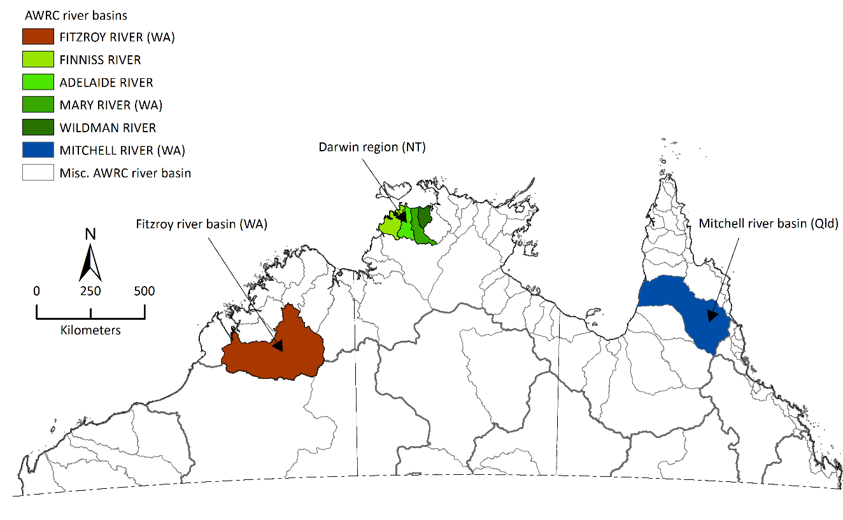
NAWRA catchments

Slide 4
NAWRA key objectives:
The Assessment key Objectives were to investigate:
soil and water resources
water capture and storage options and supply reliability
commercial viability of agricultural opportunities, aquaculture, forestry
environmental, social and economic impacts and risks
Aims of the Indigenous water values, rights and development objectives sub-project:
Improve existing information
explore options
Show key issues for and views of Indigenous peoples of the Mitchell catchment
Share knowledge
Notes:
The project aimed to identify the potential to increase water-related development opportunities in northern Australia. The studies included:
evaluating the soil and water resources
identifying and evaluate water capture and storage options
identifying and test the commercial viability of irrigated agriculture opportunities
assessing potential environmental, social and economic impacts and risks of water resource and irrigation development.
Information to assist planning for future development by TOs, government, and developers

Slide 5
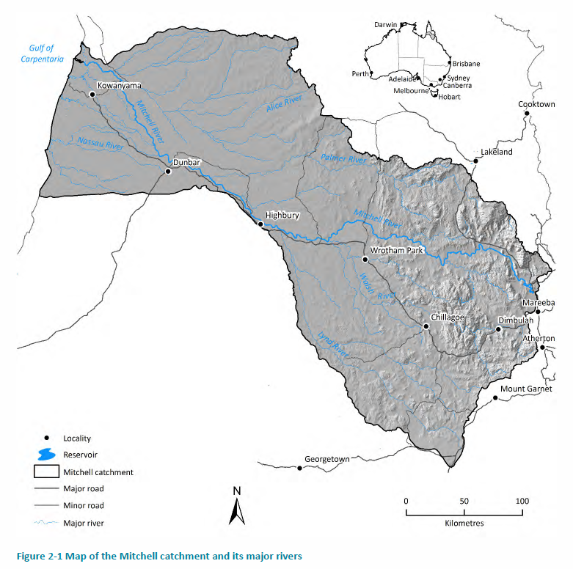
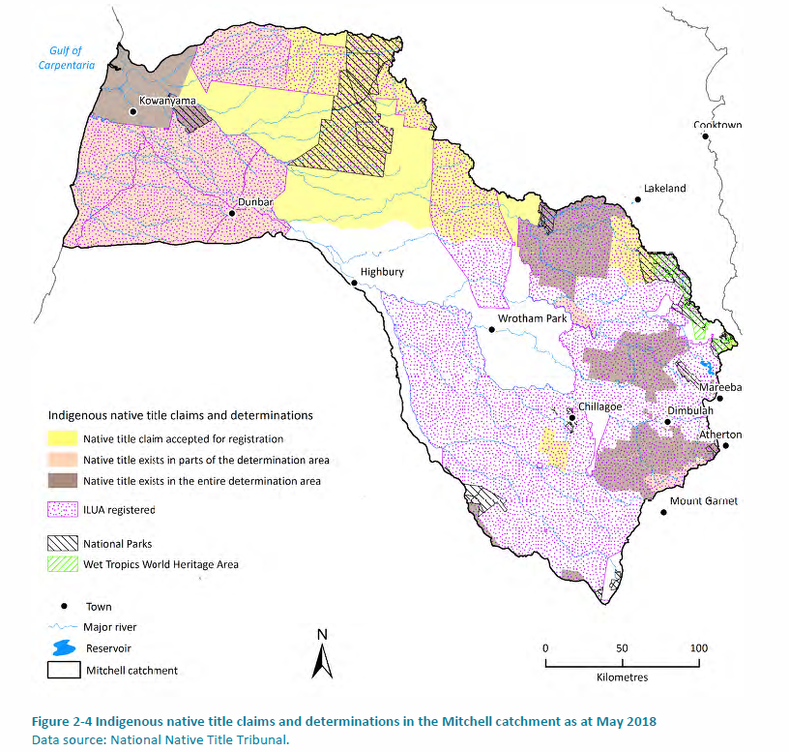
Mitchell catchment
Notes:
Indigenous people make up 25% of the population of the Mitchell catchment. This includes Indigenous people who are part of recognised local ownership groups as well as residents who identify as Indigenous but have their origins elsewhere.
These patterns of residence and dispersal reflect a combination of involuntary relocation, voluntary movement to seek jobs and other opportunities, and kinship and family links. The concentration of people in particular places means that residential location can differ from formal group and tenure boundaries
the major ways in which contemporary Indigenous people from the Mitchell catchment exercise some degree of management control over large areas of traditional lands include Native title, DOGIT land, ownership of pastoral leases, national park co-management, and Indigenous Land Use Agreements (ILUAs) are
Major Industries that rely on Water: Agriculture, Forestry and Fisheries Grazing Construction Mining Accommodation and Food services Tourism

Slide 6
What we talked about with Indigenous peoples from the Mitchell catchment
Why is water important?
Current and Future use of groundwater and river water
Best ways to get and store water
Indigenous involvement in water planning
Business ideas and plans that need water

Slide 7
Our Process
Memorandum of Understanding
Free prior and informed consent
Show spread of values, ideas, and objectives
Public process
Notes:
Intellectual property to remain owned by Indigenous participants
Not seek an agreed position
Public process did not seek restricted information
Participants have the final say about what information is made public

Slide 8
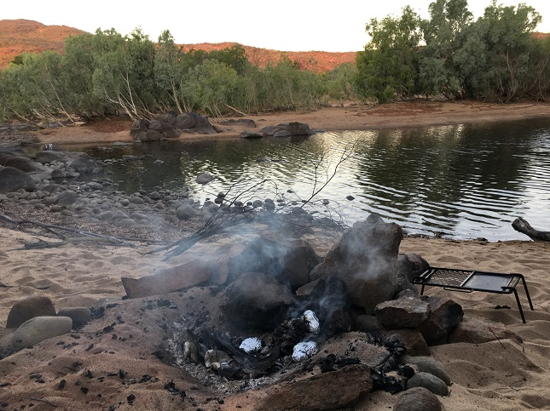
Water values
Water values associated with Dreaming, ceremonial and spiritual values, camping and hunting, obligations and responsibilities
Cultural Heritage concerns with water
development
Managing others on country
Notes:
Much evidence of the importance of water to Indigenous Australian societies. Archaeological and heritage studies demonstrate the importance of permanent water sites to pre-colonial Indigenous habitation, and these studies are often supported by evidence from Indigenous oral traditions.
Strong imperatives/needs to preserve natural and cultural resources.
Principles of Indigenous owners and managing non-Indigenous activities:
Consultation
Compliance
Compensation
Future water resource development would be assisted by supporting Indigenous understanding of the full extent of the cultural heritage assets. Cultural heritage is one key aspect of the combination of potential risks and impacts that inform and counterbalance Indigenous objectives regarding development

Slide 9
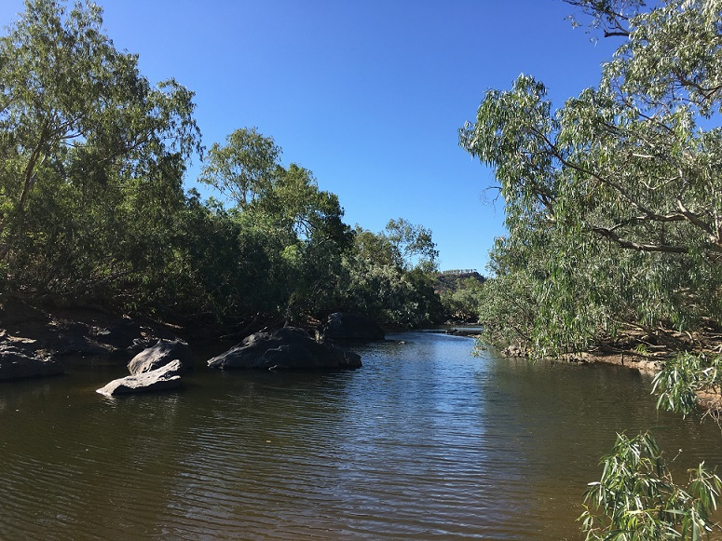
Current water use and future development
Indigenous peoples did not see current water use from agriculture, grazing and mining changing significantly in the near future
They raised concerns about the
uncertainty of impacts of continued
operations
Notes:
Concerns were raised of uncertainty about the impacts of the continued operation of these industries without proper monitoring of their current water use, impacts, and the lack of research and public information about available water supply to sustain them into the future and to support nascent Indigenous businesses, healthy environments, culture water for consumption.
There ongoing impacts of water use in mining operations across the catchment is a longstanding concern.
Indigenous peoples have felt that government and industry have not properly consulted them about the impacts on their traditional lands, their culture and potentially emerging Indigenous enterprises
Water availability for pastoral production was important to Indigenous groups in the catchment, in particular the continuous supply of water, water supply options and measured long-term use.

Slide 10
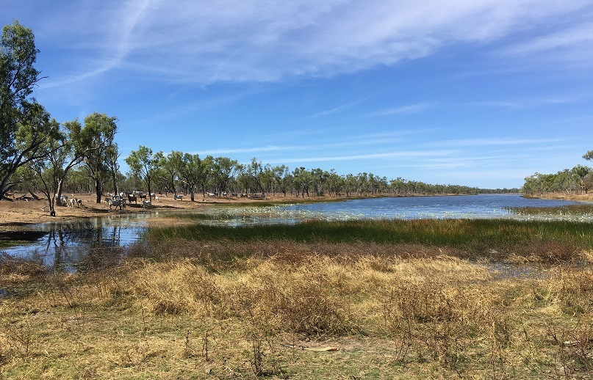
Water extraction and resource development
General preference for flood harvesting with off-stream and farm-scale dams over bores and bores over dams.
Indigenous concerns of water extraction
relate to impacts of:
water flow through rivers
groundwater connectivity
Notes:
Understanding of the full extent of cultural heritage assets.
Consistent with the findings of previous studies, further cultural heritage information is required via:
- a catchment/regional thematic history that identifies significant themes and pre-contact and post-contact places of importance
- a comprehensive survey of proposed storage/development areas in partnership with the relevant Indigenous community and/or Indigenous cultural heritage body
- some archaeological testing of sites or potential archaeological deposits which may be necessary to determine the scientific significance of cultural heritage sites

Slide 11
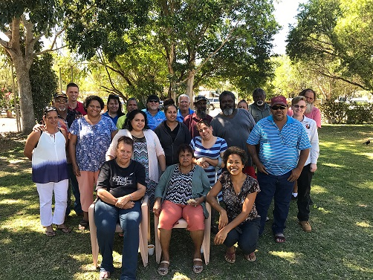
Water planning and development
Indigenous peoples in the catchment seek greater formal recognition of their water values, and obligations to country and to neighbouring groups as a basic foundation for water planning.
Notes:
Knowledge amongst Indigenous people about both the general and Indigenous-specific features of water planning was low amongst the resident Indigenous population.
Indigenous peoples of the Mitchell catchment seek greater involvement in water planning and catchment processes, -
Want a planning framework that includes science and supports collective planning across groups that have a stake and interest in water use in the catchment.
Role as central to multi-interest planning processes and decision making based on their location in the catchment and as custodians of their traditional lands prior to occupation.
Role as one of oversight of consultation processes to ensure: - delivery of benefits to Indigenous peoples when they are involved in planning, proper engagement that recognises Indigenous governance and water values as well as economic objectives and greater inclusion of local knowledge of water.
They see opportunities to be involved in monitoring water use across user groups and greater

Slide 12
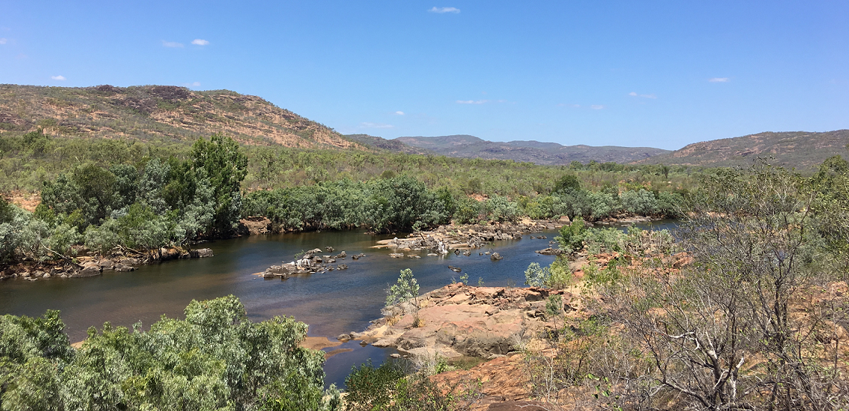
Indigenous water allocations
The prospect of Indigenous specific allocations was perceived to be positive for a variety of reasons:
for enterprise projects
opportunities to generate income through leasing of water
formal recognition of rights and management of those rights
Notes:
Amongst those who have heard of it, the prospect of Indigenous specific allocations was perceived to be a positive one for a variety of reasons:
for farming projects, opportunities to generate income through leasing of water, formal recognition of rights and management of those rights between Indigenous and non-Indigenous corporation.
Indigenous peoples in the catchment want to negotiate greater rights to access ground and surface water for their cultural, social and economic needs, as well as ensuring that there is considered broader understanding of industry needs and the capacity of the rivers to support different values and uses today and into the future.

Slide 13
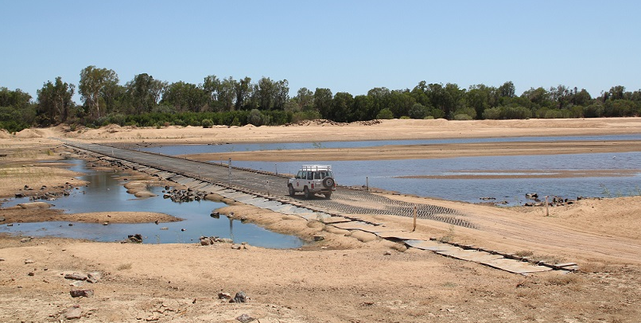
Indigenous enterprises
Indigenous sustainable development objectives are diverse and include the development of Indigenous-owned and operated businesses, as well as involvement in other businesses and activities in the region
Notes:
OBJECTIVES ARE DIVERSE
Pastoral intensification
Indigenous models of agriculture, horticulture and bush productions
Eco and cultural tourism
Aquaculture
Community wellbeing
Employment and training (knowledge gaps)
Natural and cultural resource rights
Residence and re-settlement

Slide 14
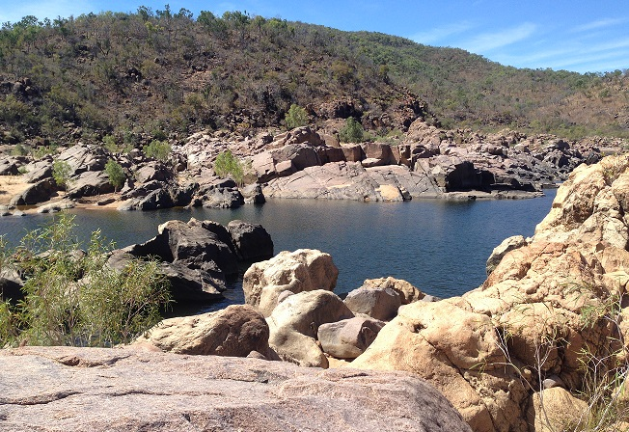
Supporting local capacity in water planning
Build on existing Indigenous water knowledge and expertise
Involvement in water planning to formalise Indigenous water values, rights and interests
Catchment scale discussions and
formal structures
Research and information on impacts of
various types of water extraction
Notes:
A range of views exist about the prospect of further water development in the catchment. These include opposition (based on the potential negative impacts and caution about perceived benefits), through to endorsement of the prospects and the economic opportunities water development may create. This again emphasises the importance of group consultation and planning processes.
The desire for Indigenous involvement in water-development planning and implementation was a consistent finding across all participant groups, as was the need for benefits to Indigenous people to flow from such developments
-Building on existing expertise through focused, catchment-scale skills and capability building in formal water planning
Consideration of Water planning and its articulation with both water development and catchment management
-Establishment of appropriately resourced formal structures for catchment-scale Indigenous water-planning consultation
--Catchment scale discussions:
Indigenous reserves and tradeable allocations
consider formal involvement of Traditional Owners in monitoring and reporting on water use and quality in the catchment
Research:
- research and information about downstream native title interests in water that water plans need to consider
- research into the impacts of various types of water extraction including cumulative impacts and resource development on water supply

Slide 15
Summary
Major study of water and agricultural potential
Indigenous people have long term intergenerational and inter-group obligations as First Nations custodians
Balance that responsibility with need for short term economic development
Considerable diversity in perspectives, but also clear ideas about which forms of development are preferable
Indigenous people want to be owners, partners, investors, and participants in future development
Notes:
Balance - Aspirations are diverse and can take many forms that usually combine economic viability and sustainability with a range of wider social, cultural and environmental goals. This brings to the fore the balancing of short- to medium-term social and economic needs with long-term cultural, historical and religious responsibilities to ancestral lands. Indigenous people understand themselves as members of a socially and economically disadvantaged group, but also as upholding a long tradition of custodianship over ancient landscapes.
- Partnerships and shared-benefit agreements with non-Indigenous businesses
- Indigenous people can act as substantial enablers of appropriate development, as well as co-investors in their own right

Slide 16
Thank you
Land and Water
Dr Peci Lyons (Pethie) Research Scientist
t +61 7 40595019
e Pethie.Lyons@csiro.au
w www.csiro.au
Land and Water
Dr Marcus Barber Senior Research Scientist
t +61 7 38335519
e Marcus.Barber@csiro.au
w www.csiro.au
Land and water

