Slide 2
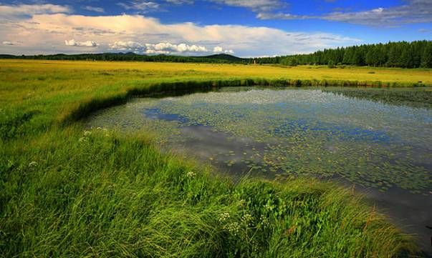


Contents
1、Groundwater ecological problem
2、Ecological protection measures
3、
Ecological effects (Beijing City)

Slide 3
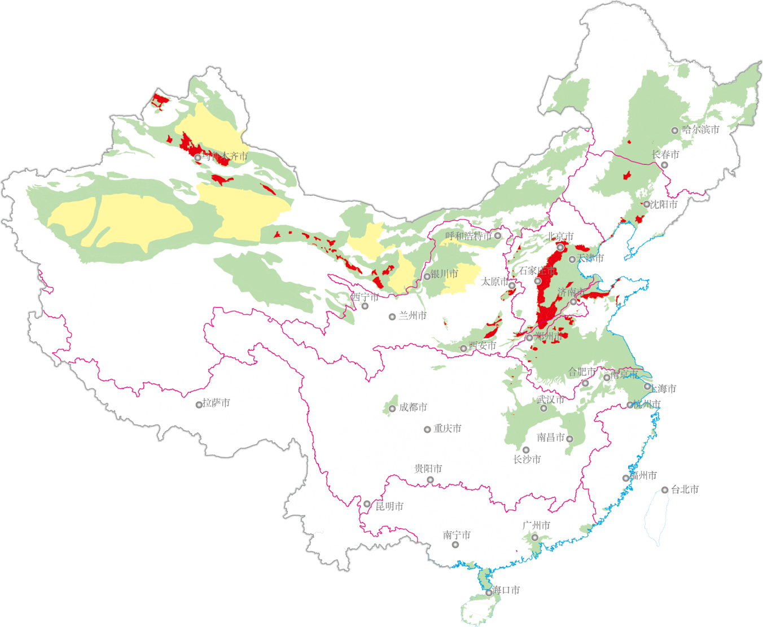
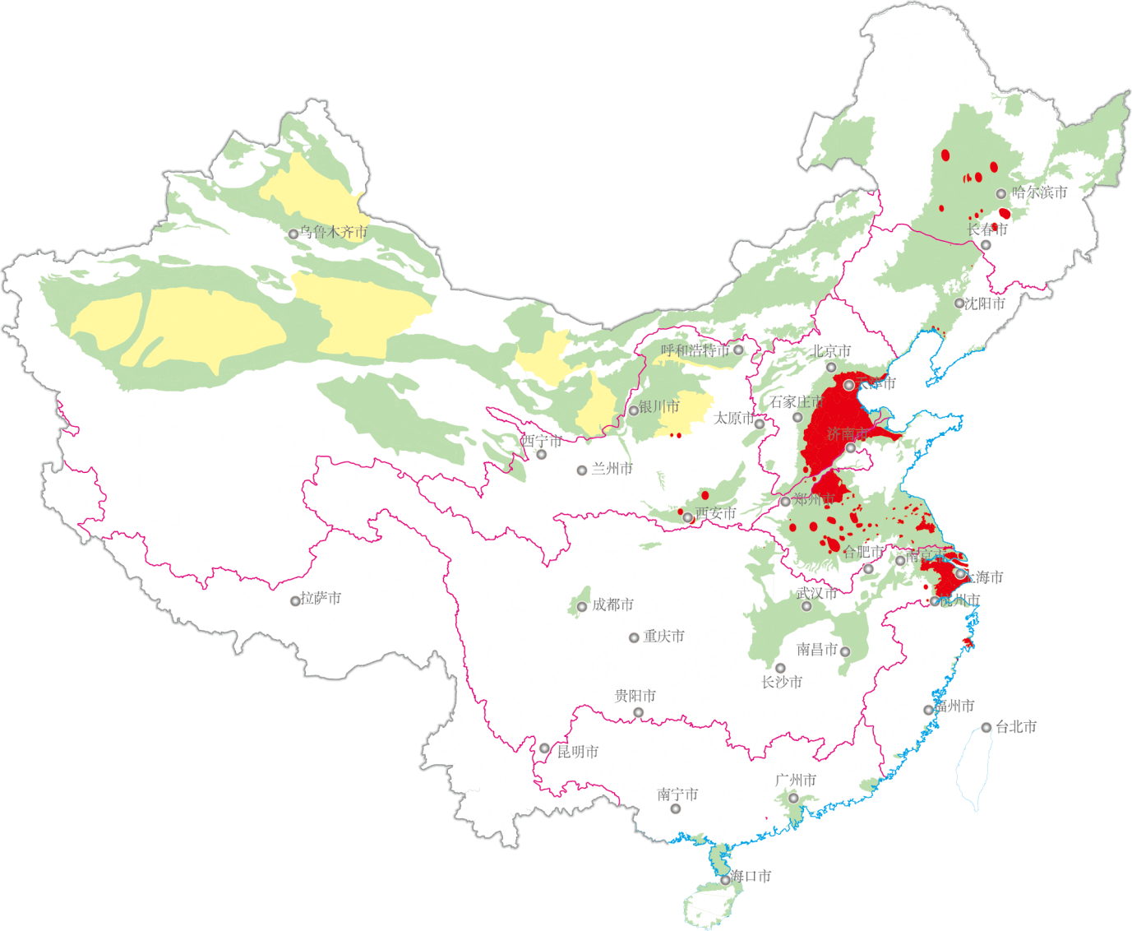
01
Groundwater ecological problem
21% of the total area
40% of the total area
Shallow groundwater over-exploitation zone
Deep groundwater over-exploitation zone

Slide 4
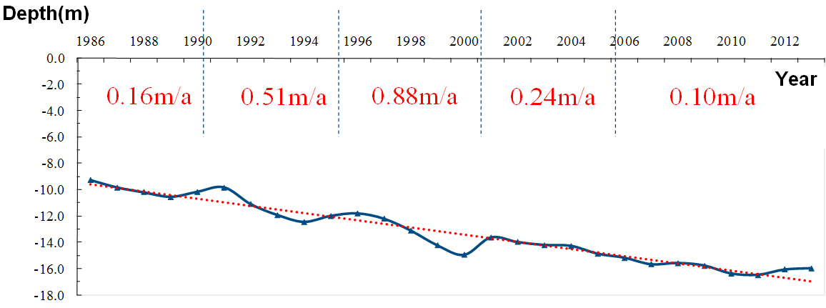
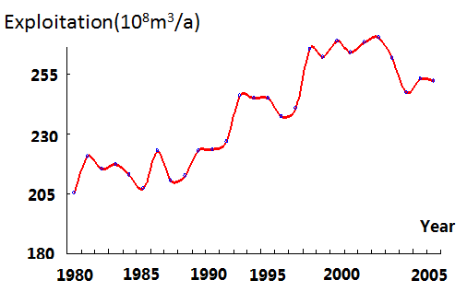
01
Groundwater ecological problem
Since the late 1970s, Hebei Province has continued to over-exploit, reaching its peak around 2000. Although the rate has slowed down, continues to be over-exploited

Slide 5
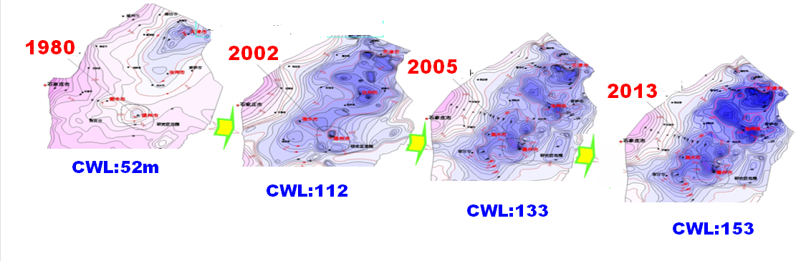
01
Groundwater ecological problem
The Change of deep pressure water depth
The central water level in eastern Hebei : dropped from 52m in the 1980s to 153m in 2013

Slide 6
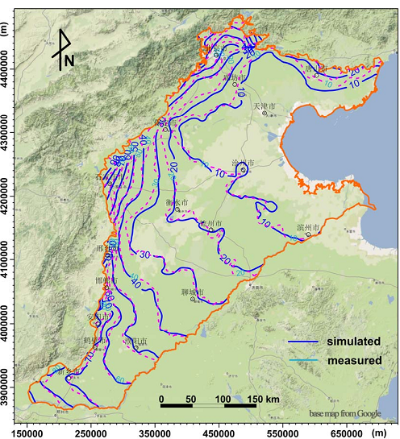
Dynamic change of groundwater exploitation in Haihe River Basin
After nearly 50 years of high-intensity exploration, the GW flow field has undergone a qualitative change: the regional groundwater runoff direction has changed from the west to the east, and has been converted into a funnel for each groundwater level, circulate to its center
The flow field of shallow groundwater in Haihe Plain
1959 (L) and 2005（R）
Notes:
After nearly 30 years of high-intensity concentrated mining and large-scale agricultural exploitation in the Haihe River Basin, the groundwater flow field in the Haihe Plain has undergone a qualitative change: the regional groundwater runoff direction has changed from the west to the east, and has been converted into a funnel for each groundwater level. Circulate to its center

Slide 7
A series of ecological and environmental problems caused by over-exploitation of groundwater in the intake area. It has become a tricky problem restricting the sustainable development of regional economic and social development .
Ground subsidence
Water quality deterioration
Ground crack
Seawater intrusion
Groundwater funnel area expanded

Slide 8
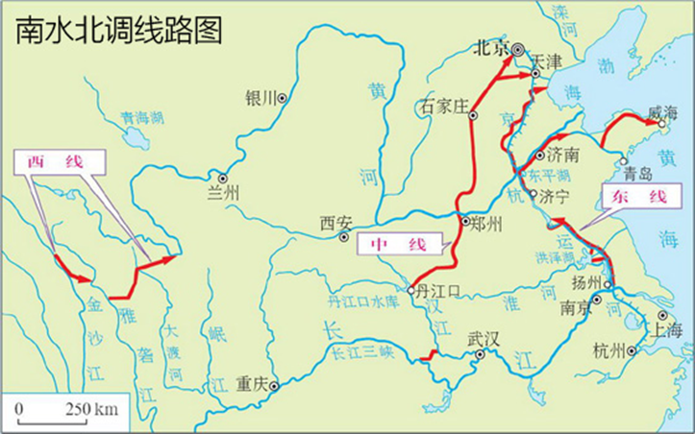
In 2013,2014, the project of South-to-North Water Transfer Project (1Phase) construction completed
Water Proute | City /Province | Intake areas (10,000 km²） | Proportion of the province （%）
Mid-line | Beijing | 0.64 | 38.1
 | Tianjing | 1.12 | 94.0
 | Hebei | 6.21 | 33.1
 | Henan | 4.20 | 25.1
Eastern line | Shandong | 6.72 | 42.9
 | Jiangsu | 4.08 | 38.2
Intake areas 230,000 km², involve 2 municipalities directly under the central government, 4 provinces, and 36 prefecture-level cities，accounting for 2.4% of the country's total land area

Slide 9
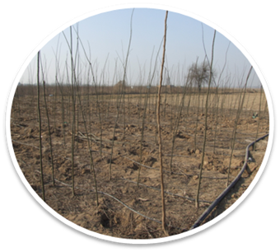
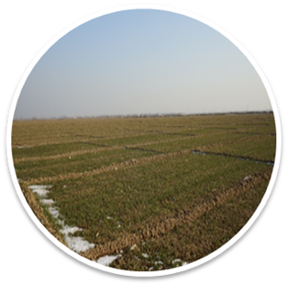
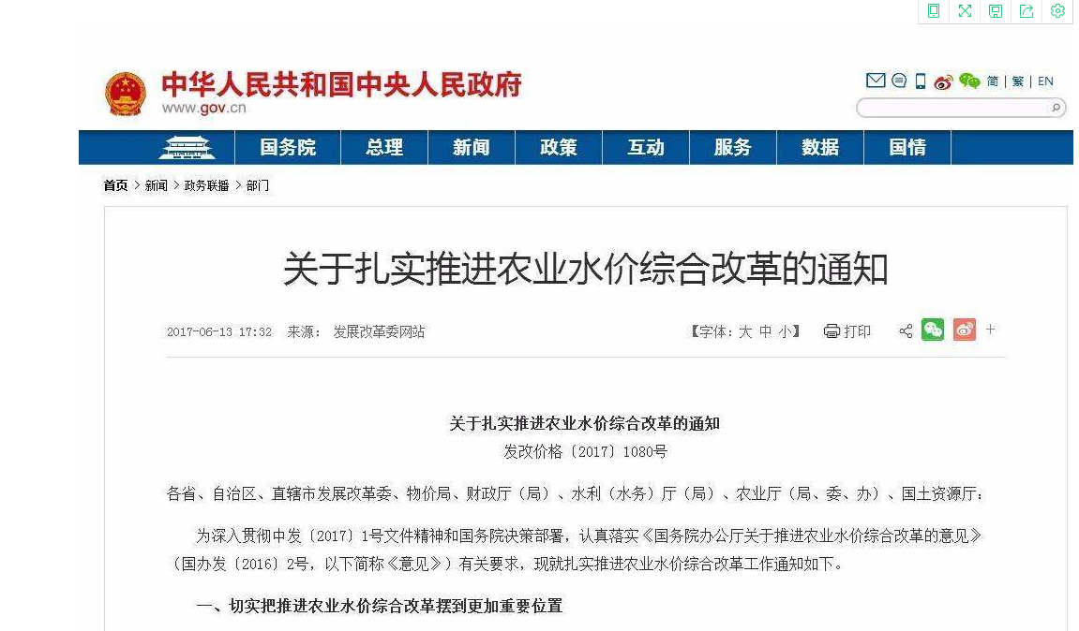
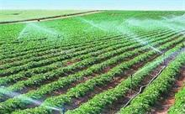
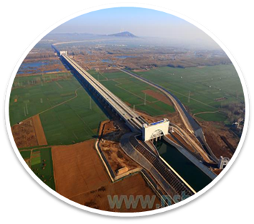
02
Ecological protection measures
Premier proposed general guidelines for water transfer projects in 2009:
Water saving before transfer , polluted water controlling before transfer ,water ecological protecting before transfer
The State Council approved the “Overall Plan for Groundwater Pressure Exploration in the Water-intake Area of the South-to-North Water Diversion Project”. Therefore a series of measures carried out to reduce the amount of groundwater exploitation in intake areas
Government issues laws and regulations: Shut down ground-water production well, prohibited mining areas division , surface water price reform, water environment,
ecological protection
Surface water replaces groundwater: The East and Central Line of South-to-North Water Transfer Project Phase I in 2013,2014
Promot and applicat agricultural water saving technology in farming: water and fertilizer inte-gration, non-crop replace-ment, drought-resistant crop varieties

Slide 10
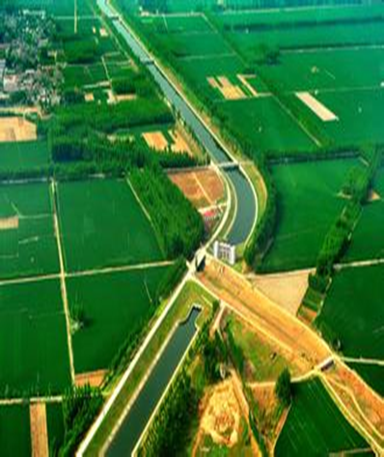
02
Ecological protection measures
Water transfer route | City /Province | Reduction in groundwater extraction under the same average annual rainfall (10⁸m³) | Number of wells sealed | South-to-North Water Transfer (10⁸m³)
Midline | Beijing | 0.71 | 103 | 11.05
 | Tianjing | 0.32 | 93 | 9.10
 | Hebei | 2.58 | 1573 | 3.65
 | Henan | 1.23 | 1940 | 13.45
Eastern line | Shandong | 0.6 | 763 | 4.51
Total |  | 5.44 | 4472 | 41.76

Slide 11
Promoting groundwater protect and conservation
Water level(m)
点评
Changes of shallow groundwater level in the plain area of Beijing City
The change of groundwater supply in Beijing
Rainfall fluctuates year by year, while groundwater supply decreases gradually
The water level increased by 0.5m during one year from 2015 to 2016, while the groundwater level dropped by 0.9m per year from 2000 to 2010.

Slide 12
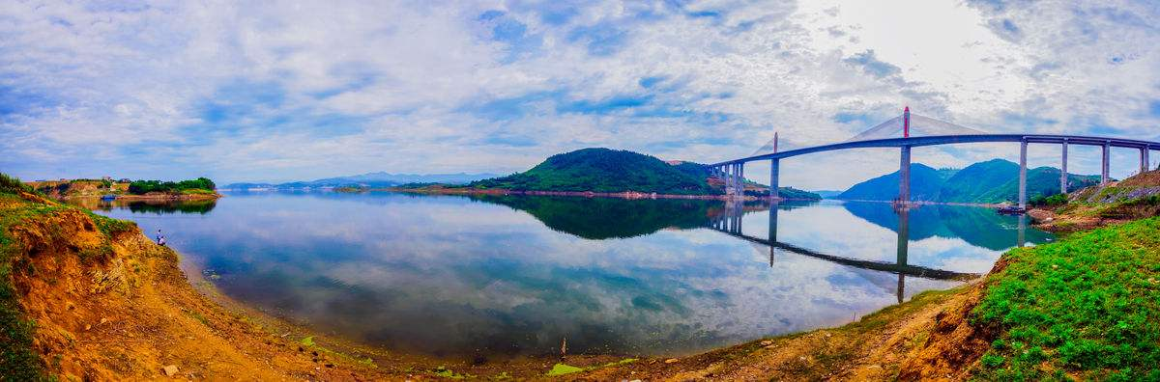
Beijing City
The area of groundwater funnel in Beijing plain area continued to increase, with an average annual speed of 16.7 km ² 2003 – 2011 ,but changed from 1 to 2 km ² annually in 2014 and 2015, especially in 2016, the area of groundwater funnel decreased by 98 km ² annually.
Changes of groundwater funnel area in the plain area

Slide 13
The structure of water supply has been adjusted, and the over-exploitation trend has been alleviated
After the completion of the project, the water supply have undergone significant changes: the water in the outer basin by transfer project and reclaimed water have increased significantly, and the surface and groundwater have decreased.
2016 compared with 2006, the proportion of groundwater and surface water supply decreased by 26% and11% respectively, and the reclaimed and the transferred water increased by 16% and 22% respectively. The situation of continuous over-exploitation of groundwater has been alleviated;
In 2015 and 2016, the city‘s water inflow reached 0.88 and 1.06 billion m3, accounting for 20% and 22% of the total water supply, and became one of the important sources of water supply.
Changes in water supply structure in Beijing

Slide 14
Increase of water consumption for ecological environment
After the water transferred into Beijing, the allocation of water have also undergone significant changes.
From 2006 to 2016, the proportion of industrial and agricultural water consumption to the total water consumption has been decreasing year by year, and the proportion of domestic and environmental water consumption is gradually increasing. In 2015 and 2016 ,the water consumption in the ecological environment increased rapidly. In 2015, the water consumption increased by 44.5% compared with 2014.
Changes in water allocation in Beijing

Slide 15
Upgrading underground water quality
Since 2013, the proportion of monitoring area reaching the standard has changed from decreased to increased gradually
The shallow and deep groundwater quality began to improve gradually from 2013 to 2016

Slide 16


Thank for your attention

