Slide 1


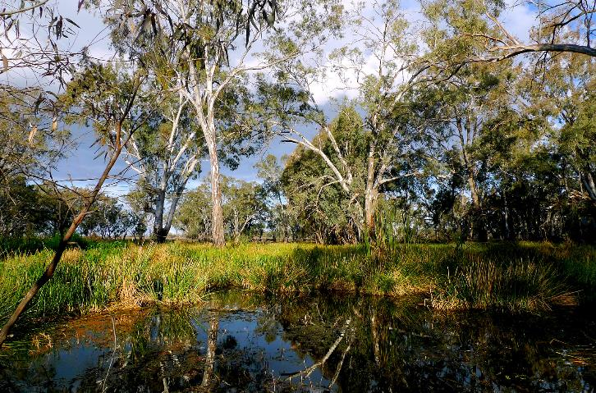

Novel evapotranspiration model to inform future water management using past riparian vegetation trends
Tanya Doody, Micah Davies, Garth Warren, Martin Nolan
15th October, 2018
SYDNEY, AUSTRALIA | 14 -18 October 2018
MANAGED BY

Slide 2

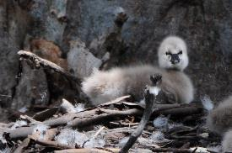
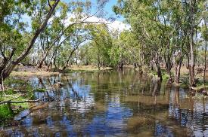
Murray-Darling Basin
Biodiversity
Ecological targets and objectives (e.g. maintain 70% of Red Gum in good health)
Mechanism - monitoring and environmental flow allocations
SYDNEY, AUSTRALIA | 14 -18 October 2018
MANAGED BY

Slide 3
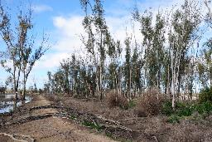
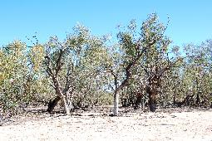
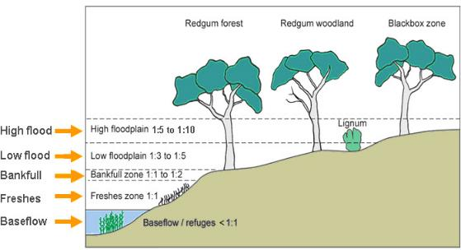
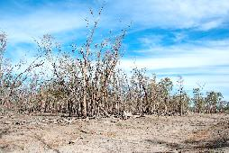
Decision context
Water for irrigation, human consumption and environment
Key tree species, condition cycles, water requirements
River Cooba
SYDNEY, AUSTRALIA | 14 -18 October 2018
MANAGED BY

Slide 4
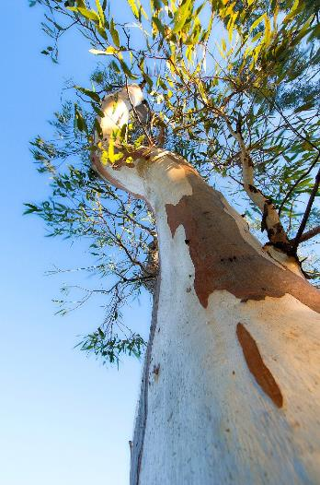
Prioritising environmental flow allocations
Tree condition surveys – seasonal at best, labour intensive
Remote sensing tool required to support decision making (temporal)
SYDNEY, AUSTRALIA | 14 -18 October 2018
MANAGED BY

Slide 5
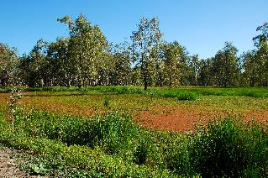
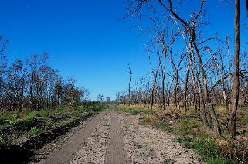
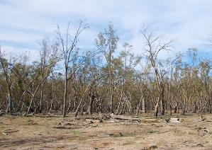
Field quantification of tree water use
Evapotranspiration (ETa) = transpiration + interception + soil evaporation
Site | Rainfall (mm) | Interception (mm) | Evaporation (mm) | Transpiration (mm) | ET (mm)
1-2yr | 422 | 42(±3) | 246(±57) | 566 (± 394) | 854 (± 394)
2-2yr | 422 | 42(±3) | 246(±57) | 392 (± 117) | 680 (± 117)
1-5yr | 395 | 17(±3) | 219(±46) | 84 (± 49) | 320 (± 49)
2-5yr | 405 | 29(±3) | 250(±73) | 208 (± 127) | 487 (± 127)
1-10yr | 396 | 18(±3) | 264(±59) | 17 (± 3) | 299 (± 3)
770
400
1:2 mean ETa = 767 mm year⁻¹
1:5 mean ETa = 404 mm year⁻¹
Potential threshold of >550 mm year⁻¹
Doody TM, Colloff MJ, Davies M, Koul V, Benyon RG, Nagler PL. 2015. Quantifying water requirements of riparian river red gum (Eucalyptus camaldulensis) in the Murray-Darling Basin, Australia –implications for the management of environmental flows. Ecohydrology. 8(8), 1471-1487.
SYDNEY, AUSTRALIA | 14 -18 October 2018
MANAGED BY

Slide 6
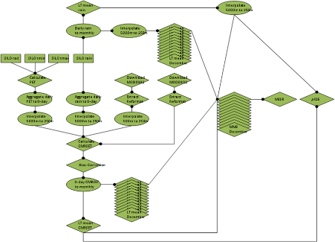
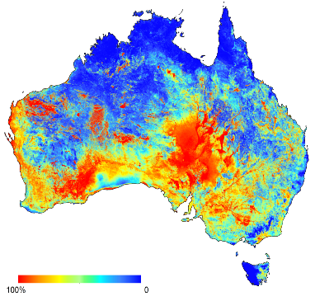
Development of CSIRO-FETa
CMRSET * (CSIRO MODIS Reflectance Scaling of ETa)
Vegetation greenness (EVI) - transpiration and interception
Surface wetness (residual Moisture Index RMI) - evaporation
Interpolated climate data (Priestley-Taylor PET and precipitation)
Produce 8-day, 250m resolution CMRSET product – national ET layer
Validation with field ETa = CSIRO FETa
SYDNEY, AUSTRALIA | 14 -18 October 2018
MANAGED BY
*CMRSET (Guerschman et al., 2009)

Slide 7
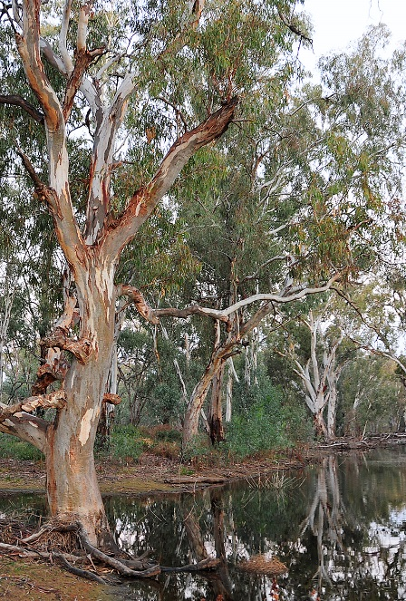
CSIRO-FETa
SYDNEY, AUSTRALIA | 14 -18 October 2018
MANAGED BY

Slide 8
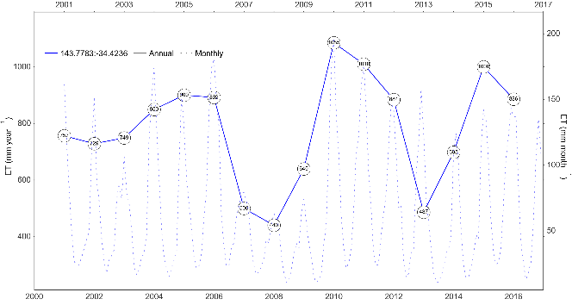
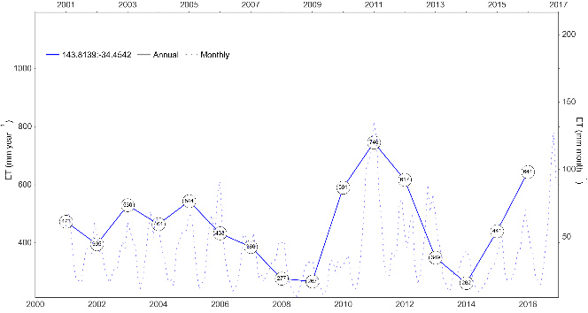


Case study – Yanga National Park Red Gum
> 3 years below threshold
SYDNEY, AUSTRALIA | 14 -18 October 2018
MANAGED BY

Slide 9
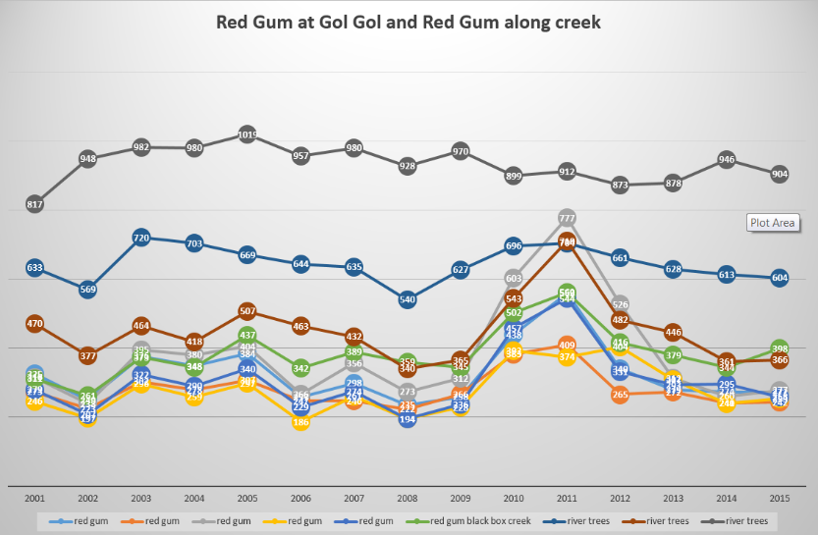
Case study – Gol Gol wetland Red Gum
> 3 years below threshold
No response of river trees to flood (max ETa)
Rapid decline of trees to previous state
SYDNEY, AUSTRALIA | 14 -18 October 2018
MANAGED BY

Slide 10
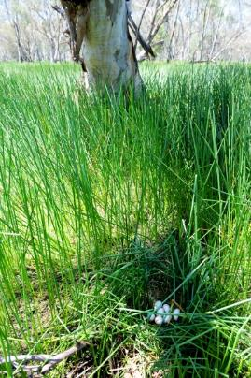
Management implications
Simple tool to observe past trends in vegetation response to flood and drought
Temporal resolution – monthly, annually, 2001-current
Mangers can compare past responses, with inundation and rainfall history and future climate projections to base e-flow decisions
Identify high priority areas for future e-flow allocations
Provide improved estimates of floodplain vegetation for water accounting purposes
SYDNEY, AUSTRALIA | 14 -18 October 2018
MANAGED BY

Slide 11

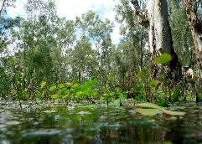
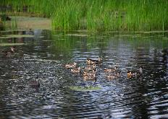
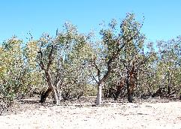
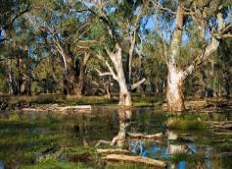
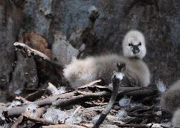
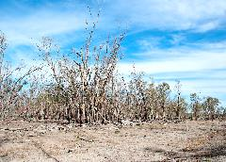
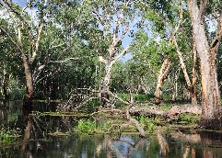
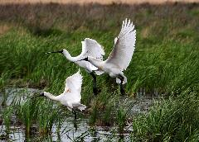
Conclusion
CSIRO-FETa provides a tool to help water managers ensure that floodplains cycle through wet and dry periods to maintain ecosystems function and biodiversity
SYDNEY, AUSTRALIA | 14 -18 October 2018
MANAGED BY

Slide 12
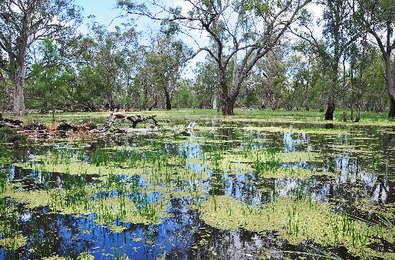
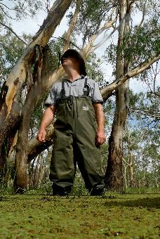
Aknowledgements
NSW Office of Environment and Heritage
James Maguire
Paul Childs
CSIRO
Richard Benyon
Matt Colloff
Micah Davies
John Lamour
Pamela Nagler
Jodie Pritchard
Leroy Stewart
Dale Worledge
Funidng: CSIRO
SYDNEY, AUSTRALIA | 14 -18 October 2018
MANAGED BY

Slide 13
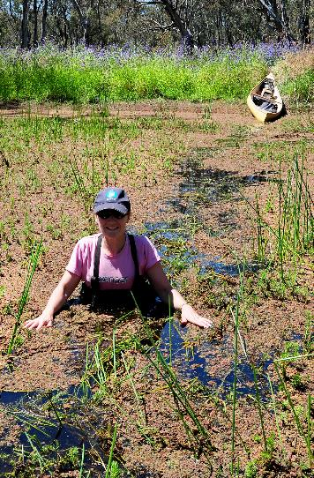
Thank you
CSIRO Land and Water
  Dr Tanya Doody
  Spatial Ecohydrologist
    t +61 8 8303 8716
    e tanya.doody@csiro.au
https://research.csiro.au/mwe/
SYDNEY, AUSTRALIA | 14 -18 October 2018
MANAGED BY

Slide 14
SYDNEY, AUSTRALIA | 14 -18 October 2018
MANAGED BY

