Slide 1
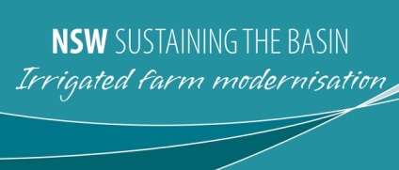
Embracing Innovation Proves a Win-Win-Win for Rivers, Irrigators, & Communities
Meg Strang & Peter Verwey
Sustaining The Basin: Irrigated Farm Modernisation
SYDNEY, AUSTRALIA | 14 -18 October 2018
MANAGED BY

Slide 2
Introduction
The Sustaining the Basin Irrigated Farm Modernisation (STBIFM) program was established in 2012 as part of the recovery efforts for the Murray Darling Basin Plan undertaken by MDB States and the Australian Commonwealth Government.
STBIFM operates in the Northern Murray Darling Basin in NSW and works with the agricultural sector to improve on farm water use efficiency through infrastructure modernisation
This presentation focuses on the innovative ideas and new technologies that STBIFM has implemented in partnership with the irrigation sector to achieve water savings.
STBIFM is funded through the Australian Government’s Sustainable Rural Water Use and Infrastructure Program (SRWUIP) and is delivered by the NSW Department of Primary Industries.

Slide 3
Water Recovery Success
STBIFM funded on-farm projects are saving an estimated 34.2 GL of water previously lost through evaporation and seepage.
In exchange for STBIFM funding for improved infrastructure, a total of 23.6 GL of water entitlement – more than two thirds of the total savings realised through STBIFM – have been legally transferred as water licences to the Commonwealth Environmental Water Holder for environmental purposes.
An estimated 10.6 GL of water savings has been kept on farm to boost production.

Slide 4
Creating a win-win-win
STBIFM focused on 3 key areas to achieve social, environmental and production gains:
Planning support – financial support through the use of Irrigated Farm Water Use Efficiency Assessments (IFWUEA) to identify where infrastructure investment was required, and to fund expert advice to calculate potential water savings vs the cost of infrastructure improvement.
Infrastructure funding for on farm improvements and modernisation such as overhead irrigation systems, strategic changes to farm layout and water storages, and automation.
Capacity building and training and development to assist irrigators to effectively plan, implement, and operate their infrastructure.

Slide 5
Irrigated Farm Water Use Efficiency Assessment
STBIFM financial support for IRRIGATED FARM WATER USE EFFICIENCY ASSESSMENT (IFWUEA) helped identify where water losses were occurring on farm and helped irrigators work out their best options for seeking project funding.
A total of $655,000 was invested in IFWUEA development including: $447,000 invested through DPI and $208,000 invested by irrigators.
Understanding where water is lost on farm is a critical step towards making an irrigation business more productive by assessing how much water allocation ends up on the crop, and how much is lost through evaporation and seepage.

Slide 6
Overhead Irrigation
Centre Pivot & Lateral Move (CPLM) technology:
Conversion from surface to overhead irrigation, primarily through Centre Pivot and Lateral Move (CPLM) technology can improve water efficiency where crop type, climate, water availability and soils are suitable.
Overhead irrigation offers greater flexibility to switch between crops, helping to improve crop rotations and take advantage of cash crop opportunities that are difficult to achieve with surface irrigation systems.

Slide 7
Bankless Systems
Bankless channel irrigation systems can assist in improving the management of surface irrigation and can lead to reduced water losses from evaporation and deep drainage.
These systems also provide considerable labour and operational efficiencies and allow for crops to be grown that are not suited to conventional siphon fed furrow systems.

Slide 8
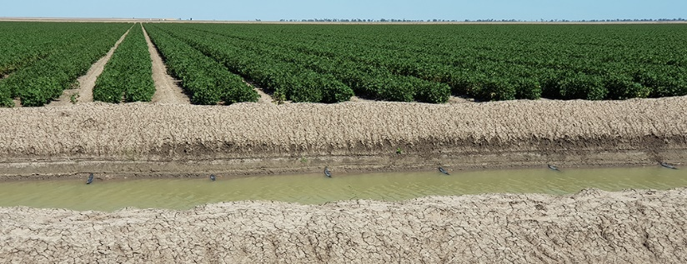
Pipes Through the Bank
Pipes-through-the-bank (PTB) irrigation systems enable better control of water application across the field.
They reduce labour input, and can be automated to improve irrigation management.

Slide 9
Field Reconfiguration
Field reconfiguration can create water savings and make the irrigation system easier to manage.
Squared, laser levelled fields can improve water infiltration uniformity, leading to increased crop yields and reduced deep drainage.

Slide 10
Storage Reconfiguration
Reconfiguring water storages on farm can dramatically reduce the amount of water lost through evaporation, particularly in summer.
The larger the surface area exposed to the sun, the larger the evaporative losses.
Leaky areas within a water storage can also be repaired or the storage walls moved to reduce seepage.

Slide 11
Automation
Automation of infrastructure assists in optimising irrigation management, allowing better control of the amount and timing of water application in accordance with the watering schedule. More timely application of irrigation can reduce water losses and increase productivity.
Labour savings can be considerable and are particularly beneficial in terms of reducing the need for onerous overnight and early morning hours, making the workplace safer and more manageable within normal work hours.

Slide 12
Training
STBIFM has actively assisted irrigators to learn how to plan for, install, and operate their new technology and infrastructure to get the best performance out of their irrigation system.
STBIFM provided subsidies to project partners and people working in the northern Basin irrigation industry to take part in educational courses and training.
STBIFM also hosted and supported field days to spread knowledge and capacity building throughout the wider community.

Slide 13
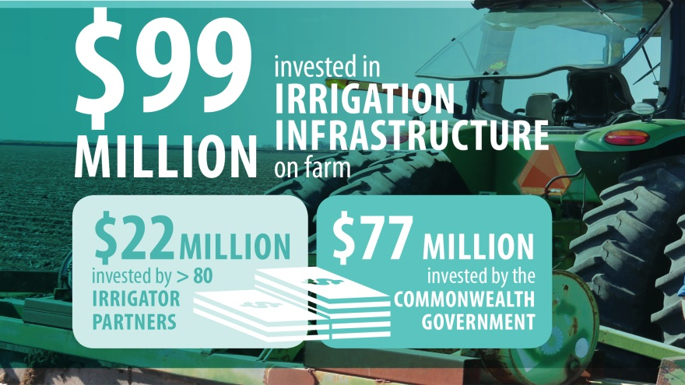
What did it cost?
The final figures show that STBIFM has generated a total investment commitment of $99 million for farm modernisation:
$77 million has been invested by the Commonwealth
$22 million has been contributed by project partners

Slide 14
The Australian Government is providing more than $13 billion for implementation of the Murray-Darling Basin Plan and associated activities, with the vast majority (more than $8 billion) being made available for modernising infrastructure and water efficiency improvements.
The Sustaining the Basin: Irrigated Farm Modernisation Program is funded through the Sustainable Rural Water Use and Infrastructure Program.

