Slide 1
Constraints and Opportunities for Management of Urban Waterways to Achieve Multiple Benefits
Beth Salt
Program Manager, Georges Riverkeeper
SYDNEY, AUSTRALIA | 14 -18 October 2018
MANAGED BY

Slide 2
The Georges Riverkeeper
Best practice environmental management for a liveable urban river.
SYDNEY, AUSTRALIA | 14 -18 October 2018
MANAGED BY

Slide 3
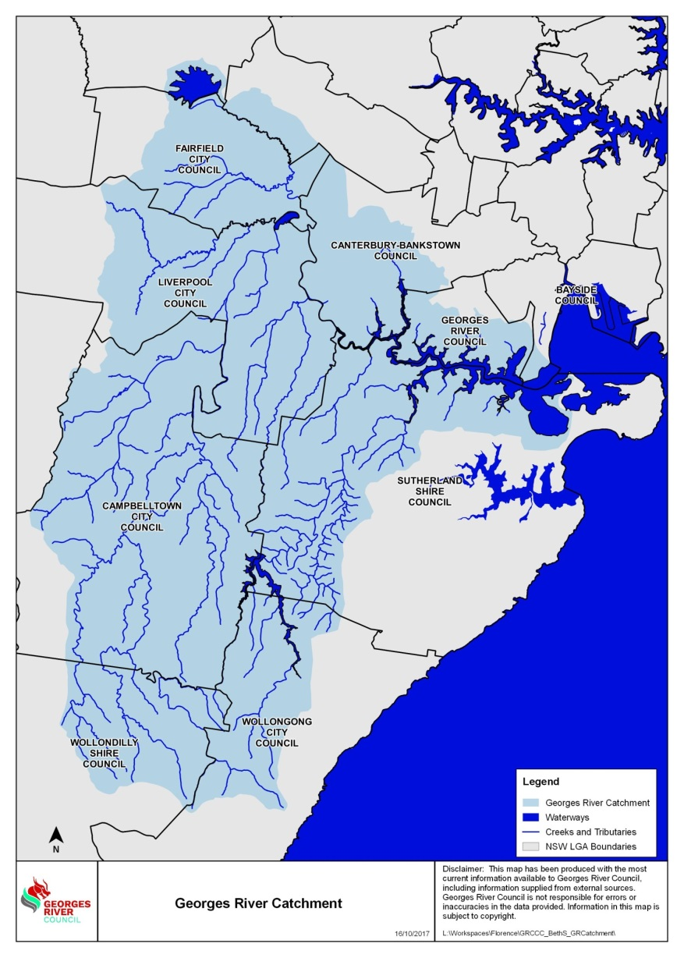
The Georges River Catchment
+ home to 1.4 million people
SYDNEY, AUSTRALIA | 14 -18 October 2018
MANAGED BY
Notes:
The Georges River is nearly 100 km long in a catchment that is 960 square kilometres in the south and south west of Sydney NSW.
The main river channel flows through national parks in the upper catchment, through the Chipping Norton Lakes and down to Botany Bay
Multiple land uses – forests to highly urbanised areas
Also home to 1.4 million people
The Georges River is valued by the community for picnicking, swimming, fishing, boating and bushwalking.
At the mouth of the Georges River in Botany Bay are the RAMSAR listed Towra Point wetlands.

Slide 4
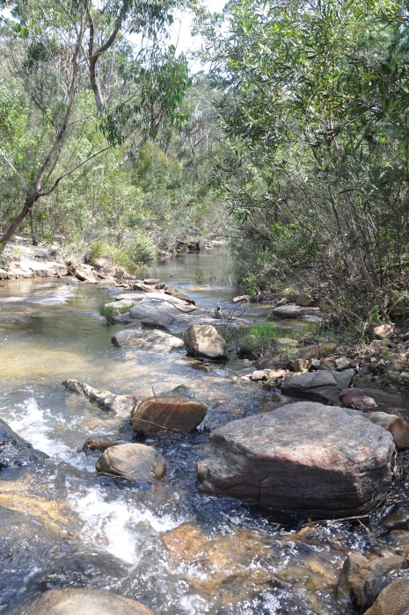
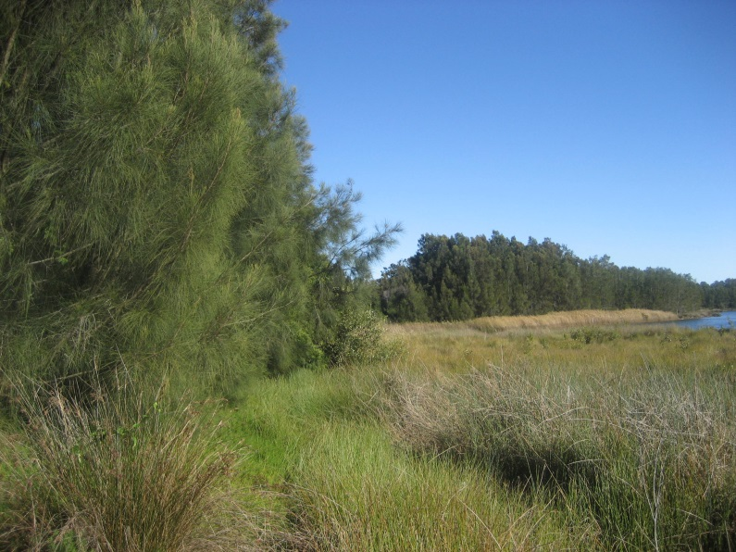
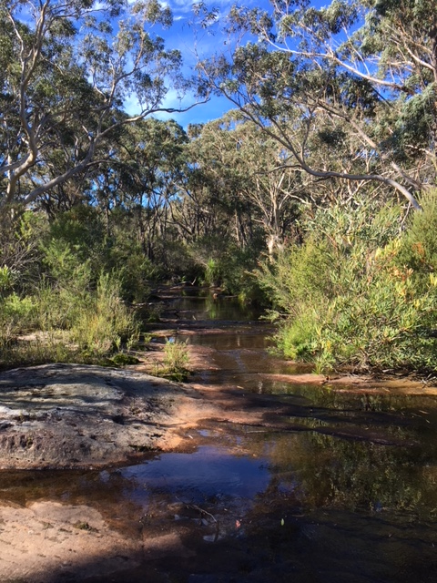
SYDNEY, AUSTRALIA | 14 -18 October 2018
MANAGED BY
Notes:
Madden’s Creek in the Upper Catchment
Brennan’s Creek also in the Upper Catchment
H1 wetlands in Kernell

Slide 5
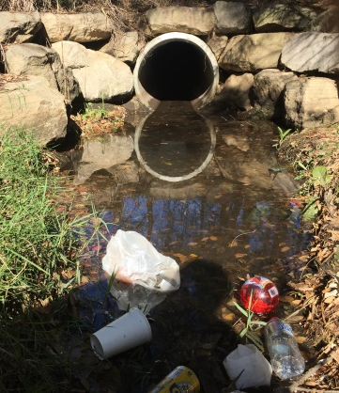
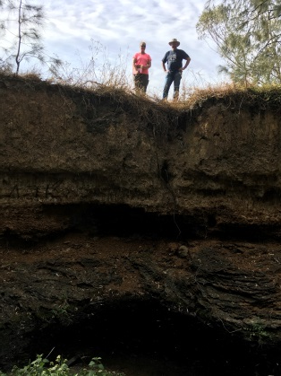
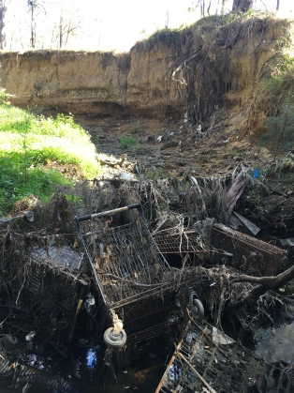
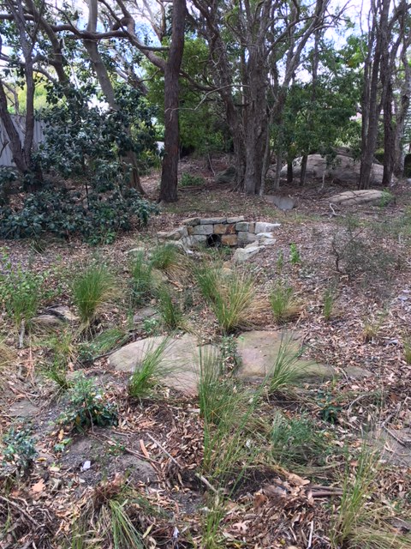
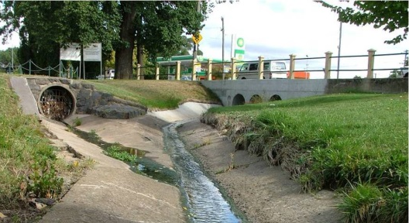
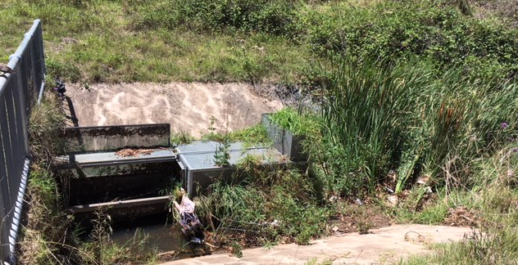
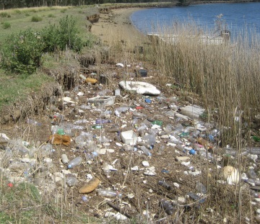
SYDNEY, AUSTRALIA | 14 -18 October 2018
MANAGED BY

Slide 6
Local Councils / State Gov’t
SYDNEY, AUSTRALIA | 14 -18 October 2018
MANAGED BY

Slide 7
Program Review
Management and Implementation Plan 2009
Georges Riverkeeper Strategic Plan 2018 – 2022
Review of Council’s River Management Practices
SYDNEY, AUSTRALIA | 14 -18 October 2018
MANAGED BY

Slide 8
Methodology
Documentation review
Online survey to assess knowledge of local waterways
Targeted workshops to assess knowledge of local waterways
SYDNEY, AUSTRALIA | 14 -18 October 2018
MANAGED BY

Slide 9
1. Documentation Review
Existence of specific documents
Currency of the documents
Completeness of the documents
Quality relating to river management
Level of knowledge of the document content (from face-to-face workshops)
Level of ‘real-life’ implementation of the document (from face-to-face workshops)
Example: Quality
1 | 2 | 3 | 4 | 5
Very poor | Poor content not up to same standard as similar documents from other Councils and/or below expected standards | Moderate In-line with similar documents from other Councils and/or just meets expected standard | High Better than similar documents from other Councils and/or is at the upper end of expected standard | Excellent Best when compared with similar documents from other Councils and/or exceed expected standards
SYDNEY, AUSTRALIA | 14 -18 October 2018
MANAGED BY
Notes:
Determination of the existence of specific documents (to allow a matrix of key documents across the eight member councils to be developed).
Identification of the currency of the documents – when they were developed, whether review timeframes were met, whether they are relevant to the current Council’s structure, so they meet relevant standards where applicable (based on the age of the document and when it was last reviewed).
The completeness of the documents in terms of how the document relates to river management (based on a five-point rating scale, where one is no content and five is comprehensive coverage).
The quality of the documents in terms of how the document related to river management (based on a five-point rating scale, where one is very poor quality and five is excellent quality).
The level of knowledge of the document content, which feeds in from the stakeholder engagement process outlined below (based on a five-point rating scale, where one is where the council staff have no knowledge of the documentation to five where the council staff have an excellent knowledge of the documentation).
The level of the ‘real-life’ implementation of the document content, which feeds in from the stakeholder engagement process outlined below (based on a five-point rating scale, where one is no implementation of the documentation to five where there is implementation of all document content/direction).

Slide 10
Types of Documentation
Annual Report (most recent)
Delivery and Operational plans (current)
Environmental policies
Environmental plans
Environmental management systems
Environmental incident reporting procedures
Water quality monitoring plans / summarised results
Georges River management specific documents
External education/promotional materials relating to the Georges River
Internal staff training or educational materials relating to the river and stormwater management
Council and Senior Management meeting minutes relating to the river and stormwater management
Any other documents relevant to the management of the Georges River
SYDNEY, AUSTRALIA | 14 -18 October 2018
MANAGED BY

Slide 11
Documentation Review - Annual Reports
SYDNEY, AUSTRALIA | 14 -18 October 2018
MANAGED BY
Notes:
All Annual reports were current and the quality was reasonably consistent across all councils
The completeness/comprehensiveness and the knowledge of the reports by staff was variable across all councils and the usefulness of the documents was very low for councils staff, which is to be expected as the primary purpose of the annual reports is a summary of council activities for those not working in council.
Amalgamated councils - large differences in the types of documentation and the content within the documents varied greatly
Councils scored between 15 and 20 points for their annual reports.

Slide 12
Documentation Review
Internal Incident & Hazard Reporting
External Incident & Hazard Reporting
SYDNEY, AUSTRALIA | 14 -18 October 2018
MANAGED BY
Notes:
Across all councils, the ratings for an internal environmental incident and hazard reporting procedures was poor.
There was quite a of room for improvement in the councils internal and hazard reporting documentation across most of the councils.
Councils A, C, D and F received a total of 5 out of 25 when all criteria was considered which is the lowest possible score meaning there is no recognised process
3 other councils tended to have an ad-hoc system and in the face-to-face workshops it was revealed that staff were generally unaware of and didn’t use any policies or procedures relating to incident or hazard reporting.
Council B scored the highest on internal incident reporting procedures with a score of 16 out of 25. Council staff indicated that it had a good system that was used to respond and report on incidents and hazards that reported up to Councillor level.
Despite the lack of formalised systems the Council discussions indicated that responses to internal incidents did generally work although there was doubt that they were robust enough to deal with a major issue and failed to provide information that might preclude future occurrences.
External environmental incident and hazards reporting and response procedures were as a whole better than the internal reporting and procedures. This is thought to be because of the customer services staff that are a central point of contact for anyone external.
The customer service staff have a process for contacting the relevant council staff or relevant external organisation regarding an incident or hazard reported by the public. Councils are under pressure to respond to community requests within set timeframes for responding to and resolving customer requests, which drives this process.
Council G scored 20 out of 25, with the majority of councils scoring between 10 and 15 out of 25.
All staff identified that the pressure to resolve the external

Slide 13
2. Knowledge of local waterways Online Survey
The survey was to be sent to all council staff to ascertain the knowledge of local waterways from a broad audience.
SYDNEY, AUSTRALIA | 14 -18 October 2018
MANAGED BY

Slide 14
Knowledge of local waterways Online Survey
Different distribution approaches by Councils which resulted in 104 surveys being completed.
Therefore the results and discussion was completed as a whole not Council by Council as anticipated.
SYDNEY, AUSTRALIA | 14 -18 October 2018
MANAGED BY
Notes:
In the event there were different distribution approaches by each council
Led to a self-selecting relatively small group of staff completing the surveys across all councils which resulted in an implied bias in this cohort, as the staff who took the time to complete the survey were probably more likely to know quite a bit about waterways and used them in personal life and/or their position at council.

Slide 15
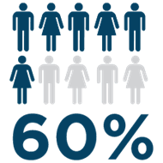
Knowledge of local waterways Online Survey
working a council in their current position for more than 3 years
did not manage any staff
79%
could name one to three waterways within their LGA
SYDNEY, AUSTRALIA | 14 -18 October 2018
MANAGED BY
Notes:
Approximately 60% of the respondents had been working at council in their current position for more than three years
Approximately 60% did not manage any staff, therefore were at officer level.
Therefore while interpreting the results it was important to keep this in mind.
Given the types of people who responded to the survey it is not unexpected that:
79% could name 1-3 waterways within their LGA
15% could name 4-9 waterways
3% could only name one
3% could name 12 waterways.

Slide 16
Knowledge of local waterways Online Survey
Uses of the waterways – Most popular waterways used by respondents
SYDNEY, AUSTRALIA | 14 -18 October 2018
MANAGED BY
Notes:
The most popular waterways utilised by the respondents in their personal life was the Georges River (almost 60%) followed up the Woronora River (29%) and the Hacking River (28%).

Slide 17
Knowledge of local waterways Online Survey
Uses of the waterways – Most popular uses of the waterways
SYDNEY, AUSTRALIA | 14 -18 October 2018
MANAGED BY
Notes:
Walking alongside the river was the most popular use of the river, followed by BBQing or picnicking and fishing or other.

Slide 18
Knowledge of local waterways Online Survey
Uses of the waterways – Most important activities to the community
SYDNEY, AUSTRALIA | 14 -18 October 2018
MANAGED BY
Notes:
The respondents also ranked what they thought was the most important activities to the local community were, which included walking alongside the river and BBQing/picnicking beside the river followed by boating and cycling alongside.
Given that the majority of the respondents of the survey are at officer level, they probably have quite a bit of interaction with their constituents and were comfortable with their understanding of wants of their community.
The respondents ranked that the least important activities to the local community were environmental purposes, swimming and stand up paddle boarding.
Overall the respondents thought that 80% of the local community felt that the Georges River was very to extremely important to many people within the community.

Slide 19
Knowledge of local waterways Online Survey
Threats to the waterways
SYDNEY, AUSTRALIA | 14 -18 October 2018
MANAGED BY
Notes:
The respondents were asked to rank what they considered to be the greatest treats to the Georges River.
The respondents considered both stormwater contamination and litter to be the greatest threats to the Georges River, followed by increased urbanisation and industrial contamination.
overuse by boats and over fishing were considered to be a moderate risk.
Interestingly biological risks were ranked quite low as a threat to the river, despite the fact that the tidal Georges River flows into Botany Bay where there is a high cahnge of the introduction of biological risks since there is a working port within the Bay that accepts vessels from all over the world. As councils tend to be focused on their LGAs, perhaps they neglected to think about the impacts downstream when the Bay wasn’t part of their LGA.
More than 40% of the respondents considered the overall risk to the Georges River as high risk to a large portion of the river.

Slide 20
Knowledge of local waterways Online Survey
Importance of Councils Role
SYDNEY, AUSTRALIA | 14 -18 October 2018
MANAGED BY
Notes:
When asked to rank the importance of the role that council plays in these threats to waterways the respondents thought that Council’s role in litter management and stormwater management were the most important, followed by weed management, community volunteers (bushcare) and enforcement activities.
It is notable that all activities scored highly, which reflects Councils multi-role aspect of the work they do.
Surprising that planning controls were not ranked higher as Councils have a huge role to play in developing and implementing planning controls. Potentially the survey respondents were not from the planning departments of council leading to the role of planning being undervalued in the survey.
The role of Council in wastewater (sewage) management was the least important, although it was interesting that was rated of any importance, considering that wastewater management and licensing of industry are not generally the responsibility of urban Council. but some councils would still have a number of on-site sewage systems that they would be inspecting and issuing ATO certificates for.

Slide 21
3. Knowledge of local waterways Face-to-Face Workshops
More in-depth exploration of the same themes covered in the on-line surveys, but with a small number of staff who’s roles involved interaction with the river and catchment management.
SYDNEY, AUSTRALIA | 14 -18 October 2018
MANAGED BY

Slide 22
Knowledge of local waterways Face-to-Face Workshops
Perceptions of staff involved directly into waterway management
SYDNEY, AUSTRALIA | 14 -18 October 2018
MANAGED BY
Notes:
In the face-to-face workshops, knowledge about the rivers and catchments in the council area was the highest rated category except in Council H.
Most Councils scored well in this category, between 3.8 and 4.8.
The rating for available tools and supporting documents category was lower overall than the knowledge category. All councils except council B and C rated between 2.5 and 4. Council staff were all well aware of Council policies relating to the river/catchment management and considered that their Operational Plan was supportive of good river/catchment management. Council staff thought there was room for improvement in: summarising good river/catchment management in the Annual Reports, the appropriateness of the policies could be improved and that the available tools were not being used effectively to support good management of the river/catchment.
This was generally because staff felt like they had to ‘re-invent the wheel’ as there were a limited number of existing procedures or templates available and were constantly having to develop these themselves.
All councils thought that having the river/catchment management as a job specific focus was good, which is not surprising considering that was the people who were in the room. Except for Council C thought there wasn’t enough river/catchment management as a specific focus on jobs within the Council.
For the majority of councils, the effectiveness of how river/catchment management initiatives were communicated internally and to the local community was lacking and also thought that external communication does not significantly contribute to better management of the river/catchments.
Most participants felt that their council didn’t do enough to let the community know about what was happening with Council and the LGA.

Slide 23
Knowledge of local waterways Face-to-Face Workshops
Perceptions of involved staff about the knowledge of council staff more broadly
SYDNEY, AUSTRALIA | 14 -18 October 2018
MANAGED BY
Notes:
The Council staff in the face-to-face workshops were asked if they could peer inside the minds of their colleagues, the council staff not at the workshop whose job probably didn’t have anything to do with the river or catchment. The same categories were ranked except for job specific focus.
Overall the scores here are lower, which you would expect.
Knowledge about the rivers and catchment in the council area was rated below half at all councils, except Council F who rated it as exactly half.
The workshop participants believed that the council staff had a bit of knowledge about the GR and its catchments and threats to these systems but thought that the options to manage the threats to the river/catchment was lower.
Workshop Participants thought that generally staff were unaware of Council policies relating to the river/catchment management or more generally environmental management and that there was nothing internal to support the broader staff being more aware. Which is not unexpected as many roles within council don’t require any knowledge of waterways to be completed successfully like finance, human resources, IT.

Slide 24
Take Home Messages
Better documentation and support materials are required.
Better internal processes for incident and hazard management is required.
External communication to the public is required.
Surveys demonstrated that respondents had a good knowledge of the waterways, community uses and values and threats.
SYDNEY, AUSTRALIA | 14 -18 October 2018
MANAGED BY

Slide 25
Conclusions
Exceptional performance can be an example for implementation in other Councils.
Council staff are aware that:
Urban waterways are severely degraded
Upstream an downstream impacts of Councils on each other
Georges Riverkeeper can help to manage these issues across the catchment
SYDNEY, AUSTRALIA | 14 -18 October 2018
MANAGED BY

Slide 26
Beth Salt
Program Manager,
Georges Riverkeeper
M: 0439 629 698
E: bsalt@georgesriver.nsw.gov.au
SYDNEY, AUSTRALIA | 14 -18 October 2018
MANAGED BY

