Slide 1
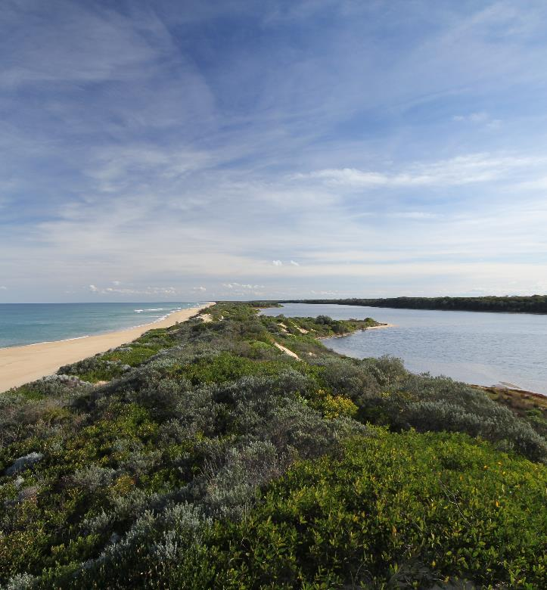
The Gippsland Lakes Program :
Delivering priorities through partnerships
SYDNEY, AUSTRALIA | 14 -18 October 2018
MANAGED BY

Slide 2
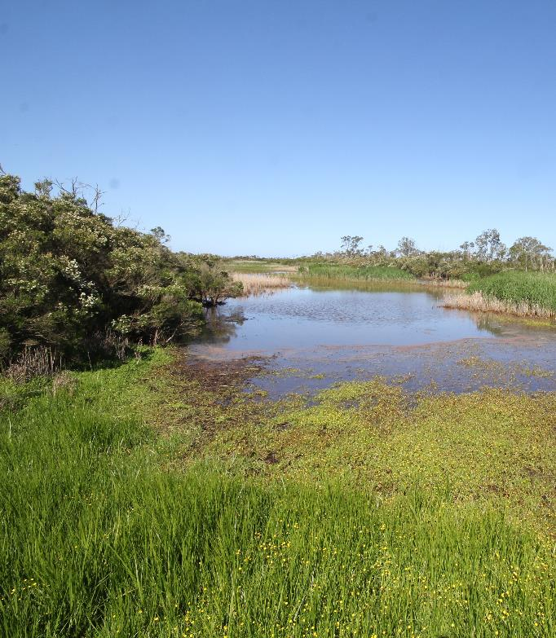
Gippsland Lakes Ramsar Site
Approx. 300km east of Melbourne
60,000ha in size
Series of coastal lagoons (350km²) and fringing wetlands formed behind a barrier dune system
Catchment area of approx. 20,000km²
7 major river systems
Significant to the Gunaikurnai people with extensive areas of Joint Managed land
Multiple administrative boundaries and jurisdictions
SYDNEY, AUSTRALIA | 14 -18 October 2018
MANAGED BY

Slide 3
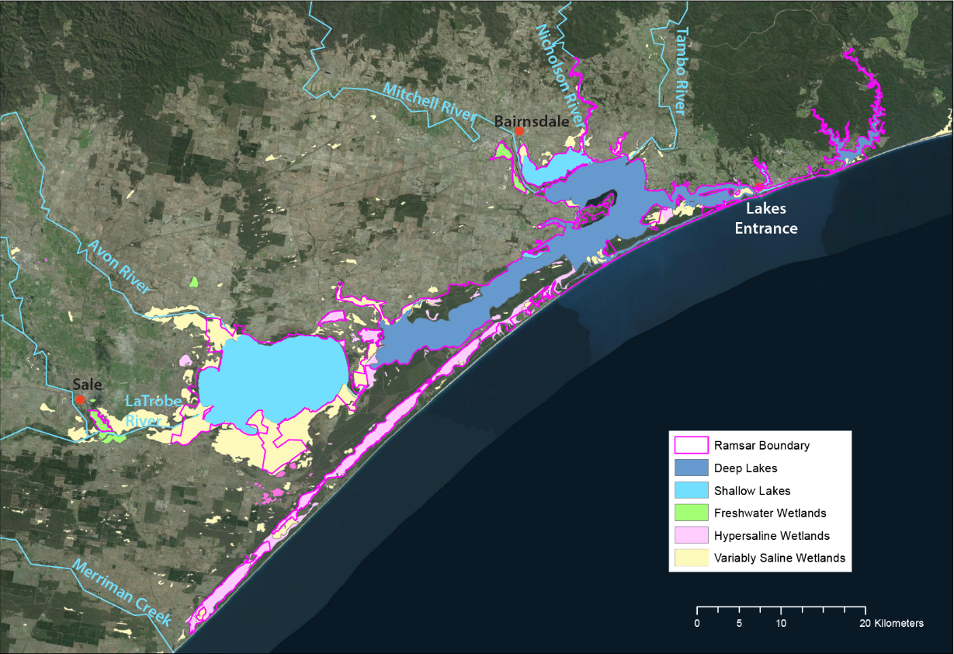
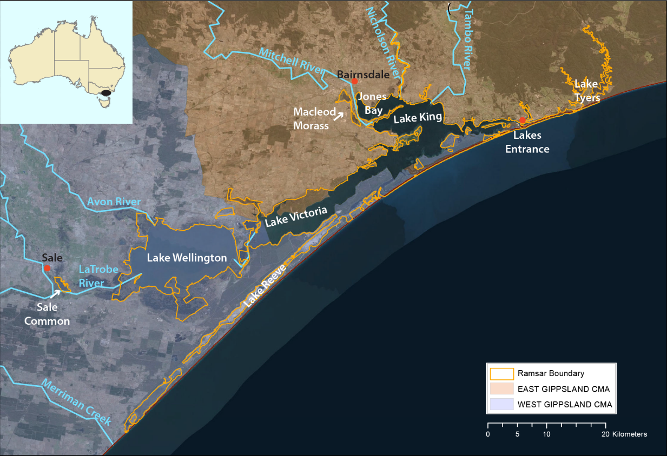
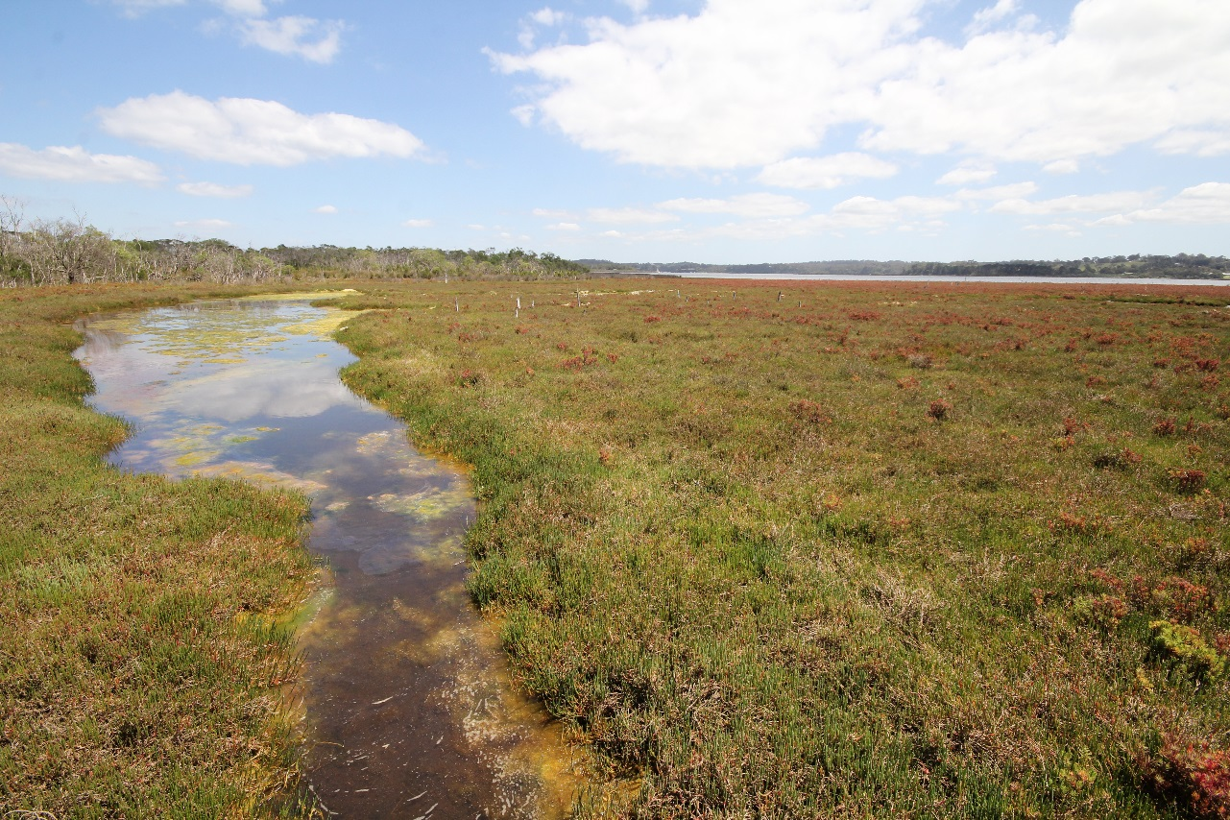
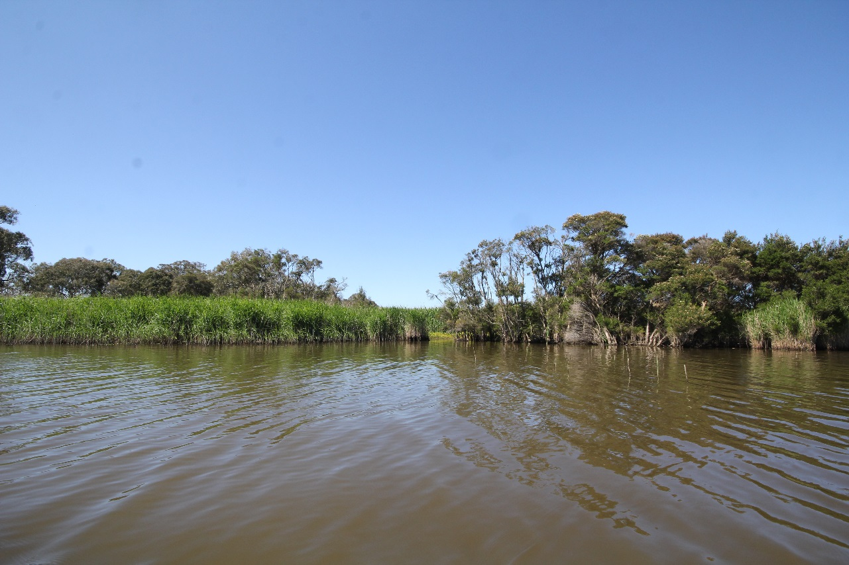
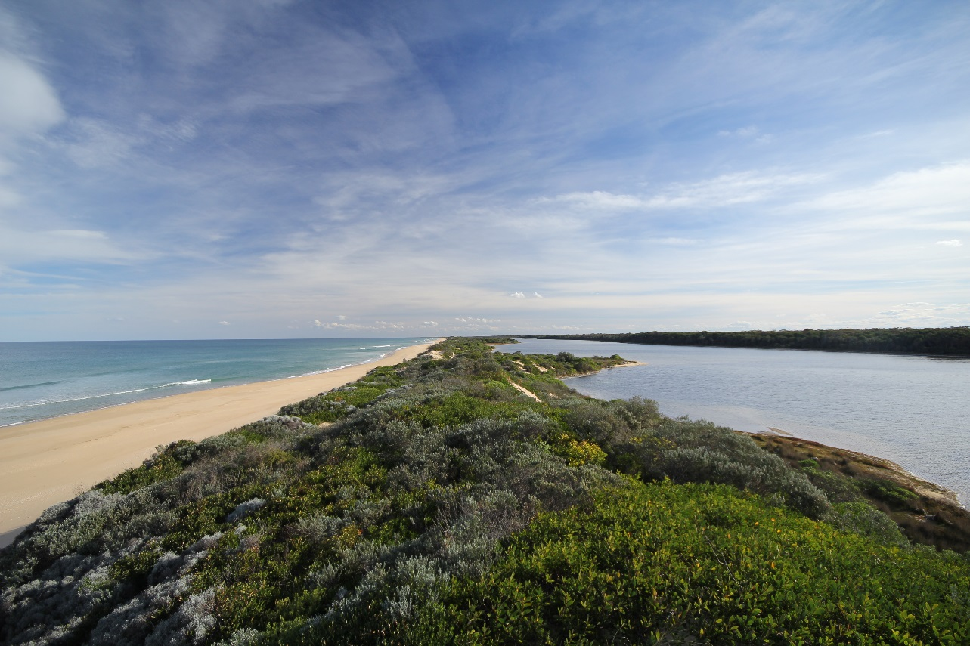
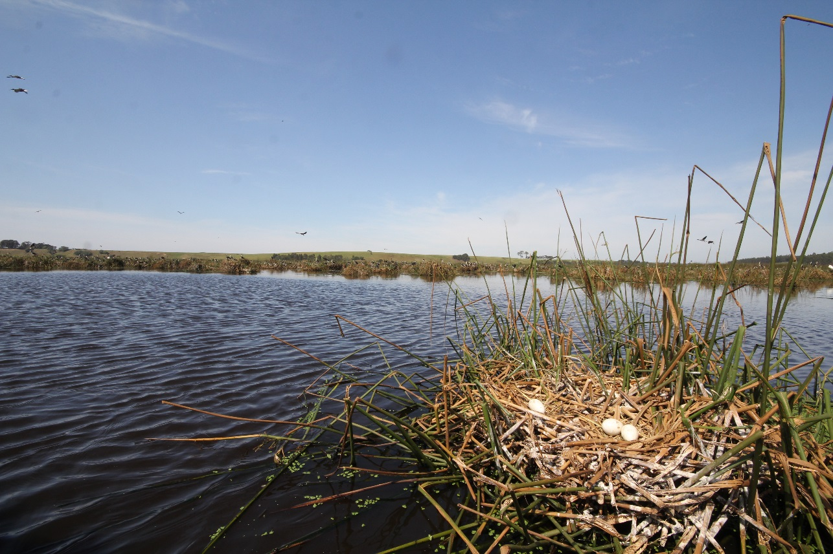
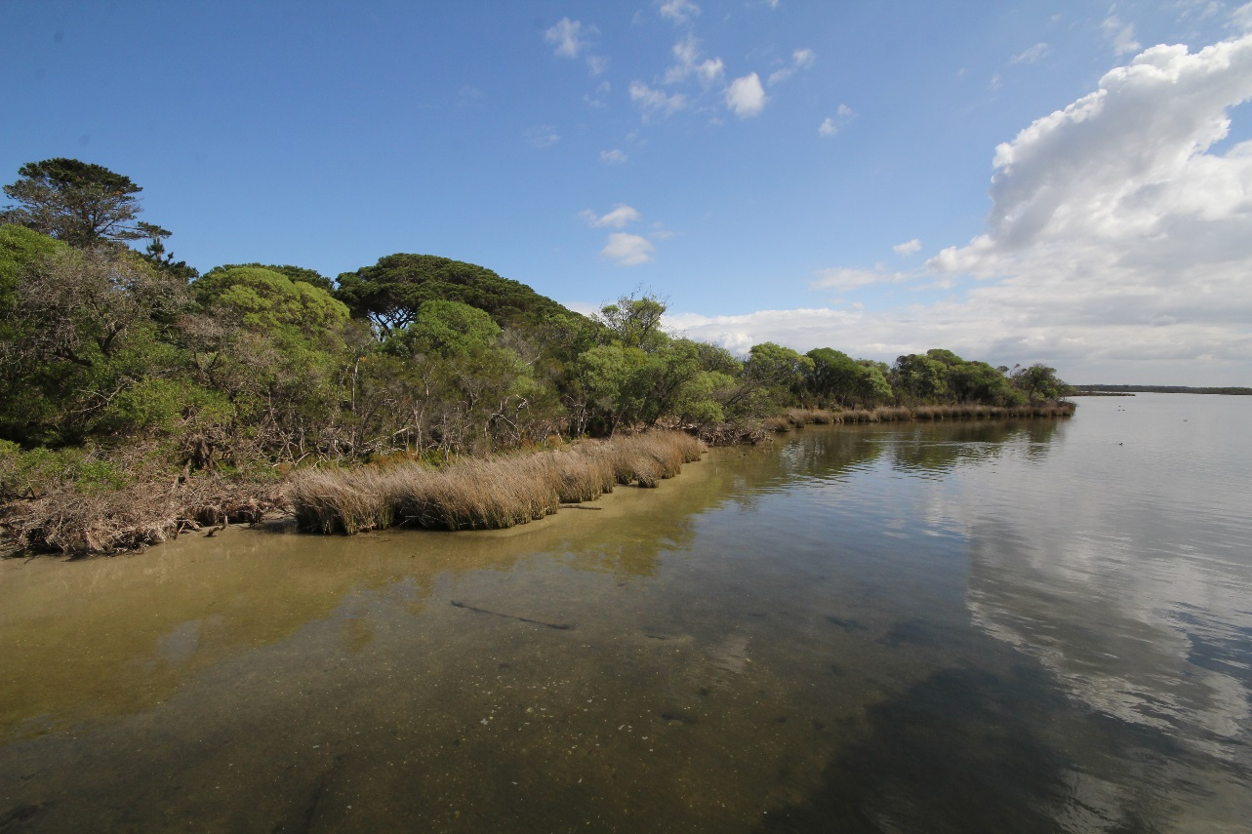
SYDNEY, AUSTRALIA | 14 -18 October 2018
MANAGED BY

Slide 4
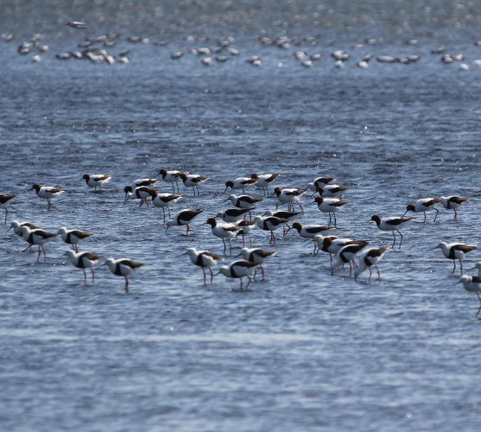
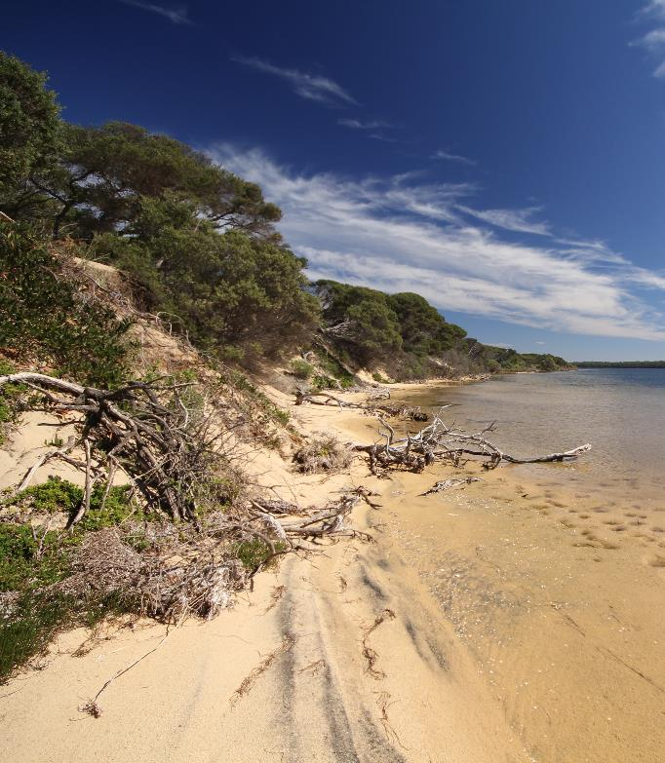
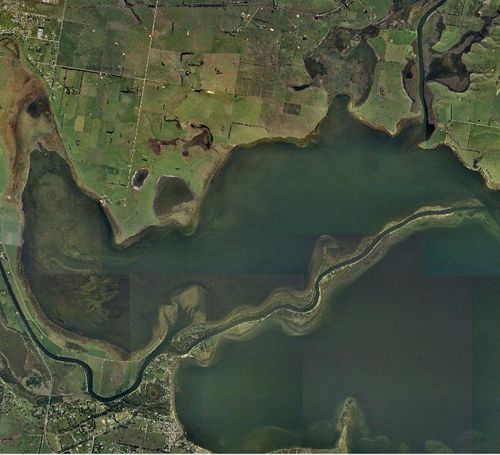
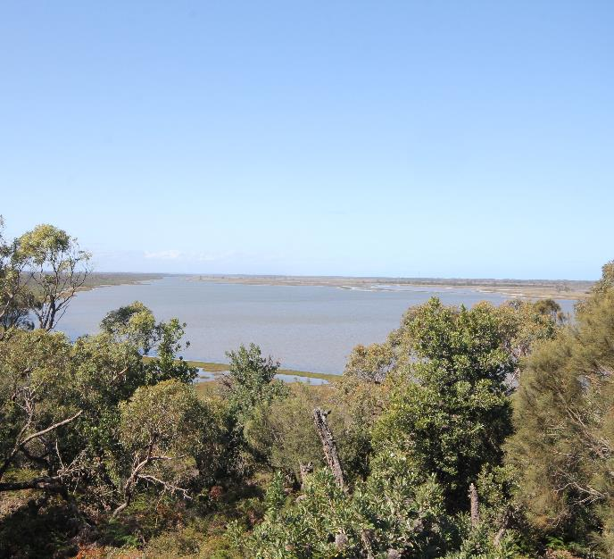
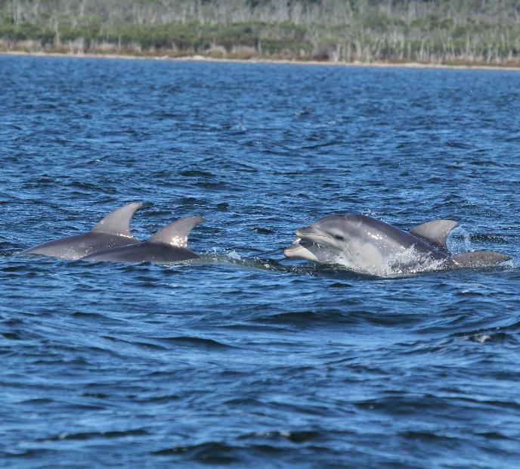
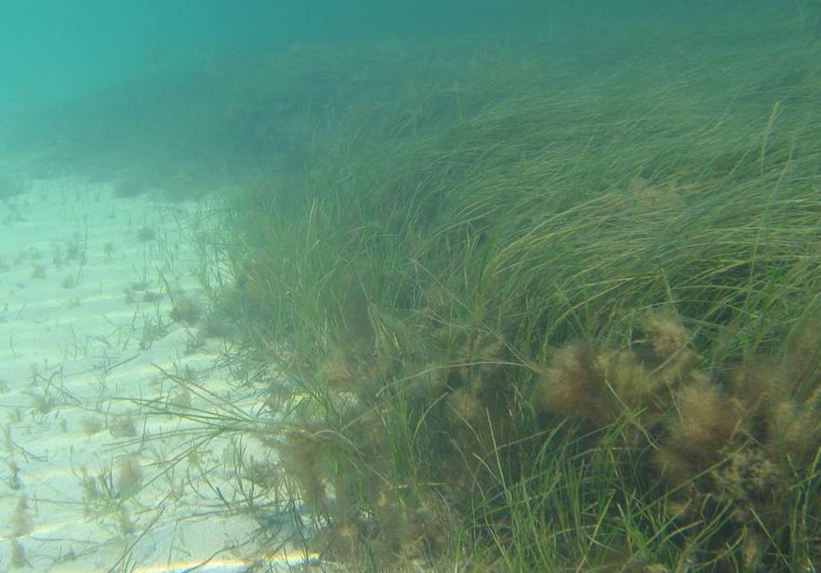
Ramsar Listing
Criteria
Representative & near natural wetland types
Supports threatened species and communities
Regularly supports 1% of a species of waterbird
Regularly supports 1% of individuals of a non-avian wetland dependant species
Regularly supports >20,000 waterbirds
Supports species at critical life stages and provide refuge sites
Important source of food, spawning or nursery habitat for fish
SYDNEY, AUSTRALIA | 14 -18 October 2018
MANAGED BY

Slide 5
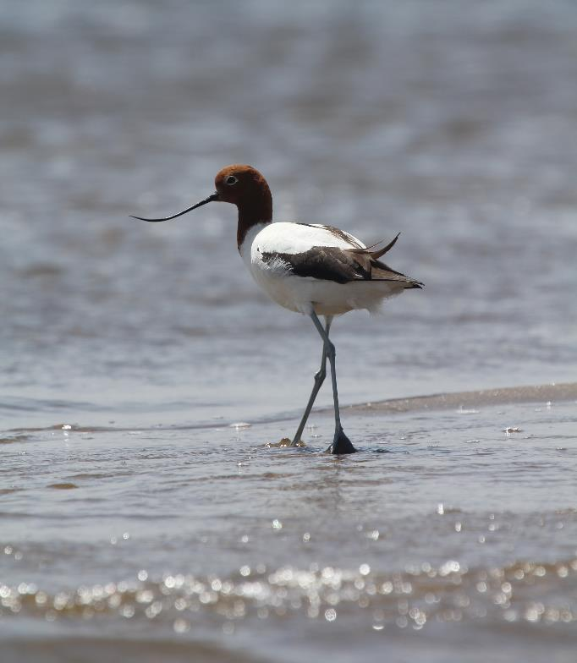
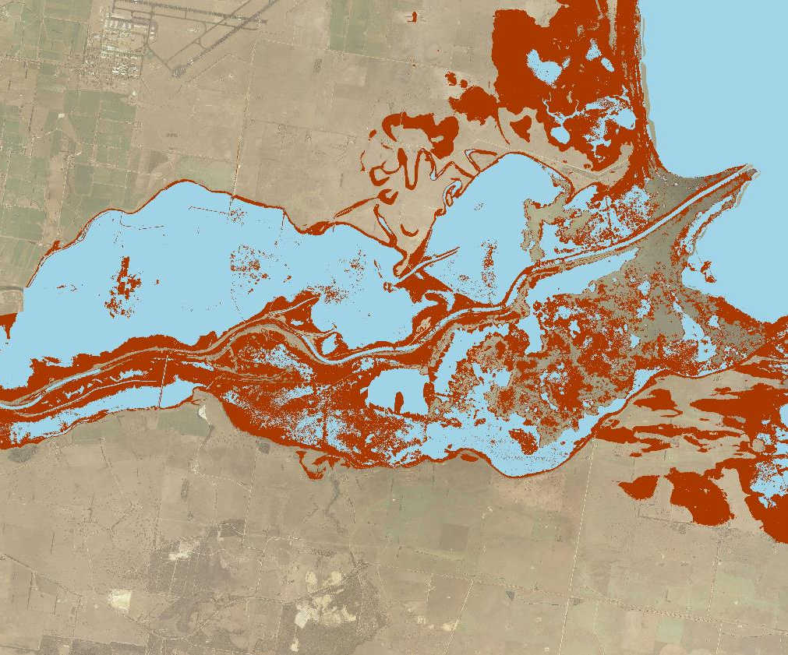
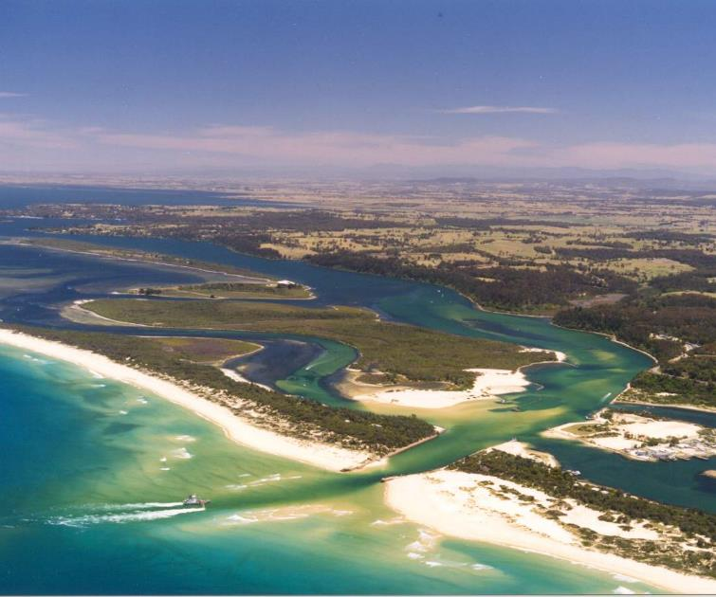
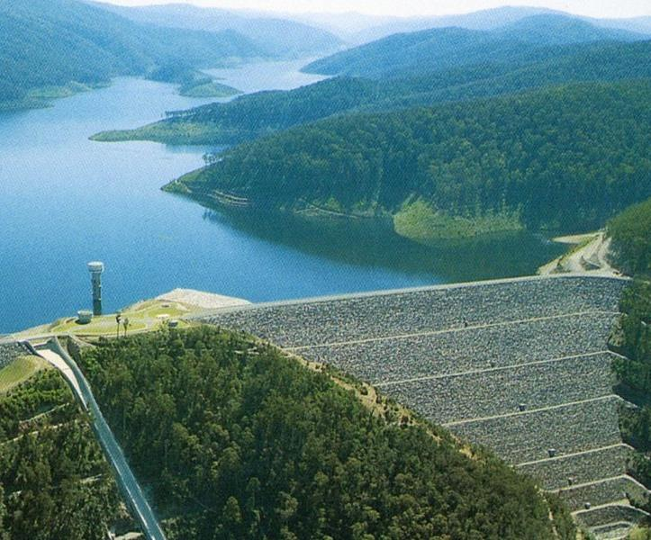
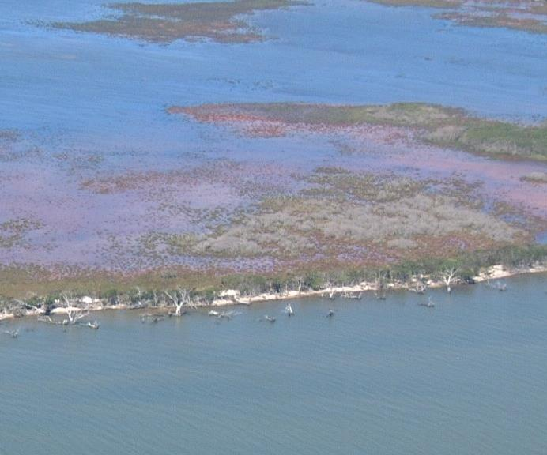
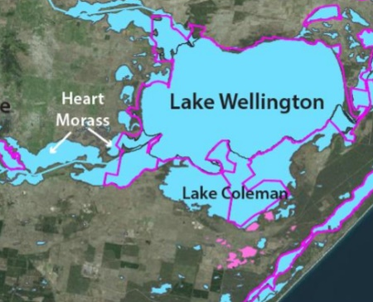
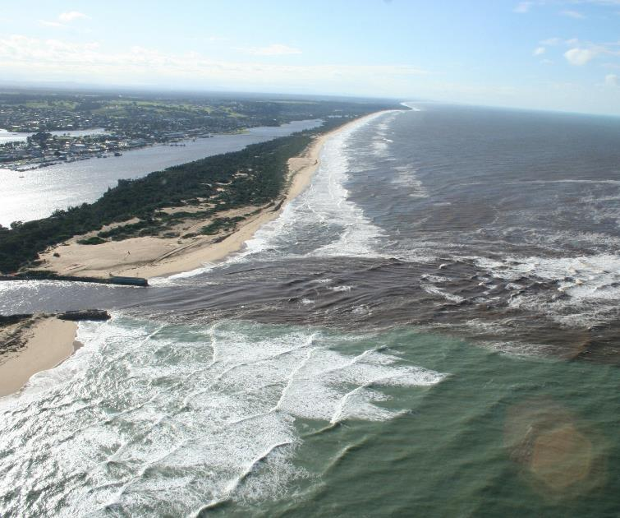
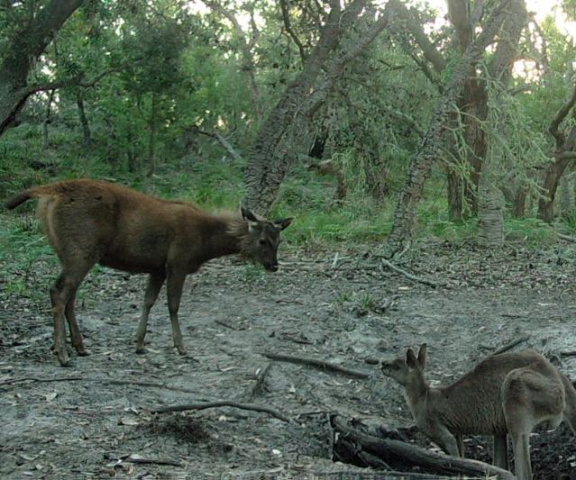
Influences
and Threats
Permanent ocean entrance opening
Extreme events and catchment inputs
Reduction in freshwater inflows
Changing salinity regimes influencing vegetation change and shoreline erosion
Impacts of pest plants and animals on biodiversity values and wetland function
Impacts of a changing climate
Complex management arrangements
SYDNEY, AUSTRALIA | 14 -18 October 2018
MANAGED BY

Slide 6
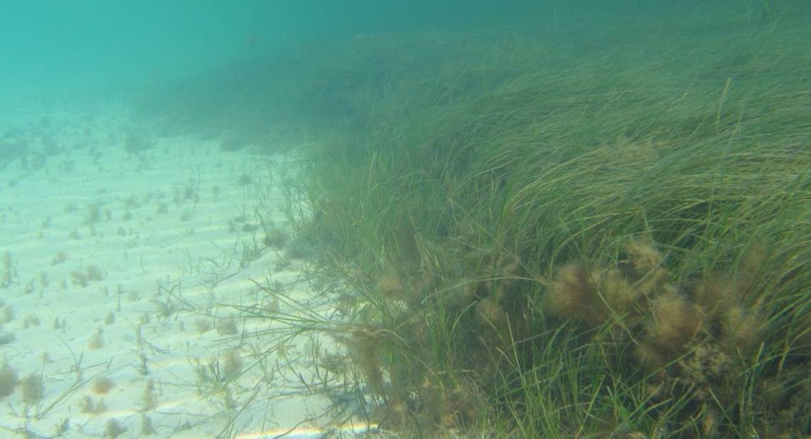
Gippsland Lakes Program
Three core components to making it work
an
effective plan
true partnership approaches
clear governance
SYDNEY, AUSTRALIA | 14 -18 October 2018
MANAGED BY

Slide 7
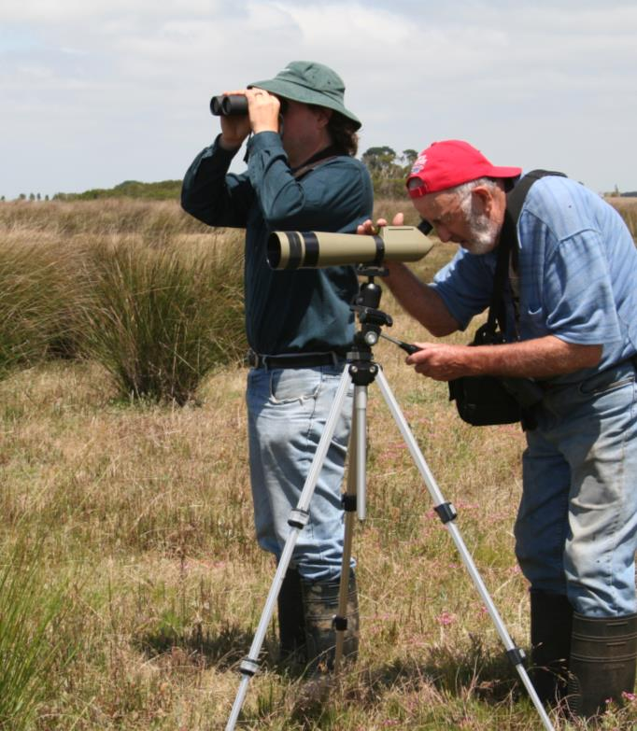
Strategic Planning
A plan for integrated management action
The Gippsland Lakes Ramsar Site Management Plan provides strategic direction for action around the lakes.
The plan is important, but its development represents a partnership approach to planning.
This included:
Collaborative approach
Clear roles and responsibilities (for the development of the plan and within the plan)
Alignment of actions with obligations
Involvement of community objectives
Clear guidance for action
SYDNEY, AUSTRALIA | 14 -18 October 2018
MANAGED BY

Slide 8
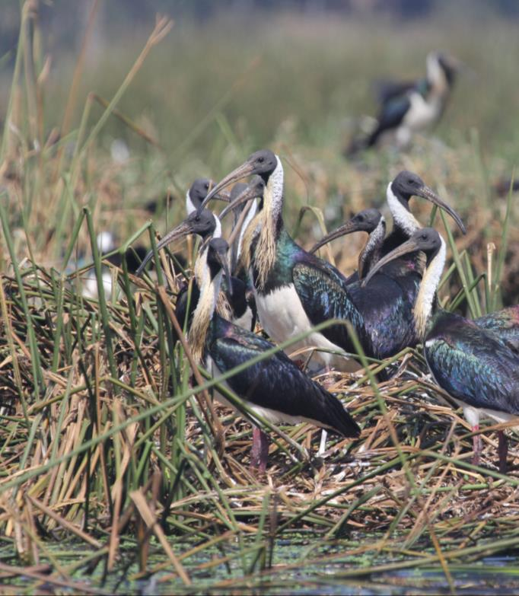
Governance
A structure to enable collaboration
Gippsland Lakes Coordinating Committee
Clear objectives
Strategic direction
Gippsland Lakes Delivery Managers
Operational decision makers
Lead coordination and collaboration
Focussed on 4 priority program areas
Identify opportunities at project level
Convened by the Delivery Managers Group
Priority Program Area Coordination Groups
Implement projects on the ground
Involve multiple partners
Agency and community working together
Project Managers
SYDNEY, AUSTRALIA | 14 -18 October 2018
MANAGED BY

Slide 9
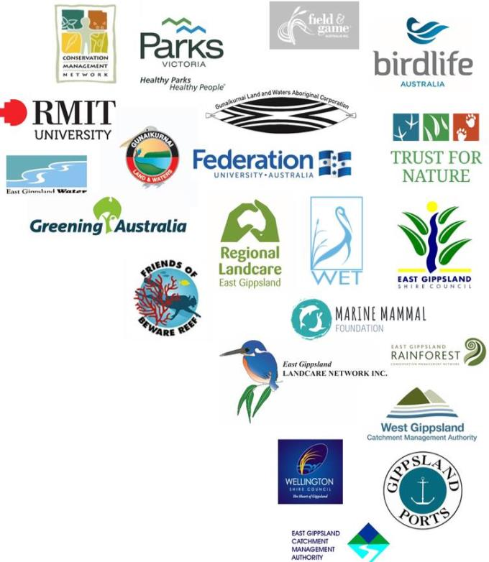
A partnership
approach
Working together on the ground
The Gippsland Lakes Program involves over 37 agency and community partners working together on a range of issues and projects.
This involves:
Aligning involvement to roles and responsibilities
Supporting community to implement their priorities (within the strategic framework)
Multiple partners working together on ‘single’ projects
SYDNEY, AUSTRALIA | 14 -18 October 2018
MANAGED BY

Slide 10
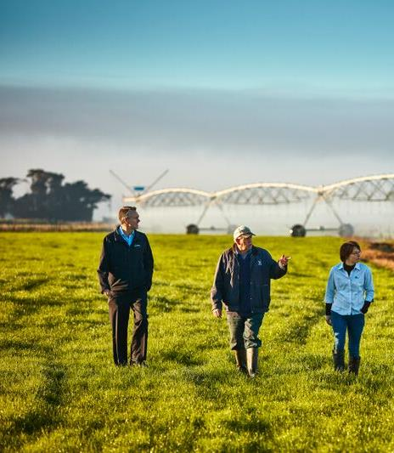
Challenges
What helped in meeting them and are we succeeding?
Issue: Gaining and maintaining support for priorities
Issue: Changing practice for the development of on ground programs
Issue: Achieving ‘real’ partnerships when implementing projects
an
effective
plan
clear governance
Incorporation of objectives into other programs
clear governance
true partnership approaches
Development of integrated programs of work
an
effective
plan
clear governance
true partnership approaches
Community and agencies working together
SYDNEY, AUSTRALIA | 14 -18 October 2018
MANAGED BY

Slide 11
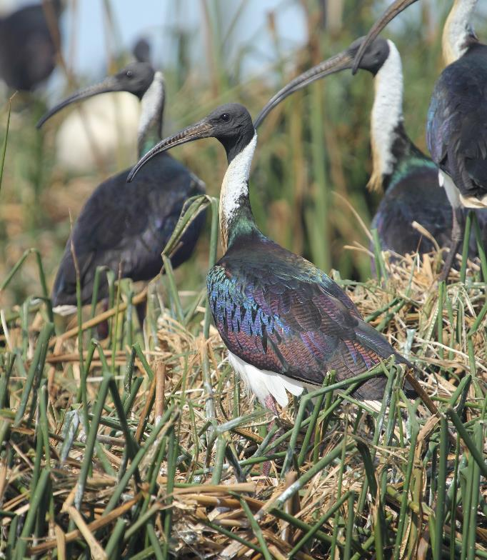
Summary
The Gippsland Lakes system is big, complex and in transition
Sound inclusive planning, prioritisation, and agreed accountabilities for management are critical to success
Partnerships are key to achieving a truly integrated approach to on ground action
SYDNEY, AUSTRALIA | 14 -18 October 2018
MANAGED BY

Slide 12
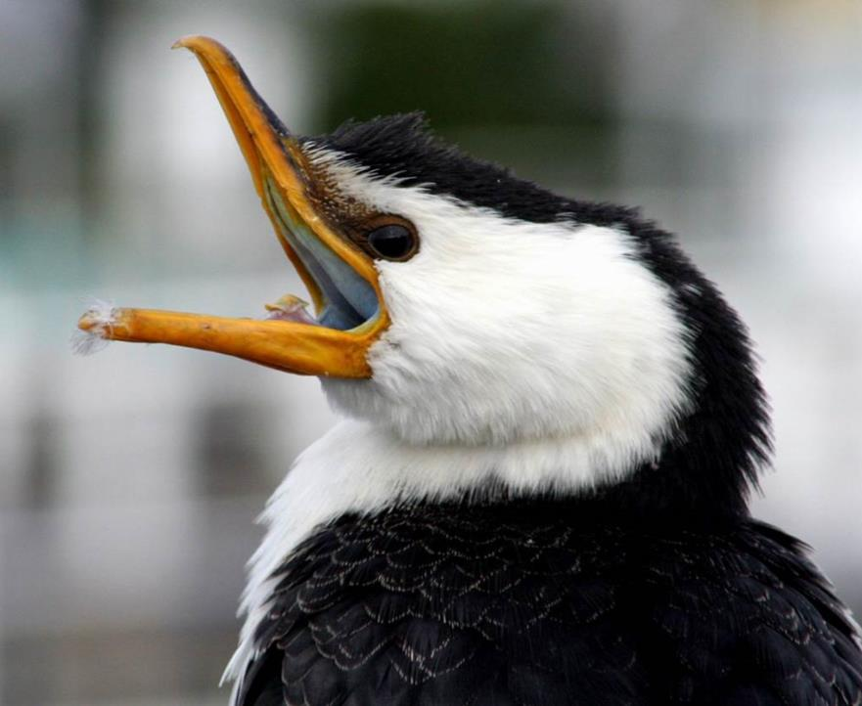
Sean Phillipson | NRM Projects Manager
East Gippsland Catchment Management Authority
sphillipson@egcma.com.au
SYDNEY, AUSTRALIA | 14 -18 October 2018
MANAGED BY

