Slide 1

Event: Flood Community of Practice workshop - Brisbane
Date: 21 September 2018
Presenter:
Ouswatta Perera – Senior Engineer, Flood Policy and Planning
Natural Environment Water and Sustainability

Slide 2
Objective of the day
e
Our Strategy – FloodSmart Future
Building resilience
The Flood Resilient Homes Program (FRHP)
Our Data – Overland flow study
FRHP – Components and Strategies
Flood Hub
Challenges & Opportunities

Slide 3
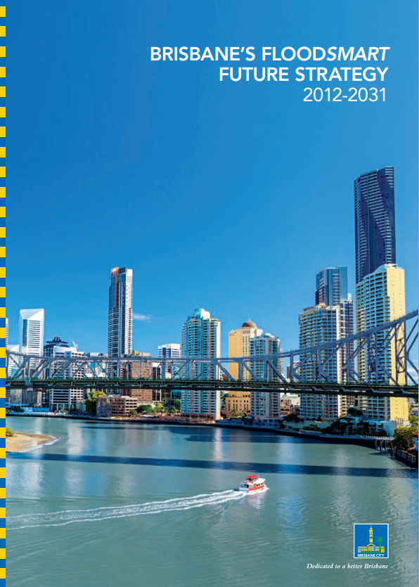
Our Strategy
FloodSmart Future
Long term strategic approach to flood management
Supports the sustainable and economic development of the city
Improves the resilience and liveability of our New World City
“Together we can build a more resilient city, a city that is safe, confident and ready”
  Improving community resilience
  Ensuring the resilience of the city’s built fabric

Slide 4
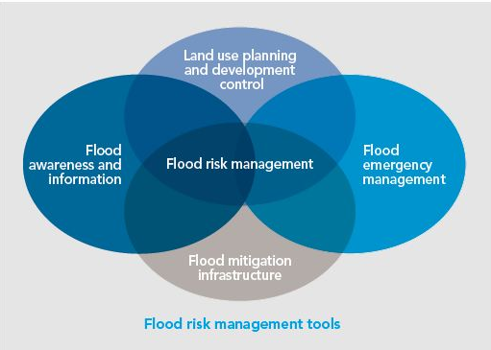
Our Strategy
Integrated mix of measures
Structural flood mitigation
A hazard based approach to land use planning
Providing good quality flood information
World-class emergency management

Slide 5
Our Journey
Building resilience
Overland Flow Study completed / Flood Resilient Homes Program pilot
Improved household resilience to water & energy stresses
Re-invigorated integrated catchment management
Brisbane River Flood Study completed
City Plan updated with latest creek data
Resilience
City Plan 2014
New Disaster Management Tool and Improved Arrangements
New Flood Awareness Maps
Backflow Prevention Program
FloodSmart Future Strategy
Flood Action Plan
Temporary Local Planning Instrument
2011
2012
2013
2014
2015
2016
2017
2018

Slide 6
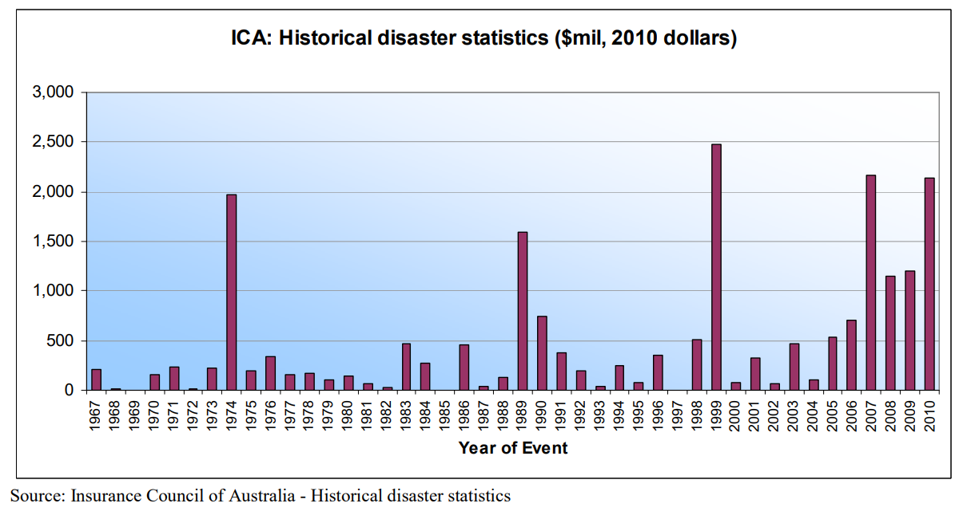
Resilience is long overdue
I have been with Woolworths home insurance in the same house for 3 years with no claims. When this year's renewal came up I was refused renewal because "your suburb (Gordon Park) is a flood risk".
Why else would you pay out thousands of dollars over the years if not in the case of a bad event they could assist you?

Slide 7
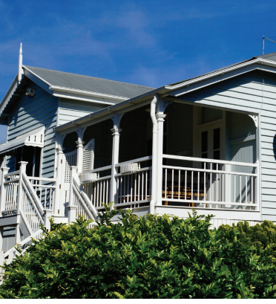
Flood Resilient Homes Program
Helping Brisbane residents build flood resilience
An initiative of Brisbane City Council - delivered in partnership CitySmart, Council’s sustainability agency.
Helping residents prepare for, live through and recover from overland flow flooding events.
Piloted in selected locations.

Slide 8
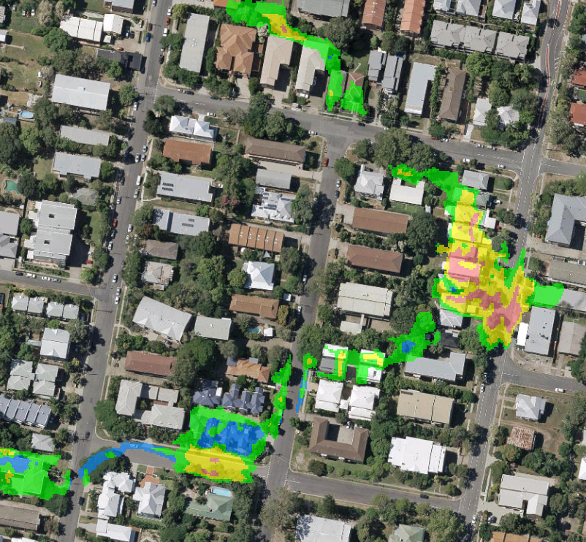
Our Data
Citywide overland flow study
From coarse multiple broad scale datasets to a consistent citywide methodology incorporating pipe networks and latest aerial topography

Slide 9
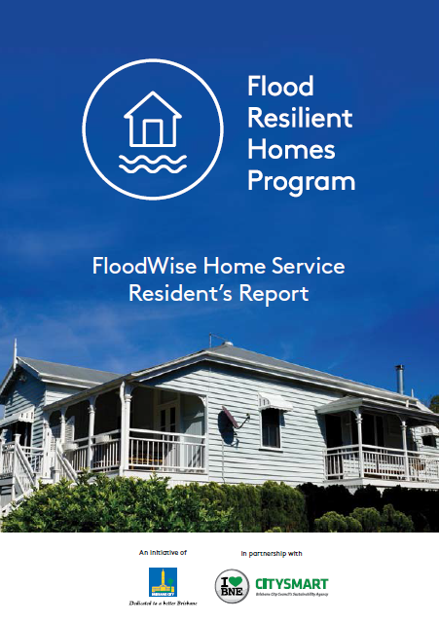
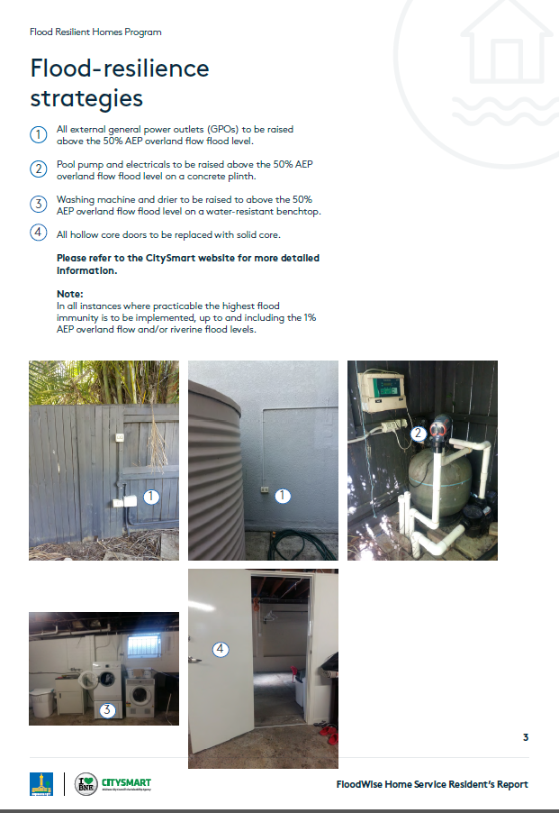
Flood Resilient Homes Program
Services
FloodWise Home Service:
  a free in-home assessment of your property’s flood resilience
FloodWise Home Service Resident’s Report
  a tailored property report providing flood resilience information and recommendations for you and your property
FloodWise Resilience Incentive Scheme
  in eligible cases, providing financial assistance for property modifications.

Slide 10
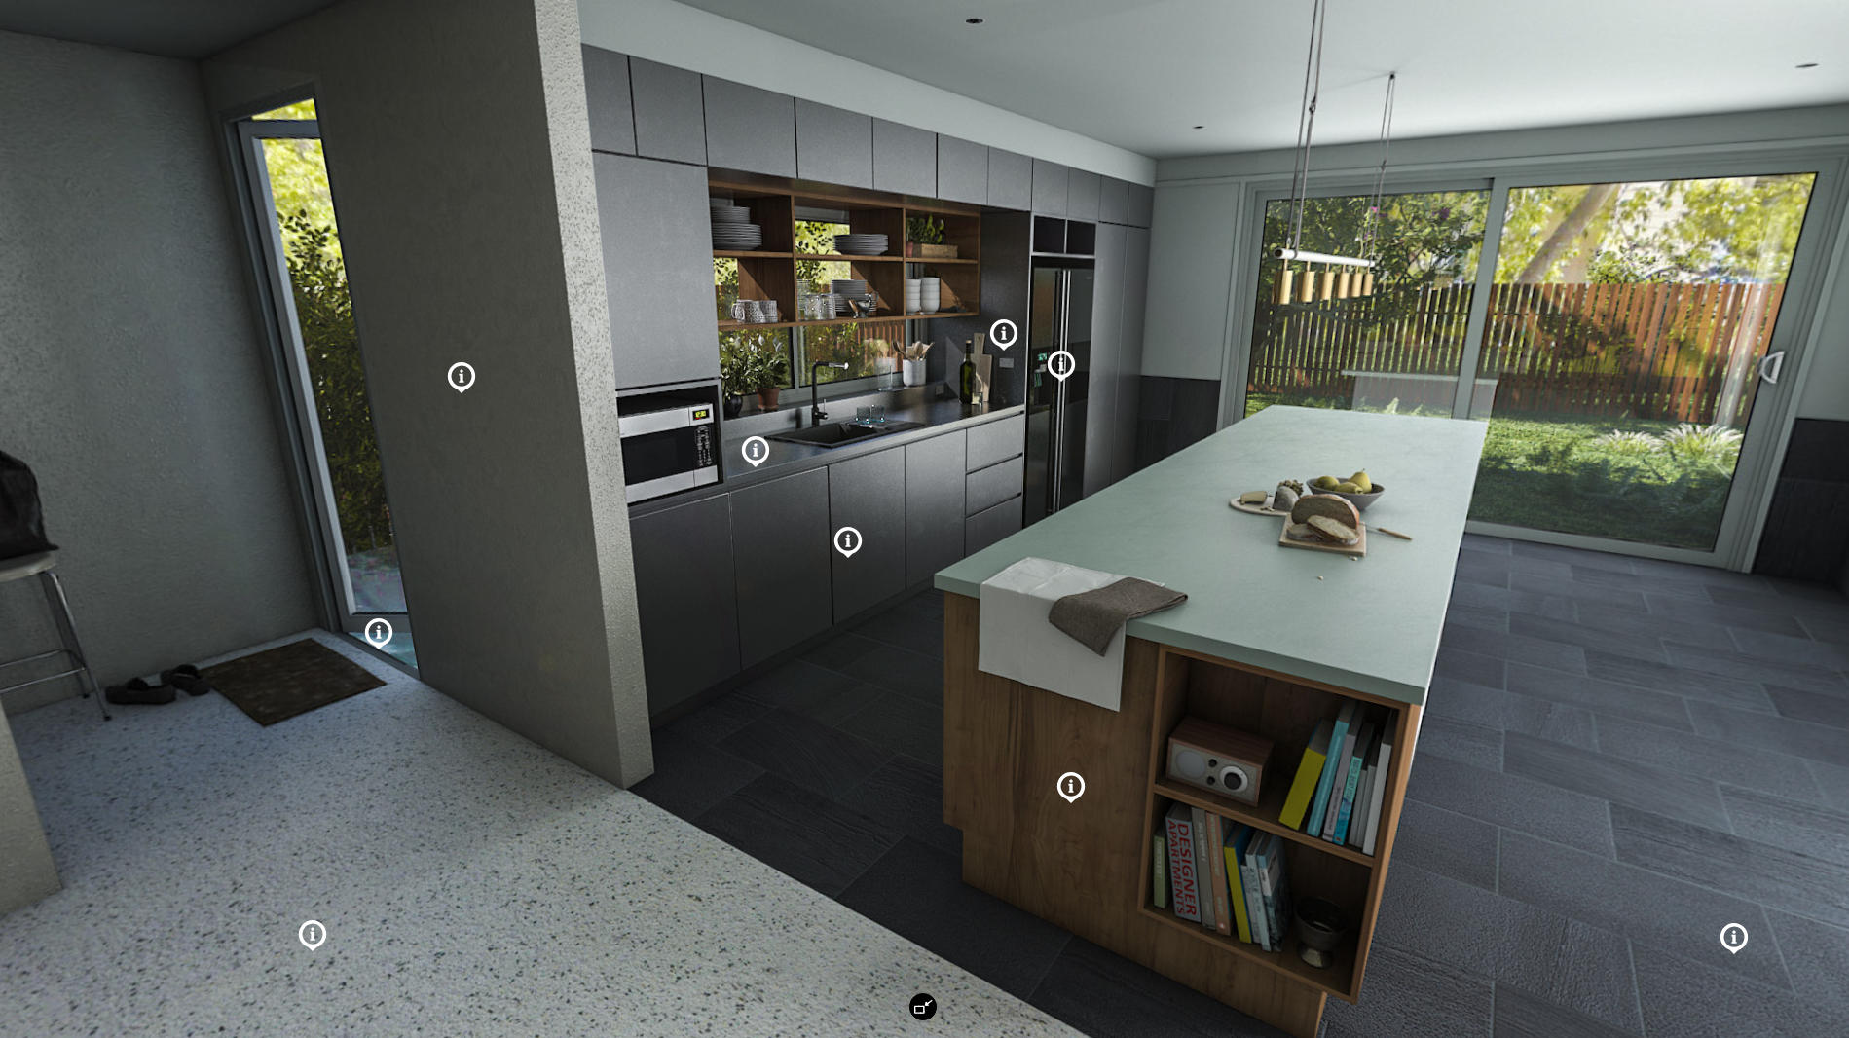
Flood Resilient Homes Program
Strategies
External Services
  Raise electrical meter board, separate circuits, raise hot water, non-return valves…
External Structure
  Consult RPEQ (subsidence/cracking), adequate drainage and ventilation to sub floor
Exterior
  Water resistant cladding, additional weep holes, consult RPEQ (obvious damage)…
Interior
  Water resistant flooring & wall linings, elevate powerpoints, eliminate cavities…
  Door, Windows and Building Openings
  Remove stepped door thresholds, seal all frames…

Slide 11
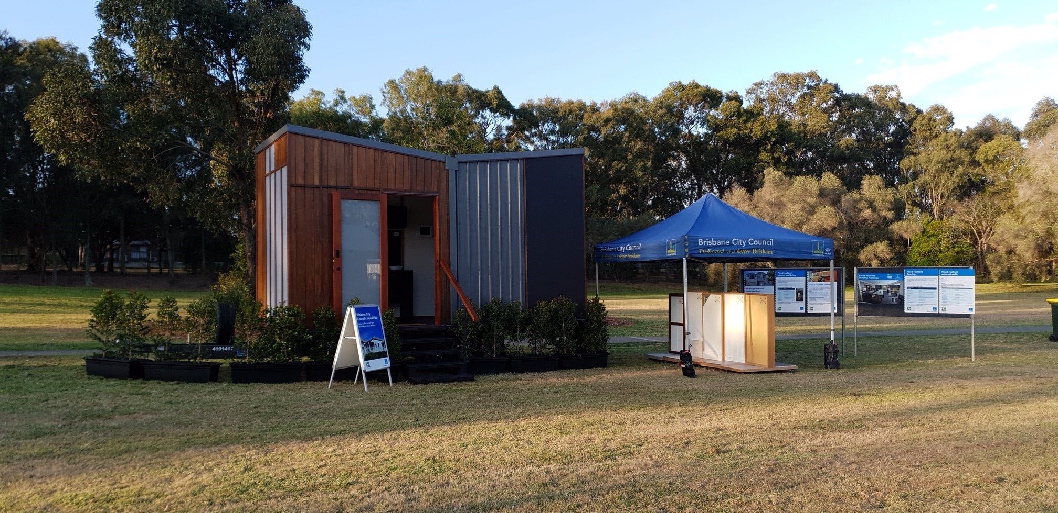
Flood Resilient Homes Program
Flood Hub

Slide 12
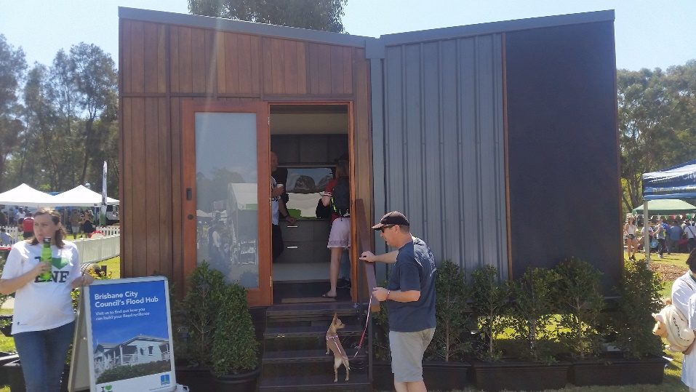
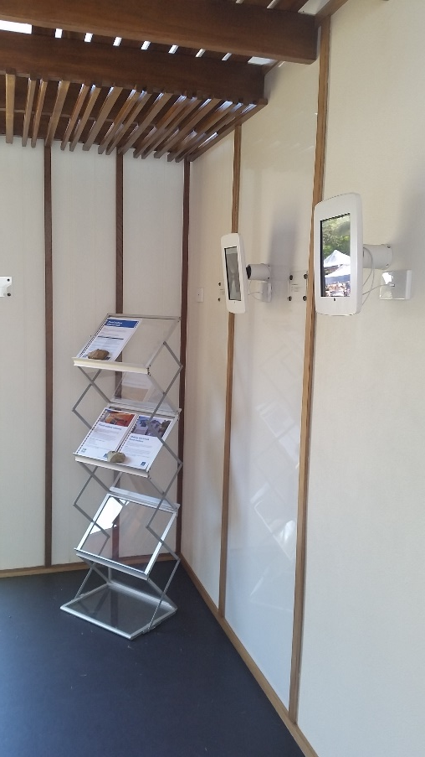
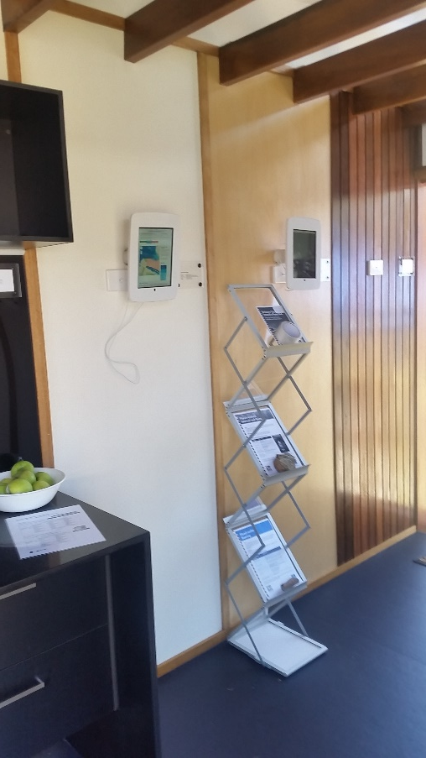
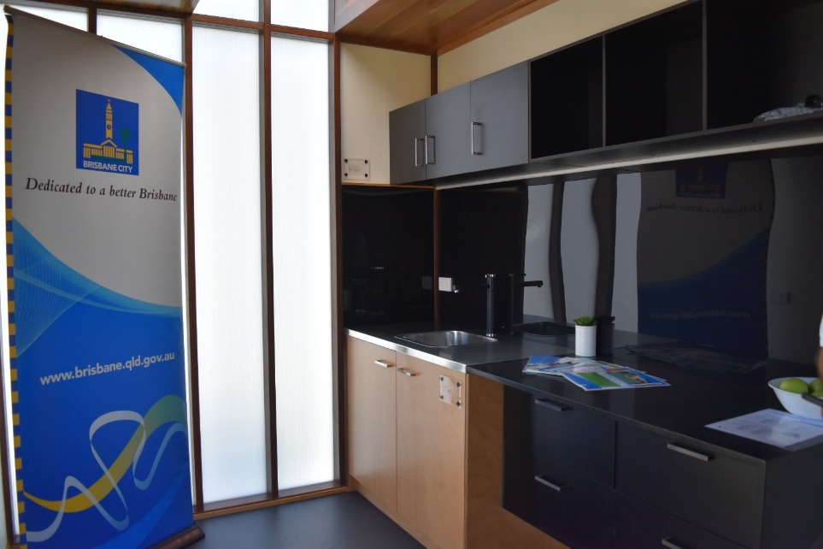
Flood Resilient Homes Program
Flood Hub

Slide 13
Flood Resilient Homes Program
Challenges & Opportunities
Landscaping
  Pervious pavement, raingardens, bioswales, relocating of yard structures...
  Potential adverse impacts elsewhere
Knock-on effects of structural modifications
  Asbestos, termites, H&S etc….
Changing ownerships
  Potential for the FRHP modifications to be modified!
  Transferring the resilience learning with the transfer of titles!
Temporary residents/tenants

Slide 14
Acknowledgements
BCC Project team
CitySmart Project team
JDA

Slide 15

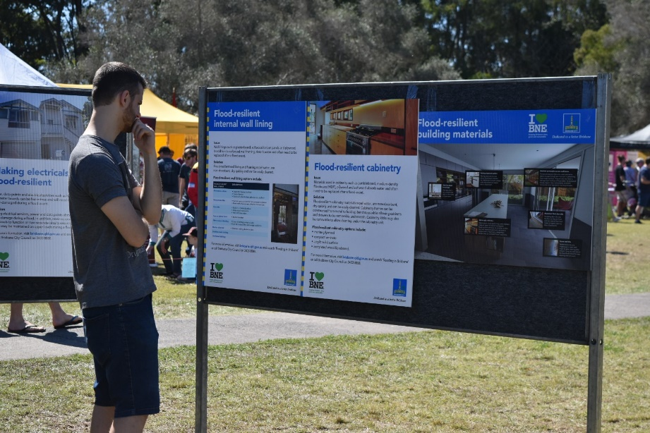
Thank you!

