Slide 1
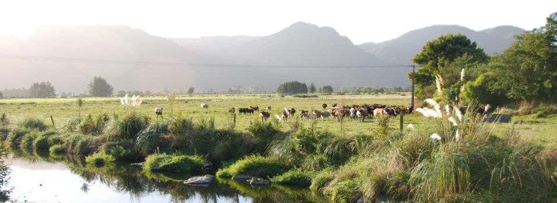
Lessons from the Aorere River: The NZ Riverprize Winner
SYDNEY, AUSTRALIA | 14 -18 October 2018
MANAGED BY

Slide 2
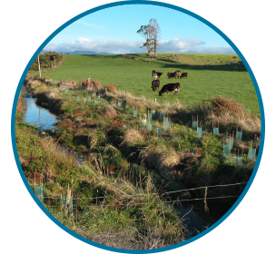
Presentation Overview
Exemplifying Success – Aorere River Catchment
Lessons Learnt
Identifying Predictors of Success
SYDNEY, AUSTRALIA | 14 -18 October 2018
MANAGED BY

Slide 3
The Aorere River
Tasman District, Upper South Island, New Zealand
Catchment Initiative Supported by NZ Landcare Trust since 2006
Winner – Morgan Foundation NZ Riverprize 2015
SYDNEY, AUSTRALIA | 14 -18 October 2018
MANAGED BY

Slide 4
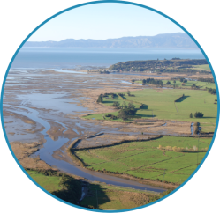
The Aorere River Catchment
Covers an area of 573 km2
Short steep river with a length of 72km
80% of catchment is native forest
16% agriculture, 3% scrub, 1% exotic forest
Dairy farming most common agriculture
11,000 - 13,500 cows on 34 farm
SYDNEY, AUSTRALIA | 14 -18 October 2018
MANAGED BY

Slide 5
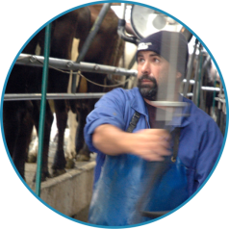
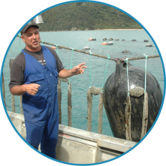
The Challenge
Dairy Farming ($18M/per annum) vs. Shellfish Farming ($15M/per annum)
E. coli contamination leading to shellfish harvesting restrictions
Shellfish harvesting as low as 28% of the year
Perception that high E. coli due to pasture runoff
SYDNEY, AUSTRALIA | 14 -18 October 2018
MANAGED BY

Slide 6
The Science
Intensive modeling of nutrient and pathogen impacts from land use
Contaminant budgets and predicted causes of contamination
Presentation of modeling results to marine farmers, dairy farmers and Tasman District Council
Identification of E. coli as the key contaminant
On-farm solutions to reduce E. coli loads
SYDNEY, AUSTRALIA | 14 -18 October 2018
MANAGED BY

Slide 7
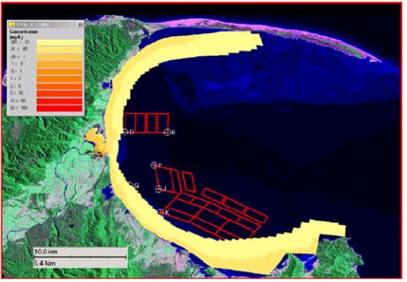
Aorere plume model
A tool to predict nitrogen, sediment and faecal coliforms within the estuary and bay under baseflow and stormflow conditions.
SYDNEY, AUSTRALIA | 14 -18 October 2018
MANAGED BY

Slide 8
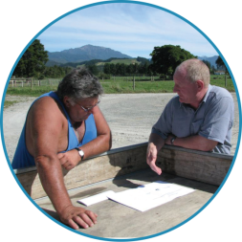
The Solutions
Community based, problem solving field-day held on local farms
Scientists and farmers identify BMPs for E. coli management
Individual farm planning systems tailored to specific farms
Independent contractor developed farm plans with each farmer
SYDNEY, AUSTRALIA | 14 -18 October 2018
MANAGED BY

Slide 9
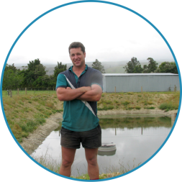
Social Science for Adaptive Management
Farmer surveys in 2007, 2010 and 2012 to assess environmental awareness and attitudes
Explored motivations to adopt BMPs
Determined confidence in effectiveness of BMPs
Targeting farmer support to achieve behaviour change
SYDNEY, AUSTRALIA | 14 -18 October 2018
MANAGED BY

Slide 10
Confidence in Effectiveness of BMPs
Comparison between the 2007 and 2010 surveys showed that farmers confidence in promoted BMPs has grown significantly.
The percentage of farmers that reported being ‘very confident’ in BMP effectiveness increased for:
Effluent irrigation/management – 54% in 2007; 76% in 2010
Fencing – 31% in 2007; 70% in 2010
Bridging and culverting – 16% in 2007; 100% in 2010
SYDNEY, AUSTRALIA | 14 -18 October 2018
MANAGED BY

Slide 11
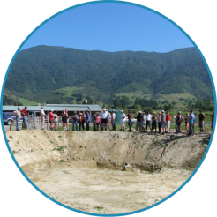
Action on the Ground
24 out of 34 farms developed voluntary farm environment plans
Each farm plan includes a 5 year action plan for BMP implementation
Audit of farm plans - average 78% of actions identified had been completed
Over $1.6M invested in on-farm best management practices ($67,000 per farm)
SYDNEY, AUSTRALIA | 14 -18 October 2018
MANAGED BY

Slide 12
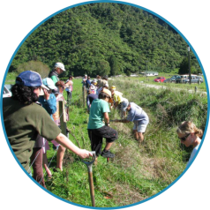
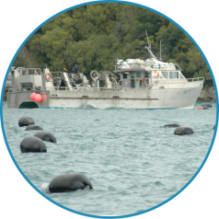
Outcomes
Since 2006 there has been a reduction in E coli spikes during low and medium river flows
Since 2006 a step change reduction in marine pathogen concentrations
Shellfish harvesting up from 28% in 2002 to 79% in 2012
Viable dairy farming and shellfish farming businesses
Improved community cohesion
SYDNEY, AUSTRALIA | 14 -18 October 2018
MANAGED BY

Slide 13
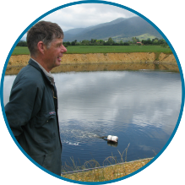
Lessons Learnt from Aorere River
Farmers as Leaders – Community Ownership
Clear Problem Identification – Good Science
Independent Facilitation – Project Coordination
Technical Support and Training
Building and Maintaining Relationships
Quality Communications – Telling Stories and Celebrating Success
SYDNEY, AUSTRALIA | 14 -18 October 2018
MANAGED BY

Slide 14
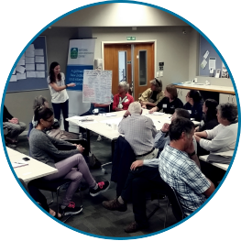
Identifying Predictors of Success
Literature Review
National Catchment Management Workshop – collaborative identification of “enablers and challenges”
Surveys of Farmers in 3 NZ Catchments – Kakanui, North Canterbury and Buller Rivers
SYDNEY, AUSTRALIA | 14 -18 October 2018
MANAGED BY

Slide 15
Key Determinants / Predictors
Access to Science, Training and Information
Confidence in Regulatory Policies
Leadership
Farm Planning and Monitoring
Trust in the Public
Concern for Water Quality
SYDNEY, AUSTRALIA | 14 -18 October 2018
MANAGED BY

Slide 16
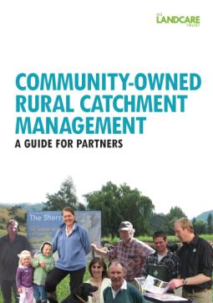
Valuable Innovations
“Commnuity-Owned Rural Catchment Management: A Guide for Partners”
Catchment Management Masterclasses
Sister River Approach (“Twinning”)
www.landcare.org.nz
SYDNEY, AUSTRALIA | 14 -18 October 2018
MANAGED BY

Slide 17
Acknowledgements
Farmers in the Aorere, Kakanui, North Canterbury and Buller River Catchments
Co-researchers: Professor Ben Tyson and Christine Unson
Ministry for the Environment and Ministry for Primary Industries
Staff and Trustees of NZ Landcare Trust
SYDNEY, AUSTRALIA | 14 -18 October 2018
MANAGED BY

