Slide 1


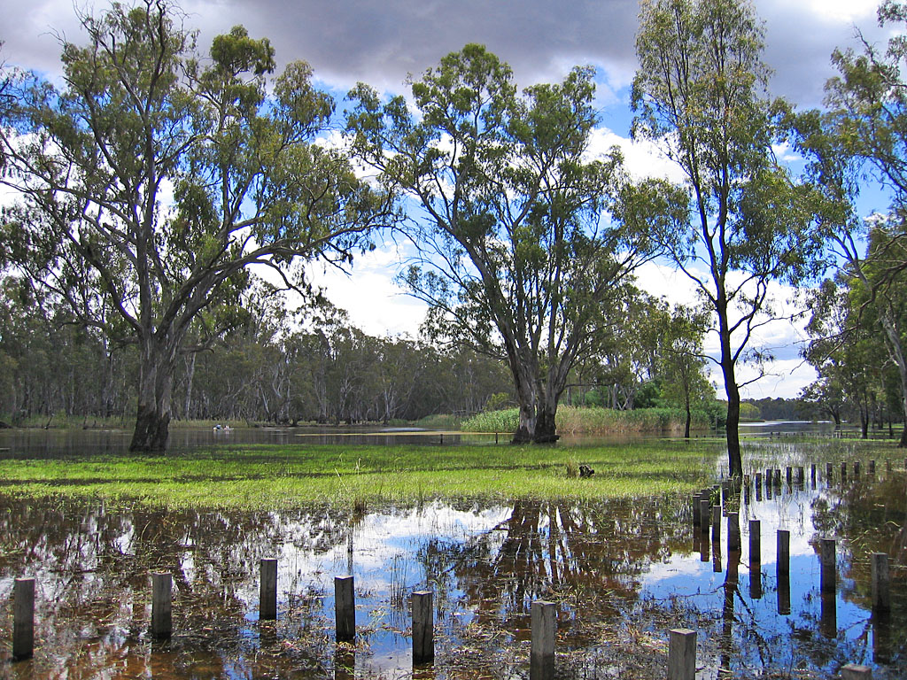

What can predictive eco-hydrology tell us to help inform water management in the Basin?
Danial Stratford, Sam Nicol, Andrew Freebairn, Carmel Pollino, Darran King, Susan Cuddy, Mitchell Korda (CSIRO); Rebecca Lester (Deakin Uni); David Stevens, Peter Bridgeman, Michael Wilson, Nathan Pereira (MDBA)
A partnership project between CSIRO and the Murray-Darling Basin Authority
SYDNEY, AUSTRALIA | 14 -18 October 2018
MANAGED BY

Slide 2
Acknowledgements
Many people have contributed to the development of the project, through attendance at workshops, interviews, as advisers, steering committee and conception discussions.
Francis Chiew, Ian Cresswell, Nicky Grigg, Bruce Taylor, Klaus Joehnk, Tanya Doody, Ian Overton, Martin Nolan (CSIRO);
Rebecca White, Gill Whiting, Ian Neave, Jim Foreman, Matthew Bethune, Matt Coleman, Jong Lee, Sue Powell, Stuart Little, Willam Vlotman, Jacqui Russell, Peter Davies, David Bell, Paul Carlile, Matt O’Brien (MDBA)
Jane Roberts (Cnsl); Nick Bond (Latrobe Uni); Mike Stewardson (UoM); David Straccione (CEWO); Sam Roseby (DoE); Andrew Sharp (Vic EWH); Enzo Guarino, Ross Thompson (UC)
Notes:
Material or intellectual input into the project

Slide 3
Predicting ecological change project
Project goal:
‘To develop and demonstrate a method that can predict trajectories of spatio-temporal change in ecology as a consequence of future water management decisions’
Notes:
Predict; forecast; project; trajectories; futures; pathways;
We refer to trajectories as methods that track environmental condition* through time. This can include antecedent/past condition through incorporation of model hindcasting, as well as the prediction/forecast of possible ranges in the future condition of environmental assets.
Create an understanding of the range of plausible futures – spatial and temporal env change

Slide 4
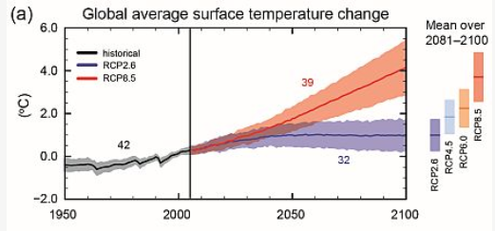
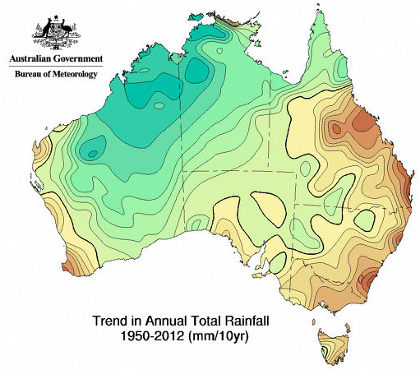
What are the roles of predictive ecohydrology?
(Value propositions developed during CSIRO-MDBA conception discussions)
Scenario analysis (e.g. counter factual and benefit of management interventions)
Forecasting progress towards a set of targets
Understanding risk / characterising uncertainty
Informing priorities (urgency) and management
IPCC - http://ar5-syr.ipcc.ch/topic_futurechanges.php
Notes:
http://ar5-syr.ipcc.ch/topic_futurechanges.php
https://www.researchgate.net/figure/Trend-in-annual-total-rainfall-in-Australia-19502012-Source_fig1_287176779

Slide 5
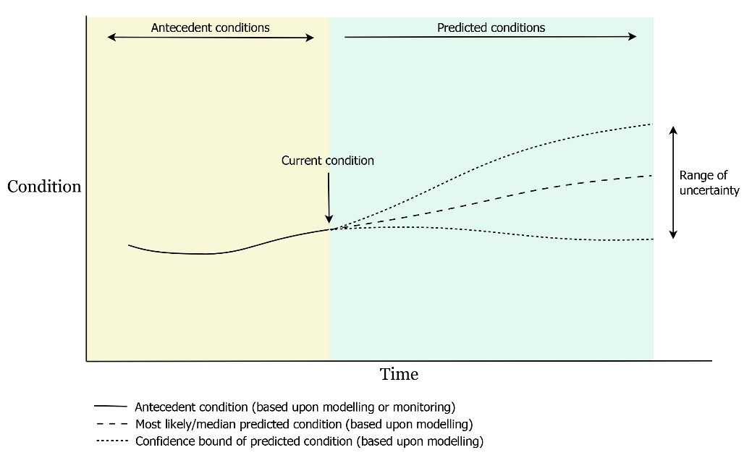
Concept design
Notes:
-Two time periods (antecedent and future)
-Temporally explicit
-Uncertainty increases through time (not after precision)
-current condition dictates the range of possible future conditions

Slide 6
Understanding and predicting ecological response
(Evolution of methods used in the Basin)
Murray Flow Assessment Tool (MFAT)
Environmental water requirements (e.g. MDBA EWRs) *
Dynamic ecological modelling (e.g. Ecological Elements) *
Forecasting methods and assessment workflows *

Slide 7
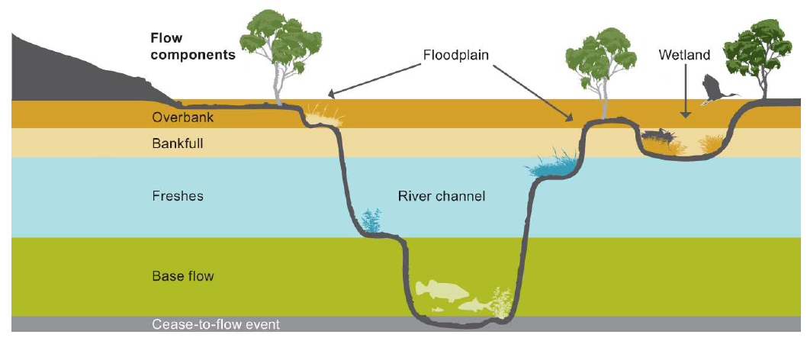
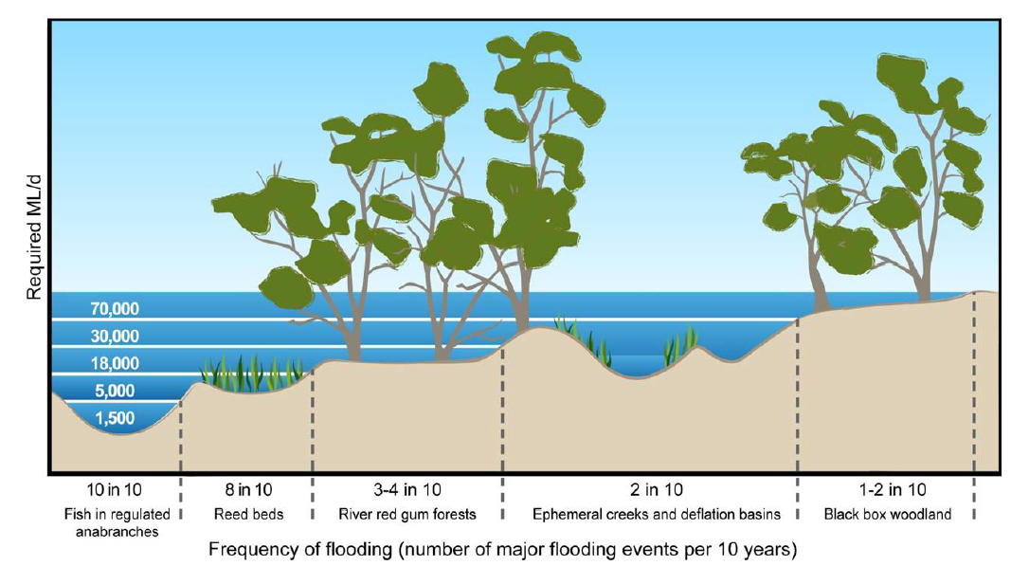
Environmental flow requirements
MDBA 2011
Flow requirements consider:
magnitude
duration
timing
frequency
Notes:
Flow targets: -Ecologically relevant- not linked directly to condition- not sensitive to event sequencing
(considered over a 114 year modelled flow regime)
ESLT: MDBA (2011) The proposed “environmentally sustainable level of take” for surface water of the Murray‐Darling Basin: Methods and outcomes, MDBA publication no: 226/11. Murray‐Darling Basin Authority, Canberra
SFI: MDBA (2012) Assessment of environmental water requirements for the proposed Basin Plan: Barmah–Millewa Forest. Canberra

Slide 8
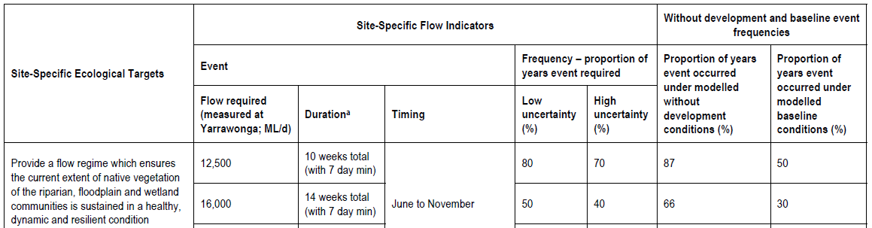
Environmental flow targets
Value propositions (from conception discussions):
Scenario analysis
Forecasting progress
Understanding sequencing of flows to assess risk
Inform annual watering priorities
Notes:
MDBA (2012) Assessment of environmental water requirements for the proposed Basin Plan: Barmah–Millewa Forest. Canberra

Slide 9
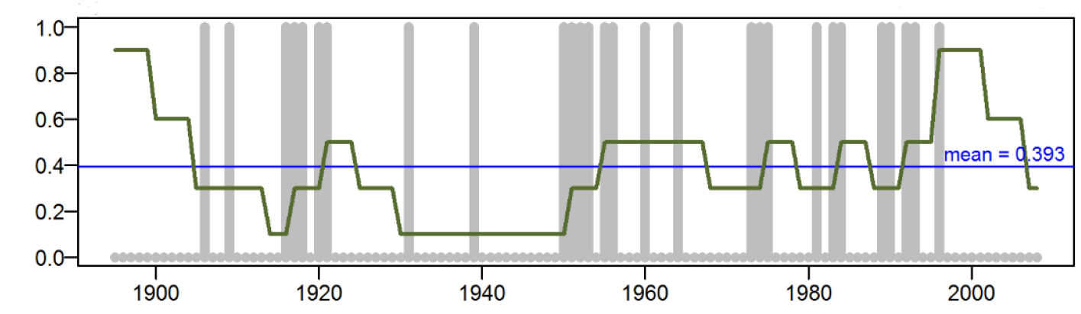
Dynamic ecological modelling
Formalised association between flow regime and conditions
Enables tracking of condition through time (dynamic change)
Input requirements can include:
flow requirements (e.g. SFIs)
response functions (e.g. response curves, population matrices)
spatial representation
Notes:
Condition is a response to surface flows – does not consider local rainfall, ground water etc
Parameters can be regionalised or localised
Overton et al (2014) Development of the Murray-Darling Basin Plan SDL Adjustment Ecological Elements Method. Report prepared for the Murray-Darling Basin Authority. CSIRO, Canberra

Slide 10
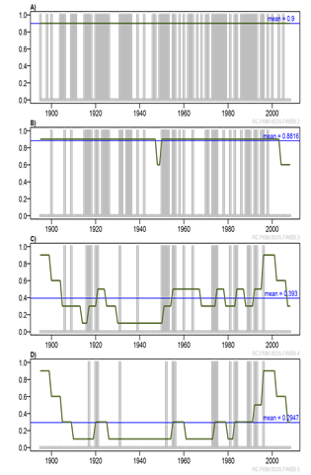
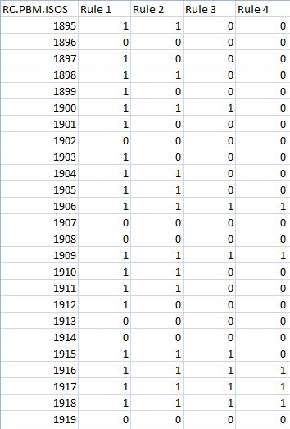
Dynamic ecological modelling

Slide 11
Dynamic ecological modelling
?
Value propositions (from conception discussions):
Scenario analysis
Forecasting progress
Understanding sequencing of flows to assess risk
Inform watering priorities
Notes:
Can be used for scenario analysis: - condition improvement/decline – see risks and impacts associated with scenarios

Slide 12

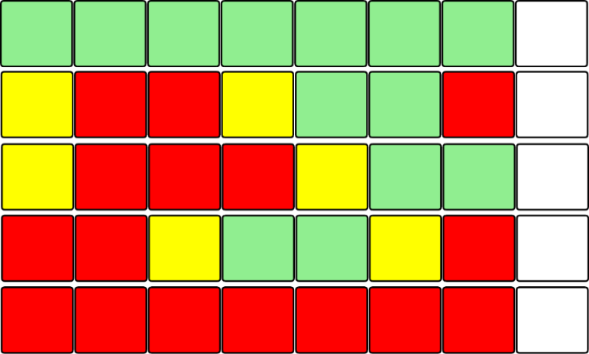
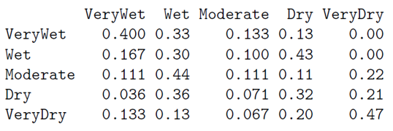
Historic flow time series
…
1981
1982
1983
1984
1985
1986
1987
…
Identifying ‘states’ and
‘transitions’
…
1981
1982
1983
1984
1985
1986
1987
Year:
+1
+2
+3
+4
…
Building a Markov transition model
…
…
…
…
…
Notes:
Sampled years are concatenated to create plausible future flows
Base upon similar characteristics to historical – can modify to represent different attributes/changes
-magnitudes; frequencies; timings and durations- sequencing (multiyear)
Represent variability and uncertainty – multi-run

Slide 13
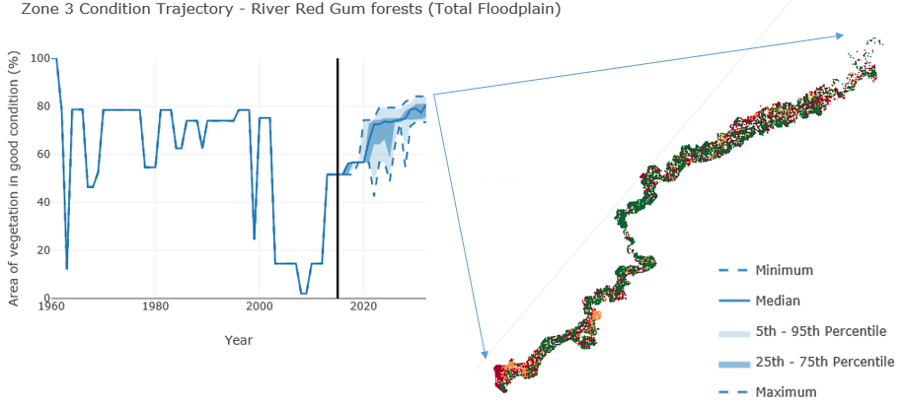
Forecasting methods
Value propositions (from conception discussions):
Scenario analysis
Forecasting progress
Understanding sequencing of flows to assess risk
Inform watering priorities

Slide 14
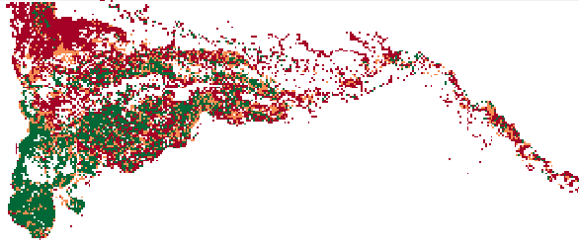
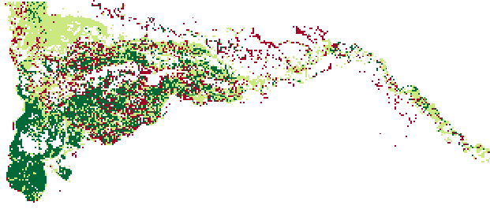
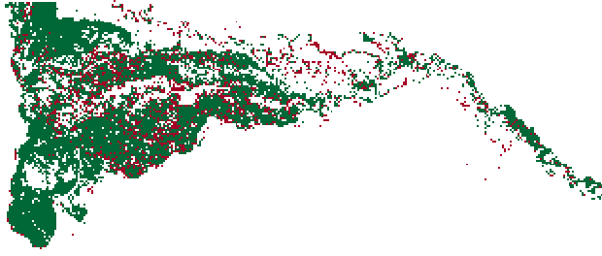
What can the workflow tell us?
Evaluate differences between locations and ecological community types
Identify areas of concern
Evaluate risk and understand likely, bad and good outcomes
Inform and test management actions that may assist (including multi-year consideration)
Notes:
Identify locations of possible decline of concern
Calculate the probability of detrimental conditions
Determine what, and when, interventions are required
Test hypothesis about management actions (adaptive learning)

Slide 15
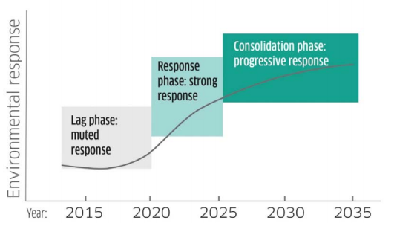
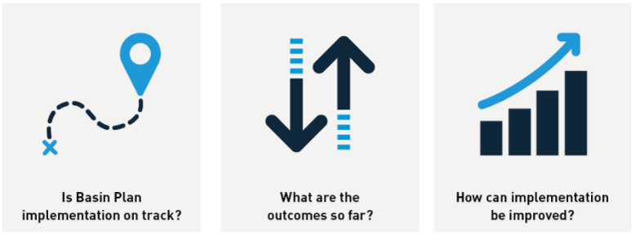
Potential Applications
2020 MDBA Evaluation report
2024 BP review
BWS review
Chapter 8 EWP review
Informing annual watering priorities

Slide 16
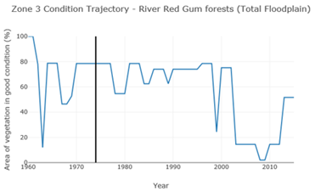
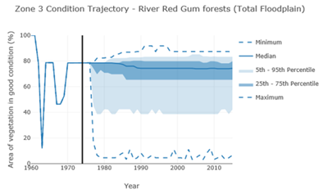
Understanding risk / characterising uncertainty
Dry spell length (= or >) |  | Avg exceedance (10,000 runs)
 | 1 | 0.979
 | 2 | 0.800
 | 3 | 0.522
 | 4 | 0.308
 | 5 | 0.171
 | 6 | 0.088
 | 7 | 0.045
 | 8 | 0.023
 | 9 | 0.010
 | 10 | 0.005
Important to understand probability and impact of extreme events
Notes:
CC prediction/scenarios – differences between changes in mean flow and changes in extremes (e.g. drought length)
Recovery and resilience processes – how can these be supported

Slide 17
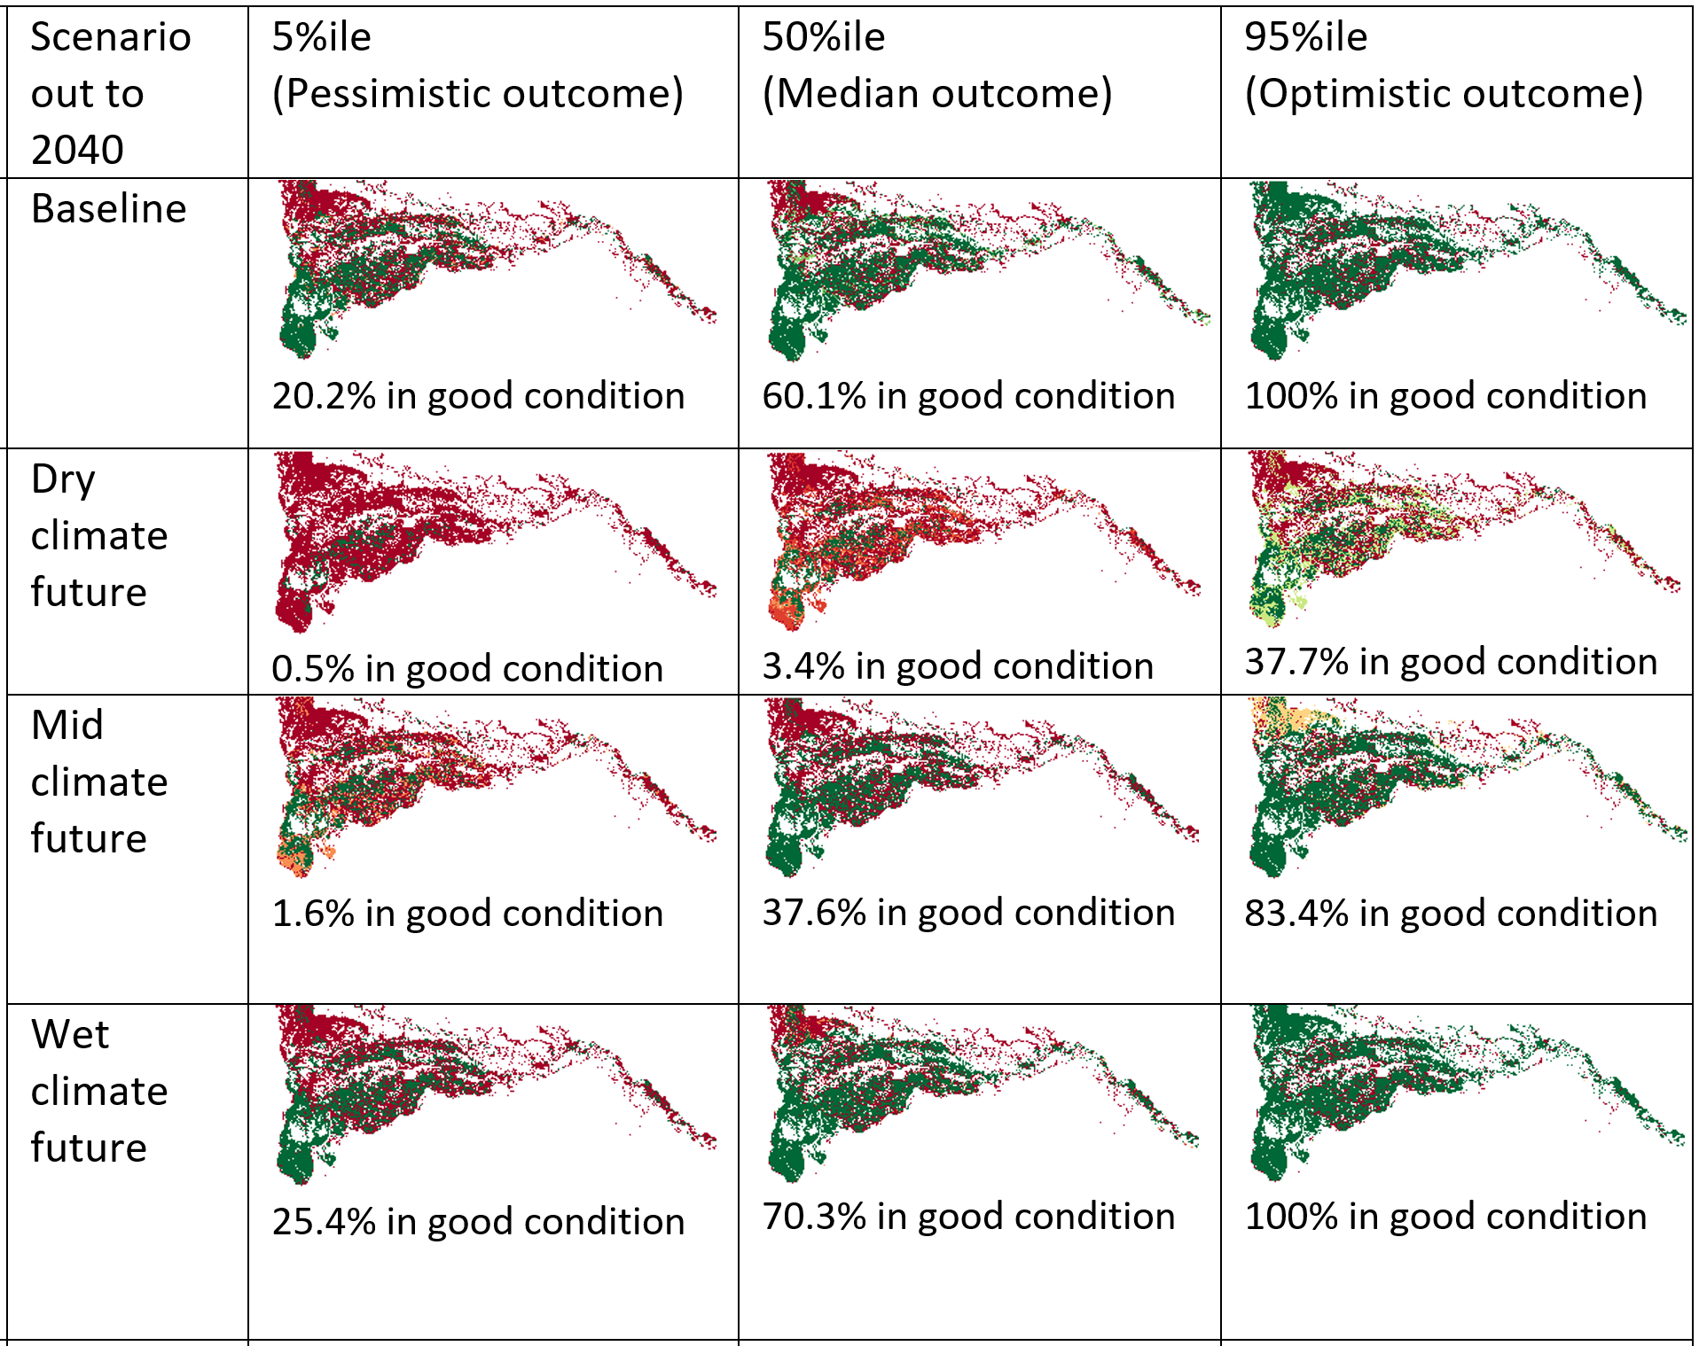
Exploring outcomes
Notes:
Vegetation NDVI and Cunningham composite

Slide 18


CSIRO Land and Water
  Carmel Pollino
    e carmel.pollino@csiro.au
  Susan Cuddy
    e susan.cuddy@csiro.au
Thank you
Murray-Darling Basin Authority
  Michael Wilson
    e Michael.Wilson@mdba.gov.au
  David Stevens
    e david.stevens@mdba.gov.au
CSIRO Land and Water
  Danial Stratford
    t +61 2 6246 5993
    e danial.stratford@csiro.au
    w www.csiro.au/
CSIRO Land and water
A partnership project between CSIRO and the Murray-Darling Basin Authority

