Slide 1
Looking Forward: Exploring Innovation in the Murray-Darling Basin
ASHMITA Sengupta, Tanya Doody, Danial Stratford, Carmel Pollino
MANAGED BY
SYDNEY, AUSTRALIA | 14 -18 October 2018

Slide 2
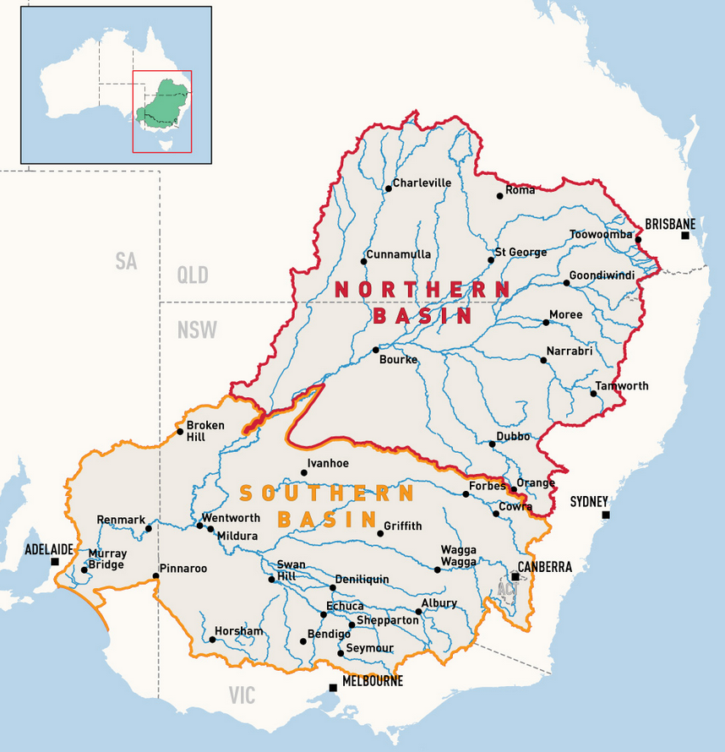
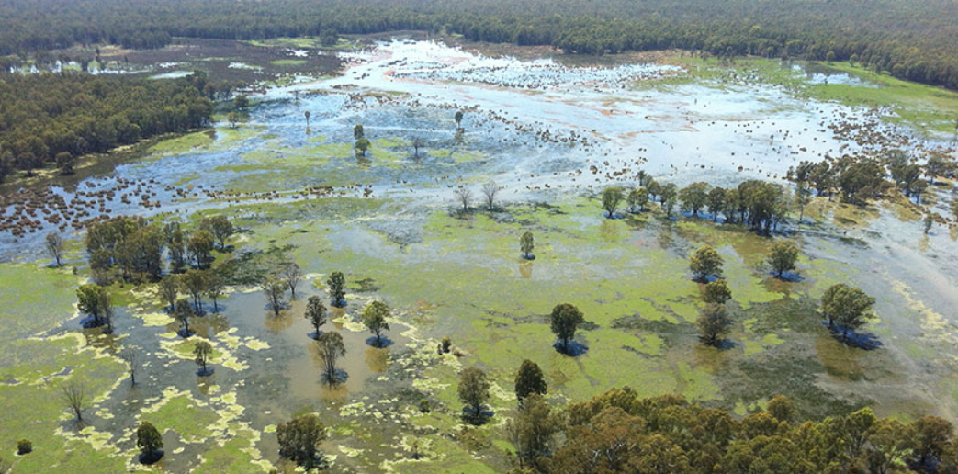
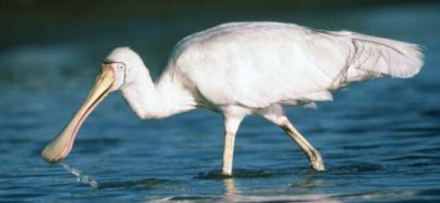
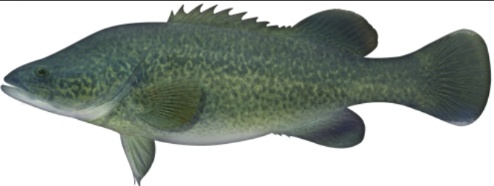
A Hardworking River System
SYDNEY, AUSTRALIA | 14 -18 October 2018

Slide 3
Why Do We Need Innovation
Sharing between States
Transportation
Manage flooding
Occasional droughts
Salinity
Focus on environment
Implementation
Periodic reviews
1820s
2003
2012
2026
Basin Plan: 13 Billion dollars
Management in the Murray-Darling Basin
MANAGED BY
SYDNEY, AUSTRALIA | 14 -18 October 2018

Slide 5
Why Do We Need Innovation
Sharing between States
Transportation
Manage flooding
Occasional droughts
Salinity
Focus on environment
Implementation
Periodic reviews
$$ limited
Next decade is crucial (IPCC)
Limited engagement in certain sectors
1820s
2003
2012
2026
Basin Plan: 13 Billion dollars
Management in the Murray-Darling Basin
MANAGED BY
SYDNEY, AUSTRALIA | 14 -18 October 2018

Slide 6
Breakthrough
Innovation
Basin Plan
Sustaining
Innovation
Water market
Sustainable Diversion Limit
Well
How well is the problem defined?
Early Basin Plan
Not Well
Basic Research
Disruptive
Innovation
Not Well
Well
MANAGED BY
How well can we define the skills needed?
SYDNEY, AUSTRALIA | 14 -18 October 2018

Slide 7
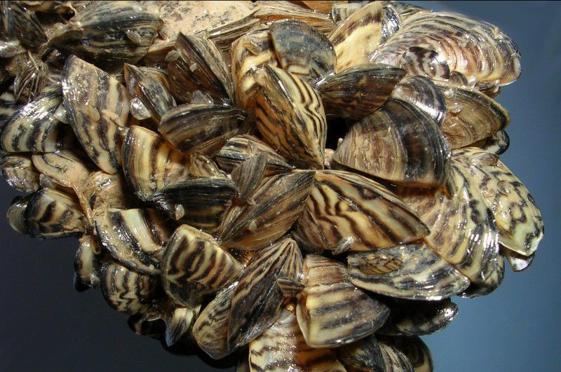
Basic Research
Translating from science to policy
Zebra mussels are invasive
$3.6 Billion US dollar projected clean up
Biobullets
MANAGED BY
SYDNEY, AUSTRALIA | 14 -18 October 2018

Slide 8
Basic Research
Translating from science to policy
First scientific report in 1981
No policy uptake for a decade
Not translated to other invasive species
MANAGED BY
SYDNEY, AUSTRALIA | 14 -18 October 2018

Slide 9
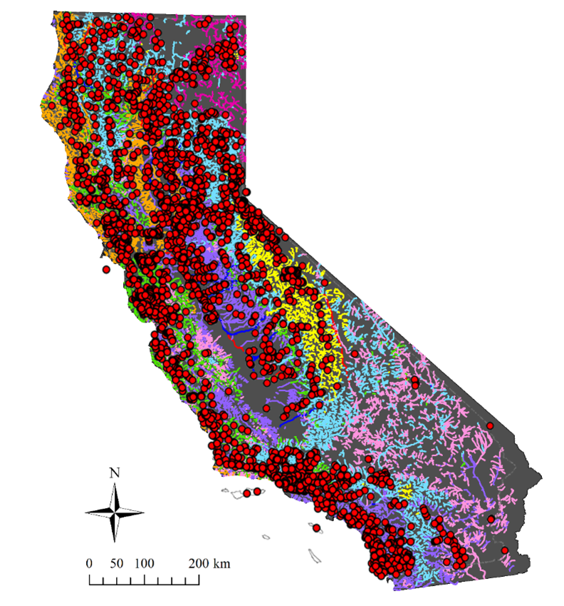
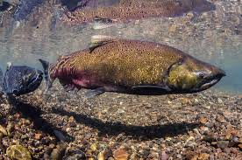
Breakthrough Innovation
Taking the broader view
Macroinvertebrate data (California Stream Condition Index) data and flow alteration information to develop regional thresholds for instream flow standards
Chinook Salmon
MANAGED BY
SYDNEY, AUSTRALIA | 14 -18 October 2018

Slide 10
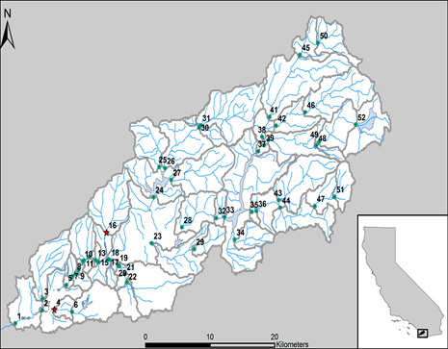
Breakthrough Innovation
State
Regional
Local
San Diego River Watershed
MANAGED BY
SYDNEY, AUSTRALIA | 14 -18 October 2018

Slide 11
Breakthrough Innovation
Stakeholder driven management questions
What is the current state of alteration and future changes?
How can flow–ecology relationships be used to prioritize regions of the watershed into various flow management classes that can inform future planning decisions?
How can flow-ecology relationships be used to inform proposed changes to discharges and stormwater capture practices in the watershed?
MANAGED BY
SYDNEY, AUSTRALIA | 14 -18 October 2018

Slide 12
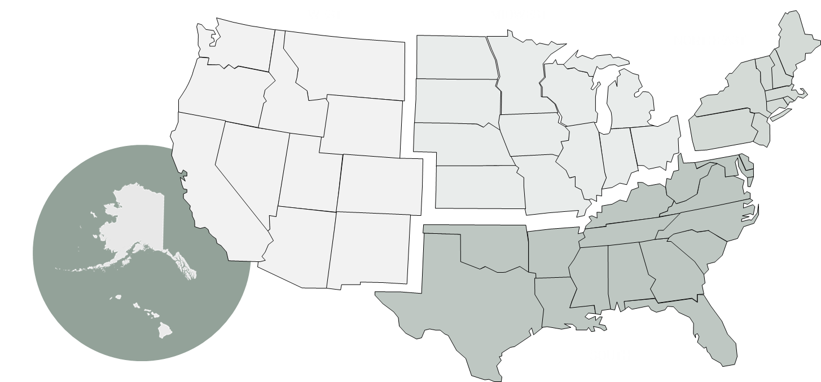
Disruptive Innovation
Bootstrapping the digital domain
How has open data made the government more efficient and effective?
How has open data made us live better lives?
How has open data spurred innovative thinking, job growth and economic opportunity
MANAGED BY
SYDNEY, AUSTRALIA | 14 -18 October 2018

Slide 13
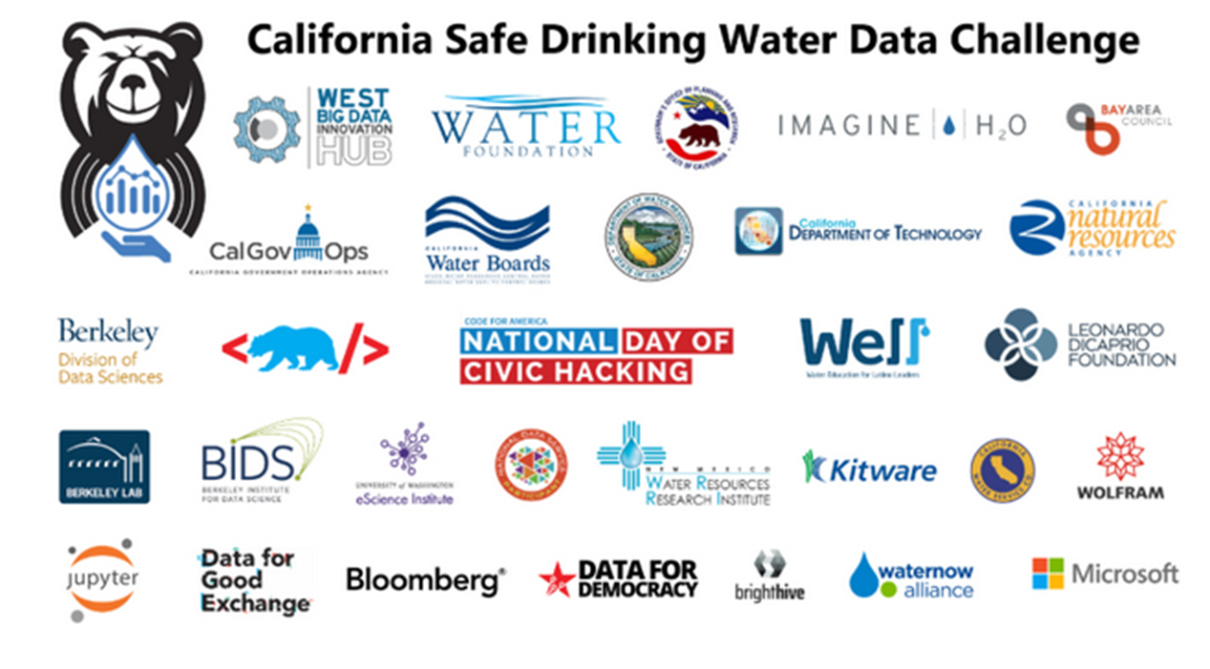
Disruptive Innovation
Across industry, academia, nonprofits, government
Address societal + scientific challenges, spur economic development,
Accelerate innovation in the national big data ecosystem
MANAGED BY
SYDNEY, AUSTRALIA | 14 -18 October 2018

Slide 14
Disruptive Innovation
Bootstrapping the digital domain
How has open data made the government more efficient and effective?
How has open data made us live better lives?
How has open data spurred innovative thinking, job growth and economic opportunity
MANAGED BY
SYDNEY, AUSTRALIA | 14 -18 October 2018

Slide 15
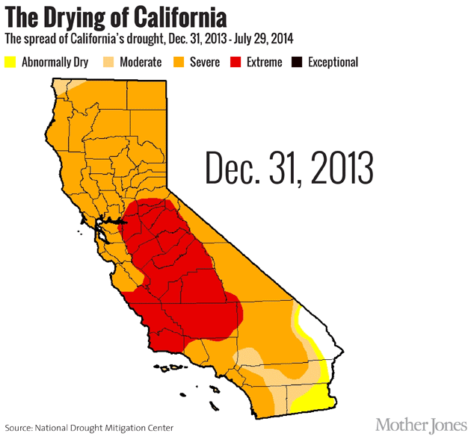
Energy savings from water conservation totalled 922,543 megawatt-hours — enough to power 135,000 homes for a year
electric utilities and water districts statewide
MANAGED BY
SYDNEY, AUSTRALIA | 14 -18 October 2018

Slide 16
Connecting Back to Murray-Darling Basin
Investment in basic research
Agile uptake of science to effective policies
Development of broad assessment tools (looking beyond the key assets)
Solutions sometimes require scaling
Open data engagements build trust and relationships, and can generate new ideas and solutions
MANAGED BY
SYDNEY, AUSTRALIA | 14 -18 October 2018

