Slide 1
Cultural Flow and Hydropower Development: Case of conflict in the Bhilangana River Basin, Uttarakhand, India
Rashmi Kiran Shrestha ,Independent Researcher, ICIMOD
Arica Crootof, Assistant Professor, University of Montana Western, USA
SYDNEY, AUSTRALIA | 14 -18 October 2018
MANAGED BY
Notes:
Good afternoon all, it is a pleasure to be here. I want to take this opportunity to especially thank ICE WaRM who has supported me to be here and present in this topic. Thank you.

Slide 2
Study Area,
Bhilangana Basin
Tehri District, Uttarakhand State, India
Hydropower Development in Uttarakhand
Explorable Hydropower potential | 17,000 MW
Under Operation | 4000 MW
Under Construction | 2518 MW
Different Stage Planning | 10482 MW
Source:Uttarankhad Jal Vidyut Nigam(2018)
Source: Suraj Mall, Delhi University
SYDNEY, AUSTRALIA | 14 -18 October 2018
MANAGED BY
Notes:
I want to take all of you to Bhilangana Basin in Uttarakhand State of India . UttarakhandThis is the byproduct of the study Supported by the Water, Land and Ecosystems (WLE) program of (CGIAR), led by International Water Management Institute (IWMI),

Slide 3
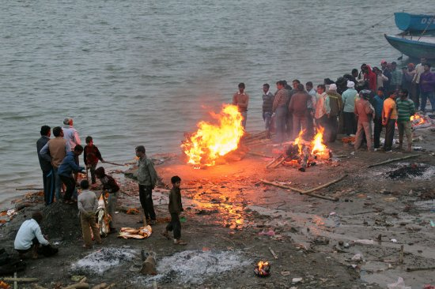
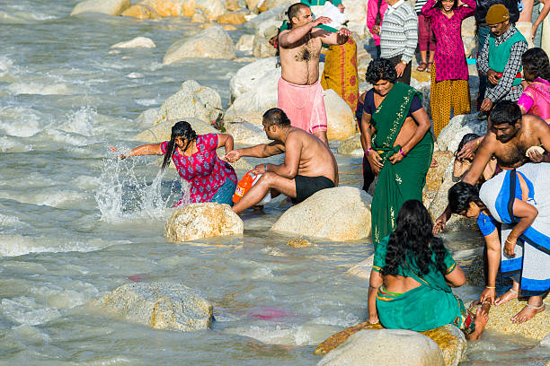
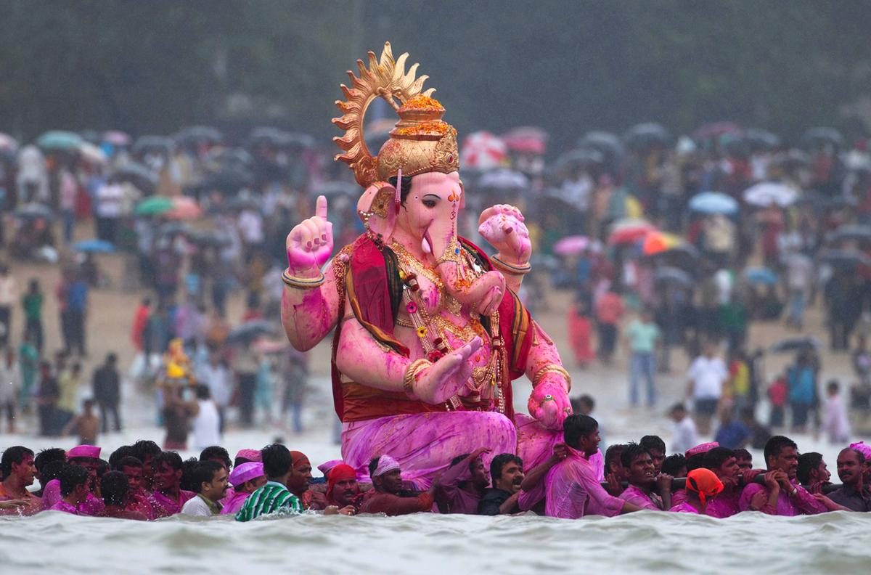
Bhilangana River, tributary of holy Ganga is deeply associated to cultures and rituals such as : Holy bath, Festival celebration, Death rituals and Others
Difference cultural activities in the river bank
SYDNEY, AUSTRALIA | 14 -18 October 2018
MANAGED BY

Slide 4
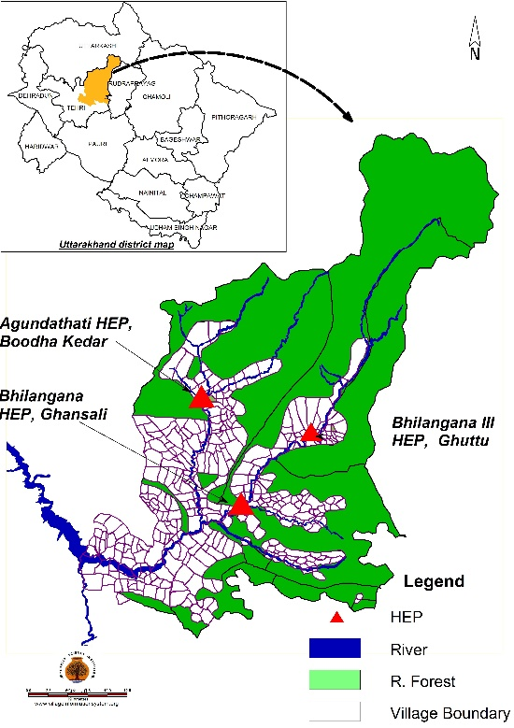
Bhilangana Basin
But, the timing and quantity of water flow changes after constructing these hydropower projects , and this creates conflicts in this basin
SYDNEY, AUSTRALIA | 14 -18 October 2018
MANAGED BY

Slide 5
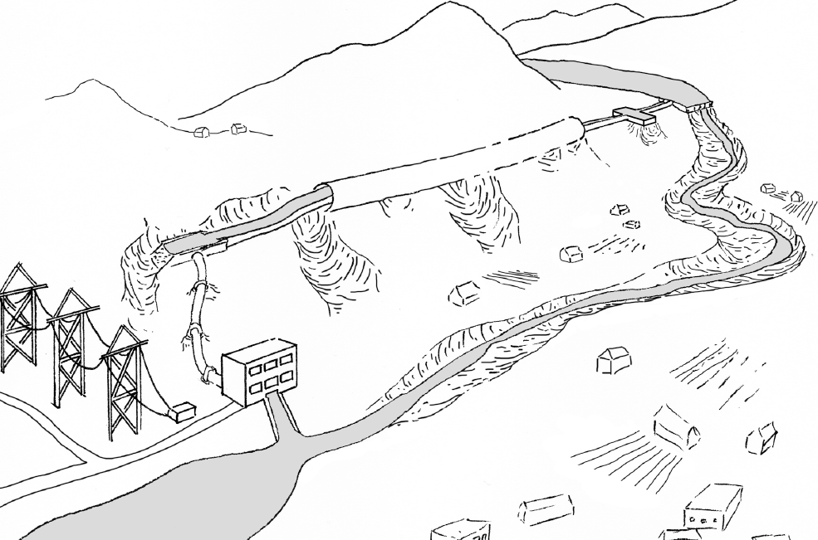
Inlet
Underground Tunnel
Diversion Weir
Run-of-the-River (ROR) Hydropower
Sedimentation Pond
Forebay Tank
Transmission Lines
Power-house
Dewater zone
Access Roads
Outlet
SYDNEY, AUSTRALIA | 14 -18 October 2018
MANAGED BY
Notes:
Good afternoon all, it is a pleasure to be here. I want to take this opportunity to especially thank ICE WaRM who has supported me to be here and present in this topic. Thank you.

Slide 6
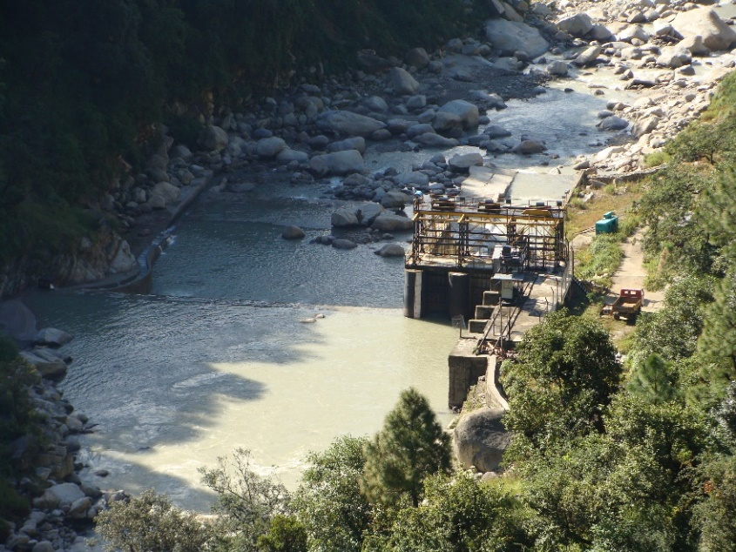
Case I: Bhilangana III Project
24 MW
SYDNEY, AUSTRALIA | 14 -18 October 2018
MANAGED BY

Slide 7
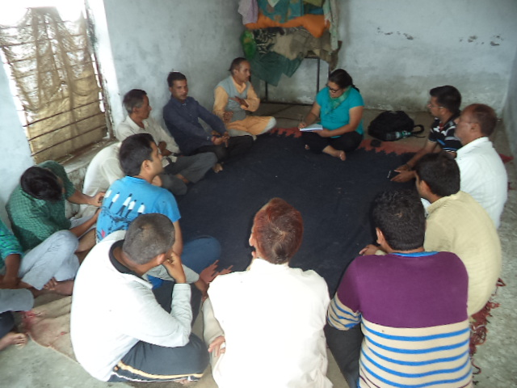
Voice from People
We need water to take bath early in the morning before sunrise but the project releases water so late and so less. We are very frustrated.
The project does not release enough water for festivals such as Bhaisakhi, Makar Sankranti and also for cremation.
We had many fights with this project for not releasing enough water on time. We complained to district office but there is no hearing.
Project releases water for 2 hours which is not enough for cremation.
Many times due to lack of water, cremated dead bodies could not be transported as per rituals.
SYDNEY, AUSTRALIA | 14 -18 October 2018
MANAGED BY

Slide 8
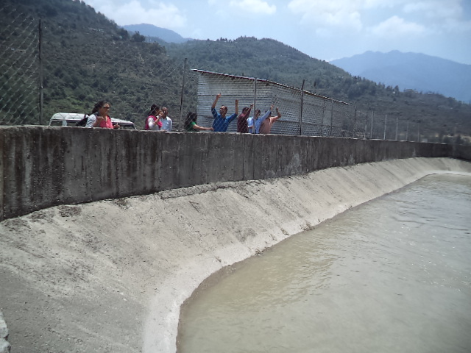
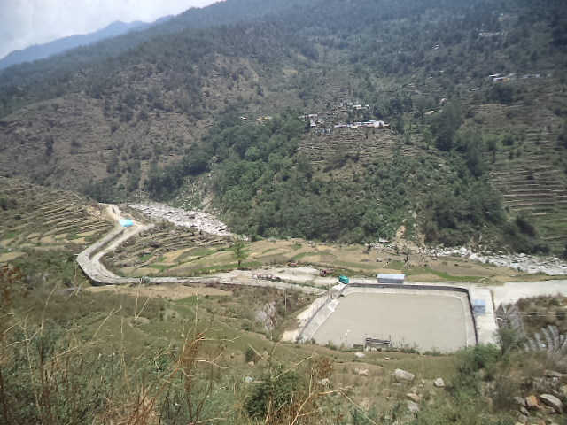
Voice from Hydropower Developer
We do not compromise for cultural water requirement, we release as per request.
The problem occurs only in dry period.
Project releases water for 4-5 hours. The project loose INR 50,000 (approx. 670 US dollars ) for each cremation.
Dewater zone
There are 10-15 request to release water for cremation every year in dry season.
Desilting basin
Alternative Solution was declined by people.
SYDNEY, AUSTRALIA | 14 -18 October 2018
MANAGED BY

Slide 9
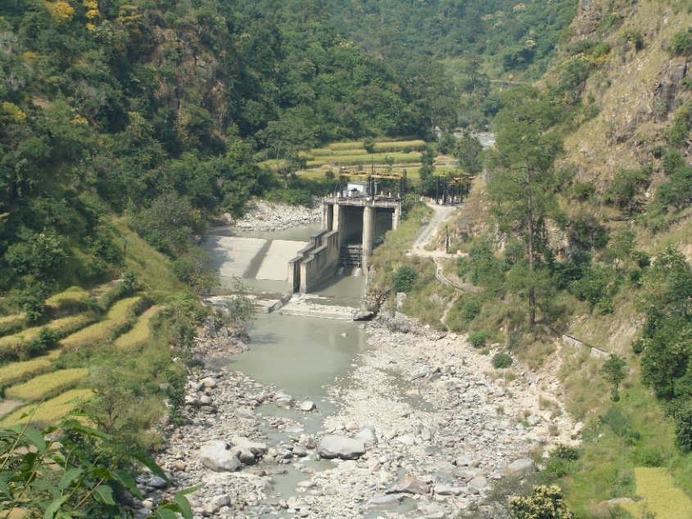
Case II: Bhilangana Project
22.5 MW
SYDNEY, AUSTRALIA | 14 -18 October 2018
MANAGED BY

Slide 10
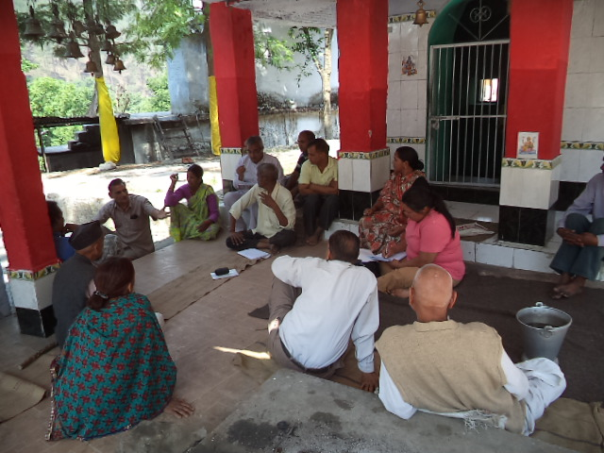
Voice of People
We did not get enough water for festivals. We protested and we had negotiation with the project. And now the project releases water. It is better but not enough.
We had to wait so long for cremation.
The project only releases for 2 hours and it takes 1.5 hours to reach the water in the cremation point.
River is again dry before the completion of the ritual .
SYDNEY, AUSTRALIA | 14 -18 October 2018
MANAGED BY

Slide 11
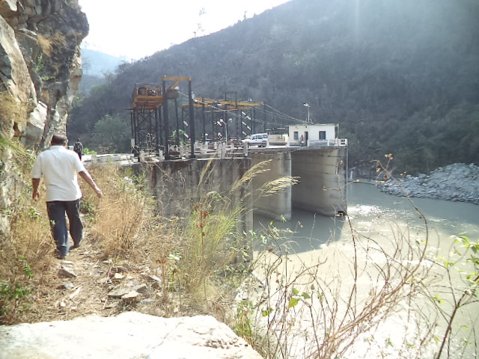
Voice of Hydropower Developer
The project has to shut down for 3 to 6 hours and the project loses 3-4 MW/hour for each cremation in dry period especially in the winter.
For the people , this river is Holy Ganga but as a investor we are loosing out. But with all this protests and disturbance, hydropower development is suffering.
For Makar Sankranti and Navaratri festivals, the project releases water from 8am to 12 am. Project loses 4-5 MW/hour for these festivals.
SYDNEY, AUSTRALIA | 14 -18 October 2018
MANAGED BY

Slide 12
More Evidence of conflict has been witnessed in our recent study in Sikkim , Arunachal and Himachal states of India.
Again conflict arises due to timing and quantity of water released.
SYDNEY, AUSTRALIA | 14 -18 October 2018
MANAGED BY

Slide 13
How much water in the river will satiate cultural requirement of the communities?
There is no single answer.
There is very limited study on cultural flow requirements of the basin.
Found one literature related to cultural flow requirements(See Lokgariwar et al.(2013)).
SYDNEY, AUSTRALIA | 14 -18 October 2018
MANAGED BY

Slide 14
Does the existing law and legislation in India/Uttarakhand address cultural flow requirements?
There is no recognition of cultural flow requirement in act or legislation.
However, Environment Protection Act 1986 through Water Quality Assessment Authority mandates “to maintain minimum discharge for sustenance of aquatic life forms in riverine systems”.
SYDNEY, AUSTRALIA | 14 -18 October 2018
MANAGED BY

Slide 15
Uttarakhand State mandates all the Hydropower Projects to release 10% of the inflow of the river as Environment Flow.
However there is no adherence of this rule in the hydropower projects as this is not legally binding on developers.
It is just an agreement between state and hydropower developer.
SYDNEY, AUSTRALIA | 14 -18 October 2018
MANAGED BY

Slide 16
Conclusion
Conflicts related to cultural flows in hydropower projects are increasing.
Some communities are able to secure cultural flow requirements through hard ways such as protests and negotiations.
There is a lack of local people’s engagement while doing the Environment Impact Assessment.
There has not been any scientific study to help understand whether the environment flow requirement will also satiate the cultural flow requirement.
SYDNEY, AUSTRALIA | 14 -18 October 2018
MANAGED BY

Slide 17
Way Forward
Engagement of local people in Environment Impact assessment of hydropower project should be mandatory to understand cultural flow requirements.
There is an urgent need of scientific study on cultural flow requirements to have science policy dialogue on cultural flows.
SYDNEY, AUSTRALIA | 14 -18 October 2018
MANAGED BY

Slide 18
Thank You
Rashmi Kiran Shrestha
Rashmi.river@gmail.com
SYDNEY, AUSTRALIA | 14 -18 October 2018
MANAGED BY

