Slide 1
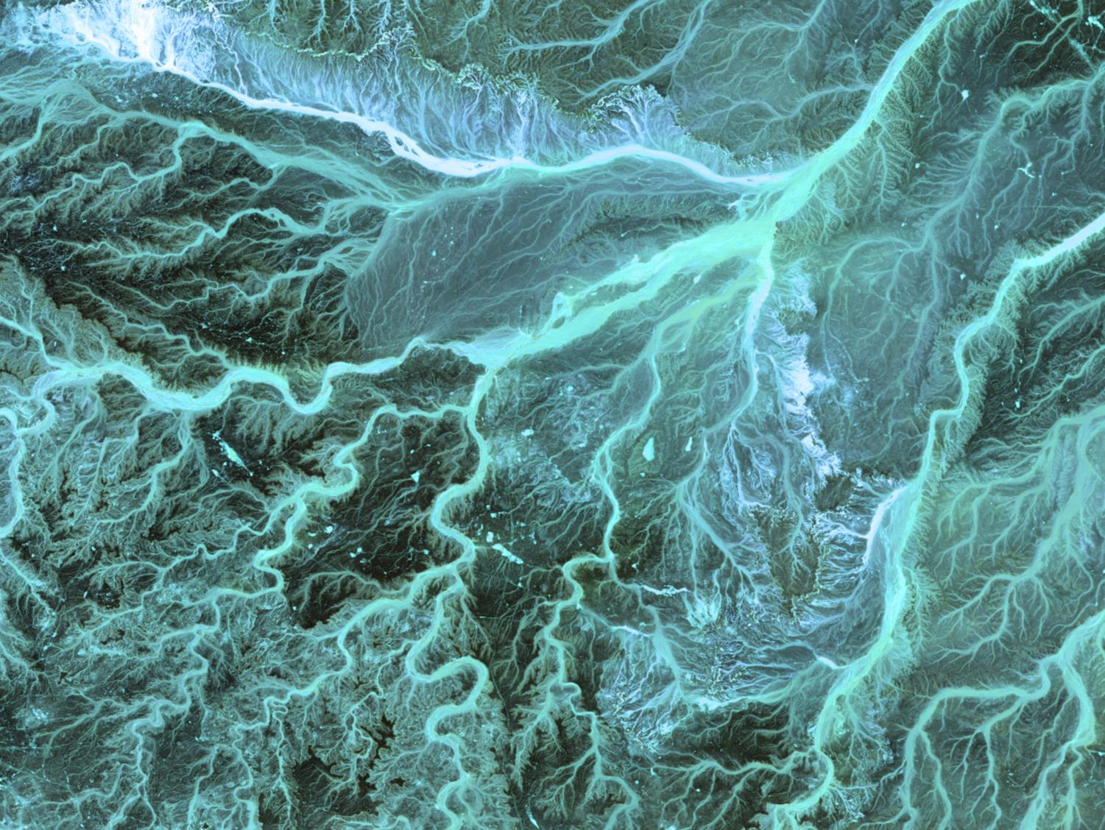
Swimming in our rivers
Inspirations, expectations and the bite of reality
16 October 2018
Notes:
Image: Jordan. Meandering wadis combine to form dense, branching networks across the stark, arid landscape of the southeastern Jordan. The Arabic word ‘wadi’ means a gully or streambed that typically remains dry exc ept after drenching seasonal rains. . SOURCE: US Geological Survey.

Slide 2
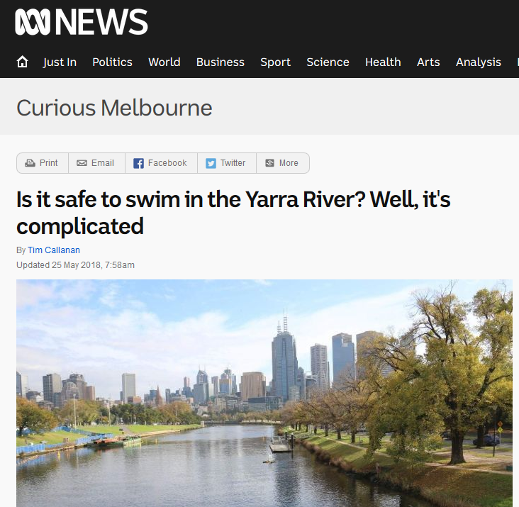
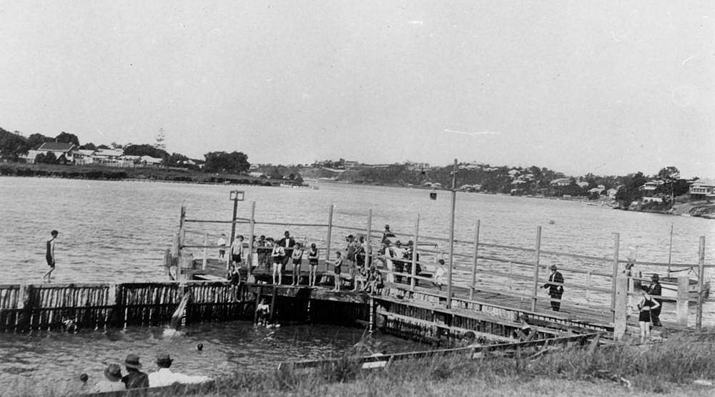
Swimming in our City Rivers

Slide 3
Aspirations
Seen as the ultimate end goal of waterway management in urban rivers
Strong community and political support
Often used as a vehicle for community engagement
Thinking that swimming = clean = healthy

Slide 4
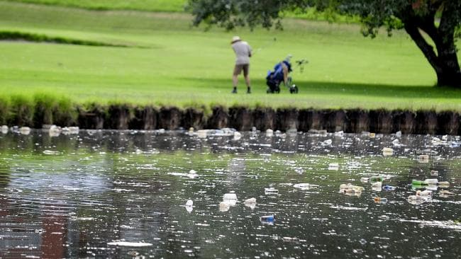
Expectations

Slide 5
Expectations
Will be able to swim in the river all the time
Is that likely?
Day vs night vs rain
Is that desirable?
When is the likelihood that swimming will actually occur?
Will be able to swim everywhere
Can jump in the river anywhere and it will be “safe”
How are we managing these?

Slide 6
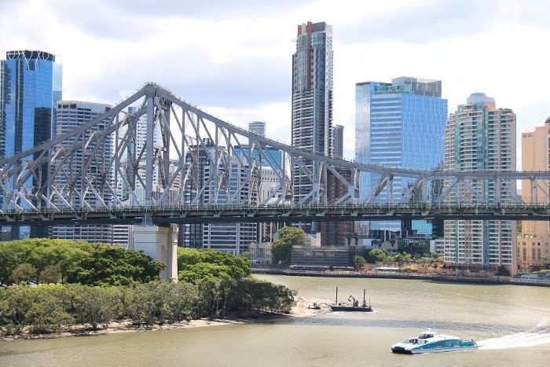
Reality
Water quality (current and legacy)
Clarity
Pathogens
Toxicants
Metals
Pesticides
Cyanobacterial

Slide 7
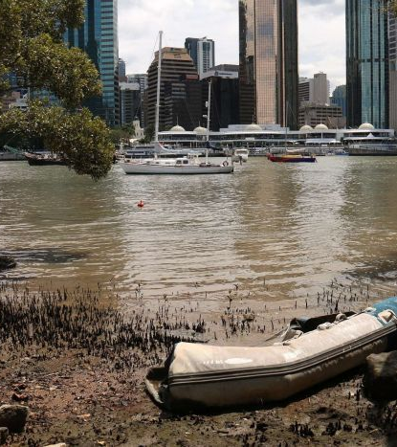
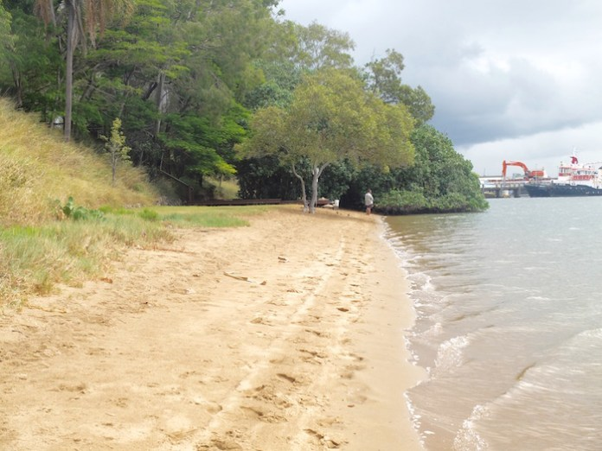
Reality
Safety
Access
Where is it possible?
When?
Controlled vs uncontrolled
Physical hazards
Obstructions
Ingress and egress

Slide 8
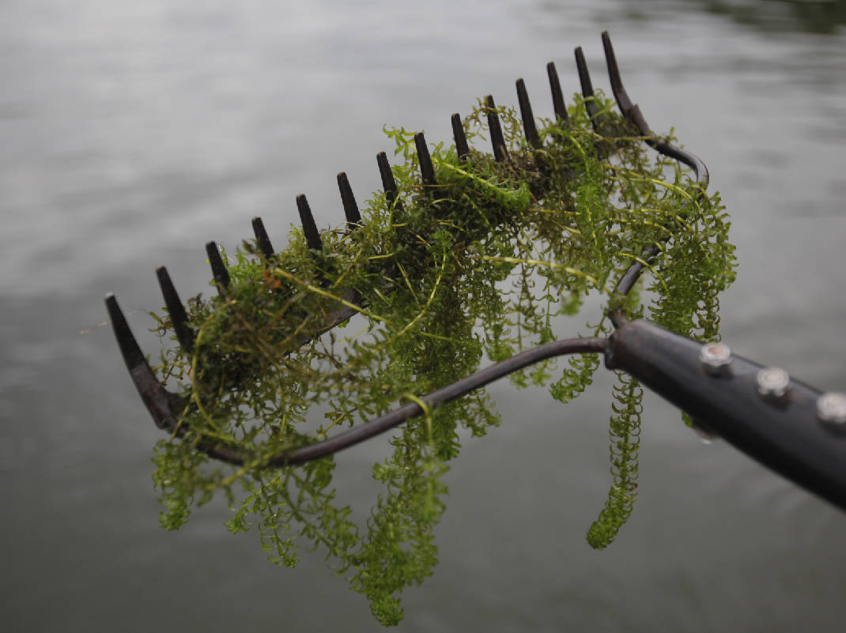
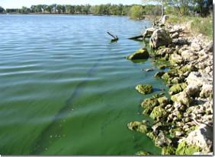
Reality
Biological hazards
Cynaobacteria
Vegetation (both instream and riparian)

Slide 9
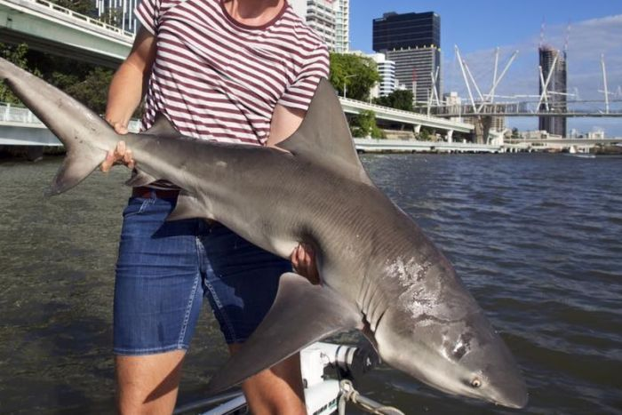
Reality
Biological hazards
Megafauna
Sharks
Crocodiles
Snakes
Parasites
Jellyfish

Slide 10
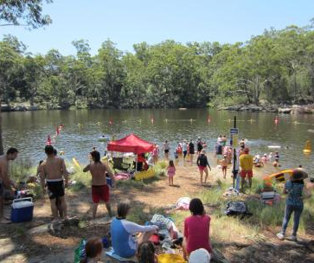
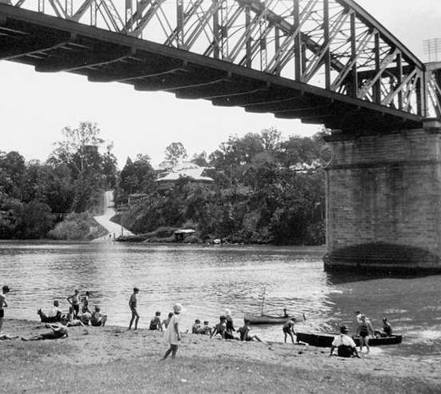
Conclusions
Should we encourage it?
Useful driver
Manage expectations
Think about what is possible
Novel vs natural systems
Controlling when and where
Managing risks
Think about what history tells us

Slide 11
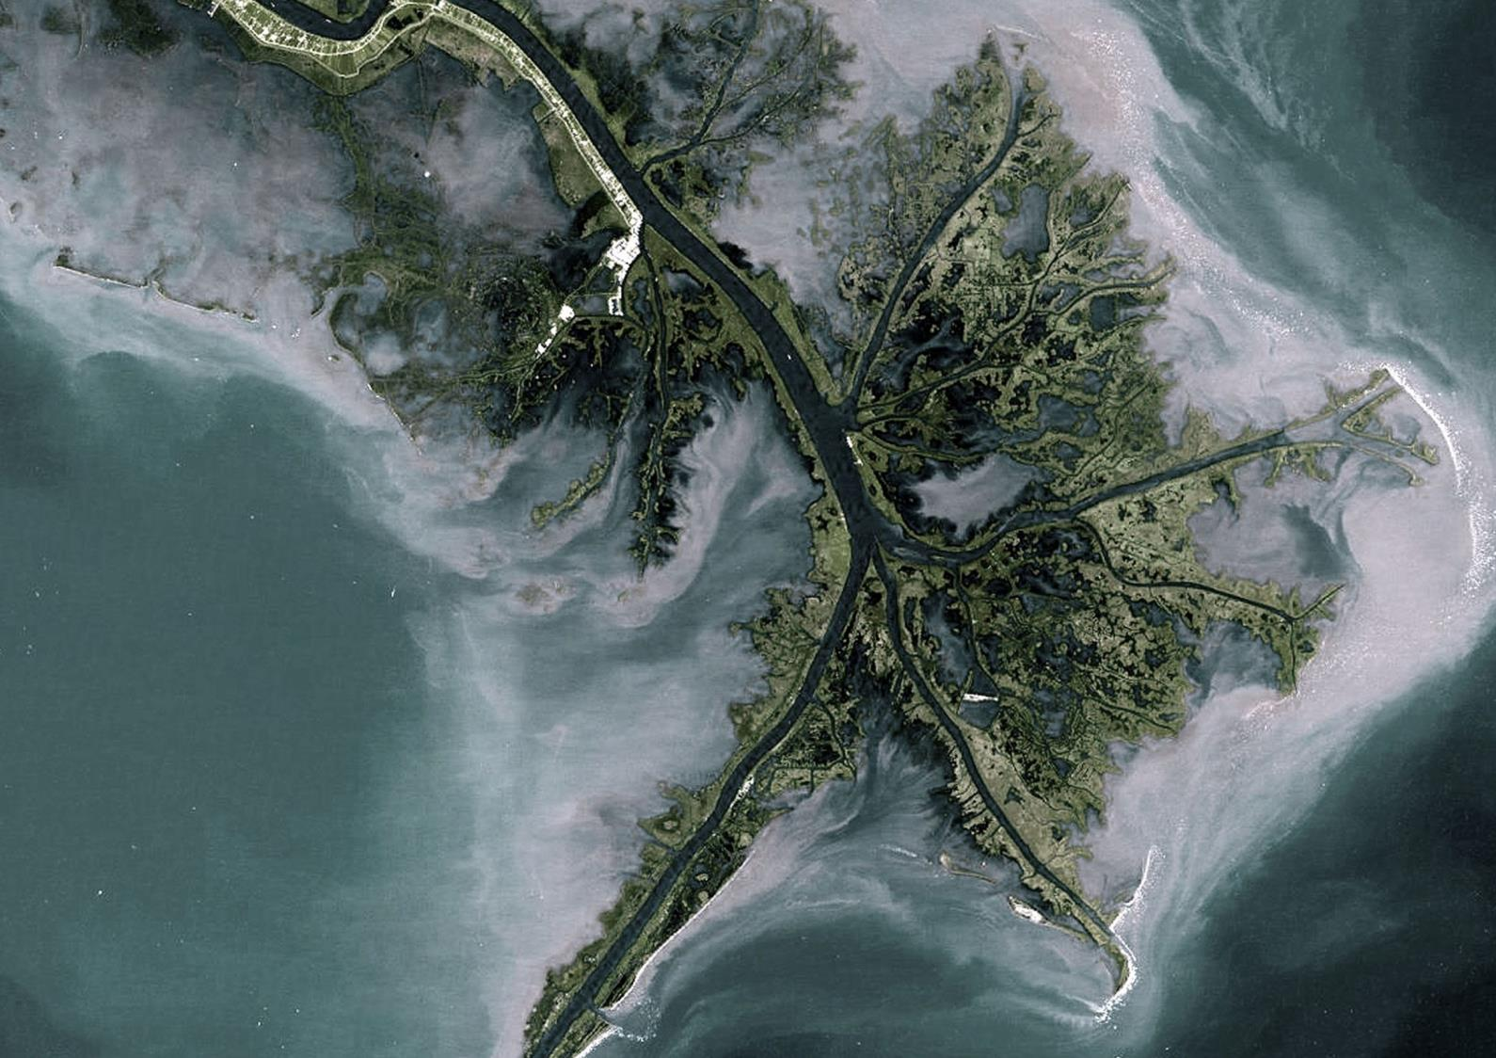
We are passionate about the protection and restoration of waterways, catchments and water resources. We strive to make a positive difference to the world we live in.
Notes:
Image: Mississippi River Delta. Turbid waters spill out into the Gulf of Mexico where their suspended sediment is deposited to form the Mississippi River Delta. Like the webbing on a ducks foot, the marshes and mudflats prevail between the shipping channels that have been cut into the delta.
SOURCE: US Geological Survey.

