Slide 1
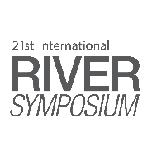
The Independent Voice of the River
A Comparison between the Yarra River’s Birrarung Council and the Human Face of the Whanganui River, Te Pou Tupa
Dr Katie O’Bryan
SYDNEY, AUSTRALIA | 14 -18 October 2018
MANAGED BY

Slide 2
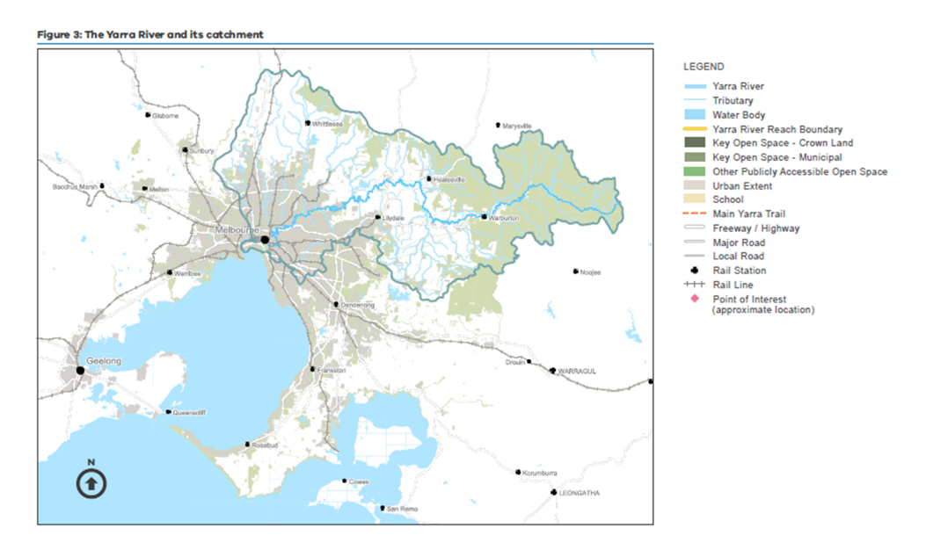
Yarra River, ‘Birrarung’
Yarra River Action Plan (Victoria, DELWP, 2017)
SYDNEY, AUSTRALIA | 14 -18 October 2018
MANAGED BY

Slide 3
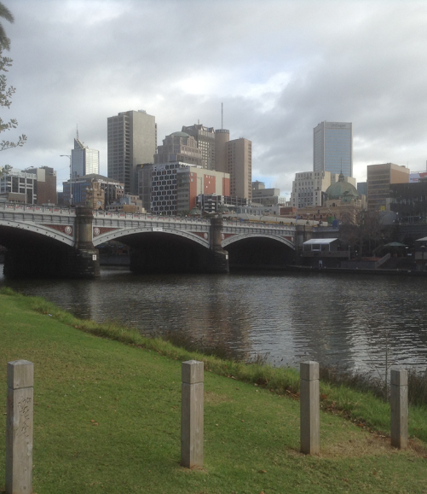
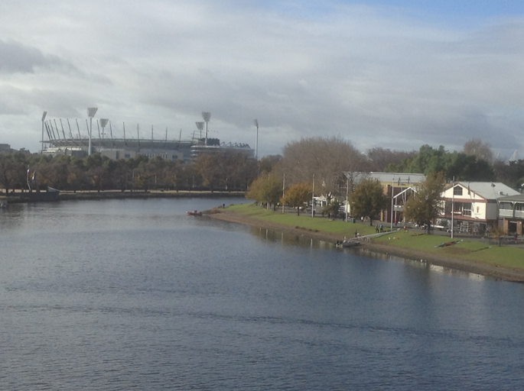
Yarra River, ‘Birrarung’
SYDNEY, AUSTRALIA | 14 -18 October 2018
MANAGED BY

Slide 4
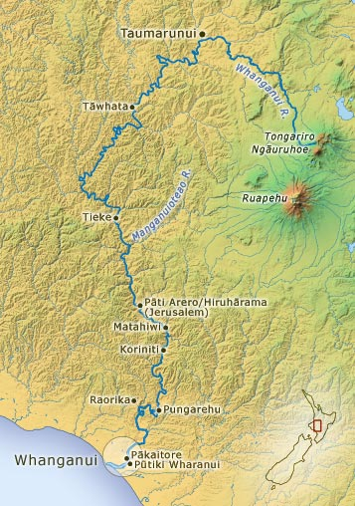
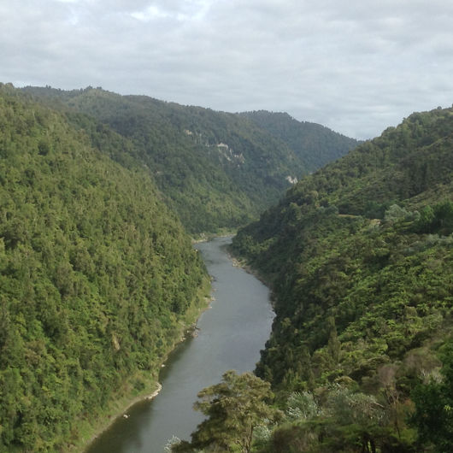
Whanganui River ‘Te Awa Tupua’
http://www.teara.govt.nz/en/map/2174/map-of-the-whanganui-river
SYDNEY, AUSTRALIA | 14 -18 October 2018
MANAGED BY

Slide 5
Yarra River Protection (Wilip-gin Birrarung murron) Act 2017 (Vic)
Five features of significance to Aboriginal Victorians:
Aboriginal language in the title and preamble;
Recognition as one living and integrated natural entity;
Overarching strategic plan;
Yarra Protection Principles; and …
SYDNEY, AUSTRALIA | 14 -18 October 2018
MANAGED BY

Slide 6
Birrarung Council (the ‘independent voice’)
At least two Indigenous members out of 12
Advisory only
Involved in developing the Strategic Plan
Advocates for the protection and preservation of the Yarra
Independent from government
SYDNEY, AUSTRALIA | 14 -18 October 2018
MANAGED BY

Slide 7
Te Awa Tupua (Whanganui River Claims Settlement) Act 2017 (NZ)
Whanganui River (‘Te Awa Tupua’):
Statutory recognition as a legal person.
Represented by a river guardian (‘Te Pou Tupua’):
Membership of two: one appointed by Whanganui Iwi, one by government.
Role of Te Pou Tupua is to protect the River and its values.
Decision-makers must consider the River values in any decisions they make.
SYDNEY, AUSTRALIA | 14 -18 October 2018
MANAGED BY

Slide 8
Some benefits:
River values are Māori river values (‘Tupua te Kawa’).
Standing is guaranteed.
Independent from government.
Deemed a public authority under the Resource Management Act (NZ).
Administers/makes decisions on applications to the fund established to protect the health and well being of the river.
SYDNEY, AUSTRALIA | 14 -18 October 2018
MANAGED BY

Slide 9
Some disadvantages:
Indirect role for Whanganui Iwi:
River Guardian doesn’t represent the interests of its members.
Indirect role for River Guardian in river management:
Not involved in decision-making (potential only)
Not involved in developing the river strategy (done by ‘Te Kōpuka’)
But in the context of wider settlement – is a positive development.
SYDNEY, AUSTRALIA | 14 -18 October 2018
MANAGED BY

Slide 10
Some Comparisons
Yarra River Protection Act 2017 | Te Awa Tupua Act 2017
No independent legal status for the river | Independent legal status for the river
Protection of Aboriginal and other values | Protection of Māori river values
Aboriginal language in the title and preamble | Māori language used more widely in the Act
Birrarung Council: | Te Pou Tupua:
Represents community interests in the river | Represents the interests of the river
12 members (2 Indigenous), no government members, 4 year terms | 2 members, 1 nominated by government, one by Māori, 3 year terms
Advice and advocacy role, no involvement in decision-making | Manages the river rehabilitation fund, but no direct role in river management
SYDNEY, AUSTRALIA | 14 -18 October 2018
MANAGED BY

Slide 11
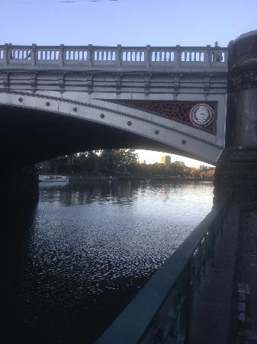
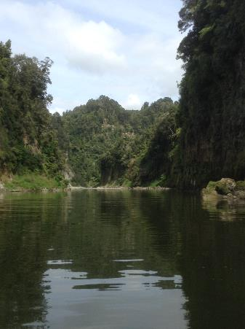
Dr Katie O’Bryan
Monash University
katie.obryan@monash.edu
SYDNEY, AUSTRALIA | 14 -18 October 2018
MANAGED BY

