Slide 1



An Evaluation System for China’s Sustainable Hydropower
Chunna Liu，Sainan Wu，Xin Sui，Ang Chen
National Research Center for Sustainable Hydropower (NCSH)
China Institute of Water Resources and Hydropower Research (IWHR)
October 16th 2018
SYDNEY, AUSTRALIA | 14 -18 October 2018
MANAGED BY

Slide 2
Outline
Background
Definition and dimension
Topics and indicators systems
Integrated assessment approach
SYDNEY, AUSTRALIA | 14 -18 October 2018
MANAGED BY

Slide 3
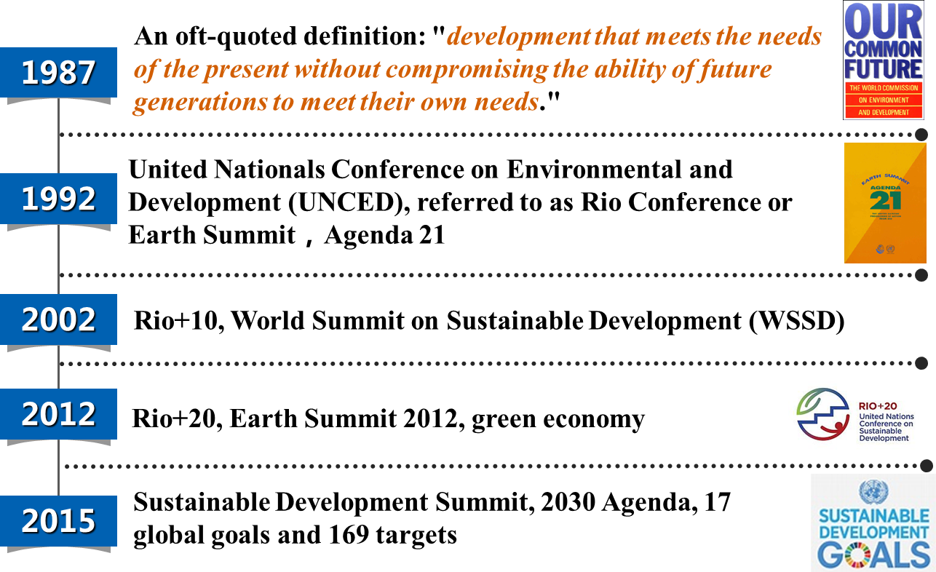
Background
SYDNEY, AUSTRALIA | 14 -18 October 2018
MANAGED BY

Slide 4
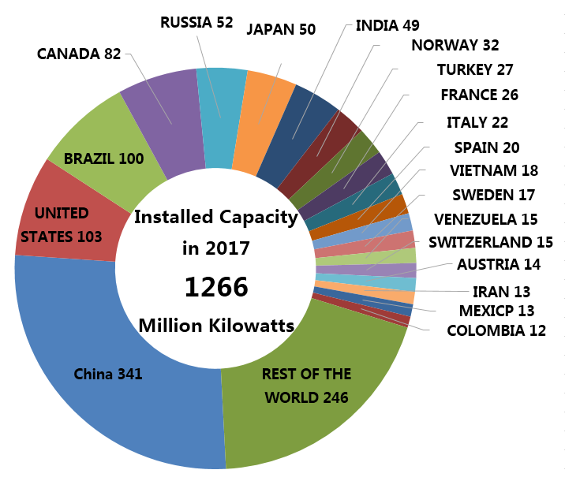
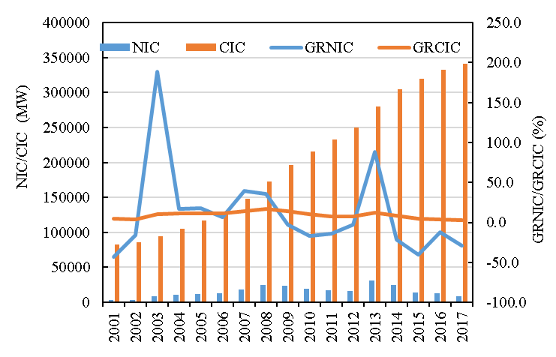
Background
In 2017, China added 9.12GW of installed capacity bringing its total to 341GW, having also contributed to nearly 20% of the total electricity generated.
While development has slowed since its most recent peak in 2013, average annual growth in installed capacity is expected to remain steady at between 3.5%-4% to 2020 in order to achieve the government’s 13th Five-Year Plan target of 380GW.
Fig. 2 Hydropower development from 2001 to 2017 in China
Fig. 1 Global hydropower installed capacity in 2017
SYDNEY, AUSTRALIA | 14 -18 October 2018
MANAGED BY

Slide 5
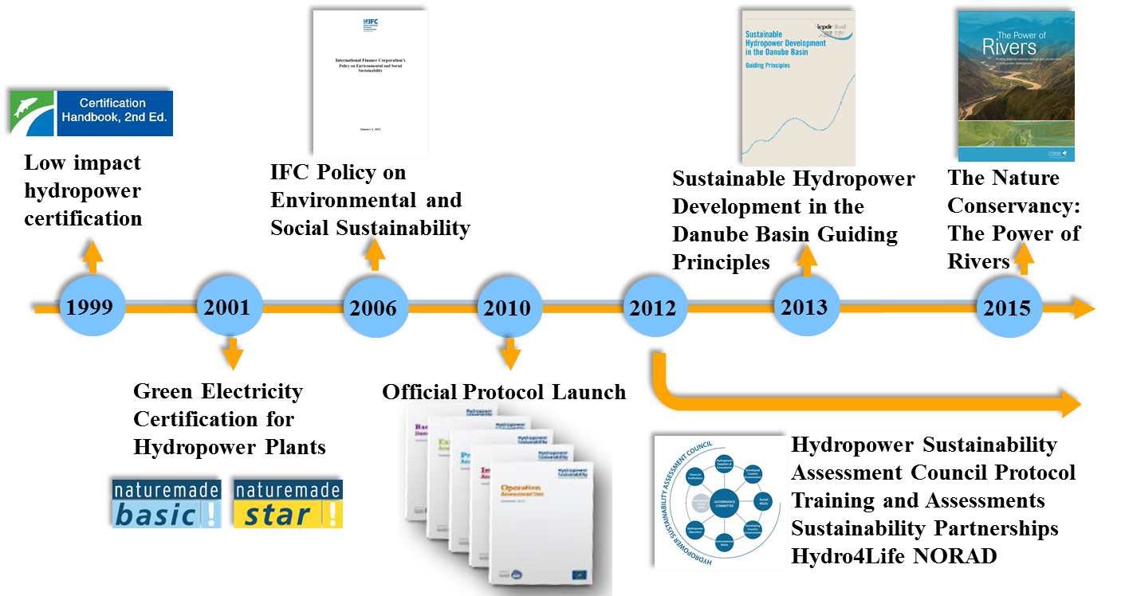
Definition and dimension
References
SYDNEY, AUSTRALIA | 14 -18 October 2018
MANAGED BY

Slide 6
Definition and dimension
Definition
A sustainable hydropower should be promoting the improvement in the aspects of social harmonious, economic affordable, environmental friendly, and administrative efficient to meet dual goals that meet hydropower development and basin/region life support system, and to guide the future hydro construction and operation in China.
SYDNEY, AUSTRALIA | 14 -18 October 2018
MANAGED BY

Slide 7
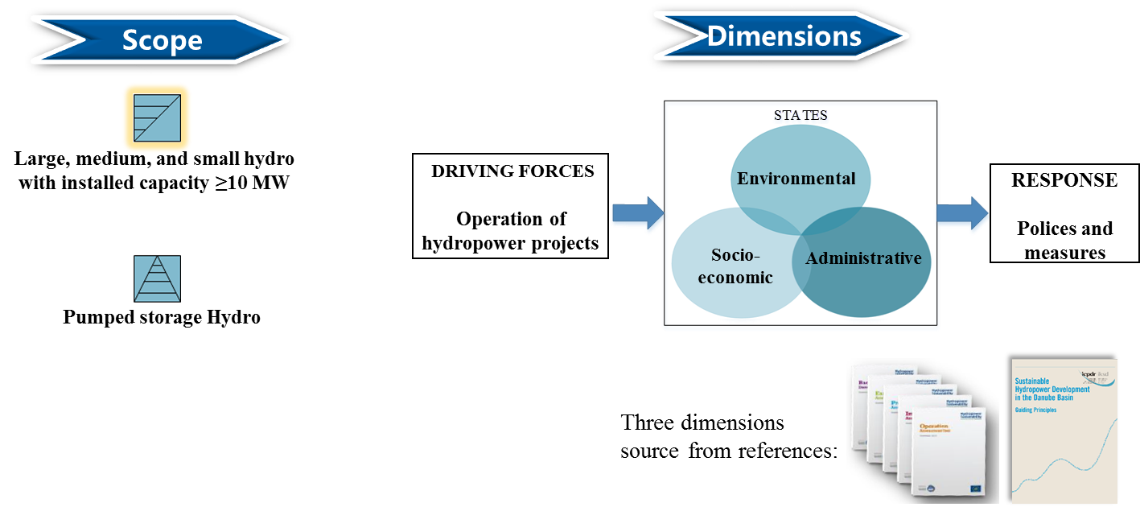
Definition and dimension
SYDNEY, AUSTRALIA | 14 -18 October 2018
MANAGED BY

Slide 8
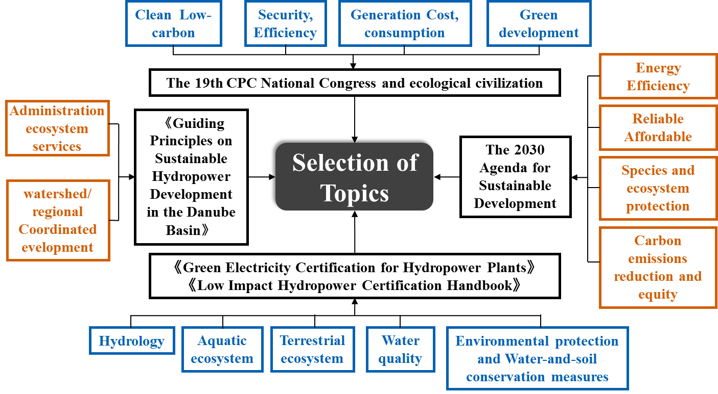
Topics and indicators systems
SYDNEY, AUSTRALIA | 14 -18 October 2018
MANAGED BY

Slide 9
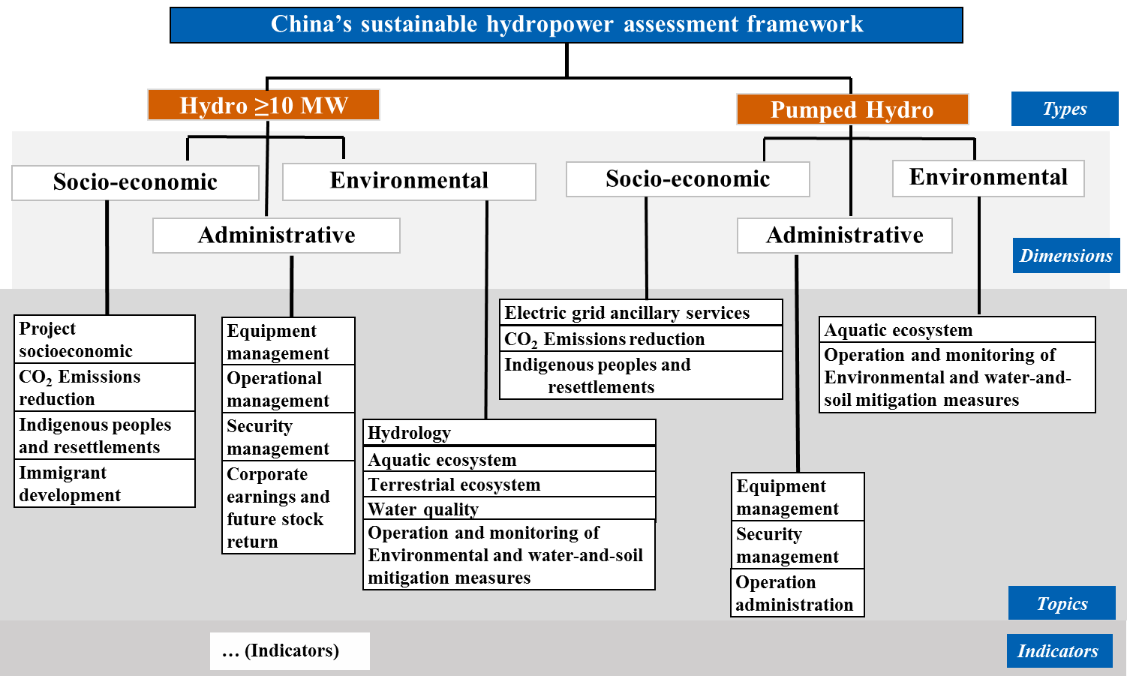
Topics and indicators systems
SYDNEY, AUSTRALIA | 14 -18 October 2018
MANAGED BY

Slide 10
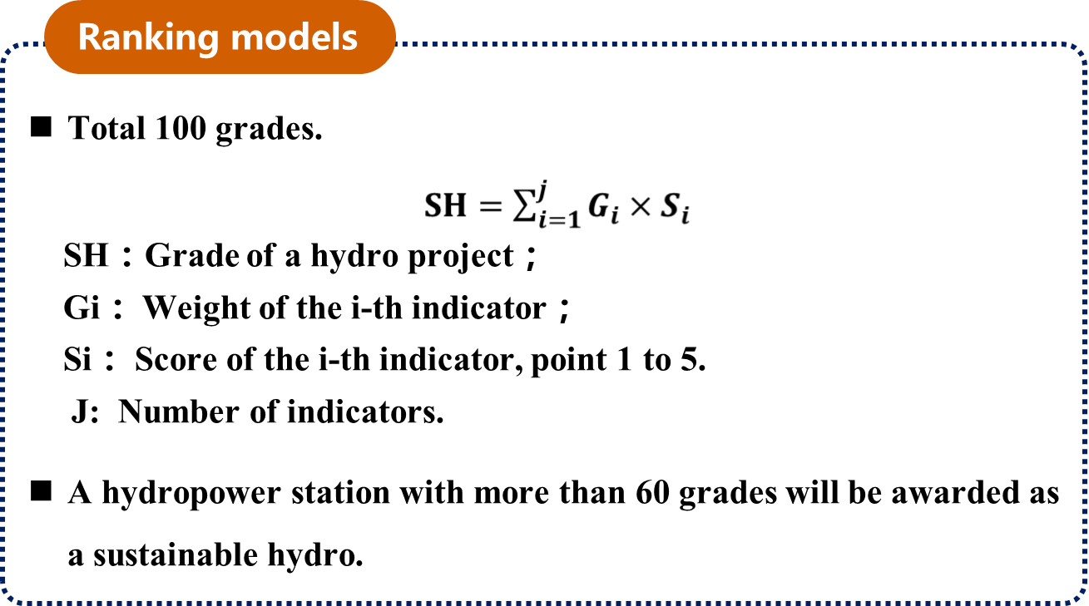
Integrated assessment approach
Multi-criteria analysis is used in Technology Guidelines, due to its effectiveness in supporting decisions which involve trade-offs between conﬂicting objectives
SYDNEY, AUSTRALIA | 14 -18 October 2018
MANAGED BY

Slide 11
Thanks for your kind attention.
Mail: liucn@tsinghua.edu.cn
SYDNEY, AUSTRALIA | 14 -18 October 2018
MANAGED BY

