Slide 1
Research on key technologies and applications of alternative habitats protection in tributary
WU Sainan, LIU Chunna
National Research Center for Sustainable Hydropower (NCSH)
China Institute of Water Resources and Hydropower Research (IWHR)
SYDNEY, AUSTRALIA | 14 -18 October 2018
MANAGED BY

Slide 2
contents
1. Introduction
2. Framework
3. Investigation
SYDNEY, AUSTRALIA | 14 -18 October 2018
MANAGED BY

Slide 3
1. Introduction
Backgrounds
“Tributary protection as a alternative for hydropower development in the mainstream river” is an important environmental protection principle during hydropower develop in China.
Notice on strengthening environmental protection during hydropower development (China EPA, [2012] No. 4)
The 13th Five-Year Hydropower Development Plan of China (in the period of 2016-2020) approved by National Energy Administration (China NEA)
Chinese government needs a easy tool to assessment environmental protection effect at a national scale
Our research group is working on the national guidelines for sustainable hydropower
SYDNEY, AUSTRALIA | 14 -18 October 2018
MANAGED BY

Slide 4
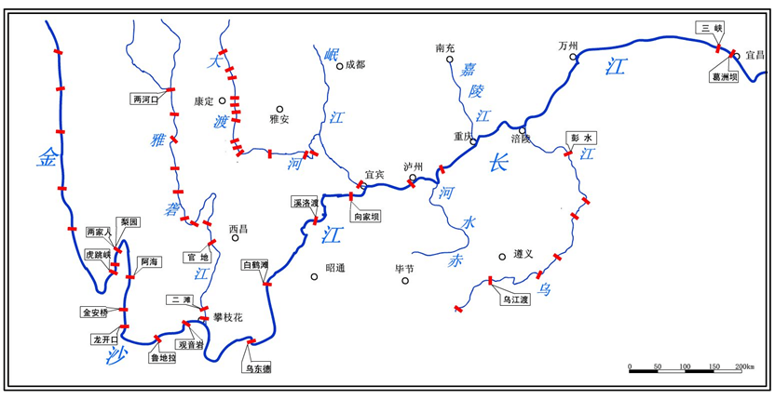
1. Introduction
Four hydropower plants built on the upstream of the Yangtze River: Wudongde, Maihetan, Xiluodu, and Xiangjiaba
Chishui River is an important tributary of the upper Yangtze river
Chishui River as a alternative habitat relative to hydropower development in the mainstream of Yangtze River
In operation:
Wudongde: 10200 MW
Baihetan: 16000 MW
Under construction:
Xiangjiaba: 6400MW
Xiluodu: 13860 MW
Total: 46460 MW, two times of three gorge hydropower stations
SYDNEY, AUSTRALIA | 14 -18 October 2018
MANAGED BY

Slide 5
1. Introduction
Objectives
Developing useful tools about how to measure benefits both in a project scale and a watershed scale
Quantifying the economic, social and ecological value of Chishui River conservation as a alternative habitat
Balancing costs and benefits between Chishui River protection and four hydropower plants in the mainstream of Yangtze River
SYDNEY, AUSTRALIA | 14 -18 October 2018
MANAGED BY

Slide 6
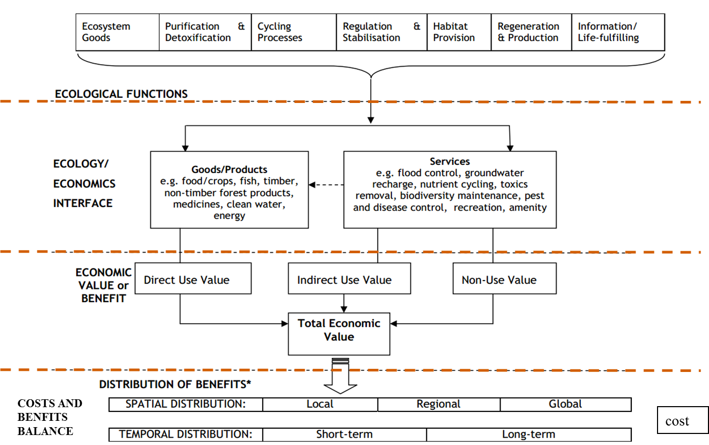
2. Framework
An integrated framework
SYDNEY, AUSTRALIA | 14 -18 October 2018
MANAGED BY

Slide 7
2. Framework
Economic internal rate of return (EIRR)
Net economic value
Cost and benefit ratio
Summarizing benefits (goods and services) in the tributary and mainstream
Defining costs of hydropower stations construction and operation, and tributary protection (economic cost)
Balancing costs and benefits
SYDNEY, AUSTRALIA | 14 -18 October 2018
MANAGED BY

Slide 8
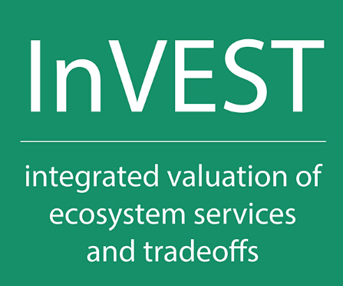
2. Framework
INVEST（Integrated Valuation of Ecosystem Services and Trade-offs）was developed by Stanford University, World Wide Fund, The Nature Conservancy.
Providing scientific information for policy makers to weigh the benefits and impacts of human activities among different scenarios.
A
B
Providing distribution of benefits of ecosystem goods and services.
Integrating the value of ecosystem services into decision-making and operational management of hydropower stations
SYDNEY, AUSTRALIA | 14 -18 October 2018
MANAGED BY

Slide 9
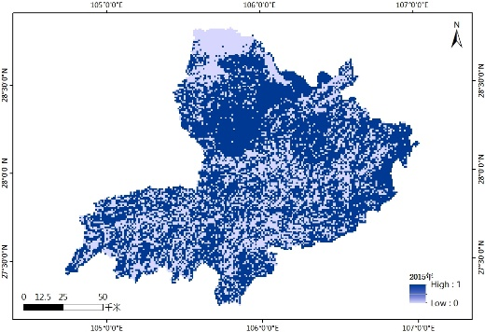
2. Framework
The change of habitat quality index in chishui river basin from 1980 to 2015 based on the InVEST model
SYDNEY, AUSTRALIA | 14 -18 October 2018
MANAGED BY

Slide 10
3. Investigation
The index of biological integrity (IBI) :
An indicator aquatic ecosystem health to assess biology assemblages
Overcome the limitations of chemical and physical parameters in the assessment of aquatic ecosystem health
A sensitive indicator in the assessment of aquatic ecosystem health degradation associated with cascading dams
Capture aquatic trophic status and identify variations in aquatic ecosystem health and degradation
SYDNEY, AUSTRALIA | 14 -18 October 2018
MANAGED BY

Slide 11
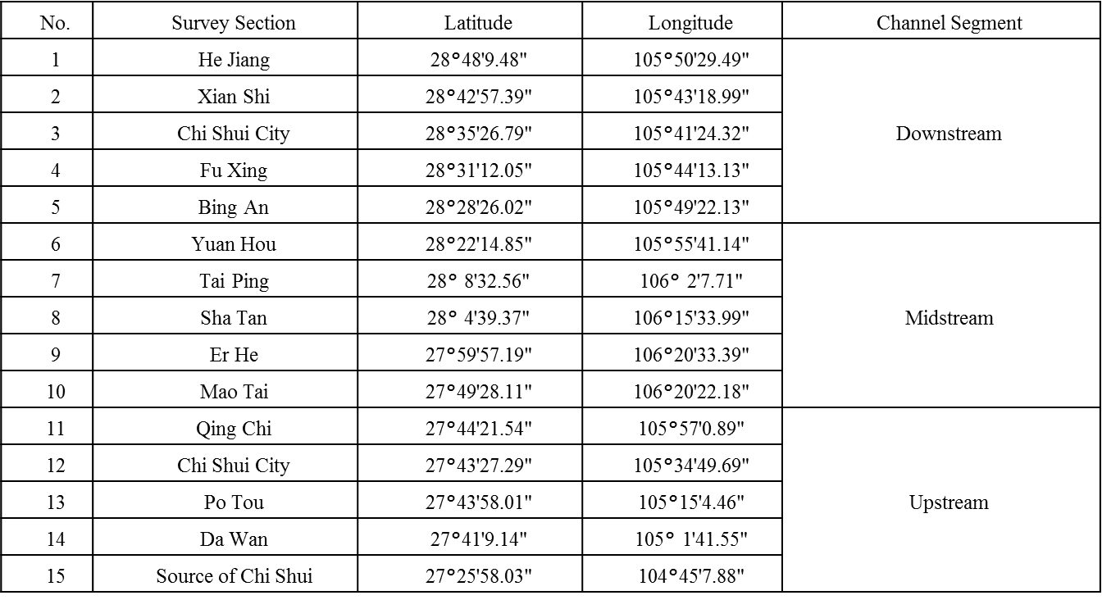
3. Investigation
Selection of field investigation points
SYDNEY, AUSTRALIA | 14 -18 October 2018
MANAGED BY

Slide 12
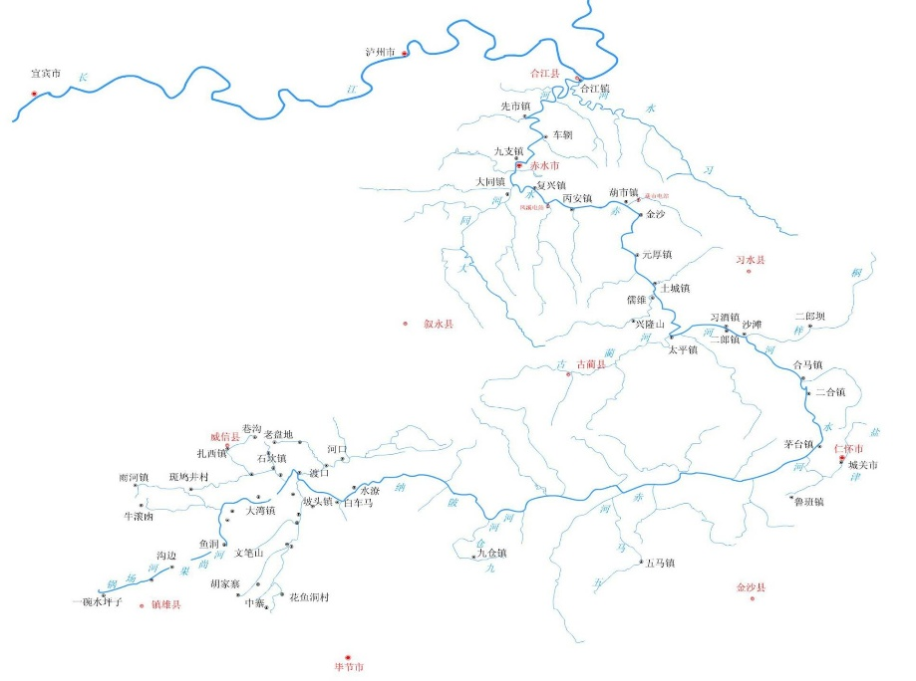
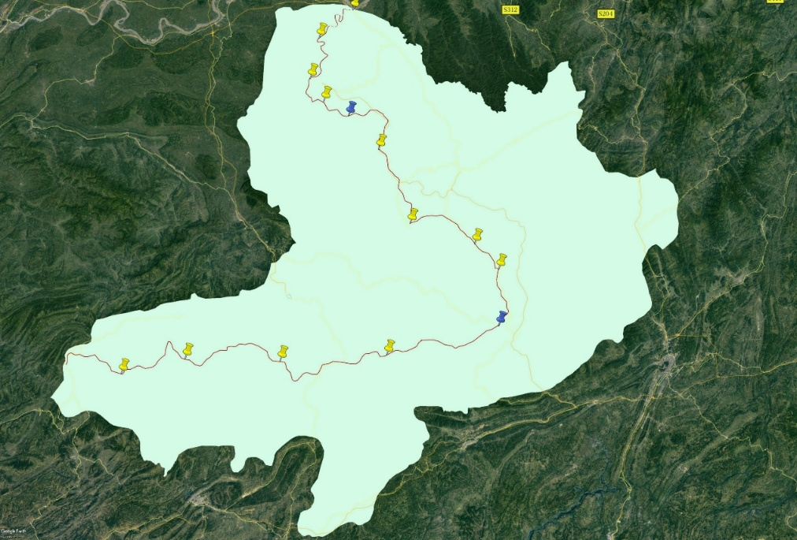
3. Investigation
Distribution of field investigation points
SYDNEY, AUSTRALIA | 14 -18 October 2018
MANAGED BY

Slide 13
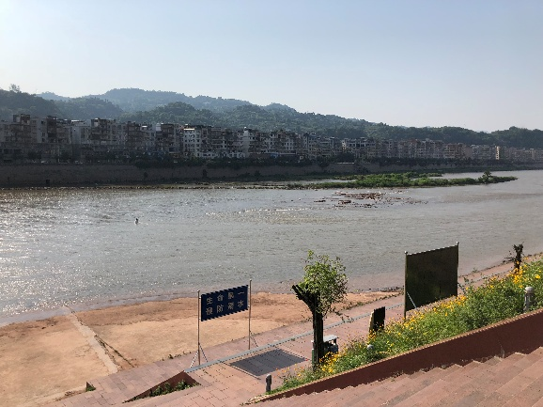
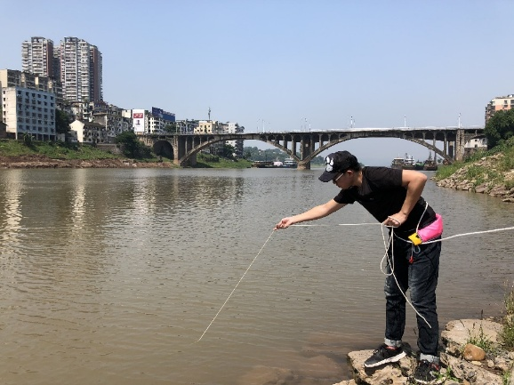
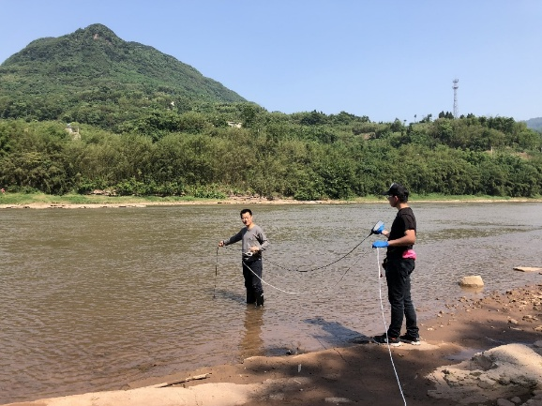
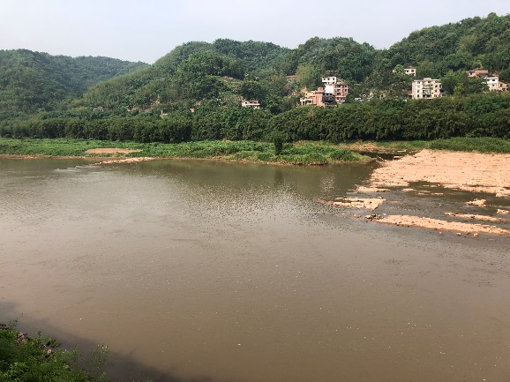
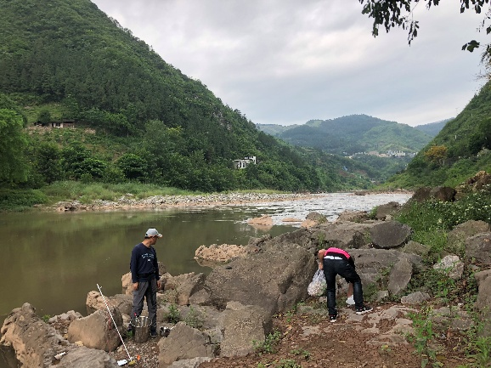
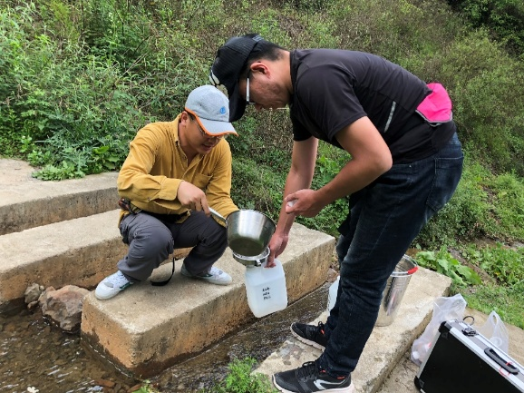
3. Investigation
Investigation on site
SYDNEY, AUSTRALIA | 14 -18 October 2018
MANAGED BY

Slide 14
Thanks for your attention!
SYDNEY, AUSTRALIA | 14 -18 October 2018
MANAGED BY

