Slide 1
Science-Policy interface: Significance of Women’s Indigenous Knowledge Systems for Adaptation to Floods in Brahmaputra
Dr. Suparana Katyaini
Post Doctoral Fellow
Department of Humanities and Social Sciences
Indian Institute of Technology Delhi
SYDNEY, AUSTRALIA | 14 -18 October 2018
MANAGED BY

Slide 2
Science-Policy interface
Strong interface continues to be a big challenge
Gap in translating scientific knowledge into policy actions
Important to bridge this gap
Enriches decision-making
Exchange and co-evolution of knowledge by bringing together scientists and other actors
The knowledge-governance gap exists because of
Lack in recognition of advanced scientific (natural and social) knowledge in policy discourse
Slow pace of integration of scientific knowledge
SYDNEY, AUSTRALIA | 14 -18 October 2018
MANAGED BY

Slide 3
Why this research ?
Women bear disproportionately larger burden of disasters
Global framework: Sendai Framework on Disaster Risk Reduction (2015) considers women
as a vulnerable group whose participation is key to climate action
Constrained participation of women in decision-making
(lack of participation freedom)
SIGNIFICANCE OF WOMEN’S KNOWLEDGE FOR ADAPTATION
SYDNEY, AUSTRALIA | 14 -18 October 2018
MANAGED BY

Slide 4
Choosing to listen: women from rural mountain communities
SCIENTIFIC KNOWLEDGE
POLICY IMPETUS
SCIENCE-POLICY INTERFACE
Living with Brahmaputra connotes living with floods’ develops indigenous knowledge systems for adaptation and resilience
Disaster management and water policies recognize the need to include women in different capacities.
Listening to their voices: bring their knowledge on adaptation and resilience in policy discussions.
SYDNEY, AUSTRALIA | 14 -18 October 2018
MANAGED BY

Slide 5
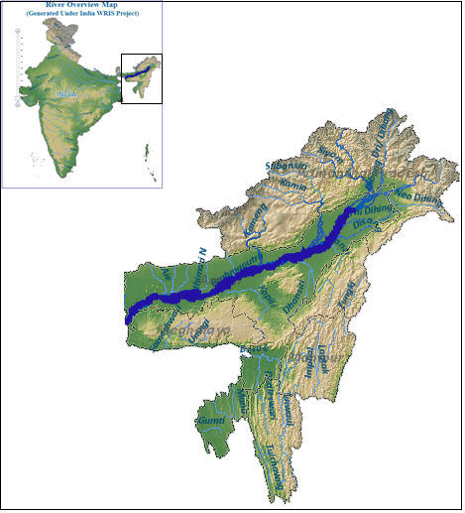
Process/method
Qualitative research: relevant for the social process of bridging the knowledge-governance gap
Group discussions (both men and women/ only women)
Lived and told stories of individual women
Observations
Narratives approach : listening to women’s voices
http://www.india-wris.nrsc.gov.in/wrpinfo/index.php?title=Brahmaputra
SYDNEY, AUSTRALIA | 14 -18 October 2018
MANAGED BY

Slide 6
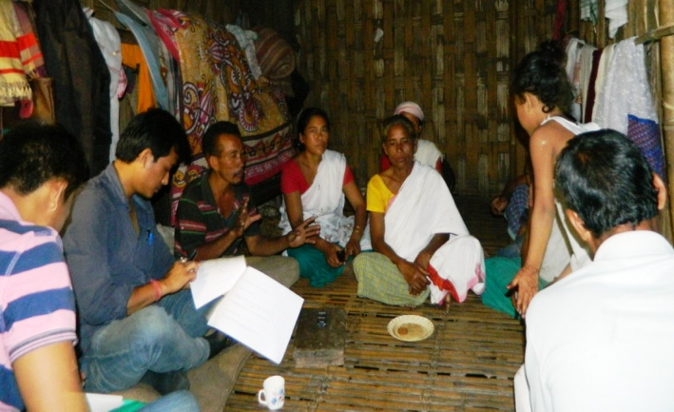
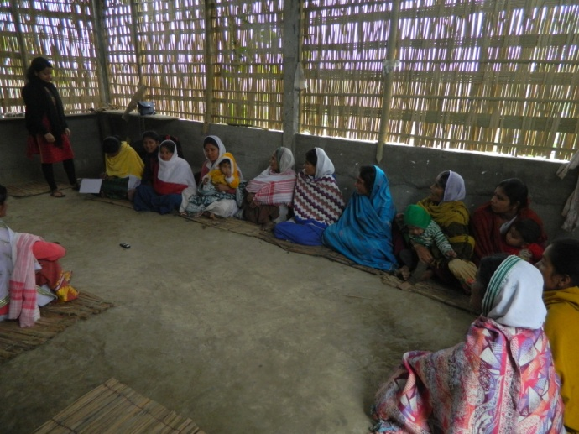
Reflections from group interactions
Underrepresentation of women’s voices: hesitant to voice their views and share their experiences in presence of men.
Undervaluing women’s voices: some men left the group when women started to speak.
Prioritizes of women: More diverse, Lack of opportunity to contribute to management because of lack of participatory freedom (skills to articulate) and space to express
Unheard, Under represented, undervalued
Group discussion: both men and women , Assam
Group discussion: only women, Assam
SYDNEY, AUSTRALIA | 14 -18 October 2018
MANAGED BY

Slide 7
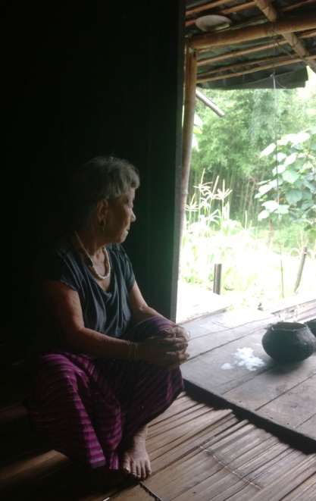
Lived and told stories
SOCIO-ECOLOGICAL RESILIENCE
Belief in animism (that all things—animals, plants, rocks, rivers, weather systems, tasks and even words—have spirit)
‘River has become part of my identity’
At the age of 80+ ‘agriculture heals me’
SOCIAL TRANSFORMATION
+governance by Gaon Buries (elderly women)
-‘erosion of traditional knowledge systems’
SOCIAL COHESION
in the times of crisis
LACK OF WOMEN LEADERSHIP
in community-led initiatives is lacking
Kherepe Meme, oldest woman in Kebali village located near the tributary of Dibang River,
Arunachal Pradesh
SYDNEY, AUSTRALIA | 14 -18 October 2018
MANAGED BY

Slide 8
Key lessons learnt: Strengthening the science-policy interface
Women’s traditional information, skills, and practices reflect their experiential learning
Women are the keepers or managers of this knowledge which has become cultural identity of the communities and is passed on from generation to generation by women
To meaningfully include women in decision-making it is important to give visibility to their knowledge and participation and focus on inclusive process rather than an inclusive outcome.
SYDNEY, AUSTRALIA | 14 -18 October 2018
MANAGED BY

Slide 9
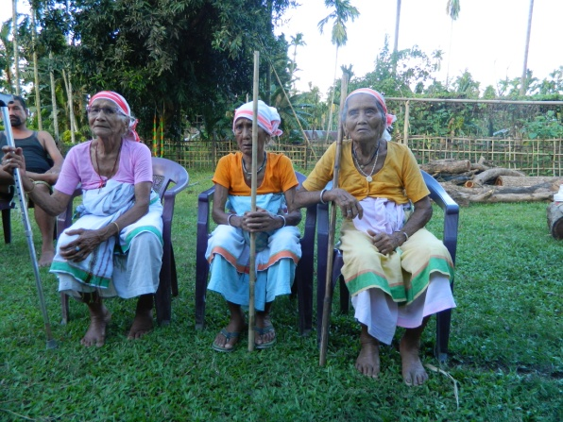
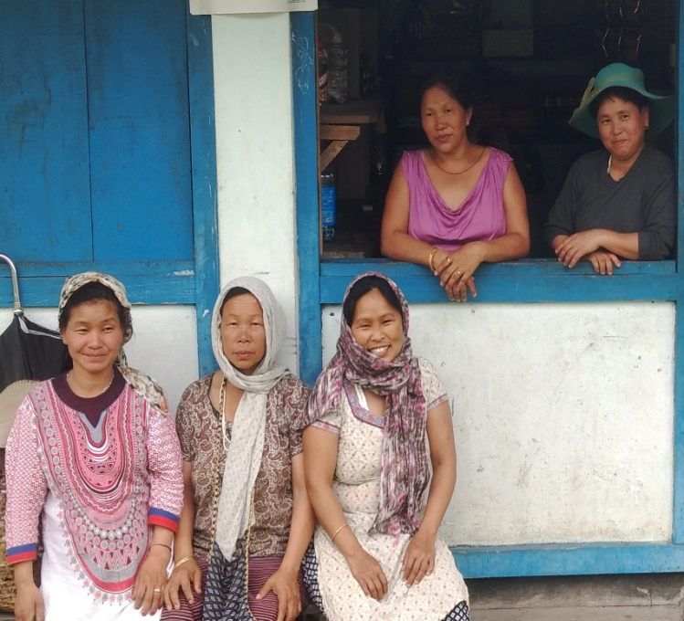
Achievements
To generate a sense that their voice matters.
I hope my research provided them with a space to express themselves and share their knowledge
Building policy relevant discourse for enabling gender sensitive decision-
Shaped my post doctoral research on
representing the ‘needs and interests’ of vulnerable groups to reduce disaster risk
Giving visibility to their voices.
Women from Deori tribe, Assam
SYDNEY, AUSTRALIA | 14 -18 October 2018
MANAGED BY
Women farmers from Idu tribe, Assam

Slide 10
Place your
logo here
Thank you
Indian Institute of Technology Guwahati (Academic and field consultations)
South Asian Consortium for Interdisciplinary Water Resources Studies (SaciWATERs)
Global Water Partnership (GWP)
Everybody who agreed to participate in the research and spared their valuable time for the interactions
International River Foundation for the Fellowship and regular interactions to shape the work
E-mail: suparana.katyaini@gmail.com
SYDNEY, AUSTRALIA | 14 -18 October 2018
MANAGED BY

