Slide 1
WATER RESOURCES MANAGEMENT IN AN INTERNATIONAL BASIN: INCO-MAPUTO by Thomas Gyedu-Ababio
Place your
logo here
SYDNEY, AUSTRALIA | 14 -18 October 2018
MANAGED BY

Slide 2
This presentation
Introduction
The Inco-Maputo Basin
Governance and Institutional Structures
Water Resource Management Issues
Actions/ Way Forward
Conclusion

Slide 3
Introduction
Water knows no boundaries. Rivers and streams run across international boundaries;
The socio-economic and political dynamics of the countries involved in an international basin play a big role in the management of the resource;
Climate change is compounding the water problems in Southern Africa.

Slide 4
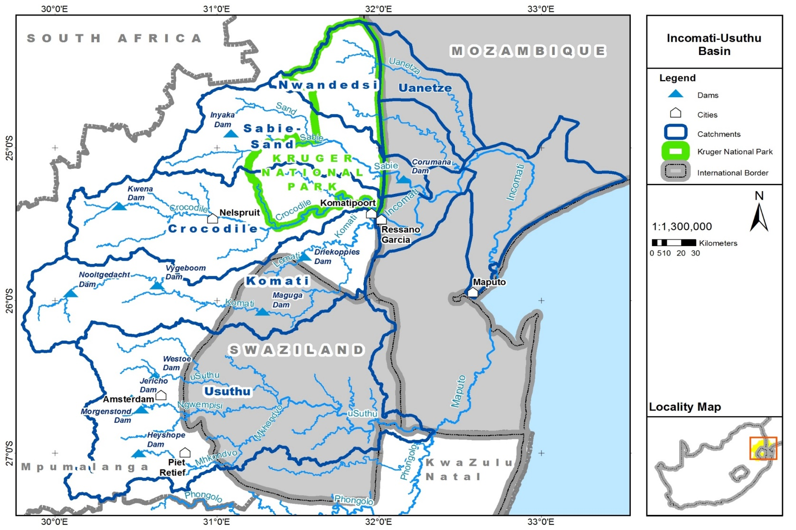
Inco-Maputo Basin

Slide 5
Governance & Institutional Structures
TRIPARTITE TECHNICAL COMMITTEE
T
P
T
C
Political (Governmental)
South Africa
Mozambique
Swaziland
Departmental
Department of Water and Sanitation
ARA-Sul
Department of Water Affairs
Operational - organisational
Inkomat-Usuthu (IUCMA)
ARA-Sul
River Basin Authority (RBA)
MOZ
RSA
SWAZI

Slide 6
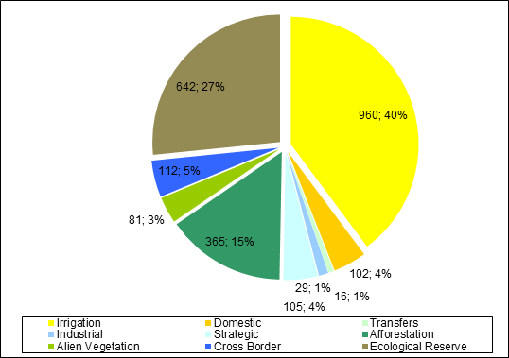
Water Resource Management Issues
Demand > Supply
Variability & Seasonality (time and space)
Little Storage
Rainfall & demand spatially disparate
Evaporation > Precipitation
Long River
International Obligations
Ecological flows.
Diverse Users
Equity
Closing Basin
Semi Arid
Run-off River
Complex, wicked problem !!

Slide 7
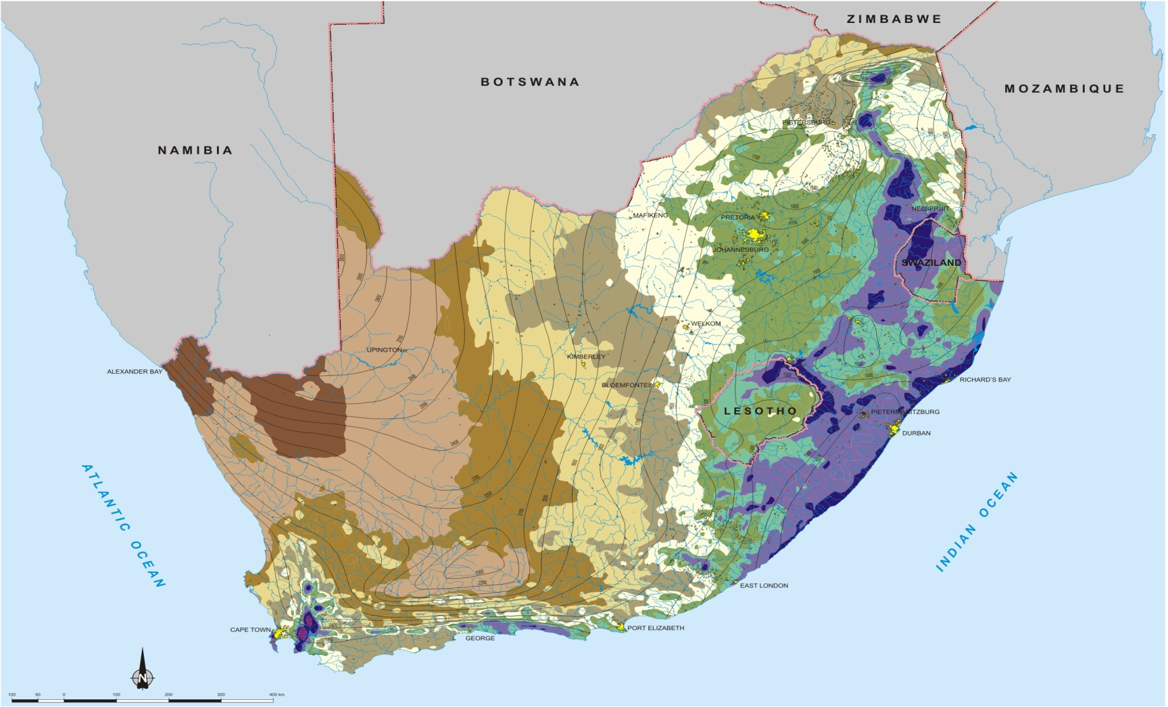
Water Resource Management Issues
Note skewed distribution of rainfall, and decrease
westwards while evaporation
rates increase westwards
With Climate Change it is highly probable that this distribution will intensify; the east will get wetter and west drier.

Slide 8
Water Resource Management issues
Water resource pollution, especially from sewage leaking/spilling into the water resources, causes a serious health risk;
Growth in Municipal water use;
Major growth in industrial and housing projects
Inefficiency of water use within municipalities
Higher demands from Mozambique regarding minimum flows at border
Water stress – huge risk for agriculture & other sectors;
Climate Change;
Sovereignty and determining reasonable and equitable use;
Uneven distribution of resources and needs; and
Differences in technical and financial capacity.

Slide 9
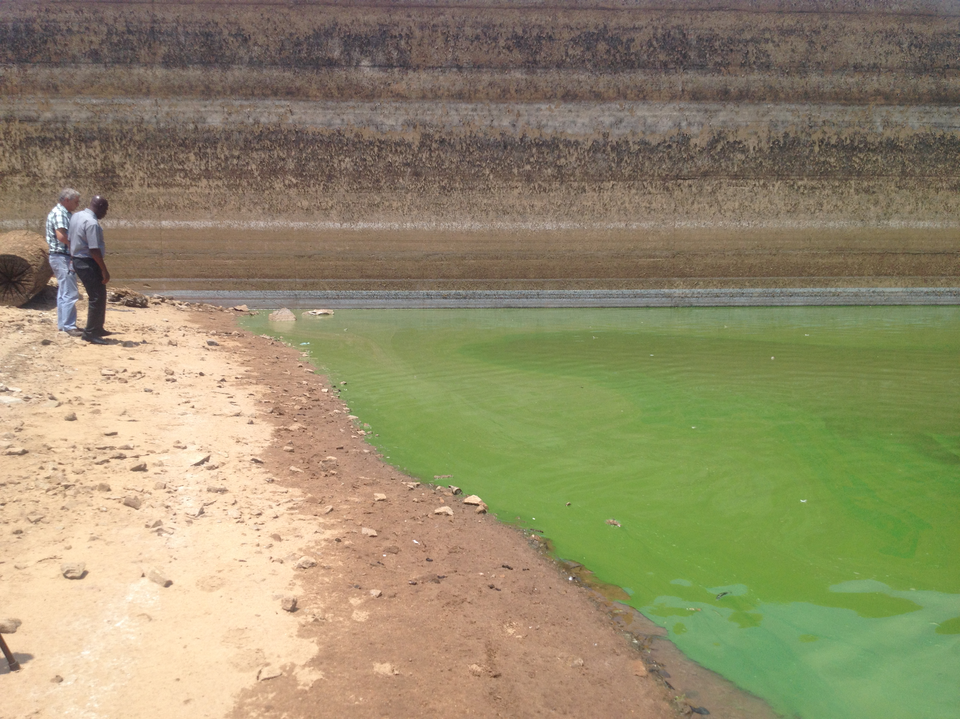
Water Resource Management Issues
POLLUTION

Slide 10
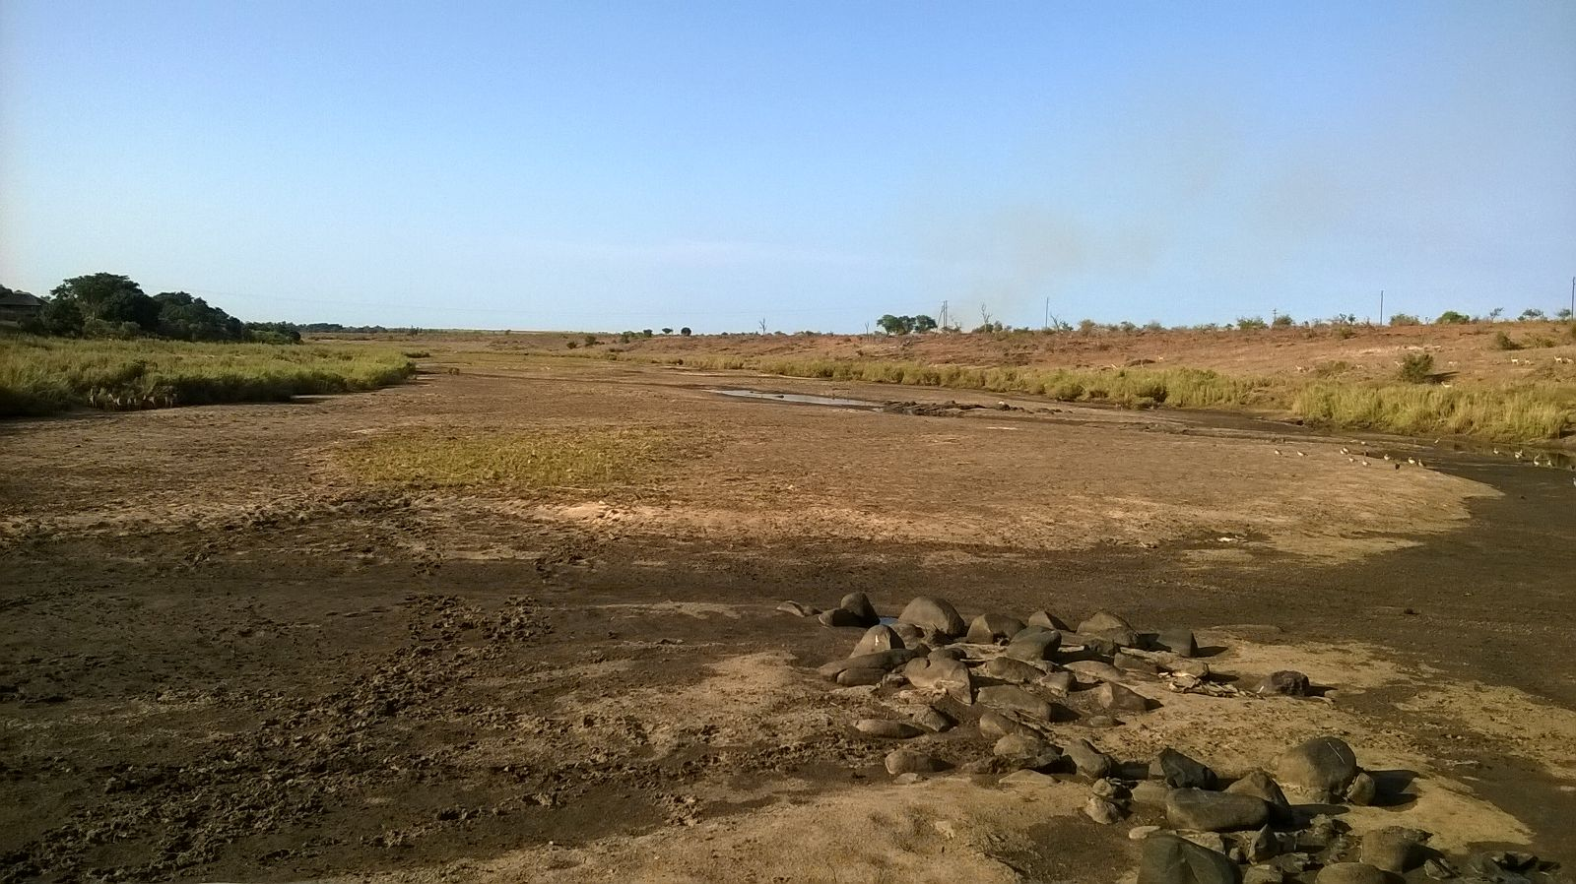
Oh My Gosh

Slide 11
ACTIONS – WAY FORWARD
Governance
Information sharing (Hydronet)
Joint projects
Ground Water Studies
Climate Change Adaptation Strategy - Implementation

Slide 12
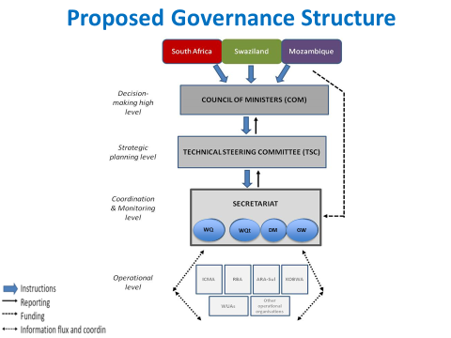

Slide 13
Hydronet for T-boundary Cooperation
HydroNet facilitates the sharing of information with stakeholders;
The use of HydroNET by the three partner countries of Swaziland, Mozambique and South Africa could promote information sharing and transparency;
It can enhance transboundary water management among the partners;
This would also build trust relationship between the partner countries;
Automated reports; and
The partners will have access to the status of the resource in the jurisdiction of other partners.

Slide 14
RIVER SYSTEMS PLANNING & OPERATIONS

Slide 15
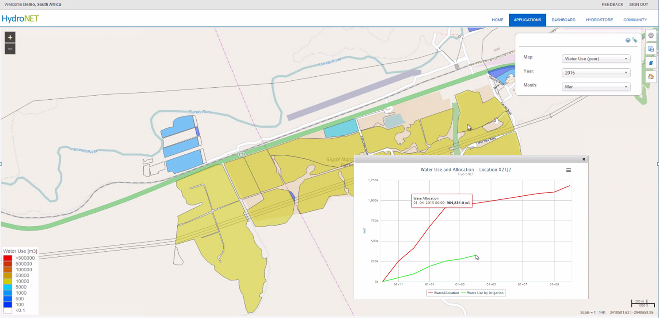
Water Auditing

Slide 16
Transforming the Water Mix
Future Water Mix:
67% Surface Water
13 % Return Flows
16% Ground Water
3% Desalination
1% AMD
Current Water Mix:
74% Surface Water
11 % Return Flows
15% Ground Water
South Africa

Slide 17
Conclusion
Overcoming the transboundary divide requires resources, time, and commitment of sharing states;
Communication;
Collaboration;
Trust and understanding;
Technology;
Equity;
Integration and the “mixes”; and
Virtual access.

Slide 18
THANK YOU

