Slide 1
INTEGRATED AGRICULTURAL AND WATER MODELLING TO GUIDE HEALTHY RIVERS IN NEW ZEALAND or HOW BACTERIA WILL HELP THE NEW ZEALAND DAIRY INDUSTRY
Place your
logo here
Richard CRESSWELL, Mark WALTON, Andrew HERRON,
Jon WILLIAMSON, Hangjian ZHAO and Nic CONLAND
BRISBANE, AUSTRALIA | 18 - 20 SEPTEMBER 2017
MANAGED BY

Slide 2
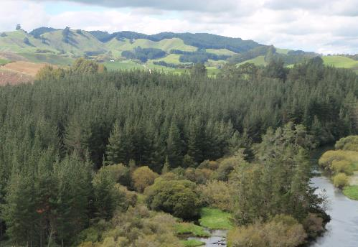
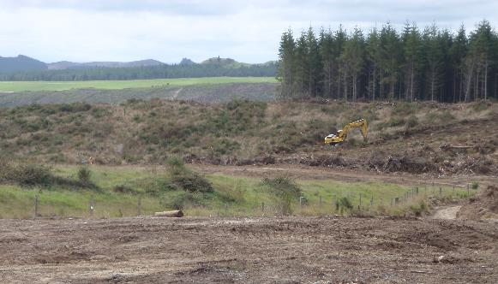
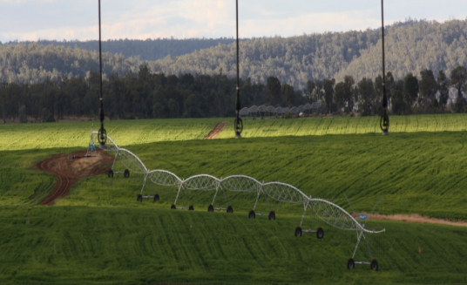
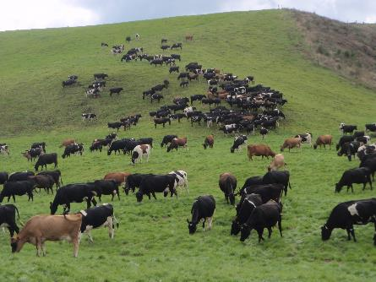
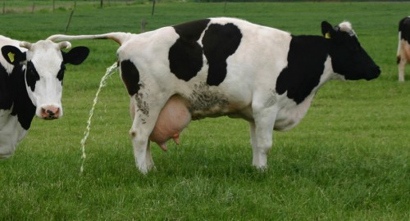
Progressive land-use change has increased nitrate levels in soils, groundwater and rivers

Slide 3
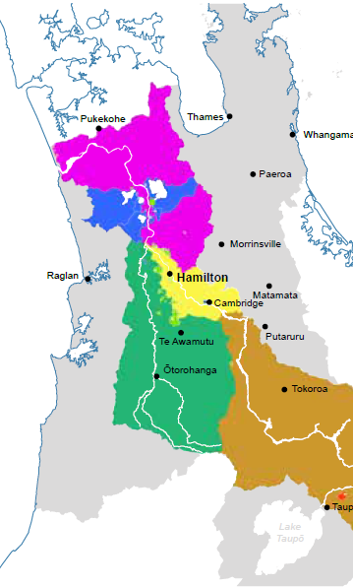
Value | Attribute
Human Health | E. coli
 | Clarity
 | Cyanobacteria (planktonic)
Ecosystem Health | Phytoplankton (lakes & lake-fed rivers)
 | Total Nitrogen
 | Total Phosphorous
 | Nitrate
 | Ammonia
Mahinga kai | E. coli
 | Cyanobacteria (planktonic)

Slide 4
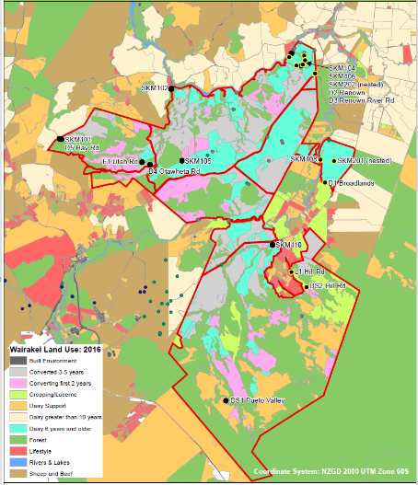
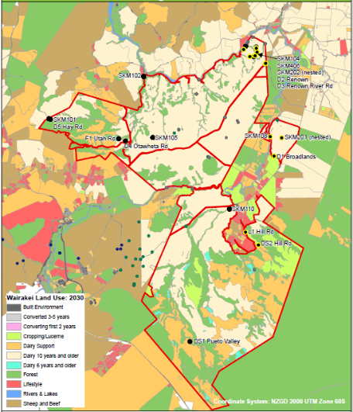
2016 → 2030 possible land use change

Slide 5
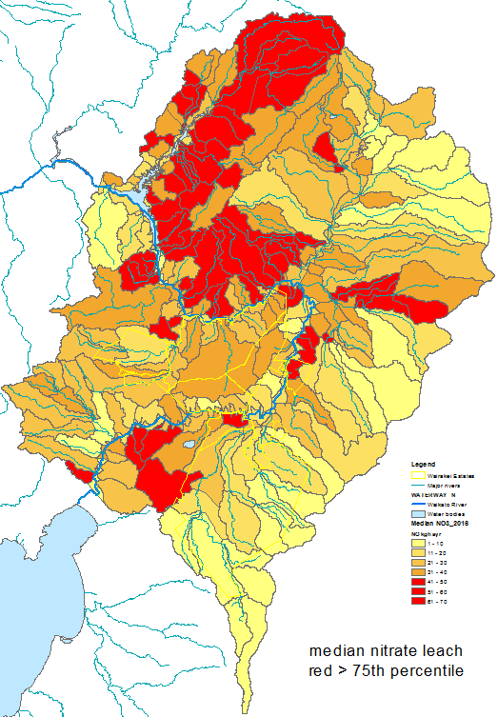
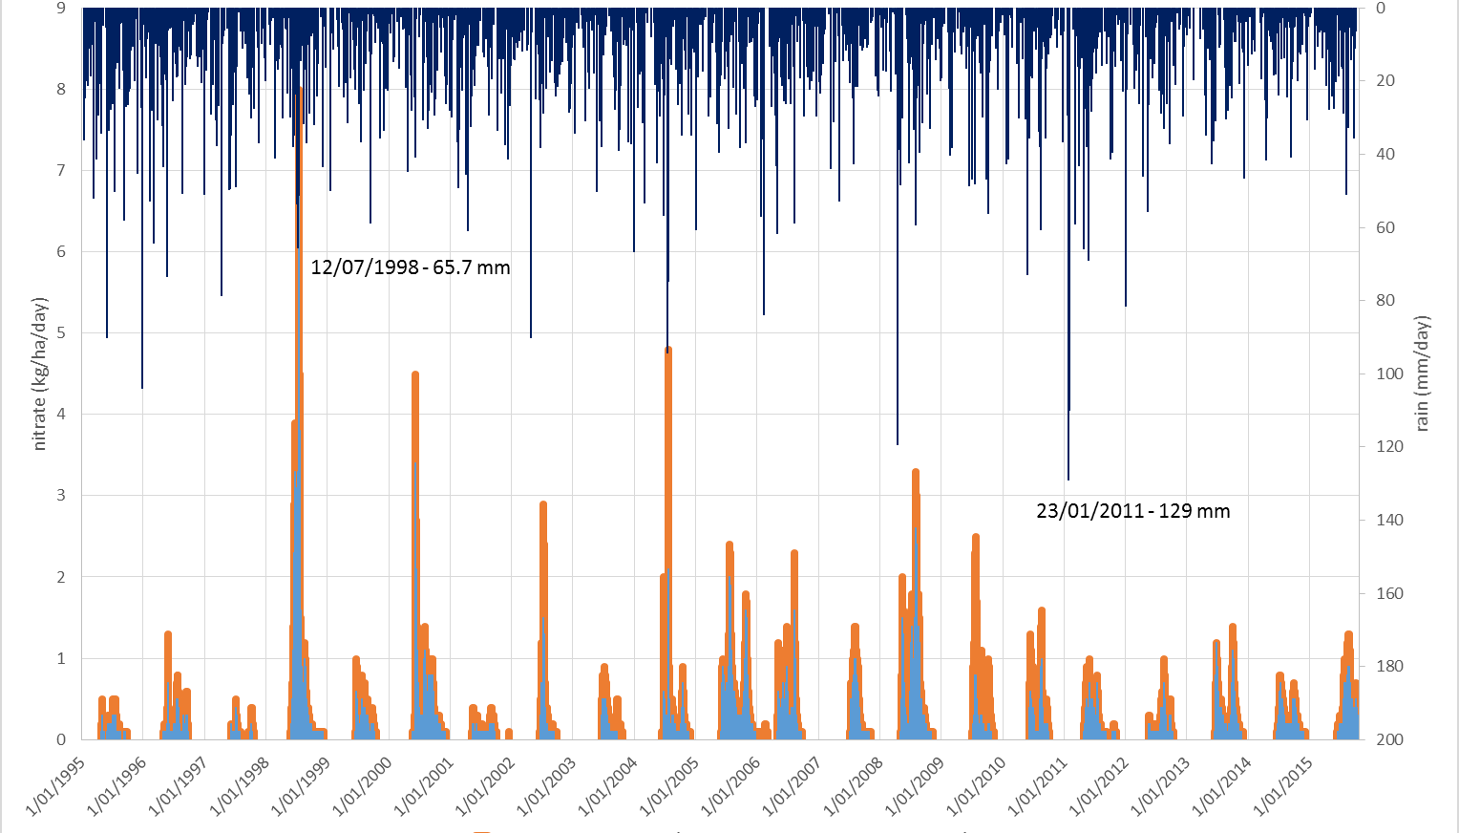
Ruahuwai annual nitrate leach (APSIM)
Strong temporal dependence
rainfall (mm/day)
Nitrate (kg/ha)

Slide 6
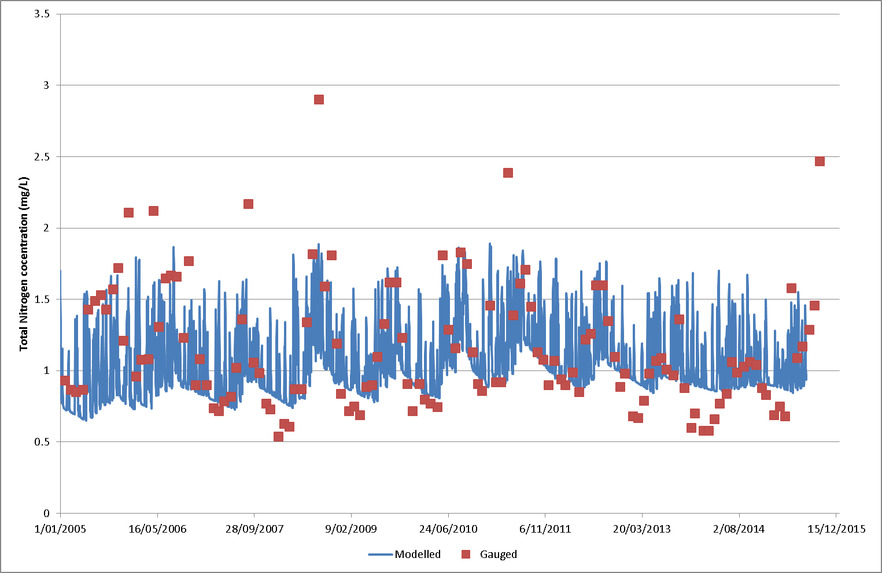
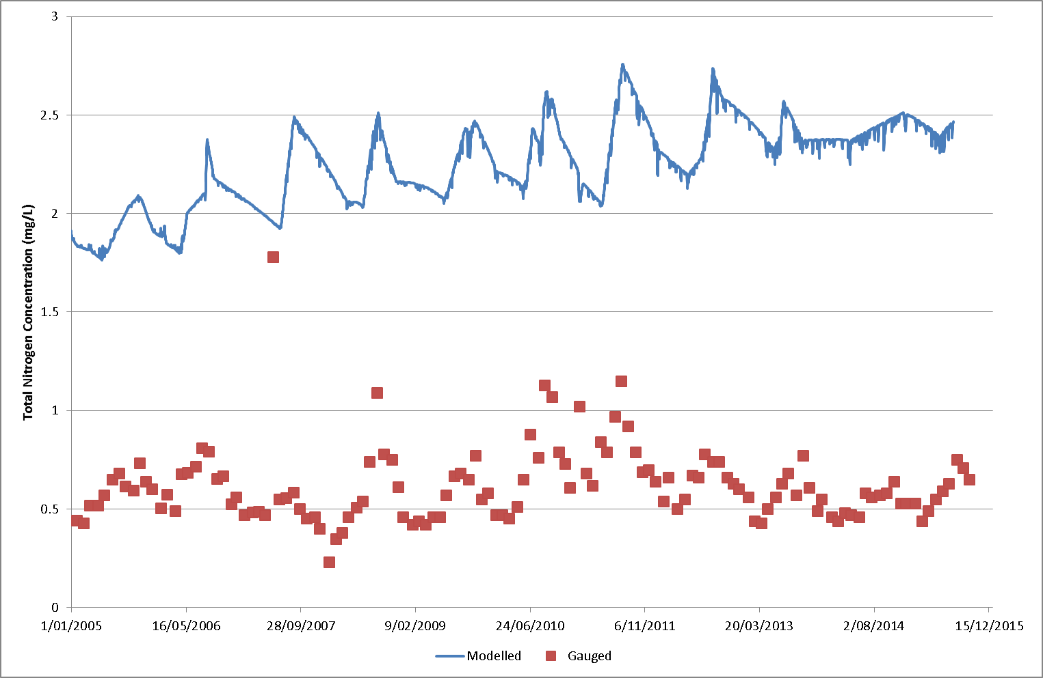
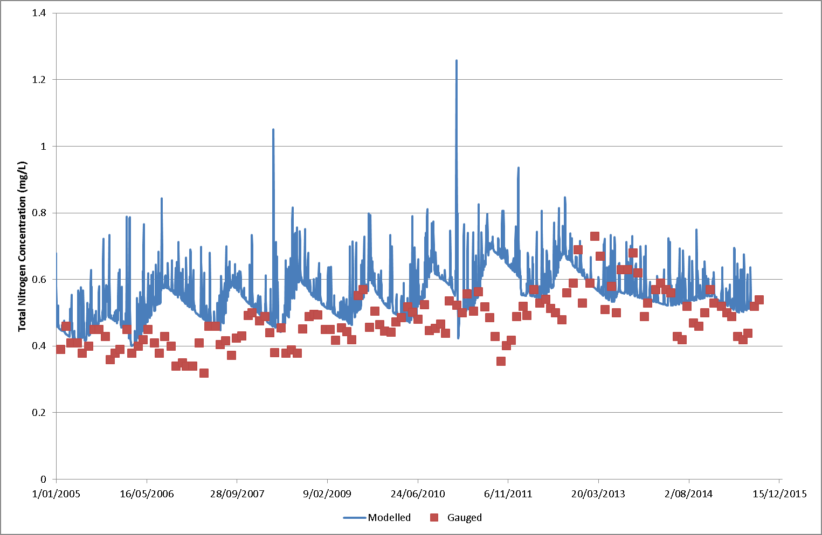
Run nitrate leach through a groundwater model (MODFLOW-MT3DMS)

Slide 7
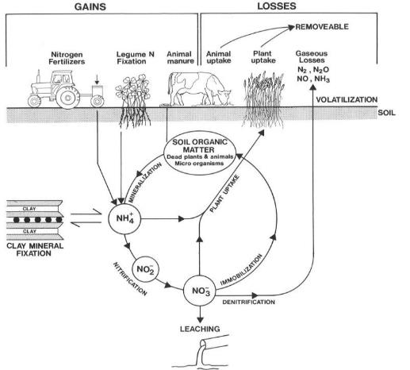
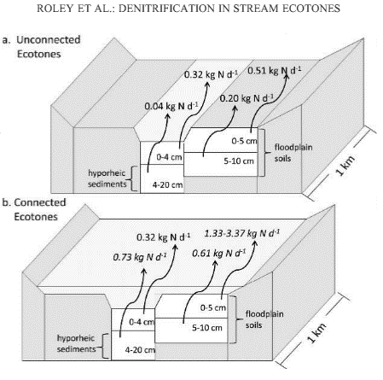
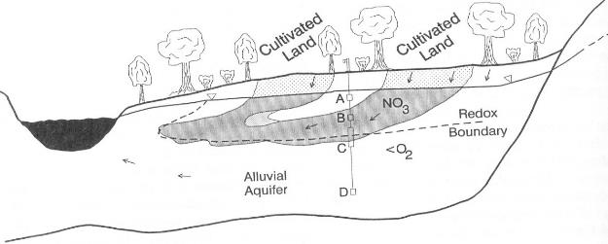
Denitrification
JGR, 2012
x1
x3
Hallberg et al., 1983

Slide 8
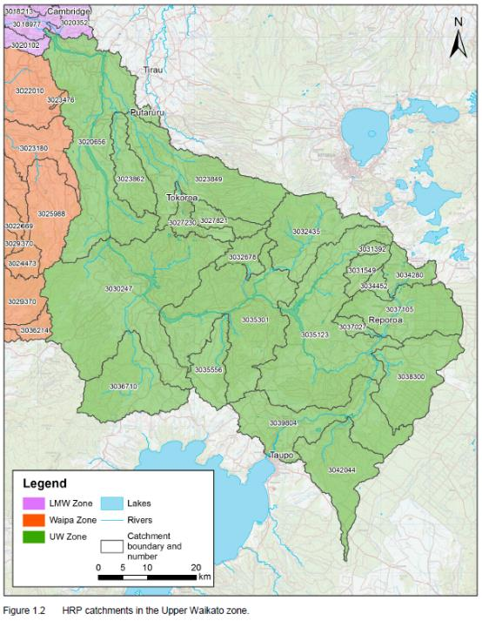
Groundwater redox status
HR/TLG/2015-2016/1.2
Strongly oxidising
Oxidising
Potentially reducing
Reducing
Strongly reducing
No data
Wairakei Data
Strongly oxidising
Oxidising
Potentially reducing
Reducing
Strongly reducing
No data

Slide 9
Run nitrate leach through a groundwater model
(MODFLOW-MT3DMS)

Slide 10
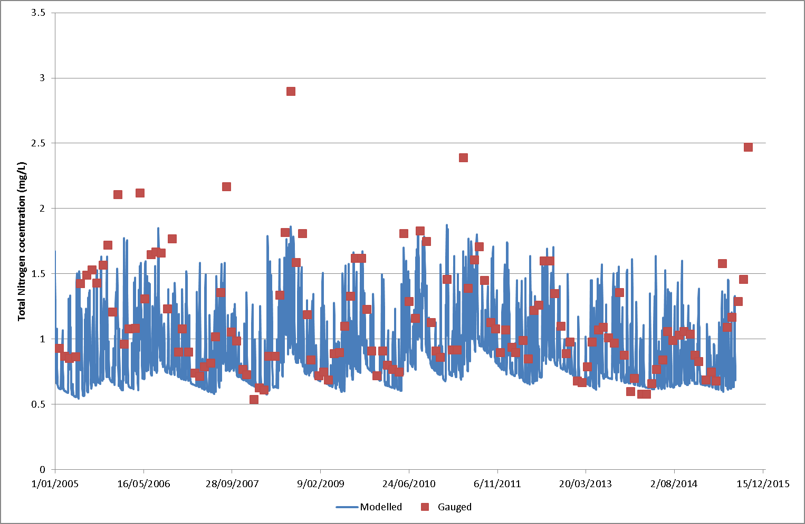
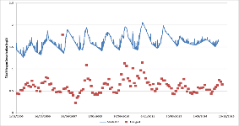
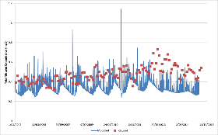
Run nitrate leach through a groundwater model
and denitrify…

Slide 11
Best nitrate reduction strategies…
x
ò

Slide 12
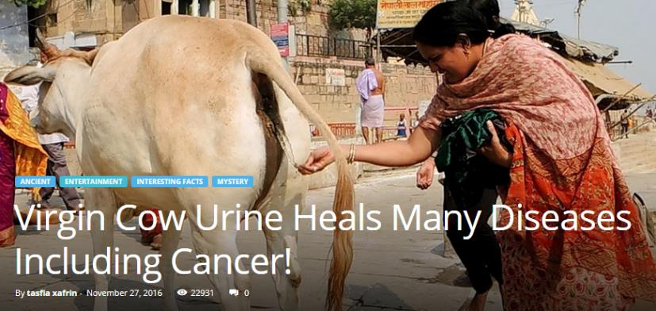
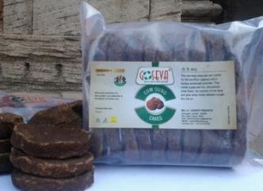
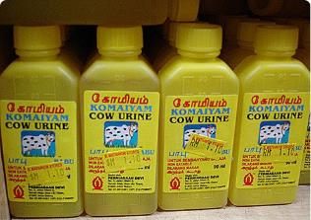
Alternative nitrate reduction strategies…

Slide 13
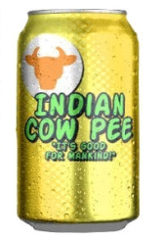
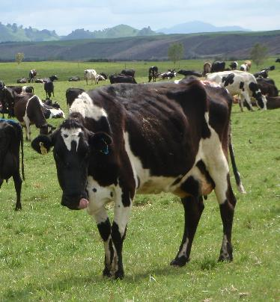
Cheers!
Richard CRESSWELL
Mark WALTON
Andrew HERRON
Jon WILLIAMSON
Hangjian ZHAO
Nic CONLAND

