Slide 1
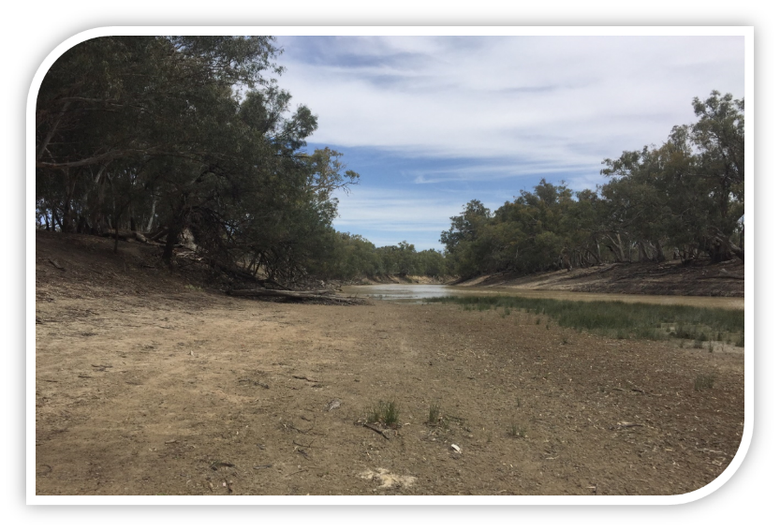
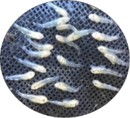
Let it Flow
Place your
logo here
How environmental flows can benefit native fish
Paula D’Santos – OEH
Clayton Sharpe – CPS Enviro
Iain Ellis – DPI Fisheries
BRISBANE, AUSTRALIA | 18 - 20 SEPTEMBER 2017
MANAGED BY

Slide 2
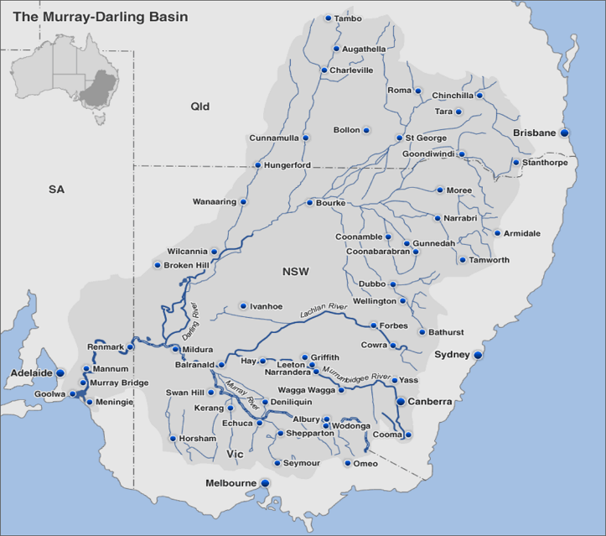
Place your
logo here
BRISBANE, AUSTRALIA | 18 - 20 SEPTEMBER 2017
MANAGED BY

Slide 3
Place your
logo here
Boom and Bust
1941 - 2015
No or Low Flow periods
Menindee Lakes storage construction
BRISBANE, AUSTRALIA | 18 - 20 SEPTEMBER 2017
MANAGED BY

Slide 4
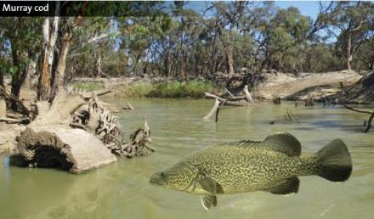
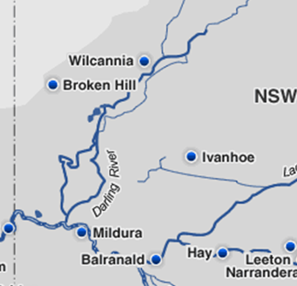
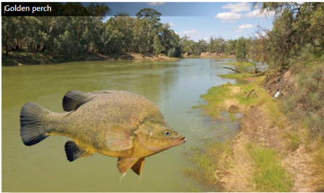
Place your
logo here
Case Study: Lower Darling Environmental Flows 2016-17
Darling River
South Australia / NSW border
Lower
Wentworth
MANAGED BY

Slide 5
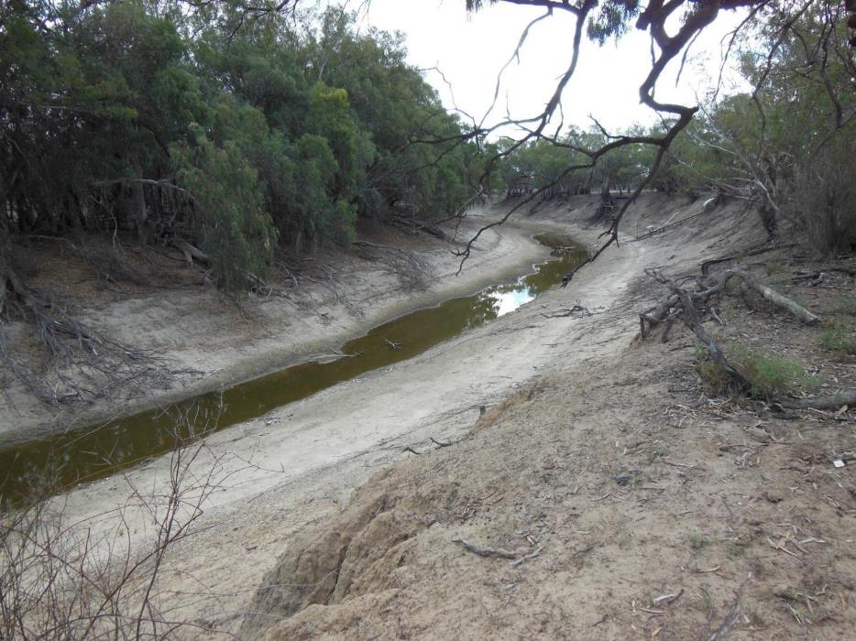
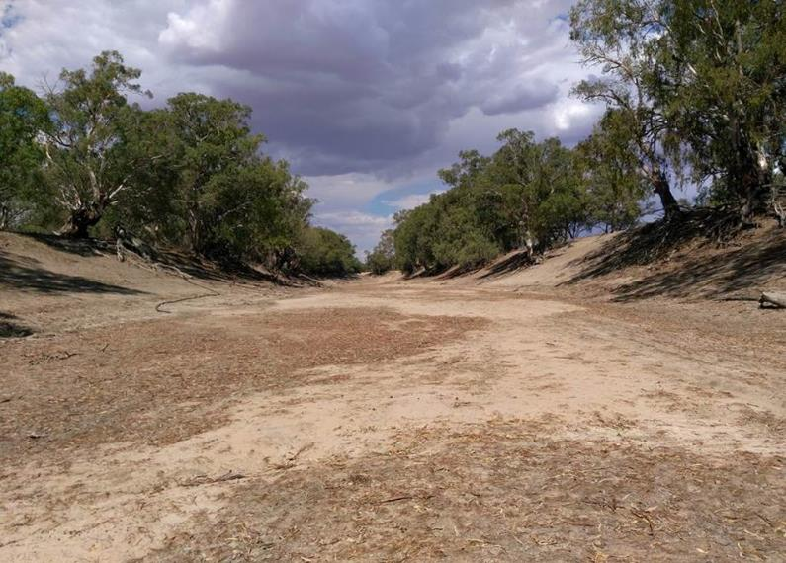
2014, 2015 & 2016
Downstream sections of Lower Darling River dry for more than 500 days

Slide 6
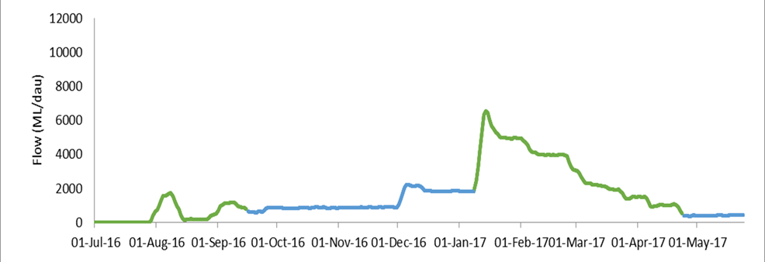
Place your
logo here
Murray cod spawning & recruitment
No flow
BRISBANE, AUSTRALIA | 18 - 20 SEPTEMBER 2017
MANAGED BY

Slide 7
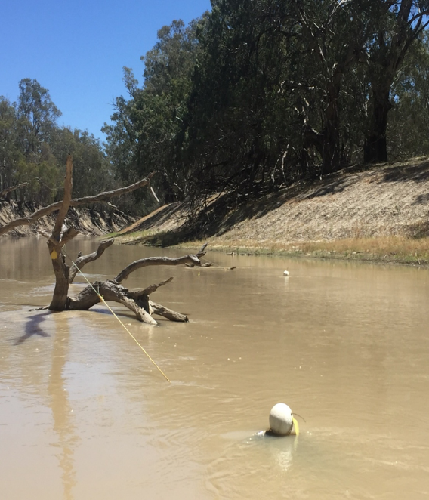
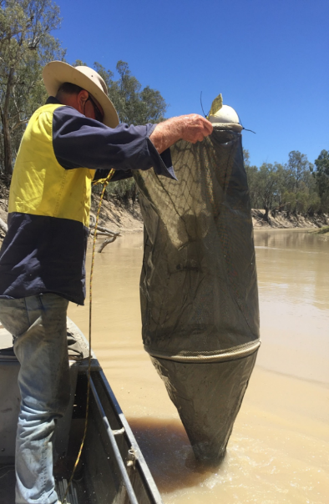

Slide 8
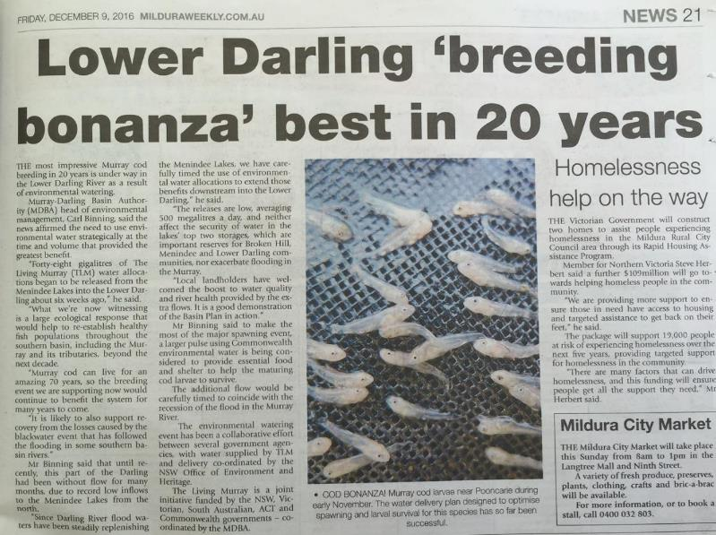
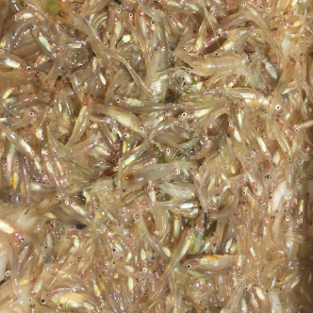
Place your
logo here
BRISBANE, AUSTRALIA | 18 - 20 SEPTEMBER 2017
MANAGED BY

Slide 9
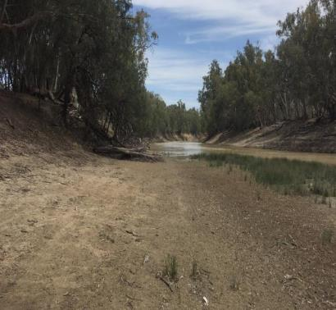
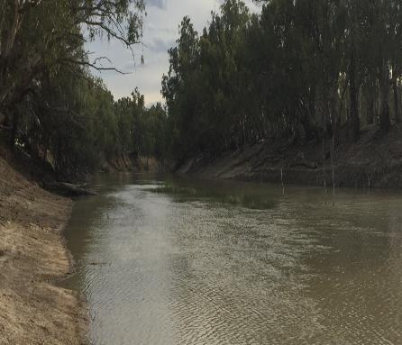
Flows increased to provide food, habitat and dispersal for Murray cod larvae

Slide 10
Place your
logo here
ii) Golden perch – dispersal & recruitment flows

Slide 11
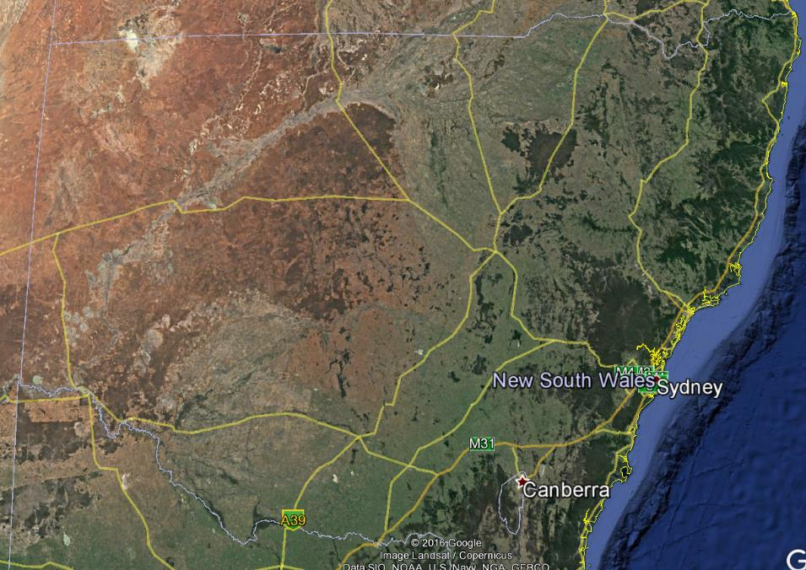
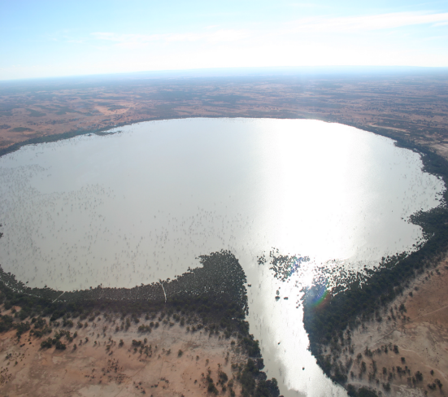
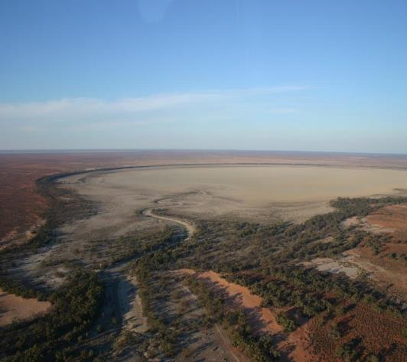
GP spawning
Bourke
Broken Hill
Wilcannia
recruitment
Menindee Lakes
Pooncarie
Wentworth
Burtundy

Slide 12
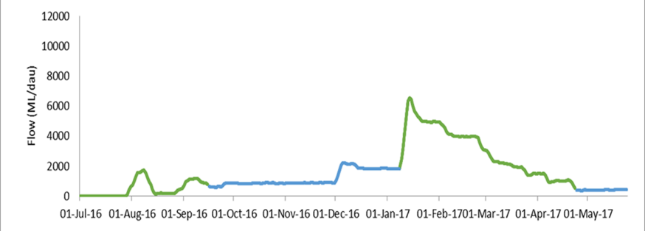
Place your
logo here
Golden perch dispersal, Murray cod survivorship
BRISBANE, AUSTRALIA | 18 - 20 SEPTEMBER 2017
MANAGED BY

Slide 13
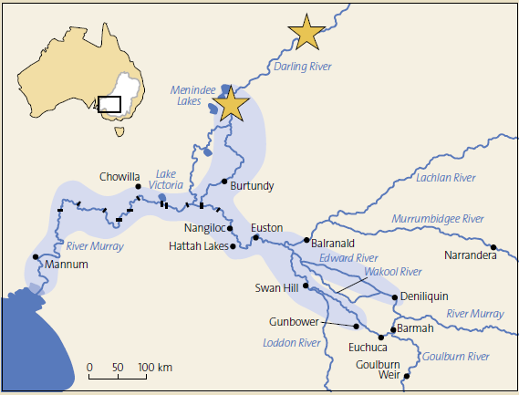
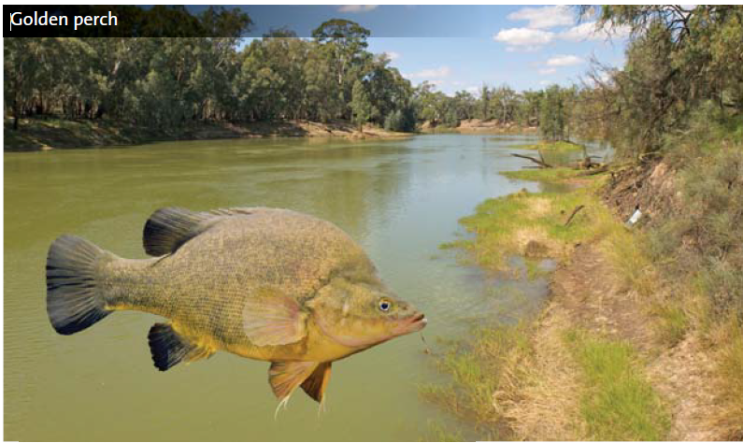
Darling River origins for Golden Perch

Slide 14
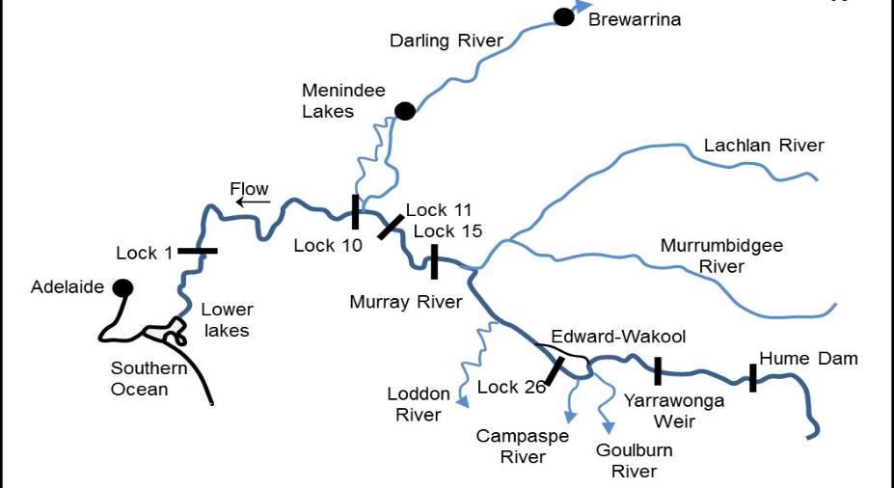
Coordinated dispersal / attractant flows – connecting the Southern Basin
MDBA Southern Connected Basin Project (Sharpe and Stuart 2017)

Slide 15
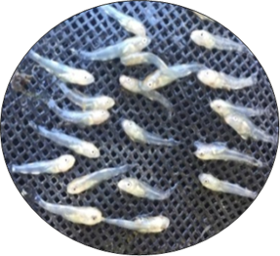
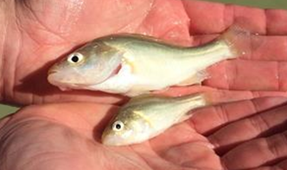
Conclusions
Place your
logo here
management + science = positive outcomes
right flows + right timing = native fish outcomes
connection, protection and provision of flows and key nursery habitats

Slide 16
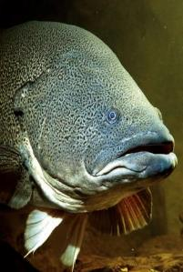
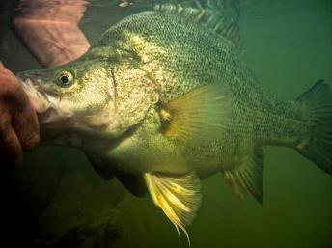
Place your
logo here
Acknowledgments
CPS Enviro – Clayton Sharpe
DPI Fisheries - Iain Ellis
Ivor Sturt
CEWO – Alana Wilkes, Irene Wegner, Sean Kelly
Water NSW – Vince Kelly
MDBA – Adam Sluggett, Adam McLean, John Waterworth
Lower Darling landholders
BRISBANE, AUSTRALIA | 18 - 20 SEPTEMBER 2017
MANAGED BY

