Slide 1



Environmental water allocation mechanisms
Release rules
Or
Active and variable Management
Avril Horne, Simranjit Kaur, Joanna Szemis, Alysson Costa, Rory Nathan, Angus Webb,
Michael Stewardson and Natashia Boland
BRISBANE, AUSTRALIA | 18 - 20 SEPTEMBER 2017
MANAGED BY

Slide 2
What is environmental water?
BRISBANE, AUSTRALIA | 18 - 20 SEPTEMBER 2017
MANAGED BY
Notes:
When we talk about environmental water or environmental flows – we often talk about it like it is all the same – an all encompassing statement of all the water provided to the environment.

Slide 3
What is environmental water?
Allocation Mechanisms
Cap
Conditions on water abstractors
Conditions on storage operators
Environmental water rights
Environmental water reserve
BRISBANE, AUSTRALIA | 18 - 20 SEPTEMBER 2017
MANAGED BY
Notes:
When we talk about environmental water or environmental flows – we often talk about it like it is all the same – an all encompassing statement of all the water provided to the environment.
But, there are a number of different ways that we provide water for the environment – different allocation mechanisms.
Broadly, allocation mechanisms for environmental water can be categorised as those that impose conditions on other water users (such as conditions on licences to abstract water, conditions on storage operators to release a flow, and implementation of a cap or limit on total abstraction volume) and those that provide a legal right to water for the Environment (such as the Ecological Water Reserve in South Africa (Republic of South Africa 1998) or Environmental Water Entitlements in Australia (Commonwealth of Australia 2007)). The former approach to allocating environmental water (referred to from here as rules-based) is the more traditional and widely applied approach. These types of mechanisms can be set through long-term planning instruments and implemented consistently between years, in some cases with rules varying depending, for example, on hydrological conditions (i.e. wet, dry or average) or dam inflows. Environmental water rights (the second broad category) is a praised approach in the literature as it provides increased legal security and flexibility to adapt to changing conditions and environmental needs (Godden 2005; Neave et al. 2015). When environmental water is allocated as a legal right, an environmental water management authority is usually established. This authority holds a parcel of water in storage, and must make decisions about how to manage it, so as to achieve the best environmental outcomes. In doing so, the manager is not constrained to achieve any pre-specified flow regime, but may respond flexibly, at any point in time, to the state of the environment, the system storage state, the decisions of other water users, and flows both current and anticipated in the future. This requires active management (O’Donnell and Garrick 2017) – in which a manager must make active and ongoing decisions about how to release water from storage, in the same way that an irrigator would call on their licenced water.

Slide 4
What is environmental water?
Allocation Mechanisms
Cap
Conditions on water abstractors
Conditions on storage operators
Environmental water rights
Environmental water reserve
Legal security
Flexibility
Resources / institutional requirements
BRISBANE, AUSTRALIA | 18 - 20 SEPTEMBER 2017
MANAGED BY
Notes:
When we talk about environmental water or environmental flows – we often talk about it like it is all the same – an all encompassing statement of all the water provided to the environment.
But, there are a number of different ways that we provide water for the environment – different allocation mechanisms.
The mechanism used to allocate environmental flows areimportant as it defines the legal security, the level of flexibility in managing environmental water, and the resources required to manage environmental flows (Horne et al. 2017; O’Donnell and Garrick 2017).
Erin O’Donnell will spend more time talking about this tomorrow afternoon.

Slide 5
What is environmental water?
Allocation Mechanisms
Cap
Conditions on water abstractors
Conditions on storage operators
Environmental water rights
Environmental water reserve
Legal security
Flexibility
Resources / institutional requirements
BRISBANE, AUSTRALIA | 18 - 20 SEPTEMBER 2017
MANAGED BY
Notes:
When we talk about environmental water or environmental flows – we often talk about it like it is all the same – an all encompassing statement of all the water provided to the environment.
But, there are a number of different ways that we provide water for the environment – different allocation mechanisms.
The mechanism used to allocate environmental flows areimportant as it defines the legal security, the level of flexibility in managing environmental water, and the resources required to manage environmental flows (Horne et al. 2017; O’Donnell and Garrick 2017).
Erin O’Donnell will spend more time talking about this on XXXX.
Now what I want to focus on is looking at just two of these mechanisms and the level of flexibility they provide in managing environmental water and ask – what does this flexibility actually mean in terms of environmental outcomes?
If we think about conditions on storage operators, we are effectively establishing a set of release rules that a storage operator can follow to ensure a downstream flow regime. These rules can be simple or complex, they may be different in dry or wet years, but they have a level of consistency. In contrast, where environmental water rights exist, an environmental manager must make ongoing and active decisions about where and when to use water. There is a high level of flexibility around how environmental water is released through time and between years, but this ongoing management is also resource intensive. How much extra benefit does this flexibility provide in terms of environmental outcomes?

Slide 6
Case Study – Yarra River, Victoria, Australia
BRISBANE, AUSTRALIA | 18 - 20 SEPTEMBER 2017
MANAGED BY
Notes:
3 environmental flow reaches that are managed for
Environmetnal objectives include macroinvertebrates, fish (Australian Grayling, Black fish) and geomorphology
Environmental water manager holds 17GL of environmental water that can be actively managed.

Slide 7
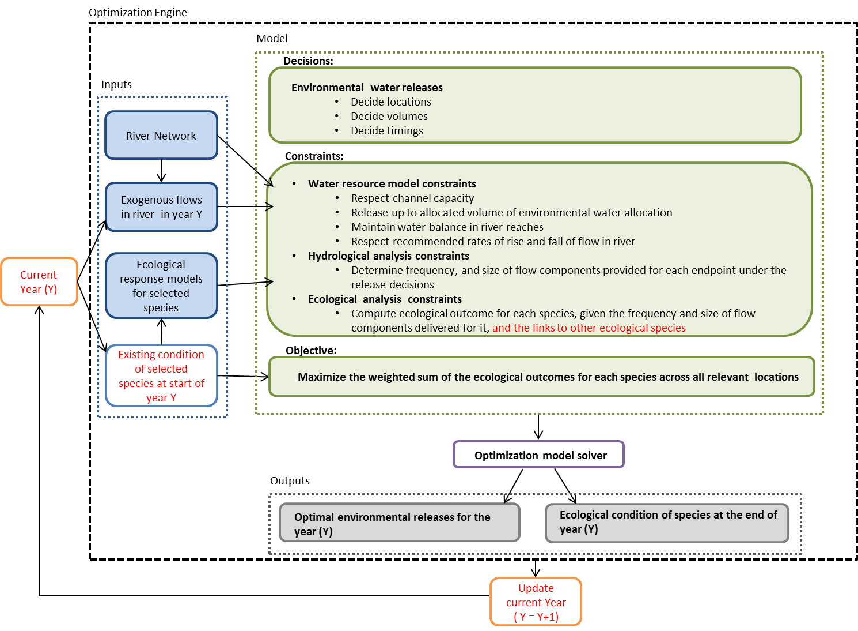
BRISBANE, AUSTRALIA | 18 - 20 SEPTEMBER 2017
MANAGED BY
Notes:
We then developed on optimization model of the Yarra catchment where the objective is to design an environmental release pattern that obtains the maximum possible environmental outcomes across the reaches of interest and the various environmental management objectives.

Slide 8
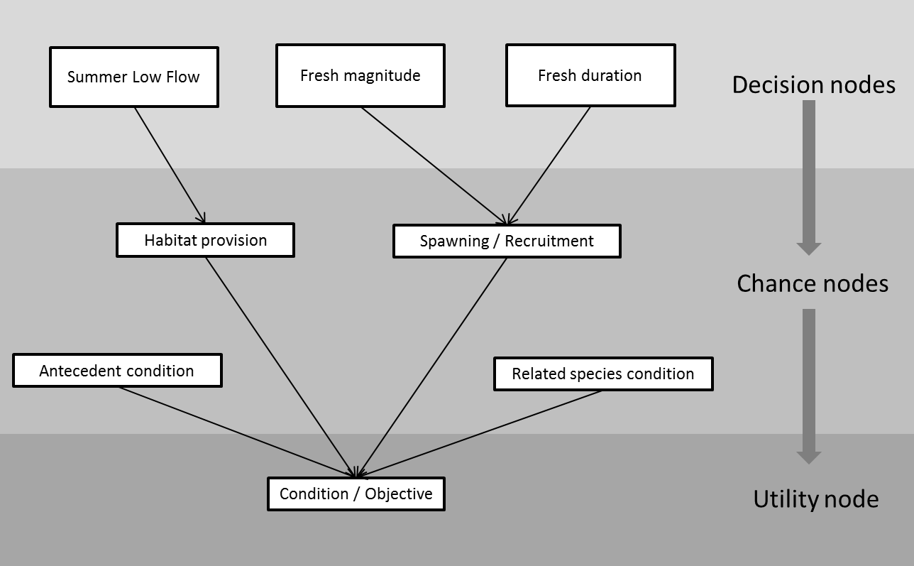
Representing Ecological Outcomes
BRISBANE, AUSTRALIA | 18 - 20 SEPTEMBER 2017
MANAGED BY
Notes:
Environmental outcomes are represented through a series of influence diagrams (Watthayu and Peng 2004) that are then translated to CPNs. These CPNs link flow release decisions (decision nodes) for a given season through to an outcome (utility node) for an individual species, with important intermediate processes linking the decisions through to the outcome (chance nodes) (Figure 2). For example, the decision to provide a fresh or pulse event (decision nodes) may impact on the probability that fish spawning will occur (chance node), which in turn impacts the likelihood of a particular fish species being in good, average or poor condition (utility node). Each chance and utility node in the CPN is linked to a table of probabilities that define how the state of a decision node will lead to a certain outcome in nodes further down the influence diagram. These probability tables can be populated through expert opinion, data or model outputs (Henderson et al. 2008). The example in Figure 2 is structured around outcomes for fish, however CPNs can similarly be produced for other types of environmental management objectives (such as vegetation, macroinvertebrates and channel form). The CPNs can also be used to link environmental outcomes together, for example where the outcome for a fish species depends on healthy macroinvertebrate communities as a food source. A major challenge in developing ecological models to include in decision support tools is developing a comparable scale of condition or outcome across management objectives. In this paper we use a common approach of defining states or severity ratings (good, average, poor condition) associated with a scale of zero to one (King et al. 2003; Sale et al. 1982; Young et al. 2003).

Slide 9
Active Management (Environmental water rights)
Storage release rule based on unlimited model runs (“unlimited median rule”)
Storage release rule based on drought (“optimized release rule”)
BRISBANE, AUSTRALIA | 18 - 20 SEPTEMBER 2017
MANAGED BY
Notes:
Different patterns of fixed monthly releases were derived to represent release rules for wet, average, and dry years based on:
the median monthly release as calculated using the previous optimization runs allowing for unlimited access to water (“unlimited median release rule”) (Scenario 6 in Table 2).
optimized monthly releases for a year derived by optimizing the monthly release decisions for the most recent 10 years of each climate type ensuring that the monthly releases were the same across years (“optimised release rule”) (Scenario 7 in Table 2)
Importantly, only the monthly release volume was defined by the optimized rules, and the daily releases were allowed to vary within each month and optimized subject to delivery of the months volume as dictated by the rule.

Slide 10
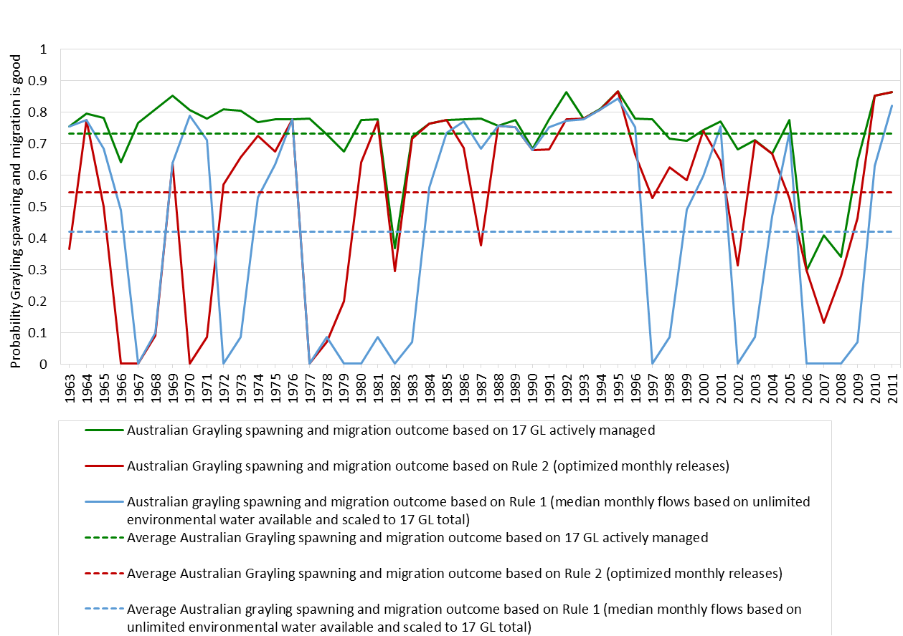
BRISBANE, AUSTRALIA | 18 - 20 SEPTEMBER 2017
MANAGED BY
Notes:
Figure 12 shows that where environmental water is actively managed (Scenario 2 shown in green), it significantly outperforms rules-based releases (Scenarios 6 and 7 shown in red and blue respectively), providing a more likely positive outcome for the Australian Grayling population for the same volume of environmental water. As expected, the optimized release rules in Scenario 7 perform better than rules-based on median monthly releases in Scenario 6. Figure 12b shows that over the past 10 years, Scenario 7 performs as well as Scenario 2 in terms of recruitment of Australian Grayling. This is due to the specific years of data used in developing the rules in for Scenario 7. The past 10 years of record have been predominantly dry, and this sequence was thus used to define the rules-based strategy for dry years. When looking further back in the historical sequence, the rules do not perform as well when applied to a different climate sequence.

Slide 11
BRISBANE, AUSTRALIA | 18 - 20 SEPTEMBER 2017
MANAGED BY

Slide 12
Conclusion
In the Yarra River, active management provided significantly better outcomes than rules based storage releases
The right mechanisms will vary depending on the River basin
Two other considerations
  Perfect foresight
  Institutional / resource costs versus benefits
BRISBANE, AUSTRALIA | 18 - 20 SEPTEMBER 2017
MANAGED BY
Notes:
The active management of environmental water delivered substantially greater ecological benefits than the rules-based approach. This suggests that there is merit in further exploring the use of legal rights to manage environmental water and investigating how such approaches may improve environmental outcomes without additional water.
However, it is important to consider two issues in more detail. Firstly, the analysis undertaken in this paper assumes perfect foresight; that is, at the time watering decisions are made, the optimization model knows how the streamflow for the year will unfold. In reality, an environmental manager or storage operator is working under uncertainty concerning future climate conditions and accordingly future work could investigate the outcomes once climatic uncertainty is incorporated into the modelling framework. One approach that could be adopted is the use of a stochastic modelling framework that considers uncertainty via the use of a “scenario tree”. In this approach, different future conditions are given a probability of occurrence, with each time-step having options that branch from the suite of conditions possible to the previous time-step (Powell 2014). This modelling approach produces solutions that hedge over the range of possible future conditions, enabling environmental water managers to make decisions that put them in the best position to be able to manage outcomes whatever climate scenario unfolds. This may result in a very different release pattern to that with perfect foresight of future climate. This remains an area for further research, both from a technical perspective and considering how a model that acknowledges uncertainty in this way would be used by a manger in their institutional setting.
The second consideration is that active management of environmental water requires an institutional framework and resources to enable these ongoing decisions (O’Donnell and Garrick 2017). There are costs associated with these additional resources (Garrick 2015) and this must be compared to the potential improvements in ecological outcomes.

Slide 13
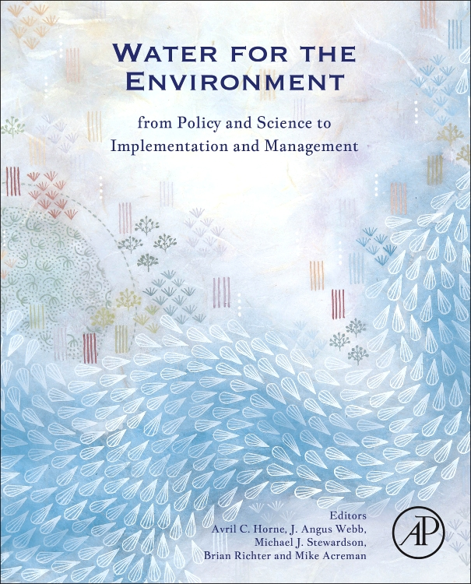
Thank - you
BRISBANE, AUSTRALIA | 18 - 20 SEPTEMBER 2017
MANAGED BY

