Slide 1
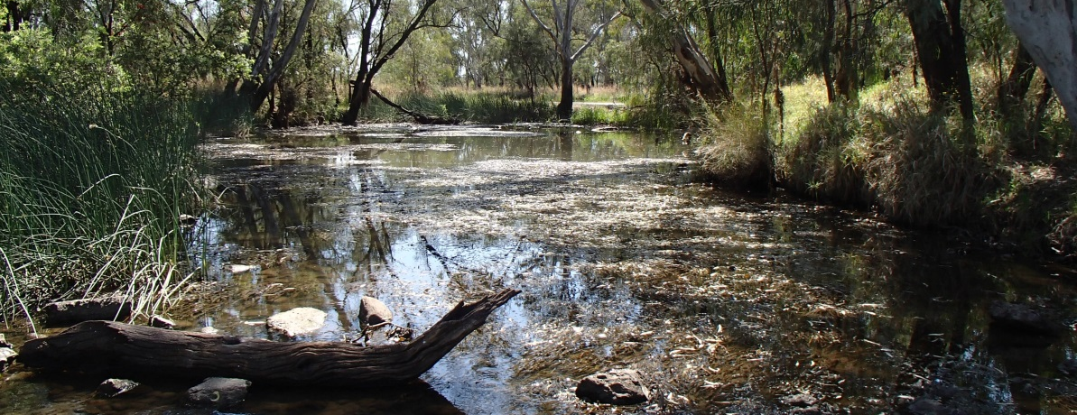
Stable low-flow spawning fish habitat assessments
Calculating flow thresholds to inform the Environmental Assessment of state Water Plans (Qld)
Janice Kerr, Andrea Prior, Dean Holloway.
BRISBANE, AUSTRALIA | 18 - 20 SEPTEMBER 2017
MANAGED BY

Slide 2
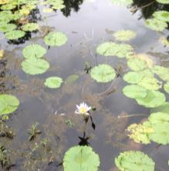
Overview
Environmental Flows Assessment Program (EFAP)
Science to inform Environmental Risk Assessments associated with the review of Water Plans
Improving confidence in risk assessments by providing site specific data to replace estimated values
Evaluating changes in the frequency of opportunities to spawn due to water management
EcoModeller
A new conceptual model
Notes:
Need:
To determine risks to SLFSF from water resource development.
Does the flow regime support population viability in SLFSF
2 projects:
Collect data to adapt off the shelf EcoModeller plug-in to local requirements
Many model parameters used estimated values, so
Collect spawning habitat data to improve confidence in model outputs
Refine the conceptual model.

Slide 3
Where are we?

Slide 4
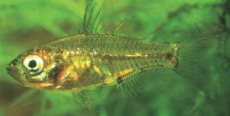
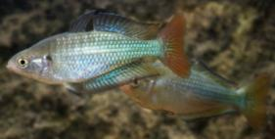
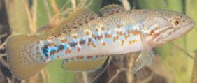
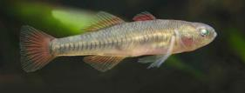
Who are the SLFSF?
Olive perchlet
(Ambassis agassizii)
Murray-Darling rainbowfish
(Melanotaenia fluviatilis)
Purple-spotted gudgeon
(Mogurnda adspersa)
Western carp gudgeon
(Hypseleotris klunzingeri)
Notes:
Asset species - Critically linked to flow regime
Found in all 3 catchments
Sufficient life history knowledge for modelling
Spawn and recruit on stable low flows
Require medium to low flows
Access to spawning and nursery

Slide 5
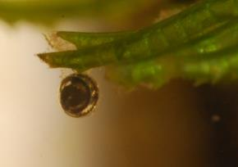
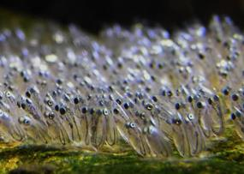
Spawning habitat requirements
Spawning
Warm water (>18-22°C)
Somewhere to attach their eggs
Stable, low velocity flows
Keep eggs from drowning or drying out
Larvae and juveniles
Habitat for foraging
Protection from predators
Relatively stable, low velocity flows
Stop larvae getting washed away
Melanotaenia fluviatilis egg
Mogurnda adspersa eggs
Photos: http://www.rainbowfish.info
Notes:
In addition to low flows, spawning habitat requirements are:
Temperatures above spawning threshold
Rocks, submerged and marginal vegetation, woody debris as spawning substrate
Adhesive and demersal eggs are attached close to the water surface
Require stable, low velocity flows – use creeks, wetlands, backwaters, stream margins and macrophyte beds.
Larvae and juveniles need:
Food – zooplankton
Cover, refuge from predators
Stable, low velocity flows – remain in nursery habitat, submerged veg requirement.

Slide 6
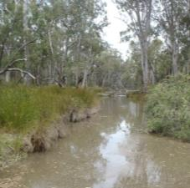
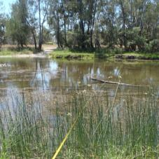
Spawning habitat in our catchments
Where is it?
What is it made of?
What depth and flow velocity provides access to habitat?
How does this relate to discharge at the relevant gauge?
Notes:
Where do SLFSF spawn in the Condamine-Balonne, Moonie and Border Rivers catchments?
How do we recognise spawning habitat?
What is the characteristic stream depth: width ratio?
What flow at the downstream gauge represents stable low flows at the spawning habitat?

Slide 7
Sites
Selection Criteria
SLFSF present
SLFSF at risk
Floodplain Assessment Reach
IQQM flow data available
Notes:
Field sites:
We selected sites where:
Fish monitoring showed that SLFSF were present
Changes in the flow regime due to water resource use indicated that it was likely that spawning opportunities had decreased
Were within zones where stream flows were well represented by flows at flow gauges (Floodplain Assessment Reaches)
Model flow data for pre-development and full development were available.
The requirement for low velocity flows meant that:
Most sites were in creeks or in the upper catchment

Slide 8
Model Parameters
Temperature
Change in water level for
egg development
larvae development
Site specific discharge range to give low velocity flows
Upper threshold
Lower threshold
Notes:
The SLFSF plug-in for Ecomodeller requires:
A spawning temperature threshold – available from the literature
A measure of stability (change in water level) and duration of :
The egg development period
The larval development period
Available from the literature
Locally meaningful flow threshold for “low-flows”
Estimated as less than median flow (ROP)
In these intermittent streams, the median flow was often zero.
Upper and lower thresholds based on site specific data are more meaningful.
Where temperature, flow and habitat conditions are appropriate, SLFSF are considered to have an opportunity to spawn.

Slide 9
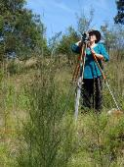
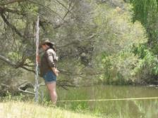
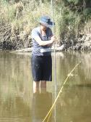
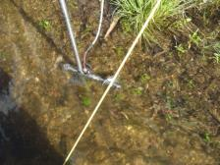
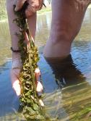
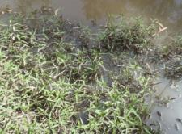
Methods
Cross-sections
Flow velocity
Plant species presence / absence and depth
Spawning habitat structure % cover and depth
Water Quality
Notes:
Methods:
Surveying
Current meter (wading)
Belt transects
YSI sonde WQ probe
Discharge calculations

Slide 10
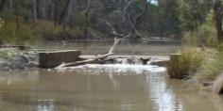
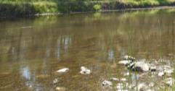
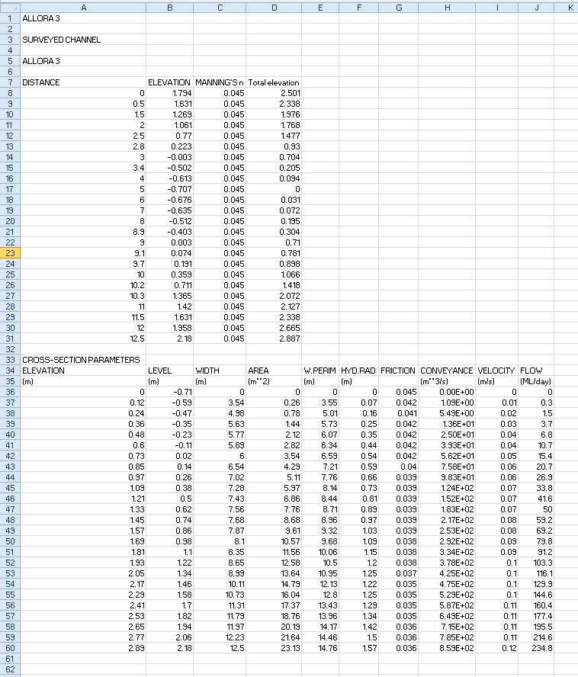
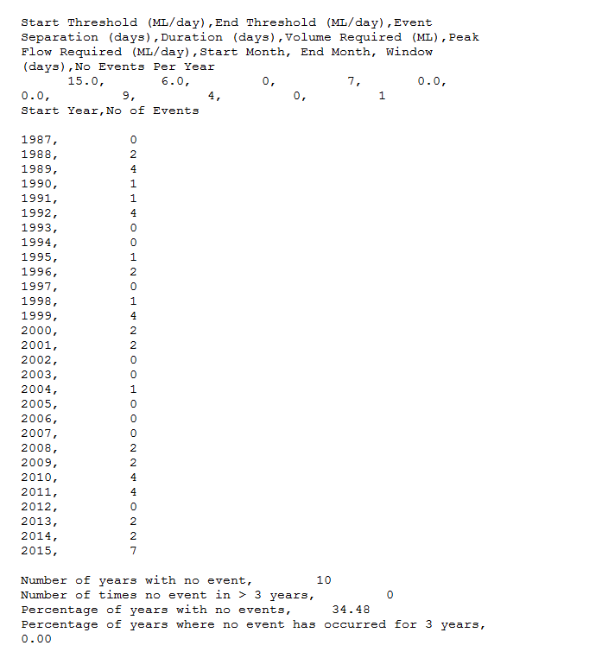
Same discharge – Different velocity
Gauging weir
Spawning habitat
Flow
Gauge Discharge
“Spell 6”
Narrow and deep
Higher velocity
Wide and shallow
Lower velocity
Spawning Opportunities
Manning’s equation
“Cross 2”
Notes:
Spawning habitat is located at broad shallow stream sections
Gauges are located in deep narrow reaches
Used DOS based flow models (Paul Harding – DSITI)
CROSS2 uses Manning’s equation to derive lower “low-flow” thresholds (ML/day) from cross-sections and flow velocity.
SPELL6 uses flow thresholds, stable period duration and start and finish months to calculate annual spawning opportunities.

Slide 11
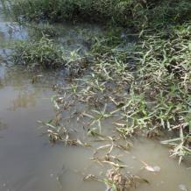
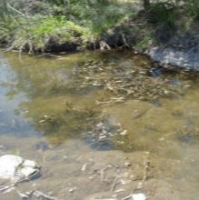
Results
Different sites have different types of habitat and water quality and may need different flow rules.
Sites with submerged macrophytes may have more spawning opportunities than we thought.
Chinchilla
Roseneath
Turbid
Riparian veg
Rigid
Water level ↑
eggs drown
Water level ↓
eggs dry out
Needs water level rise to make habitat available. Old stability rules OK.
Clear
Submerged veg
Flexible
Water level ↑
eggs drown
Water level ↓
eggs OK
Greater downward fluctuation in water level is permissible.

Slide 12
Conceptual model
Where we have different habitat conditions, we should use different flow thresholds and different stability rules
So we updated the conceptual model

Slide 13
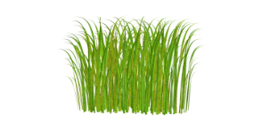
Turbid Conditions → Non-living Substrates
Threshold = low flow band (riffle + 30 cm)
Water Level fluctuation ±5 cm
Turbid Conditions → Rigid Plants
Threshold = riparian vegetation inundated
Water Level fluctuation ±5 cm
Upper threshold
Lower threshold
Lower threshold
No flow
Clear Conditions → Flexible Plants
Threshold = vegetation root depth + >20 cm
Water Level Increase of 5 cm
Water Level Decrease of > 5 cm
All conditions
Low water velocity
Temperature above spawning threshold
Notes:
All SLFSF require low flow velocity (<0.1 m/s) and suitable temperatures.
Some fish are able to spawn under no-flow conditions, scattering their eggs on cobbles or other substrates, provided that pools contain water.
Where streams are turbid
There are no submerged macrophytes. Eggs are attached to submerged branches and trees, close to the water level.
Upper flow thresholds should provide <0.1m/s flows at the spawning site.
After eggs are laid, increasing water levels may leave the eggs too deep where there is not enough oxygen, decreasing water levels may allow the eggs to dry out or be eaten.
In turbid streams with marginal vegetation:
Following the dry winter, water levels must increase to submerge these plants.
Eggs attached to vegetation near the banks, close to the water surface.
As these structures are rigid, water level changes affect eggs in the same way as for non-living substrates.
Where streams are clear:
Submerged vegetation is likely to be present.
This is high quality nursery habitat – food, cover, low velocity.
Water depth must be at least 20 cm to allow submerged macrophytes to establish (lower threshold).
These plants are flexible, so eggs are attached to them remain submerged as the water levels falls.
This allows greater latitude for decreasing in water levels before eggs become exposed → a relaxed stability threshold.

Slide 14
SLFSF Eco-modeller Plug-in
Risk assessments for SLFSF in the Condamine-Balonne and Border Rivers WP areas are underway.
Outcomes of SLFSF I inform:
Distribution
Temp thresholds
Duration of stable flow
Outcomes of SFLSF II provide an understanding of when relaxed stability thresholds can be applied.
Our colleagues at DSITI brought in Nick Marsh (eWater) to modify the SLFSF Ecomodeller plug-in.
Where habitat information is available, the updated model can be used.

Slide 15
Water Planning Implications
EcoHydraulic rules will be adapted to incorporate the new understanding of the needs of SLFSF in FARs where we have habitat data.
The needs of SLFSF can now be considered in developing revised Environmental Flow Objectives (EFO)
The outcomes of the SLFSF I & II projects provide sufficient information to add a new ecological outcome to the Water Plans of the Condamine-Balonne and Border Rivers following their review.

Slide 16
Knowledge Gaps – Future Projects
Expand spatial scope
Collect habitat data for FARs not covered under these two projects
Validation
Sample fish larvae downstream of spawning habitat patches
Habitat mapping
Improve knowledge of life history
Population genetics
Sex ratio
Fecundity
Movement

Slide 17
Questions?

