Slide 1
Modelling population dynamics of fish in the Murray-Darling Basin- from local to Basin scale
John Koehn, Arthur Rylah Institute, DELWP, Victoria
Charles Todd
Ivor Stuart
Brenton Zampatti
Stephen Balcombe
Clayton Sharpe
Joshua Barrow
Scott Raymond
Jamin Forbes
Wayne Koster
David Moffatt
Jason Thiem
Large scale population dynamics of an enigmatic fish

Slide 2
The Basin Plan – A key management driver
Delivers environmental water to the Murray-Darling Basin
Native fish are a key asset
There is a need for tools to assist water plans
There is a need to demonstrate benefits of flows
Project Objective:
Develop flow-related population models for eight MDB fish species to help predict likely outcomes

Slide 3
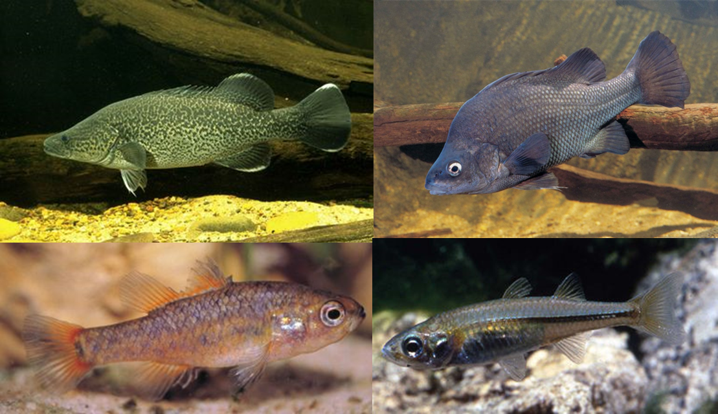
Software developed for MDBA
An application of
ESSENTIAL by Charles Todd Applied Aquatic Ecology ARI
MDBA Native Fish Population Models
Version 2.20, 20 th April 2017

Slide 4
The species and models
Eight native species: Murray cod, Trout cod, Golden perch, Silver perch, Macquarie perch, Murray hardyhead, Southern pygmy perch, Olive perchlet
Applied basin-wide
Stage-based models
Applicable to the individual species
Consider each life stage
Built on the very latest ecological concepts and data
Consider all threats

Slide 5
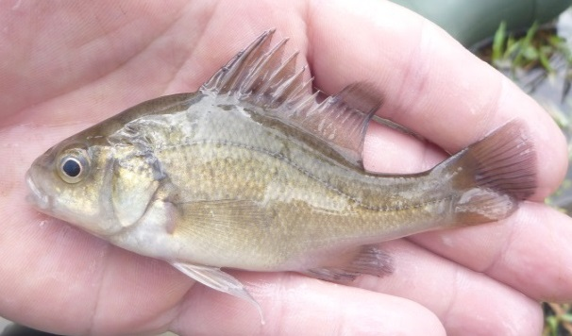
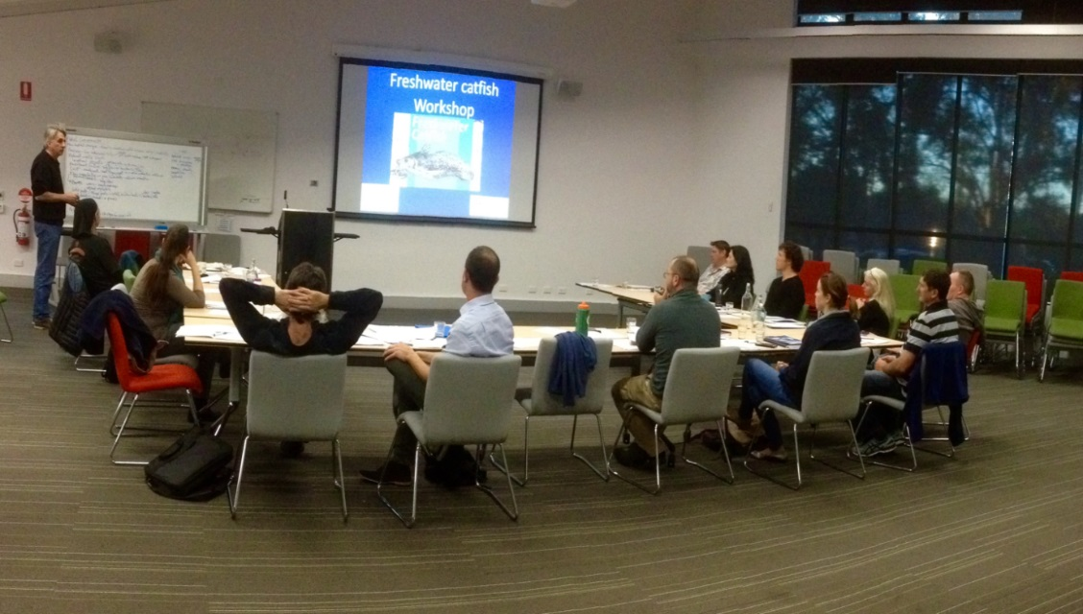
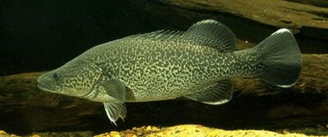
Underpinning knowledge
Collate latest knowledge, concepts, data
27 workshops; 60+ ecological experts and managers
Agreed ecological understanding
Applied to the management needs

Slide 6
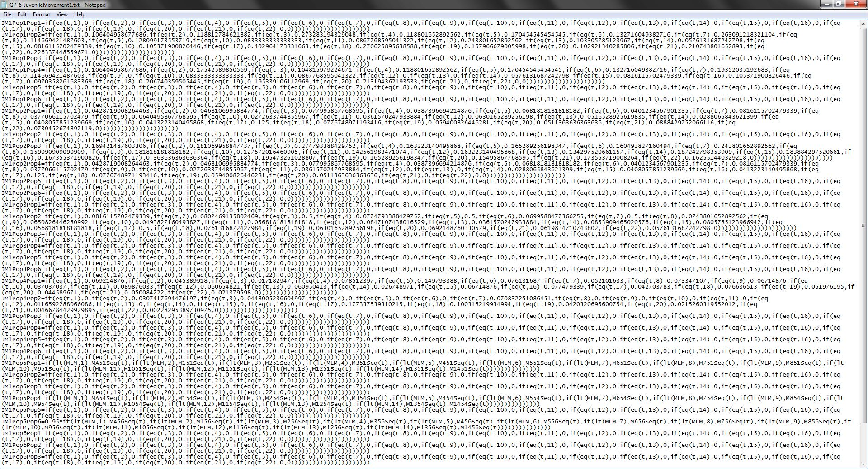
Converting ecology into mathematics

Slide 7
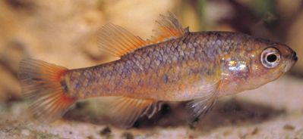
Southern pygmy perch
Small wetland species
Fragmented populations
Low numbers
Habitat specific species
Threats: Redfin and carp, high flow habitat destruction
Candidate for protection and re-introductions rather than natural recolonisation
Population viability-type model at local sites scale: (new and donor populations)

Slide 8
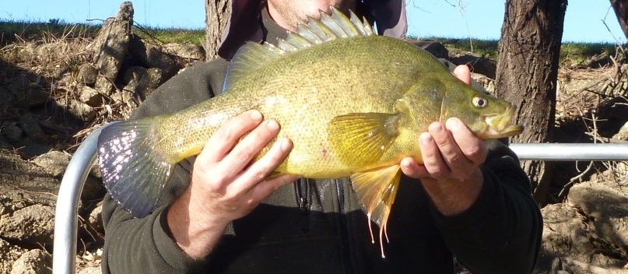
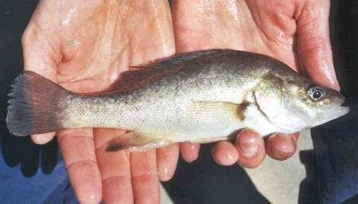
Golden perch
Widespread, highly mobile at all life stages
Flow-specific species
New knowledge of the lifecycle
Large spatial scales
Many barriers in the MDB
Use of nursery areas???
Angler take
Basin-wide approach

Slide 9
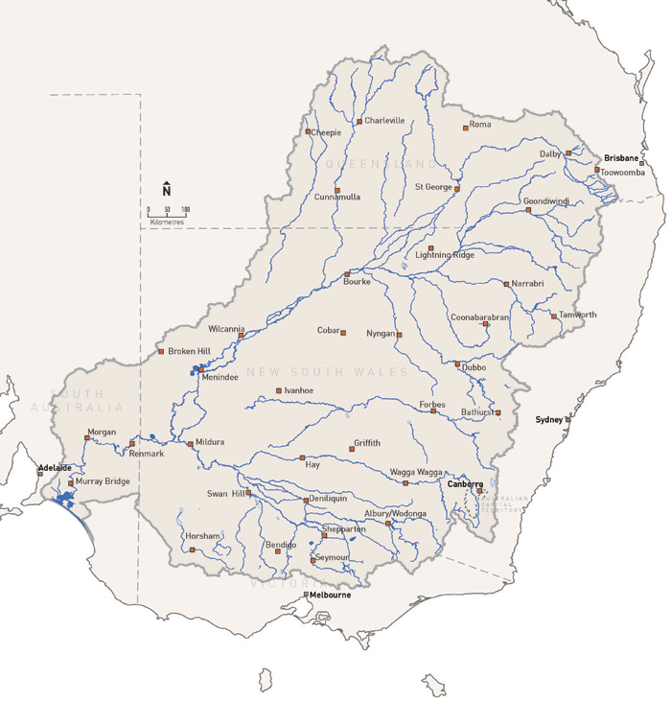
Importance of new knowledge
Golden perch
Large upstream adult (pre spawning?) movements
Downstream egg and larval drift
Upstream recolonization of juveniles- in pulses
Adult movements dramatically changing population structure
Juvenile downstream movements
All linked to flows

Slide 10
Population connectivity for Golden perch
Scale:
whole of Basin management
Menindee lakes
P6
P5
P4
P1
P2
P3

Slide 11
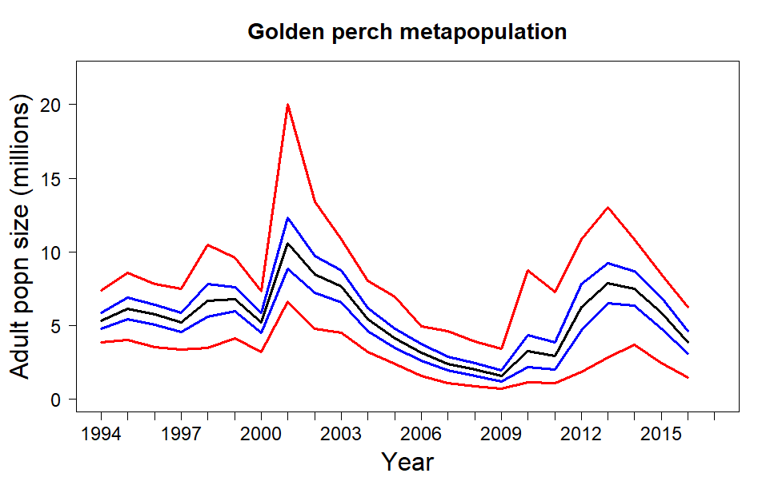
Model outputs

Slide 12
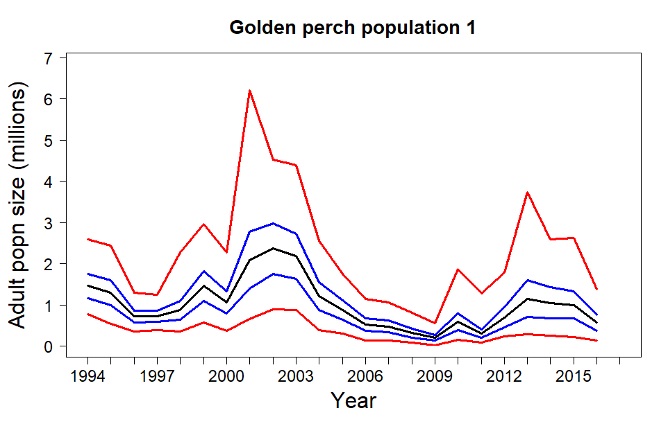
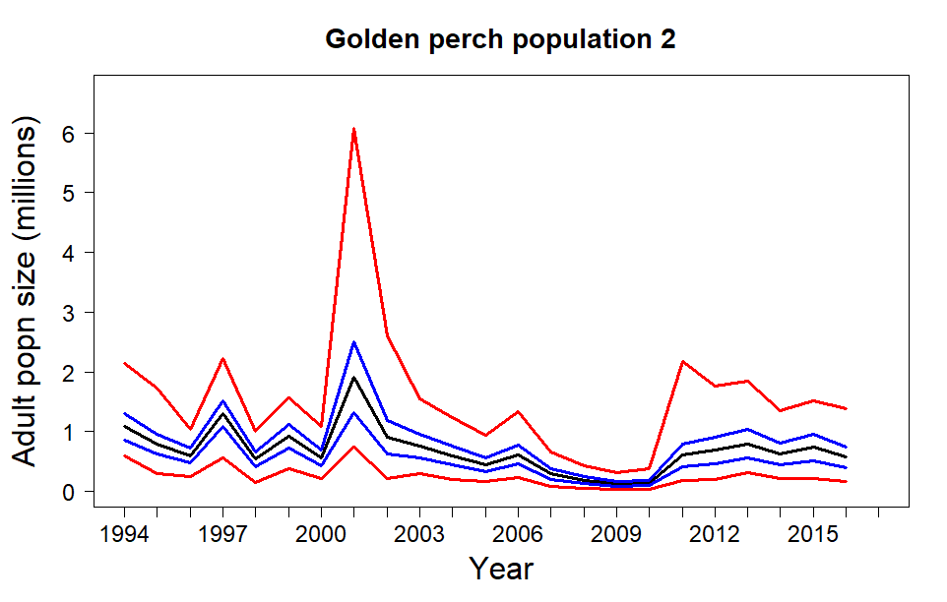
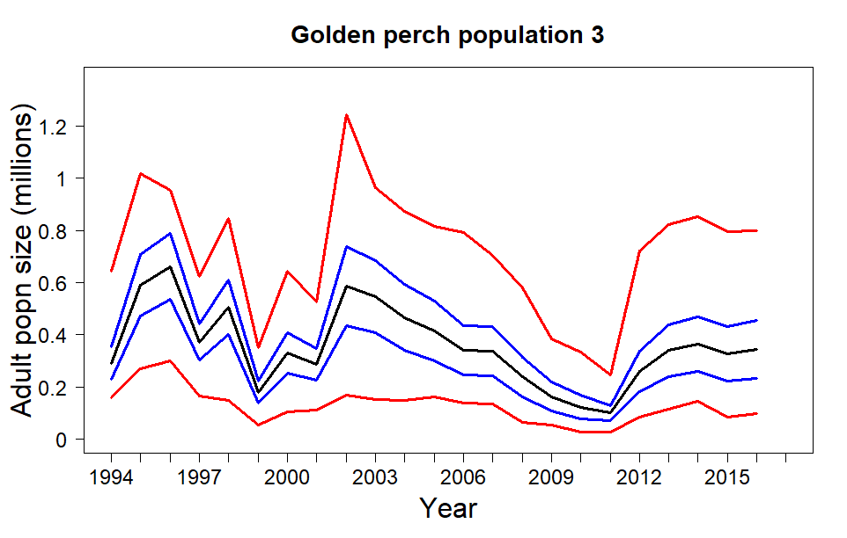
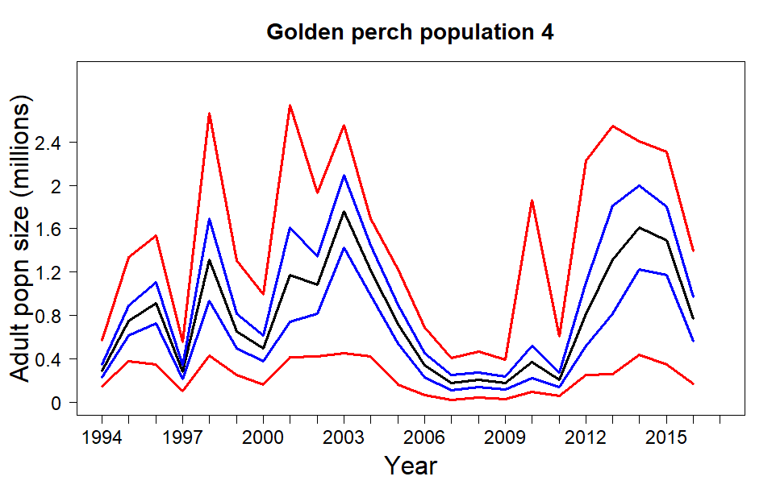
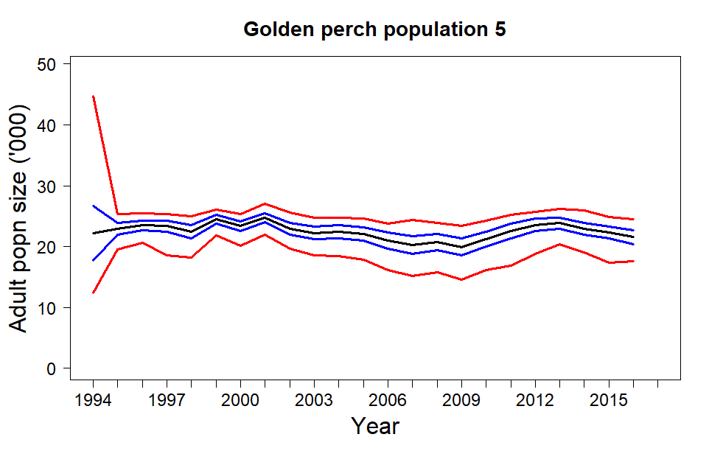
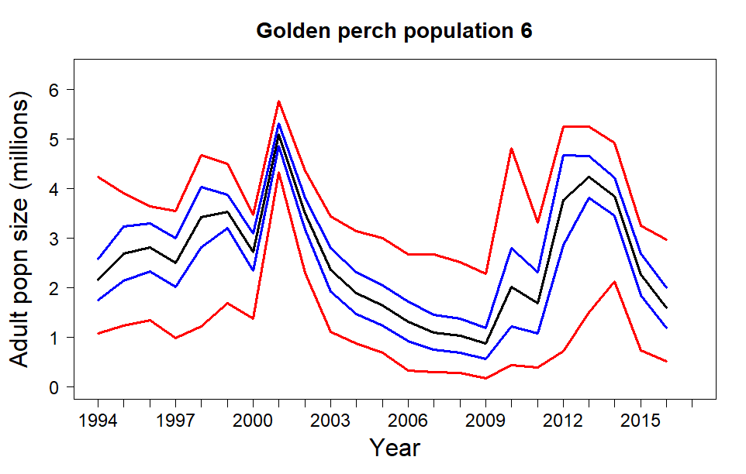
Model outputs
Lower Murray R
Mid Murray R
Mid-upper Murray R
Lower Darling R
Darling just above Menindee
NMDB

Slide 13
Menindee lakes on
NMDB
Lower Murray R

Slide 14
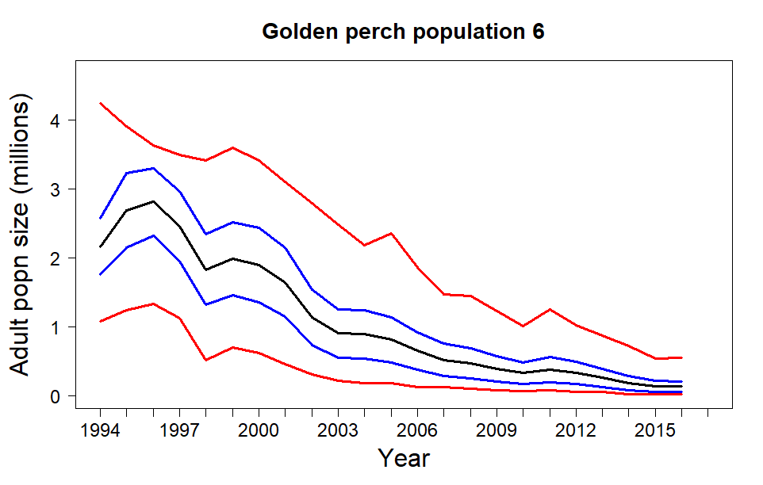
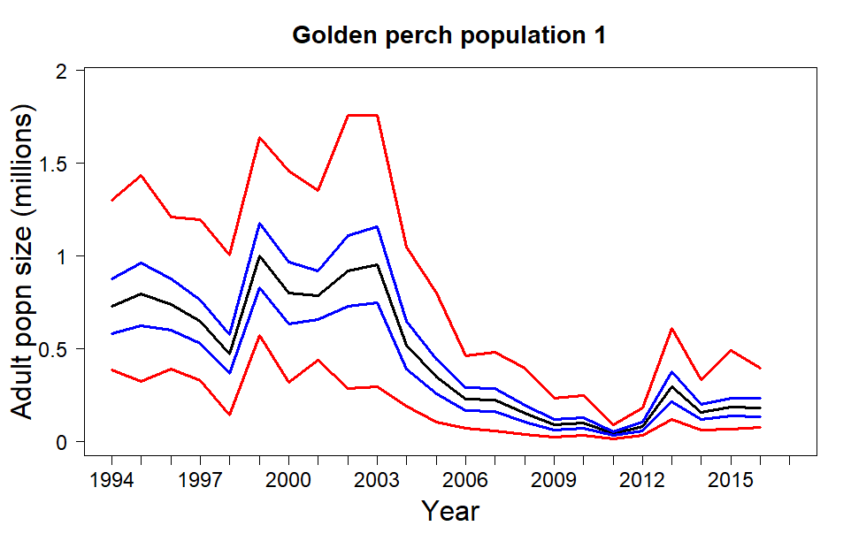
Menindee lakes off
NMDB
NMDB
Lower Murray R
Lower Murray R

Slide 15
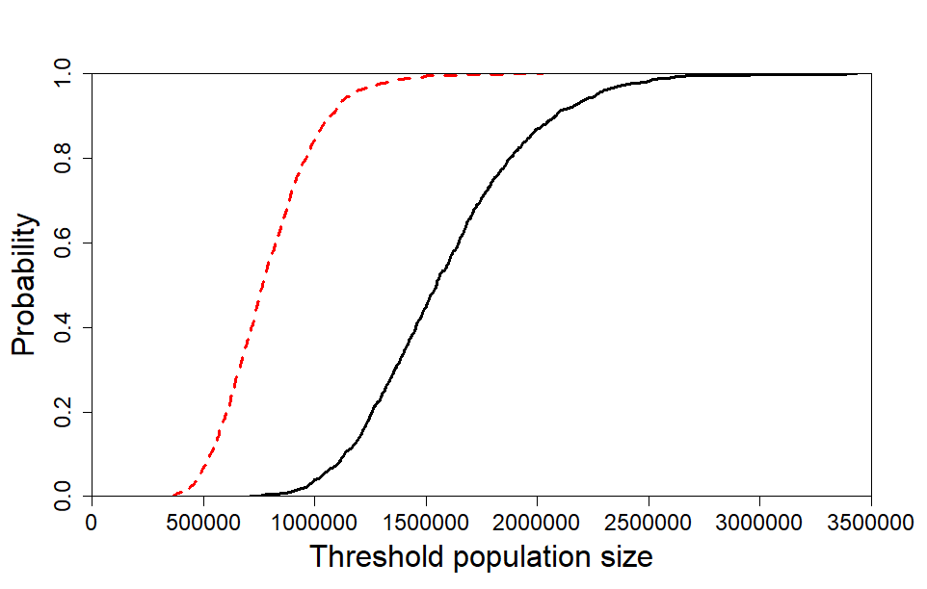
Risk to populations
Added risk

Slide 16
Messages vital to GP management
Flows, connectivity and large scale are vitally important
A significant decline in flows in the northern basin will impact Golden perch in the southern Basin
Operation of Menindee Lakes influences GP populations across all the Basin

Slide 17
Overall conclusions
Population models allow for threat and flow management options to be methodically examined within the risk framework
Models need to be species-specific and anchored by the latest ecology
The must be constructed and utilized at appropriate scales
Can be used to assess outcomes of competing management actions

Slide 18
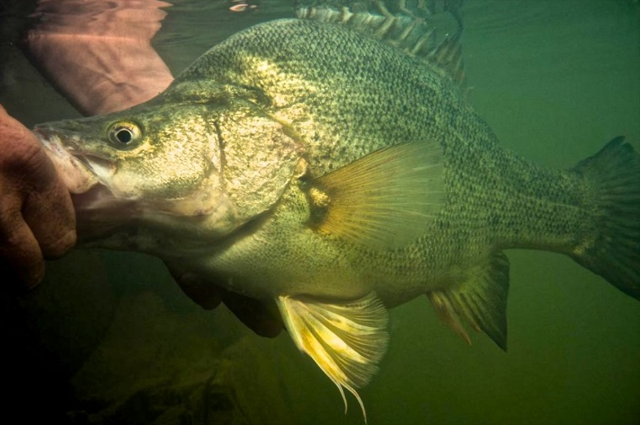
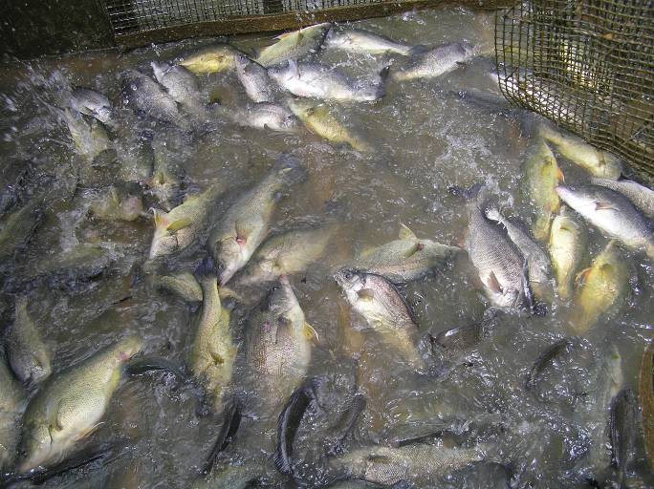
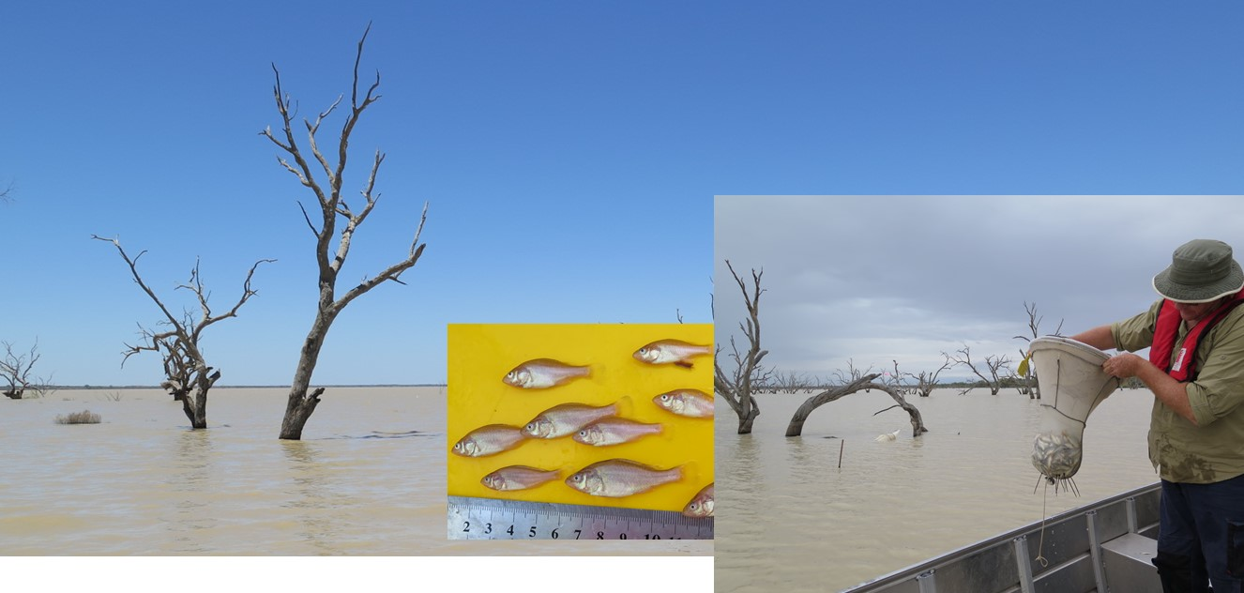
Thank you
Charles Todd: Arthur Rylah Institute, DELWP, Heidelberg, Victoria
charles.todd@delwp.vic.gov.au
John Koehn: Arthur Rylah Institute
Ivor Stuart: Arthur Rylah Institute
Brenton Zampatti : South Australian Research and Development Institute, West Beach, SA
Clayton Sharpe: CPS Enviro P/L, Irymple, Victoria
Joshua Barrow: School of BioSciences, Melbourne University, Parkville, Victoria
Scott Raymond: Arthur Rylah Institute
Stephen Balcombe: Australian Rivers Institute, Griffith University, Nathan, QLD
Jamin Forbes: NSW Department of Primary Industry, Fisheries, Narrandera, NSW
Wayne Koster: Arthur Rylah Institute
David Moffatt: Environmental Monitoring and Assessment Science, DESITA, Brisbane, QLD
Jason Thiem: NSW Department of Primary Industry, Fisheries, Narrandera, NSW
Special thanks to MDBA and in particular Heleena Bamford and Stuart Little, and thanks to steering committee members Tony Townsend and Peter Jackson
Thanks also to the participants of the two Golden perch workshops: Stuart Little, Ryan woods, James Fawcett, Steven Brooks, Peter Kind, Kate Hodges, Gavin Butler, Jaye Lobegeiger, Michael Hutchison, Norbert Menke, Andrea Prior, Jonathan Marshall , Peter Jackson, Andrew Norris, Tony Townsend, Heleena Bamford , Brett Ingram, Martin Mallen-Cooper, Matt McLellan, Chris Bice and Iain Ellis.

