Slide 1





Hydropower by Design:
system-scale solutions for sustainable energy,
river conservation, and environmental flows
Jeff Opperman, WWF
Justus Raepple and Eloise Kendy, TNC
Joerg Hartmann
B.Besaw
BRISBANE, AUSTRALIA | 18 - 20 SEPTEMBER 2017
MANAGED BY

Slide 2
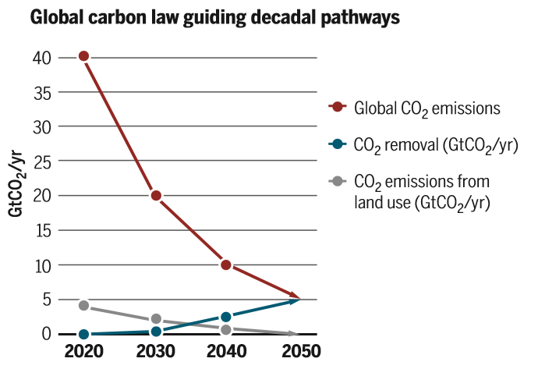

Rockstrom et al. 2017
BRISBANE, AUSTRALIA | 18 - 20 SEPTEMBER 2017
MANAGED BY

Slide 3
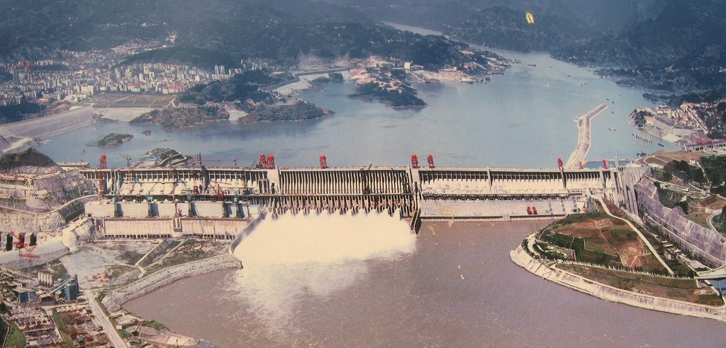
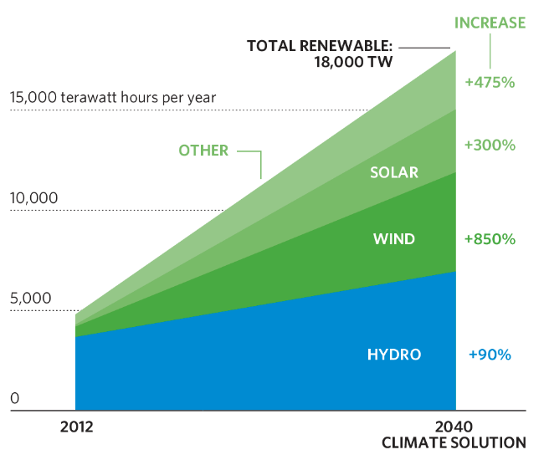
BRISBANE, AUSTRALIA | 18 - 20 SEPTEMBER 2017
MANAGED BY

Slide 4
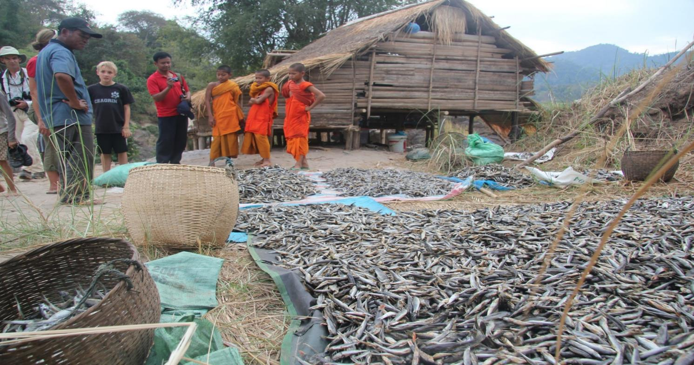
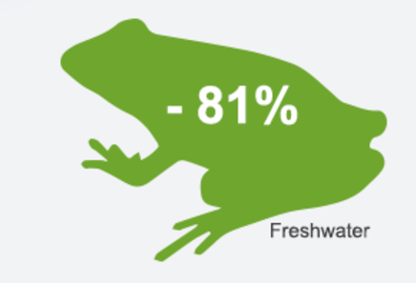
BRISBANE, AUSTRALIA | 18 - 20 SEPTEMBER 2017
MANAGED BY

Slide 5



Global climate-energy-nature challenge:
+
= ?
+
BRISBANE, AUSTRALIA | 18 - 20 SEPTEMBER 2017
MANAGED BY

Slide 6
Hydropower by Design
A comprehensive and system-scale approach;
Applied at the earliest stages of development planning;
Integrates other sectors, as well as environmental and social values;
Promotes sustainability and optimizes the delivery of multiple benefits.
BRISBANE, AUSTRALIA | 18 - 20 SEPTEMBER 2017
MANAGED BY

Slide 7
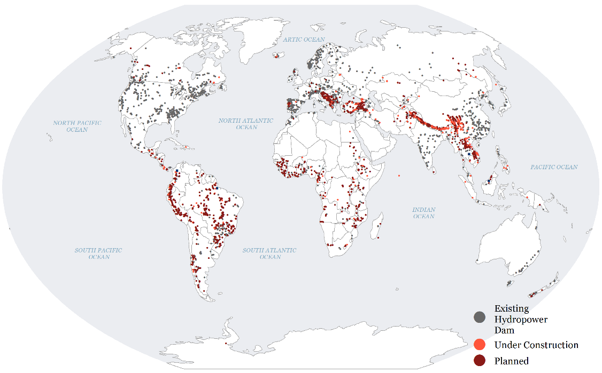
Environmental Benefits – global potential
BRISBANE, AUSTRALIA | 18 - 20 SEPTEMBER 2017
MANAGED BY

Slide 8
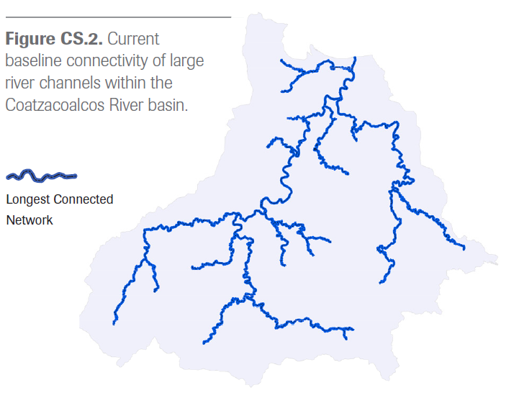
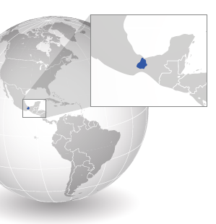
Environmental Benefits:
Coatzacoalcos River Basin, Mexico
BRISBANE, AUSTRALIA | 18 - 20 SEPTEMBER 2017
MANAGED BY

Slide 9
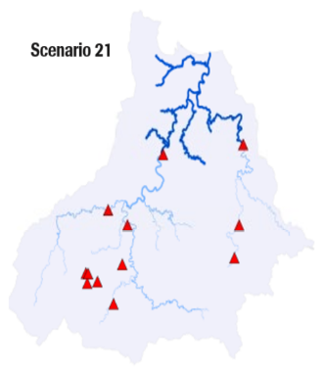
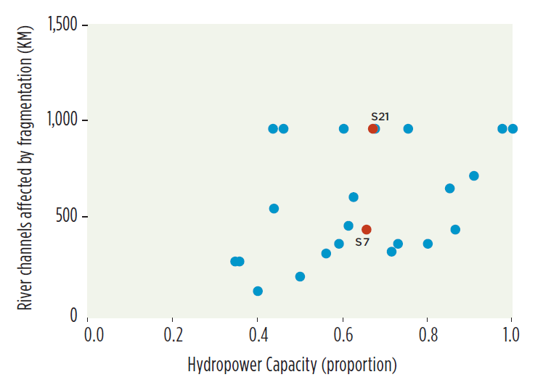
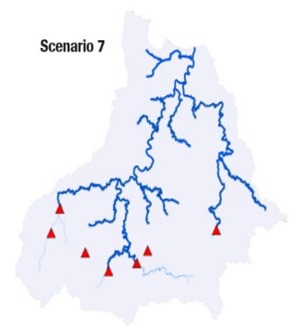
Environmental Benefits:
Coatzacoalcos River Basin, Mexico
Hydropower and fragmentation
BRISBANE, AUSTRALIA | 18 - 20 SEPTEMBER 2017
MANAGED BY

Slide 10
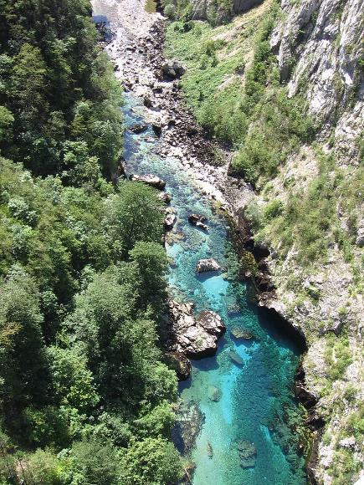
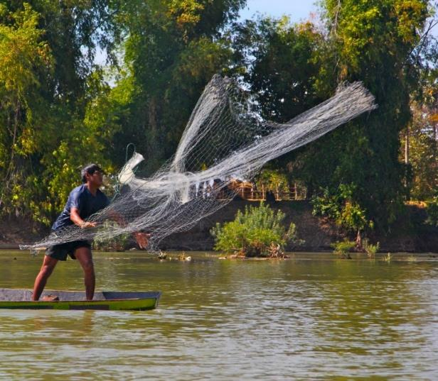

Environmental Benefits:
At the global scale, application of Hydropower by Design could reduce the amount of river length lost to fragmentation by approximately 100,000 kilometers compared to business-as-usual approaches
BRISBANE, AUSTRALIA | 18 - 20 SEPTEMBER 2017
MANAGED BY

Slide 11
But….will that be persuasive?
BRISBANE, AUSTRALIA | 18 - 20 SEPTEMBER 2017
MANAGED BY

Slide 12
But….will that be persuasive?
Economic value to countries
Financial value to developers and investors
Feasible to implement
BRISBANE, AUSTRALIA | 18 - 20 SEPTEMBER 2017
MANAGED BY

Slide 13
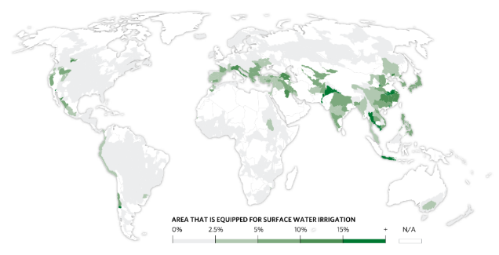
Economic value to countries
Irrigation within hydropower-influenced basins
Sector | Economic value ($B)
Irrigation | 100 - 410
Flood management | 20 - 40
Water supply | 160 - 320
Total | 280 - 770
BRISBANE, AUSTRALIA | 18 - 20 SEPTEMBER 2017
MANAGED BY

Slide 14
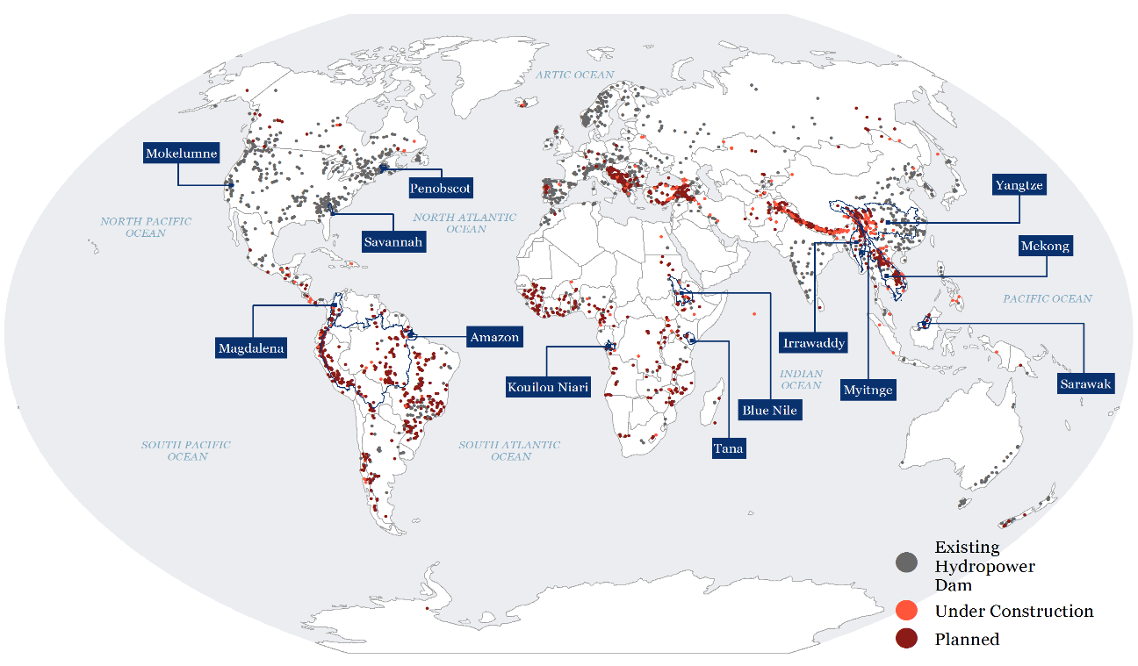
BRISBANE, AUSTRALIA | 18 - 20 SEPTEMBER 2017
MANAGED BY

Slide 15
Economic Benefits
Six case studies included another water-management service (irrigation, flood management, water supply)
BRISBANE, AUSTRALIA | 18 - 20 SEPTEMBER 2017
MANAGED BY

Slide 16
Economic Benefits
Six case studies included another water-management service (irrigation, flood management, water supply)
All showed potential improvement in other service, ranging from 10 – 50%
BRISBANE, AUSTRALIA | 18 - 20 SEPTEMBER 2017
MANAGED BY

Slide 17
Economic Benefits
Six case studies included another water-management service (irrigation, flood management, water supply)
All showed potential improvement in other service, ranging from 10 – 50%
Average improvement: 23%
Median improvement: 18%
BRISBANE, AUSTRALIA | 18 - 20 SEPTEMBER 2017
MANAGED BY

Slide 18
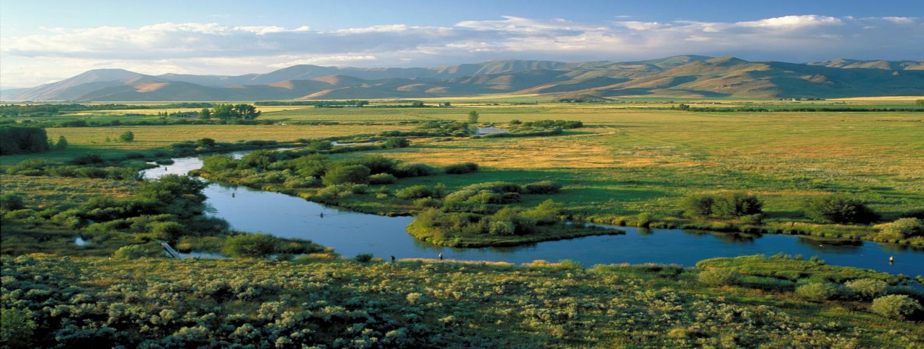
Even a 5% improvement in performance for other water-management sectors would equal up to $40 billion per year in economic value globally
H. Malde
BRISBANE, AUSTRALIA | 18 - 20 SEPTEMBER 2017
MANAGED BY

Slide 19
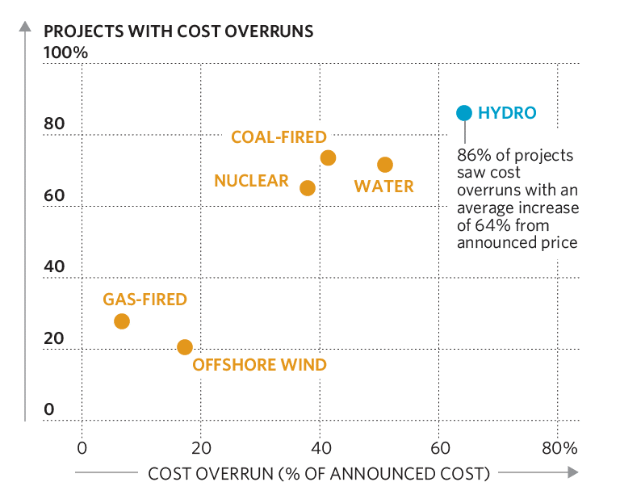

Financial Benefits
Hydropower projects have greater cost overruns than other large infrastructure projects
Friends of the Earth International
BRISBANE, AUSTRALIA | 18 - 20 SEPTEMBER 2017
MANAGED BY

Slide 20
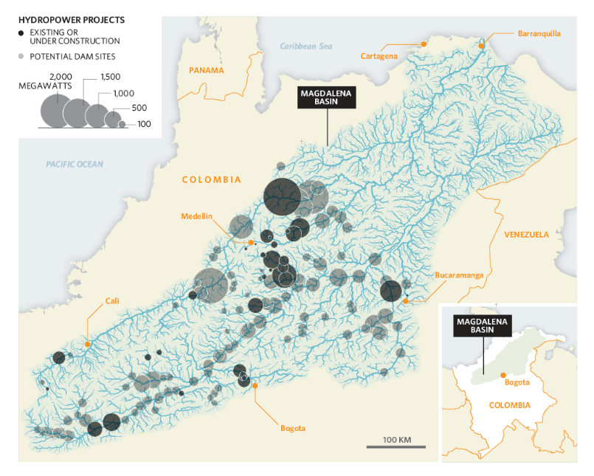
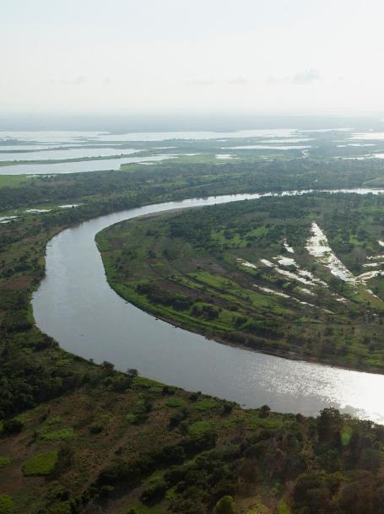
Financial Benefits:
Magdalena River Basin, Colombia
BRISBANE, AUSTRALIA | 18 - 20 SEPTEMBER 2017
MANAGED BY

Slide 21
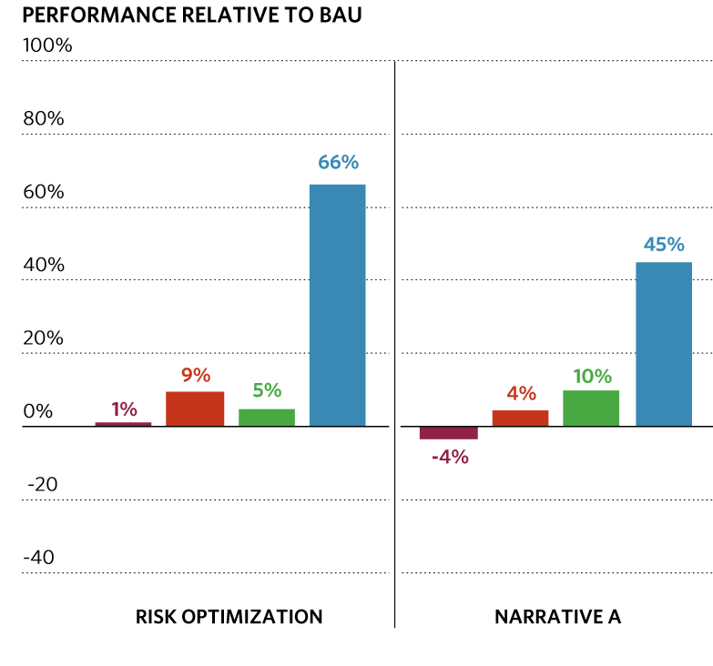


Financial Benefits
Projects selected through Hydropower by Design had higher Internal Rate of Return (IRR)
BRISBANE, AUSTRALIA | 18 - 20 SEPTEMBER 2017
MANAGED BY

Slide 22
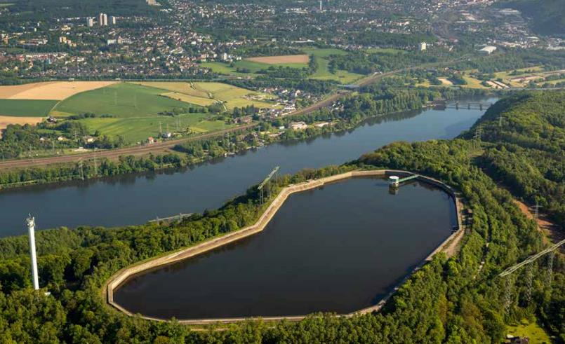

From “hydropower by design” to
“energy systems by design”
BRISBANE, AUSTRALIA | 18 - 20 SEPTEMBER 2017
MANAGED BY

