Slide 1
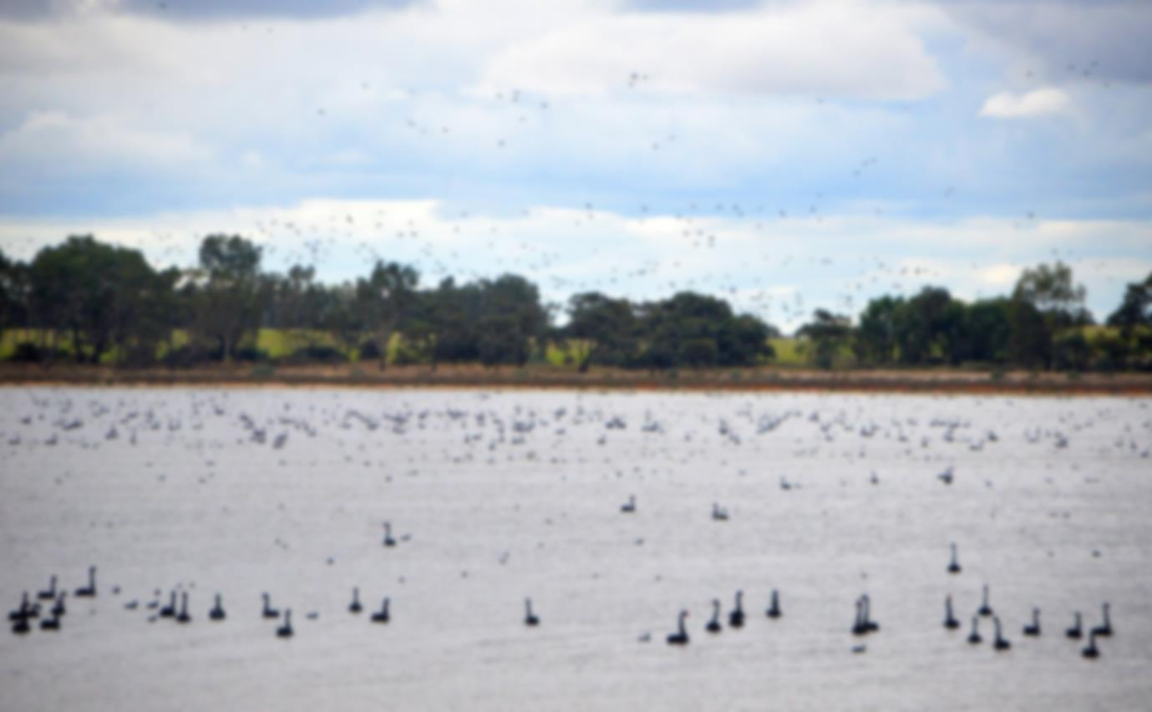
Making a big difference for a little fish (Murray hardyhead)
Amy Russell,
North Central Catchment Management Authority
BRISBANE, AUSTRALIA | 18 - 20 SEPTEMBER 2017
MANAGED BY
Notes:
Introduce self
NCCMA – 14% of Victoria

Slide 2
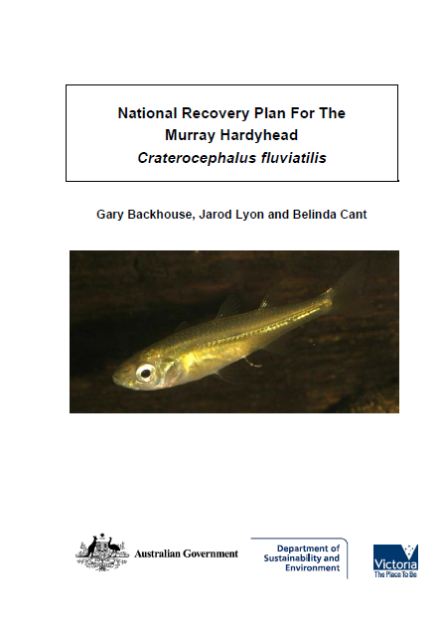
National Murray hardyhead Recovery Plan
Goal: Ensure that no wild populations become extinct.
Project aim: Manage environmental water delivery to Lake Elizabeth to maintain water quality and habitat suitable for Murray hardyhead.
BRISBANE, AUSTRALIA | 18 - 20 SEPTEMBER 2017
MANAGED BY

Slide 3
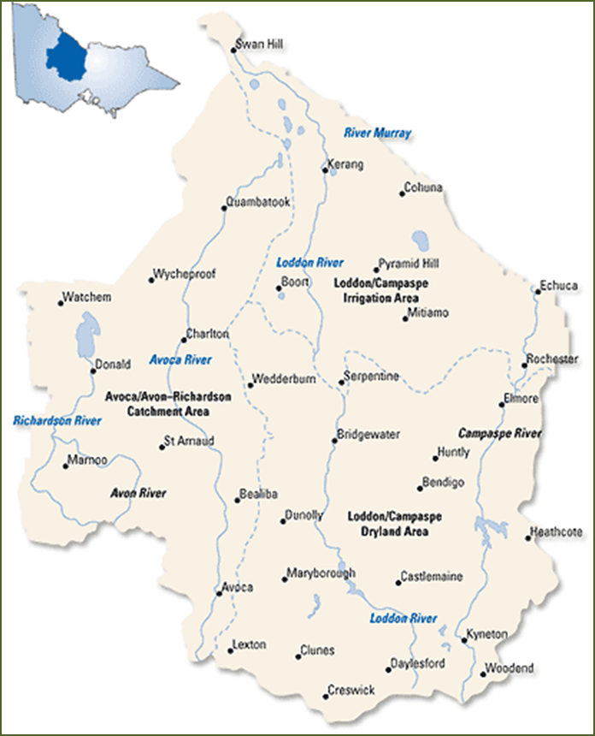
Project site:
Lake Elizabeth, Northern Victoria
Features:
Located in the Kerang Lakes area
Highly saline lake (100,000 EC +)
94 ha
Historically hosted a number of fish species
Land manager - Parks Victoria
State Wildlife Reserve
Melbourne
BRISBANE, AUSTRALIA | 18 - 20 SEPTEMBER 2017
MANAGED BY
Notes:
Lake Elizabeth is just over 3 hrs North of Melbourne and is part of the Kerang Lakes. The lake is managed by Parks Victoria, listed as a state wildlife reserve and 94ha in size. The Lake is highly saline with levels reaching about 100,000 EC when left to draw down naturally.
Environmental water is managed by the North Central CMA and delivered by GMW
Hosted a number of native fish species including MHH

Slide 4
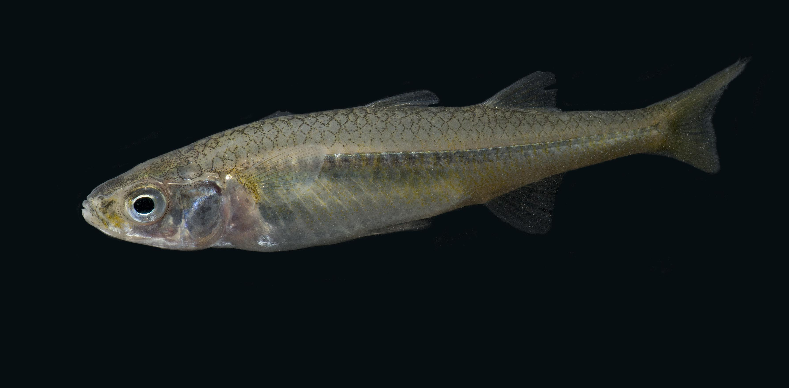
Murray Hardyhead (Craterocephalus Fluviatilus)
Photo credit: David Paul, Museums Victoria
Murray hardyhead is a critically endangered small bodied native fish species
Less than 10 populations left in the world
These fish are only found in the Murray Darling Basin
BRISBANE, AUSTRALIA | 18 - 20 SEPTEMBER 2017
MANAGED BY
Notes:
Critically endangered – facing an extremely high risk of extinction in the wild
MHH is a highly threatened small bodied native fish species with less than 10 populations left in the MD Basin, therefore the world
The fish grows to a maximum 85mm and has a lifespan of about 18 months (in captivity)

Slide 5
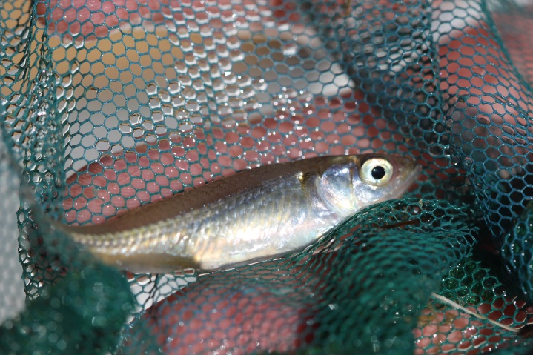
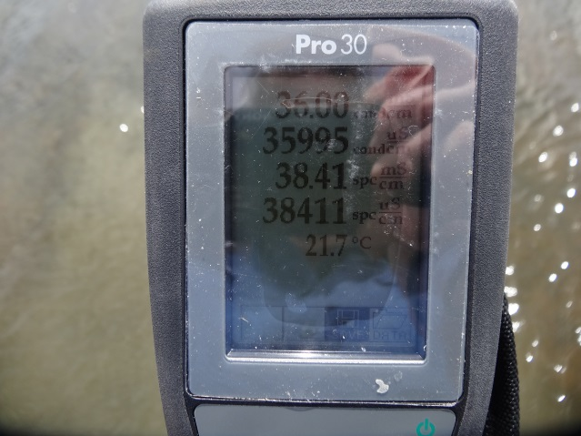
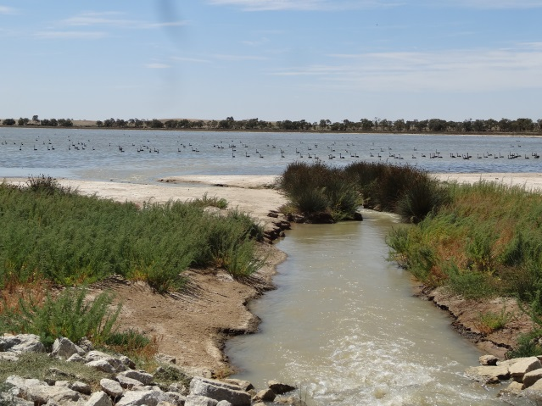
How did this trio come about to form this project?
A critically endangered species
A saline lake
Environmental water
BRISBANE, AUSTRALIA | 18 - 20 SEPTEMBER 2017
MANAGED BY
Notes:
MHH were first recorded in Lake Elizabeth in 1974 and found up until 2002.
The fish were being breed in a captive breeding program and attempt to further strengthen populations a translocation of the fish was looked into.
Surveys were conducted to find suitable locations to translocate populations of the fish, the fish can tolerate high EC’s and therefore by keeping the EC high it would keep predators at bay, giving the fish a greater chance of survival.
A site needed to be found that environmental water could be delivered to and salinity levels could be managed.
Lake Elizabeth was selected as populations of MHH were previously found there, it had the right habitat conditions, could easily be connected to the channel system so ewater could be delivered and it was highly saline.
The question about salinity levels and salt loads was still a big question and a lot of work would have to be done before the fish could be translocated into the lake.
A simple spreadsheet model was developed to consider evaporation and seepage loss
The research led to an environmental watering regime based on adaptive learning

Slide 6
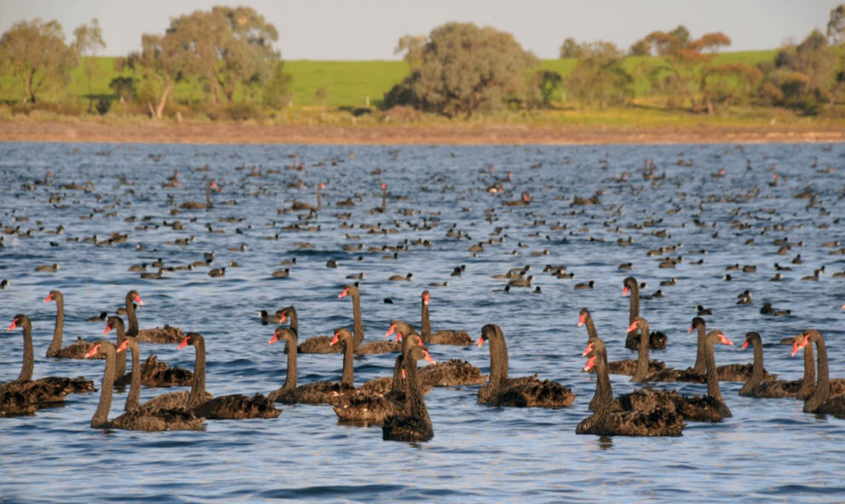
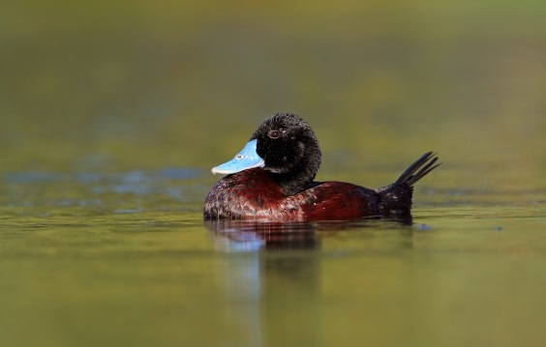
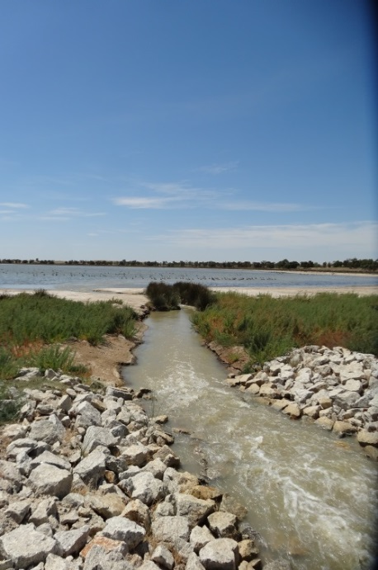
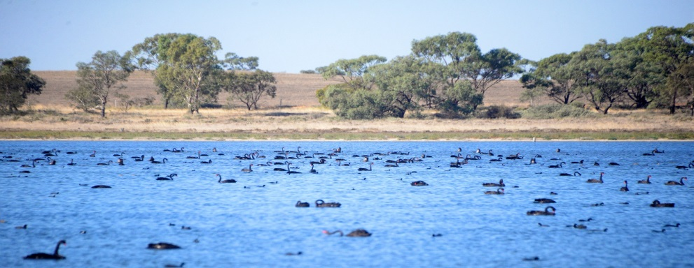
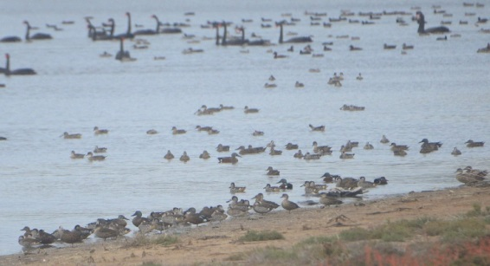
Environmental water delivery
First delivery in 2014
Managing EC between 25,000-35,000
Complementary benefits
BRISBANE, AUSTRALIA | 18 - 20 SEPTEMBER 2017
MANAGED BY
Notes:
First delivery of ewater was in 2014
EC and gauge heights are regularly monitored at the lake to have a better understanding of what is actually happening when large volumes of water are put into the lake.
Managing the lake between 25-35,000 EC, the lake is managed at this high EC level to discourage predators such as carp and gambuzia but also low enough for MHH to be able to reproduce.
By adaptive learning and management water is delivered at between 100-300 ML at a time to prevent freshening the lake too quickly and promoting conditions for predators such as gambuzia.
Working closely for project partners GMW and DELWP to monitor and deliver the water.
Complimentary benefits -
2013 = 500-1000 birds recorded on monitoring runs – 2017 = 20,000 + recorded
Field and Game use
Recreational use, bird watchers.

Slide 7
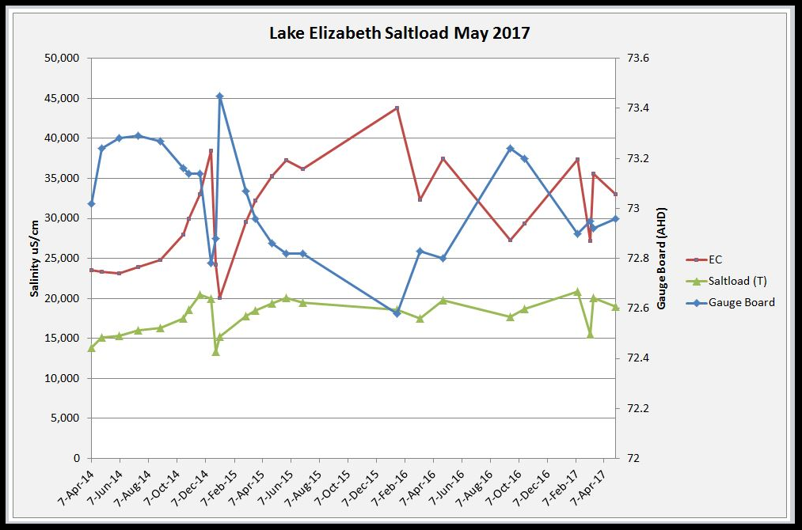
Lake Elizabeth salinity observations and findings
Loss of salt load into the water table after delivering large volumes of environmental water.
BRISBANE, AUSTRALIA | 18 - 20 SEPTEMBER 2017
MANAGED BY
Notes:
Studies by Phil D/Phil M
Landholders were also concerned about the rising level of the lake – would this mean the salt would have an impact on their crops?
Salt loads play a major factor into how much water needs to be delivered to reach our target goals
This study was all aimed at adaptive mgmt
There is usually about 15-20,000 tonnes of salt in the lake
What we found – there is groundwater intrusion (lake can not be dried out, and therefore there is a highly saline pool that is left after draw down)
How we come up with this graph – using the Bathemetry of the lake we took the volume at the time of interest and our salinity values to work out the salt loads

Slide 8
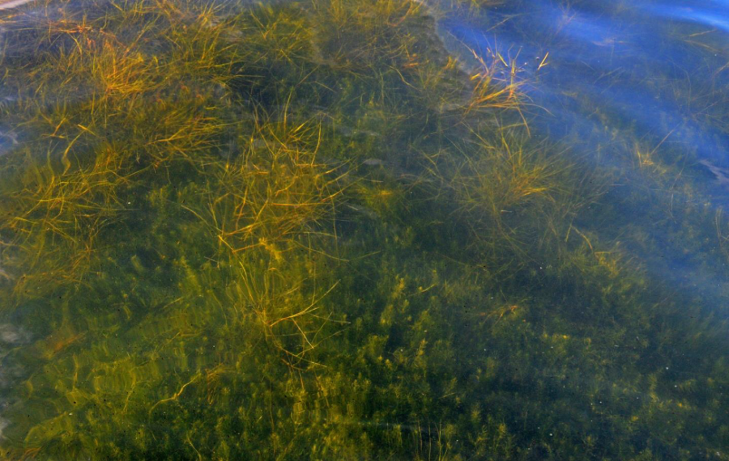
Results: Aquatic vegetation response
EVC benchmark – moderate to excellent
Vegetation coverage increase:
July 2013 = 1 ha
April 2015 = 65 ha
97% quadrats contained aquatic vegetation
Results: Aquatic vegetation response
BRISBANE, AUSTRALIA | 18 - 20 SEPTEMBER 2017
MANAGED BY
Notes:
Aquatic veg has reacted extremely well to the changed water regime
EVC benchmark – gone from ‘moderate’ to excellent since e-water has been delivered
Surveys were conducted before ewater and again after a couple of years of ewater delivery and results were extremely positive – 97% of quadrats contained aquatic veg (including ruppia which is a preferred habitat for MHH).
Aquatic veg coverage = July 2013 1 ha & April 2015 65 ha

Slide 9
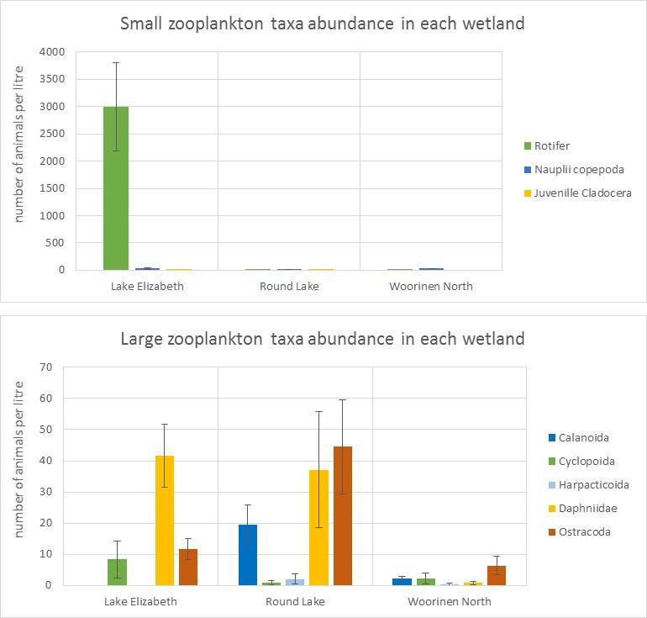
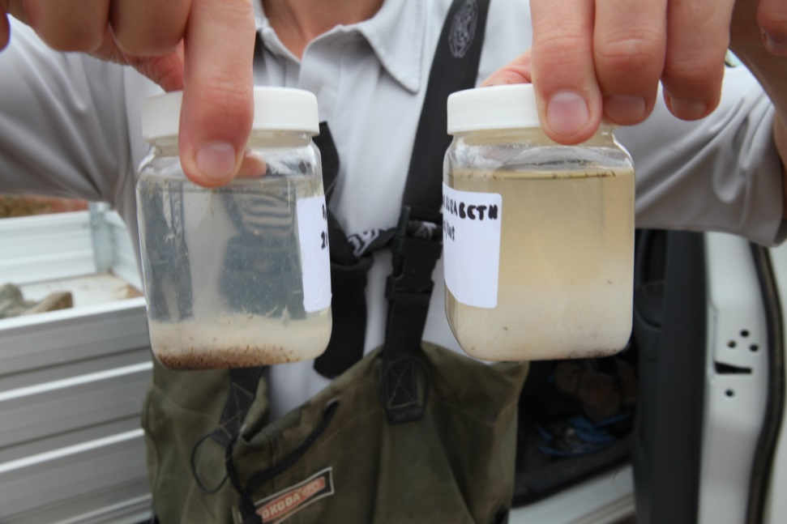
Results: Zooplankton sampling
*Lake Elizabeth sample on the right
BRISBANE, AUSTRALIA | 18 - 20 SEPTEMBER 2017
MANAGED BY
Notes:
The environmental water regime that has been used to manage the lake has seen some extremely positive zooplankton results. Especially with the small taxa. We wanted to make sure all our conditions were right before we put the fish in.
As you can see from the graphs in terms of small zooplankton our water regime was working extremely well (Rotifer is one of the MHH food source), numbers of the large zooplankton are good at both the sites that receive environmental water (the 3rd site tested does not receive ewater but contains MHH).

Slide 10
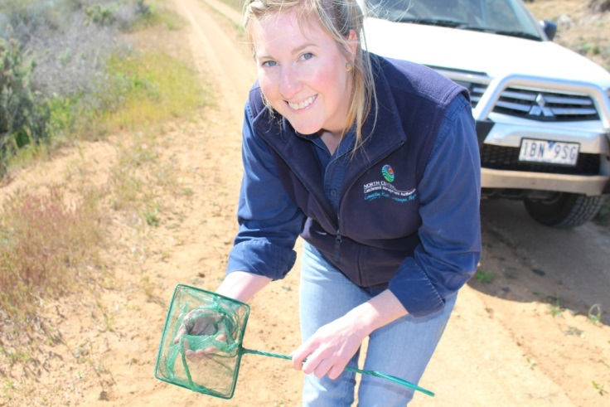
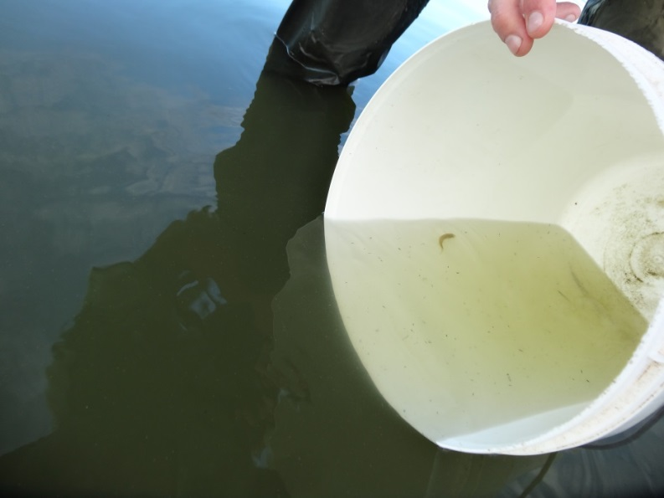
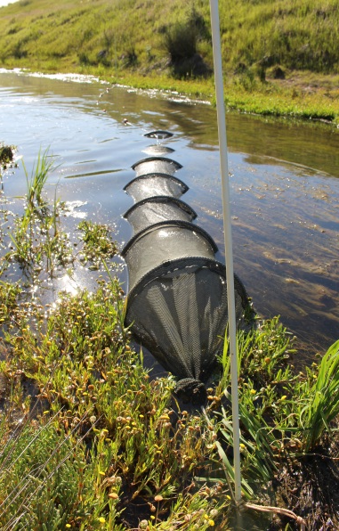
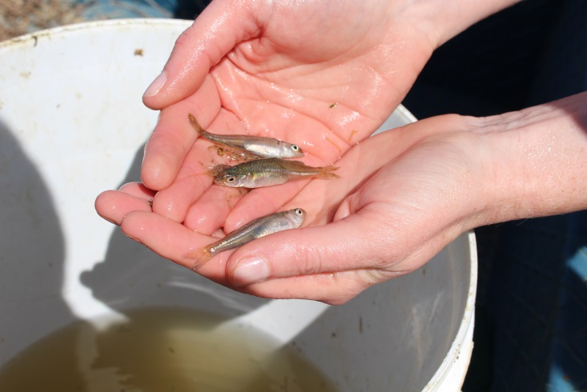
Translocation of Murray hardyhead
Nearby source (drain) has strong populations
First translocation – Spring 2015
Several more translocations to the site have occurred since.
BRISBANE, AUSTRALIA | 18 - 20 SEPTEMBER 2017
MANAGED BY
Notes:
After almost 18 months of delivering e-water the first MHH were translocated from a nearby source (drain) in spring 2015
Translocations have occurred several times since this
eDNA testing was completed a sites but results were inconclusive as there were not enough samples taken to provide any findings
Funding restraints have limited monitoring for the MHH over the last 12 months
A positive sign has been the sighting of MHH by fish ecologists around the shores of Round Lake which has held a strong population of the fish for a number of years.

Slide 11
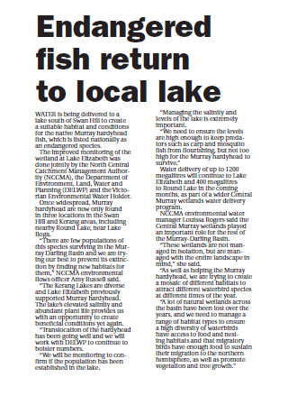
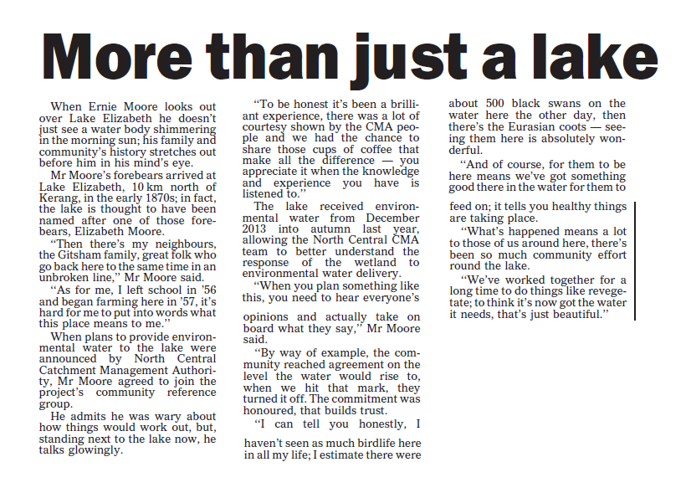
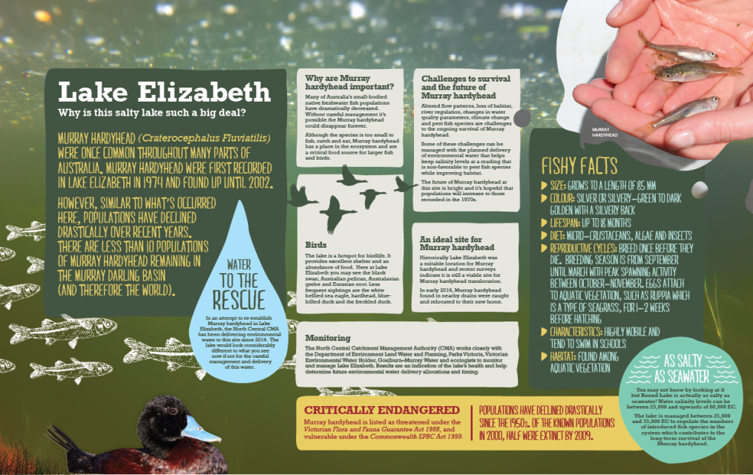
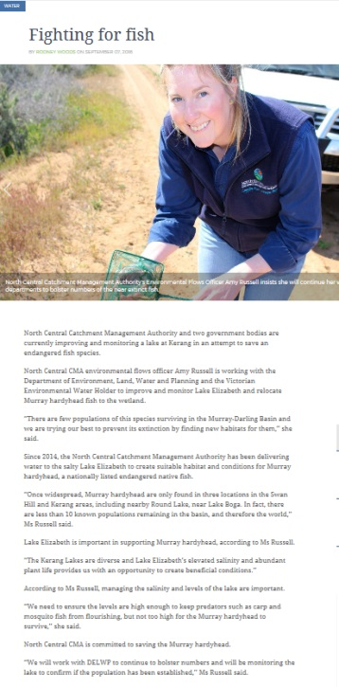
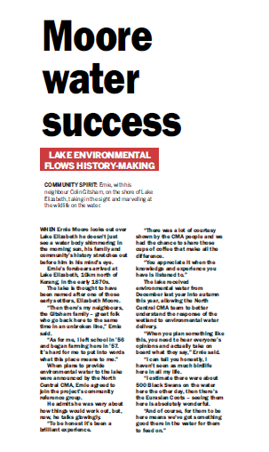
Raising the profile
BRISBANE, AUSTRALIA | 18 - 20 SEPTEMBER 2017
MANAGED BY
Notes:
Interpretive signs have been located at Lake Elizabeth and Round Lake
Media releases – on why we are releasing environmental water, how the community have reacted, results from the environmental water

Slide 12
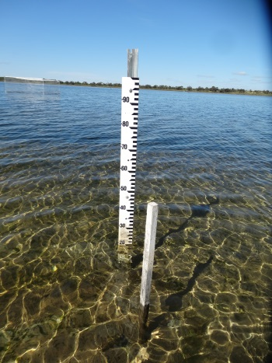
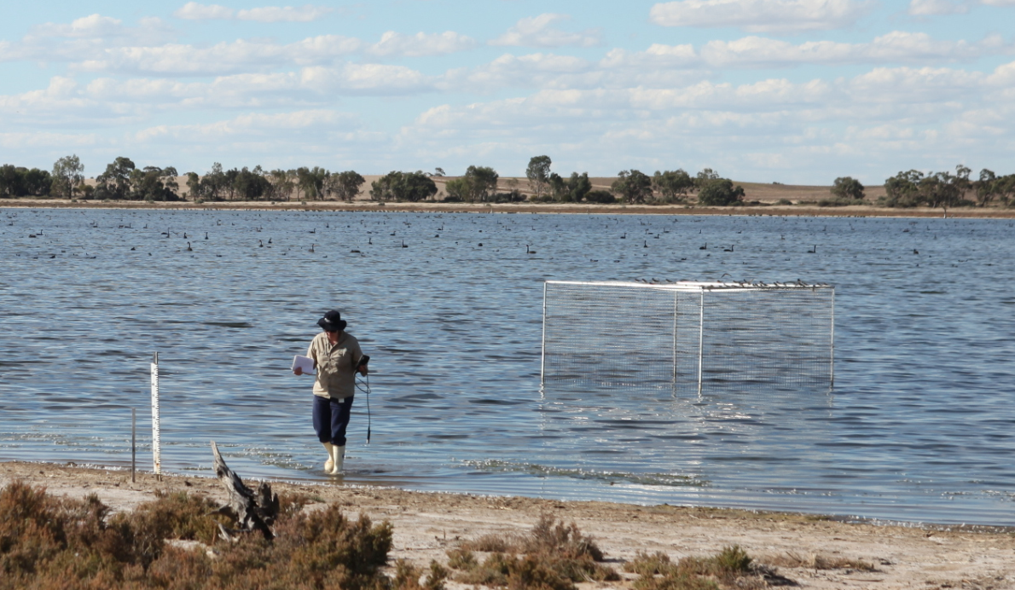
Ongoing management of Lake Elizabeth
Regular water quality monitoring
Continue to source funding for monitoring:
Populations
Vegetation
Zooplankton
Bird exclusion plots
Manage water delivery accordingly
BRISBANE, AUSTRALIA | 18 - 20 SEPTEMBER 2017
MANAGED BY

Slide 13
Thank you to the project partners
BRISBANE, AUSTRALIA | 18 - 20 SEPTEMBER 2017
MANAGED BY
Notes:
Project partners –
DELWP – Victorian Department of Environment, Land, Water and Planning
Victorian Environmental water holder
Goulburn-Murray Water
Parks Victoria
NCCMA

